Slide 1




May 2026
eCares USER TRAINING MANUAL
PROVINCIAL AND DISTRICT EDUCATION OFFICIALS
Linking ECD owners to their profile on eCares for previously migrated ECDS

Slide 2



INTRODUCTION

Slide 3


LINKING USERS TO MIGRATED ECDs
This manual explains how to link migrated ECD profiles from provincial Master Lists to their responsible users. The user will typically be the ECD’s owner, supervisor, or principal.

Slide 4
WHY DO WE NEED TO LINK MIGRATED ECDs TO USERS?
There are two types of ECD profiles on the eCares platform:
ECD profiles created by users as part of Bana Pele. These profiles are linked to users with a username and password.
ECDs profiles created from records migrated from Provincial Master lists. These profiles are not linked to any user and no one from the ECD has login details to eCares. These are the profiles this training module deals with.
Provincial and district officials need to link each migrated ECD profile to a user - the ECDs’ owner/principal/supervisor. These ECDs cannot register themselves because a profile for their ECD already exists; creating a duplicate would occur.
Once each ECD profile is linked to a user, the user will receive a username and password to eCares. They need to have logins so they can upload their child enrolment details, apply for registration renewal and funding and submit reporting to DBE on the platform.

Slide 5
EVERY SINGLE ECD MUST BE ABLE TO LOG IN TO eCARES
All major ECD administration and reporting processes will end up on eCares.
AVAILABLE NOW:
Update child enrolment details
SOON:
Apply for funding online
IN THE FUTURE:
Update staff details
Apply for renewal of registration
Submit quarterly funding reports
In preparation, let’s make sure that all ECDs can log in and use eCares.

Slide 6
HOW TO LINK A USER TO A MIGRATED ECD

Slide 7
LINKING ECD PROFILES: PROCESS FLOW
Find and match
Introduce user to eCares
Link user and ECD profile
Help user to log in
Update data
Identify migrated ECD profile in eCares and invite their owners / principals to link. Alternatively, you can host helpdesks at big events and send out mass invitation to all ECDs registered pre-2024.
ECDs must bring their registration certificate, funding SPA/TPA and IDs for linking
Explain what eCares is and why all ECDs need to be able to log in and use eCares. You can share eCares flyers and information materials.
Use the function to link the user to the ECD profile
Let the user know that they will receive an SMS with log in details shortly.
The user should receive the SMS within minutes. The SMS will contain their username and password to log into eCares.
Show the user how to use the username and password to log into eCares on their device.
Run through all the data on the eCares profile to check for correctness and add any missing details.

Slide 8
FIND AND MATCH: BEFORE YOU START
You will need to keep track of the ECDs that you link, and their details, on an Excel spreadsheet. Before you start finding and matching ECDs, create a spreadsheet with the column names indicated below and save it on your computer for easy access.
IMPORTANT!
Ask ECDs to bring a copy of their registration certificate, funding SLA/TPA, and ID documents when they come to be linked.
ECD Reference Number | ECD Name | Applicant First Name | Applicant Last Name | Phone Number | Email Address | Matched by | Verified Using

Slide 9
FIND AND MATCH: HOW TO START
Here are a few ways to find and match migrated ECD profiles on eCares to actual ECD principals/owners (the users):
Review migrated ECD profiles (how to do this is explained on the next slide) and phone the ECDs if you know them. Invite them to come in or even do the linking over the phone.
Host a “linking” helpdesk at registration or funding clinics.
Host a “linking” day and invite all ECDs you know that were previously registered (not through Bana Pele) to come to be set up in eCares.
Link users ad hoc when the ECD representatives come into the office to submit documents.
IMPORTANT!
Ask ECDs to bring a copy of their registration certificate, funding SLA/TPA, and ID documents when they come to be linked.

Slide 10
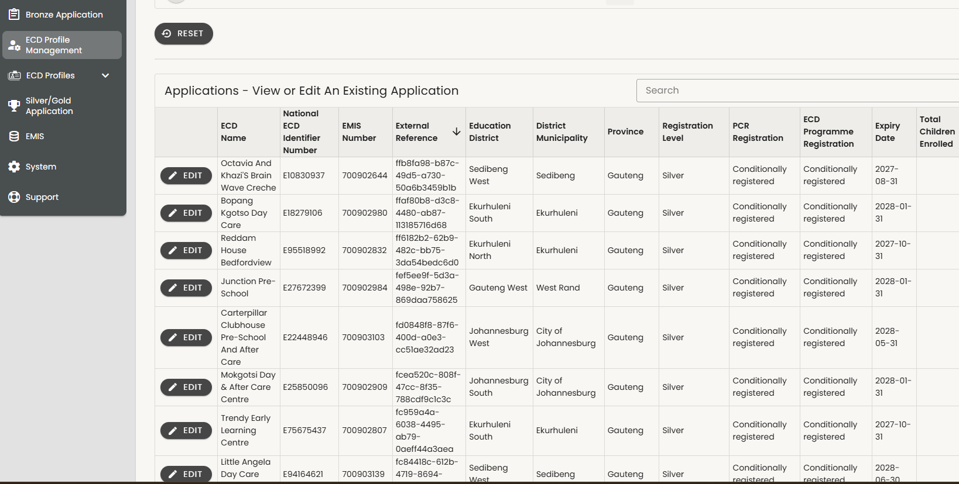
FIND AND MATCH: HOW TO LOCATE MIGRATED ECDs
Use the ECD Profile Management – ECD Programme Editor/viewer Role.
Look at the field called “External Reference”.
All records with text in this field are migrated and will need a user linked.

Slide 11
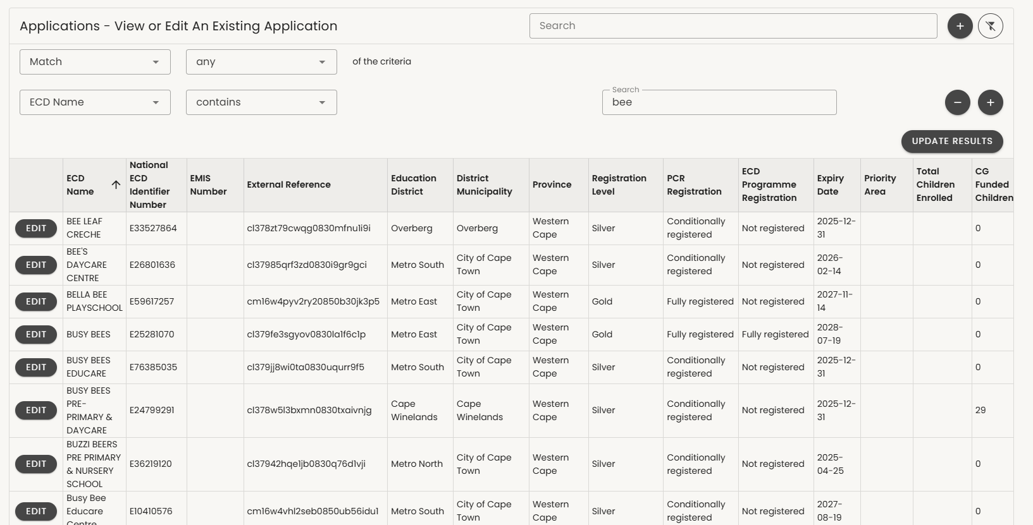
FIND AND MATCH: MATCH A SPECIFIC ECD IN ECARES Step1/4
1
2
3
Click the PLUS button next to “Search”.
Select “Match any ECD Name” that “contains”.
In the search bar, type a part of the name that is unlikely to be misspelled and click “UPDATE RESULTS”.
Find the most likely ECD match and click “EDIT” to check the details
4

Slide 12
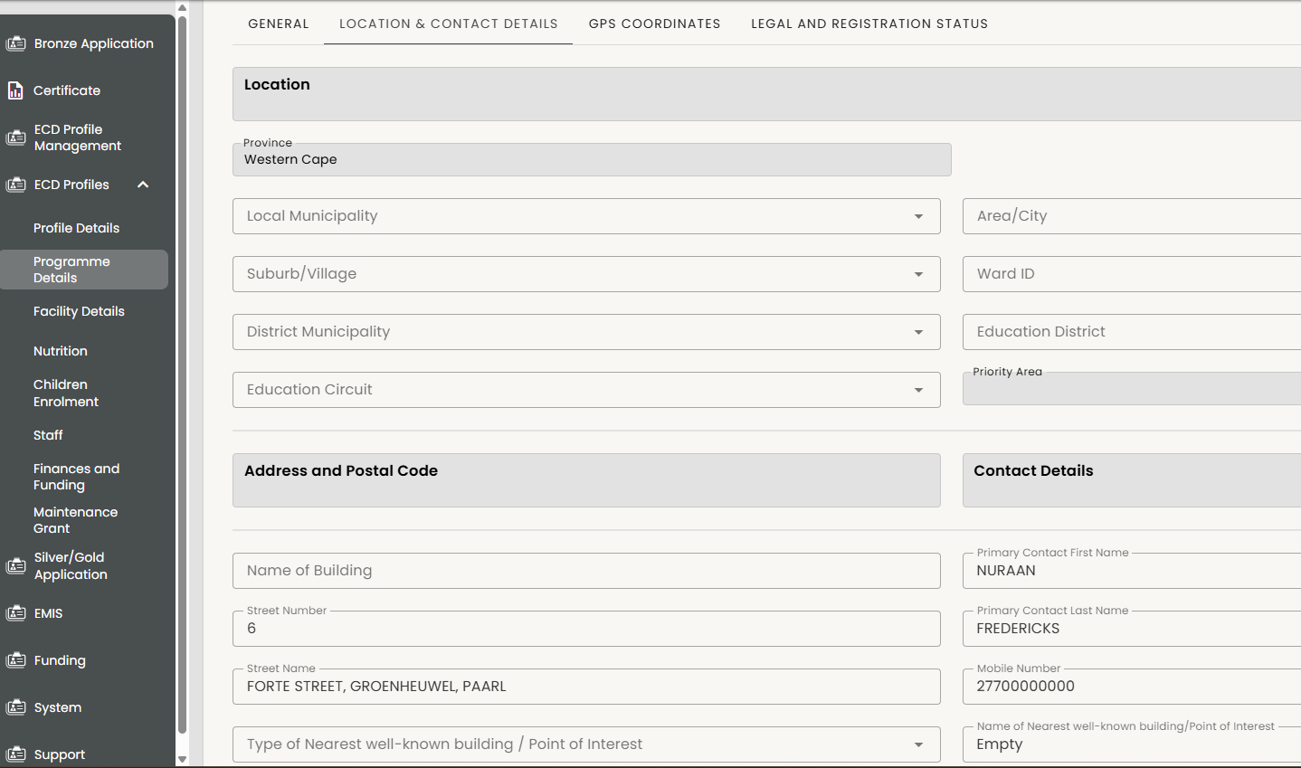
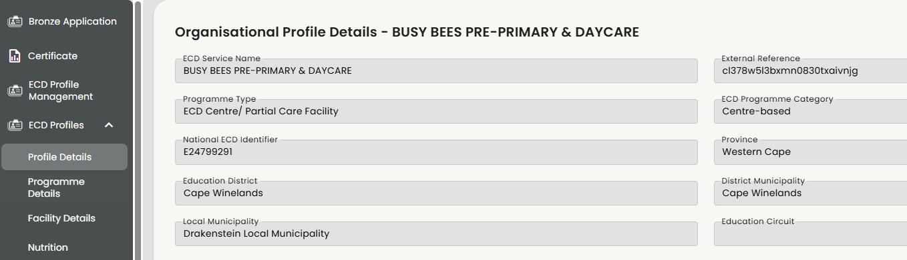
FIND AND MATCH: MATCH A SPECIFIC ECD 2/4 (CONT.)
2
You can match the ECD using address details:
Select “Programme Details” from the Profiles Menu
Select “Location & Contact Details”
Confirm it is the correct ECD by reviewing the “Address and Postal Code” and “Contact Details”.
Once you have confirmed that this is the same ECD – go to (4) Profile details on the menu and note the centre's details and reference number on your Excel spreadsheet.
1
3
4

Slide 13
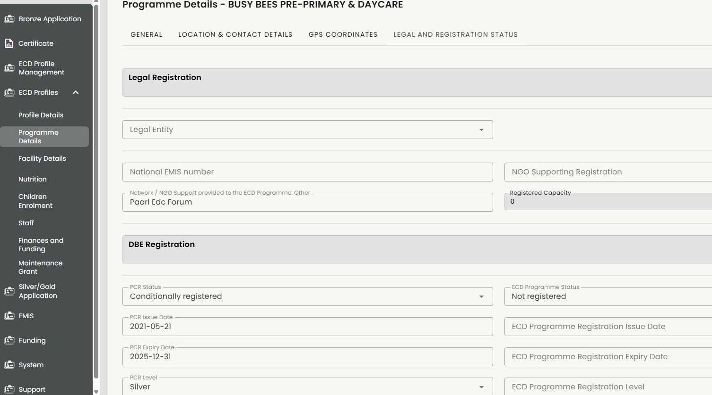
If you have a person in your office and need to find the right ECD, check the details of the ECD to make sure it is the correct one...registration details
FIND AND MATCH: MATCH A SPECIFIC ECD 3/4 (CONT.)
2
You can match the ECD, using registration details (if the person has a registration certificate with them):
Select “Programme Details” from the Profiles Menu.
Select “Legal and Registration Status”
Match the ECD by checking the National EMIS Number and the
DBE Registration details.
Once you have confirmed that this is the same ECD – go to Profile details on the menu and note the reference number on your Excel spreadsheet (if you have not done so already).
If you are certain it is the right one – you could complete any missing details
5
1
3
4

Slide 14
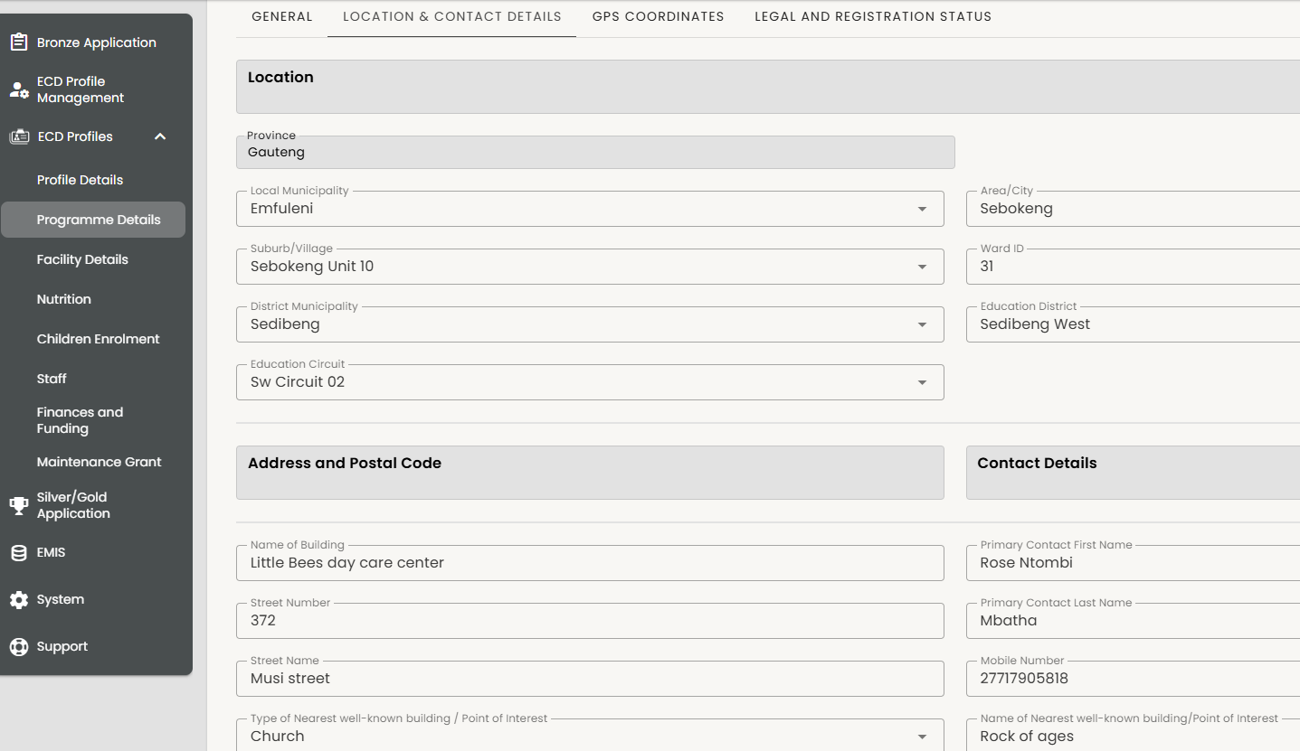
FIND AND MATCH: MATCH A SPECIFIC ECD 4/4 (CONT.)
If you don’t know the person to link to you can search in any ECDs location and contact details for any contact people.
2
Matching an ECD without knowing the responsible user:
1. Select “Programme Details”.
2. Select Location & Contact Details”.
3. Phone any of the numbers listed under “Contact details” or check on other Provincial data records like master-lists, funding files or registration files for the contact numbers. Call the person to confirm that they are still the right contact or get updated details.
You will need the:
Phone number,
First Name and last name
email if available
NB: Note these details down carefully with the eCares reference number for the ECD in your Excel spreadsheet
1
3

Slide 15
TAKE STOCK OF ALL MATCHED ECDs BEFORE LINKING
ECD Reference Number | ECD Name | Applicant First Name | Applicant Last Name | Phone Number | Email Address | Matched by | Verified Using
E24798291 | Busy Bees Pre-Primary | Cate | Carroll | 2772XXXXXX |  | Your name | Registration Certificate
Before you can start linking you will need this information recorded on your Excel sheet.
Email address is very helpful but not compulsory
Options for Verification:
Registration Certificate – name and registration date match
Registration certificate – EMIS number matches
Registration certificate / verbal match of street address
Registration Certificate – name matches, district matches and no other ECDs with similar name listed
SLA – name and address match
SLA – EMIS number matches

Slide 16

LINKING ECD PROFILES: PROCESS FLOW
Find and match
Introduce user to eCares
Link user and ECD profile
Help user to log in
Update data
You have now matched a responsible user to an ECD record.
You have the eCares reference number and their details ready to start the linking process.
But first you must introduce the user to eCares and explain its importance.
Identify migrated ECD profile in eCares and invite their owners / principals to link. Alternatively, you can host helpdesks at big events and send out mass invitation to all ECDs registered pre-2024.
ECDs must bring their registration certificate, funding SPA/TPA and IDs for linking
Explain what eCares is and why all ECDs need to be able to log in and use eCares. You can share eCares flyers and information materials.
Use the function to link the user to the ECD profile
Let the user know that they will receive an SMS with log in details shortly.
The user should receive the SMS within minutes. The SMS will contain their username and password to log into eCares.
Show the user how to use the username and password to log into eCares on their device.
Run through all the data on the eCares profile to check for correctness and add any missing details.

Slide 17
INTRODUCE THE USER TO ECARES
The goal is for the user to understand that all ECD administration will eventually be on
eCares and that it’s important they are comfortable using it.
If the user is with you in person:
Share the ELP eCares flyer. (Link)
Explain that they can update the child enrolment numbers.
Explain that they will be able to use it to apply for funding in future (Link: Preparing for
funding guide).
If you are communicating via phone do the same but:
WhatsApp the flyer and guide

Slide 18
LINKING ECD PROFILES: PROCESS FLOW
Find and match
Introduce user to eCares
Linking user and ECD profile
Help user to log in
Update data
You have now matched a responsible user to an ECD record.
You have introduced the user to eCares.
It’s time to start the linking process.
Identify migrated ECD profile in eCares and invite their owners / principals to link. Alternatively, you can host helpdesks at big events and send out mass invitation to all ECDs registered pre-2024.
ECDs must bring their registration certificate, funding SPA/TPA and IDs for linking
Explain what eCares is and why all ECDs need to be able to log in and use eCares. You can share eCares flyers and information materials.
Use the function to link the user to the ECD profile
Let the user know that they will receive an SMS with log in details shortly.
The user should receive the SMS within minutes. The SMS will contain their username and password to log into eCares.
Show the user how to use the username and password to log into eCares on their device.
Run through all the data on the eCares profile to check for correctness and add any missing details.

Slide 19
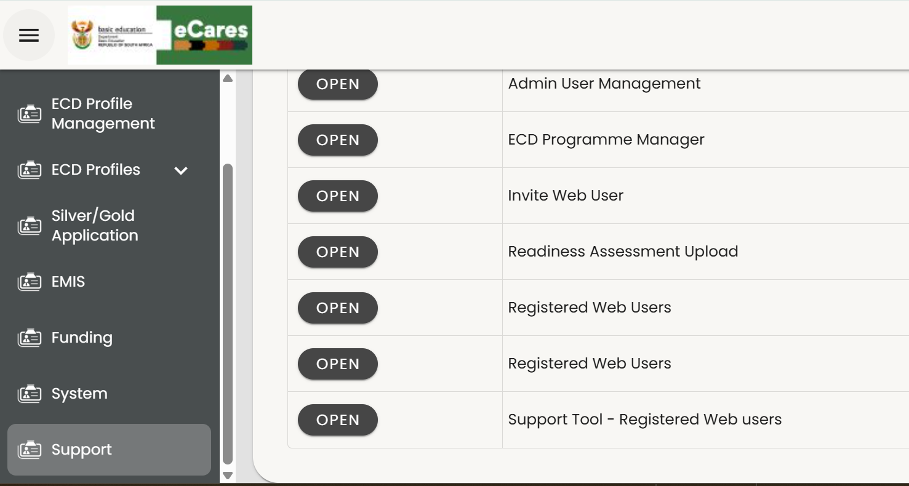
1. Find the Prson
LINKING: SELECT ECD PROGRAMME MANAGER ROLE
Select SUPPORT from the sidebar Menu.
Select the ECD Programme Manager role.
2
1

Slide 20
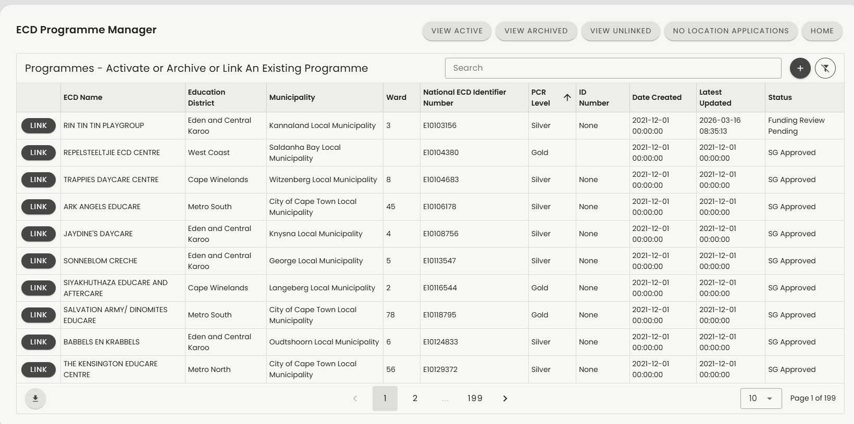
v
LINKING: VIEW ALL UNLINKED ECDs
2
Go to the Link ELP Function
Select “VIEW UNLINKED” from the top menu buttons.
These are all the ECD programs that do not have a responsible user with a username and password yet.
3

Slide 21
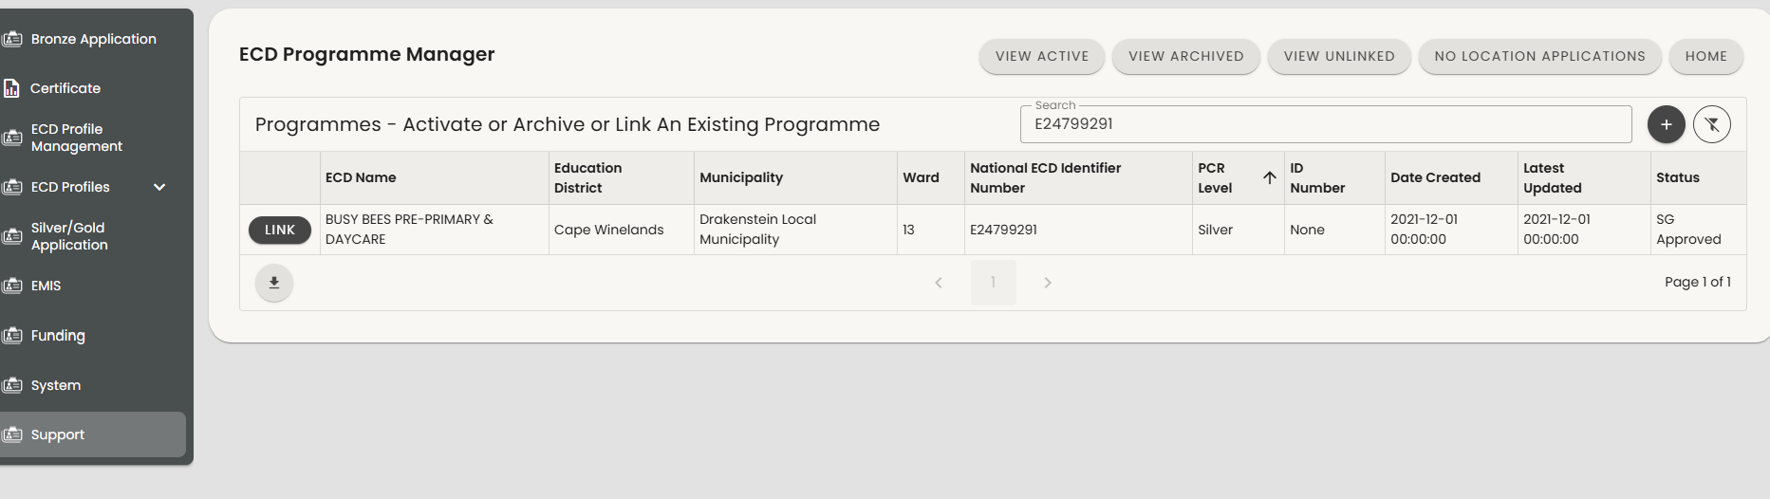
1. Find the Prson
LINKING: LOCATE SPECIFIC ECD TO LINK
v
1
2
Refer back to your Excel spreadsheet for the details of the ECDs you want to link.
Paste the reference number in the “Search” bar. Make CERTAIN it is the right ECD.
Click on LINK

Slide 22
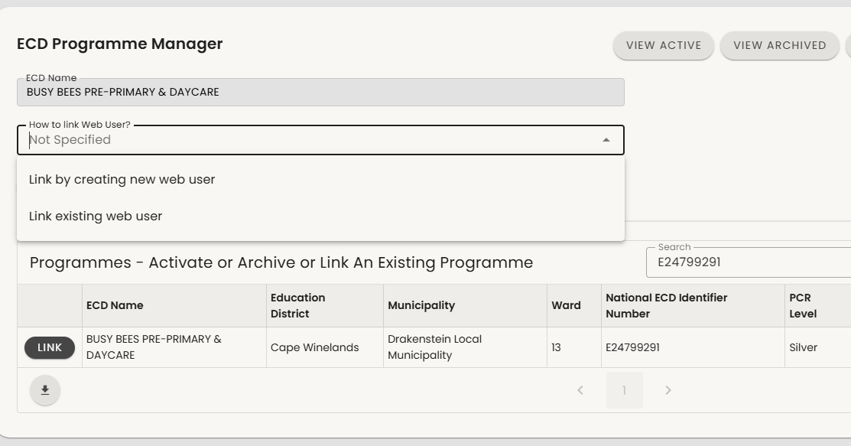
LINKING: STEP 1
1
1. In the dropdown “How to link Web User?”, select Link by creating a new web user.
Note: A web user is the system name for someone outside the DBE/PED who has login details to eCares. Bronze applications are web users. We are creating new web users for already registered ECDs
1

Slide 23
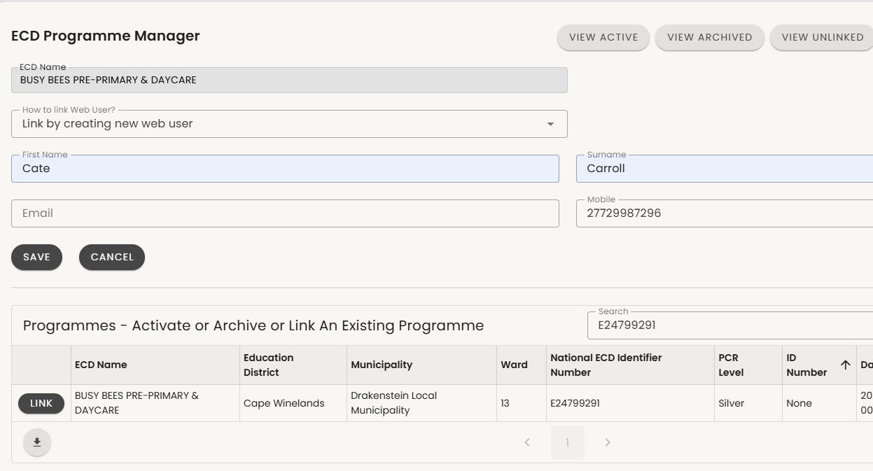
1. Find the Prson
LINKING: STEP 2
1. Complete the details for the responsible user:
First name
Surname
Email (not compulsory)
Mobile – remember to start with 27
2. Press SAVE
1
2

Slide 24
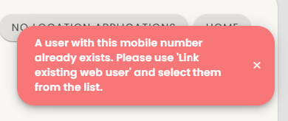
If you get an error…
LINKING: ERROR
If you have tried to link by creating a new web user and have seen the error alongside, this means that the user has already registered on eCares. The next slide shows how to resolve the error.

Slide 25
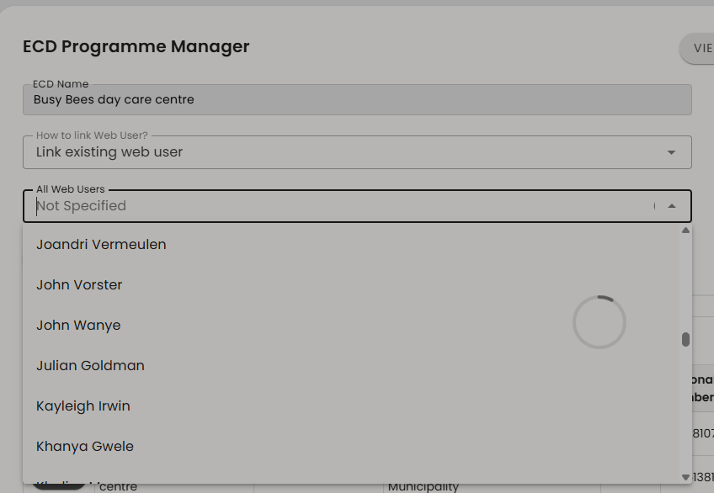
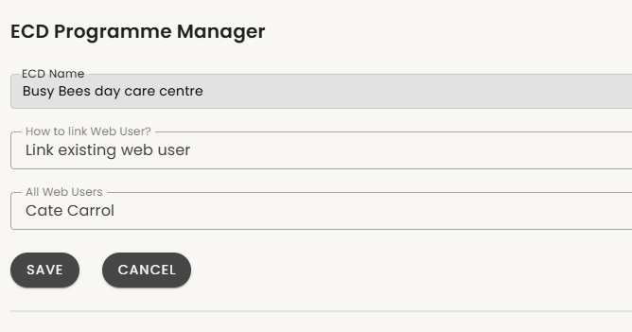
LINKING: RESOLVING ERROR “A USER WITH THIS MOBILE NUMBER ALREADY EXISTS ”
If you get an error…
Select “Link existing web user” in the drop down from “How to link Web User?”
eCares will automatically generate a drop down list of all web users. Start typing the name or use the slider to scroll down.
Click on the correct person.
Press SAVE
2
1
3
4

Slide 26
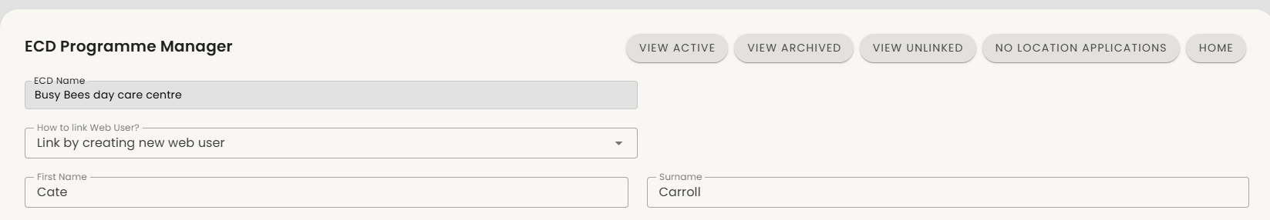
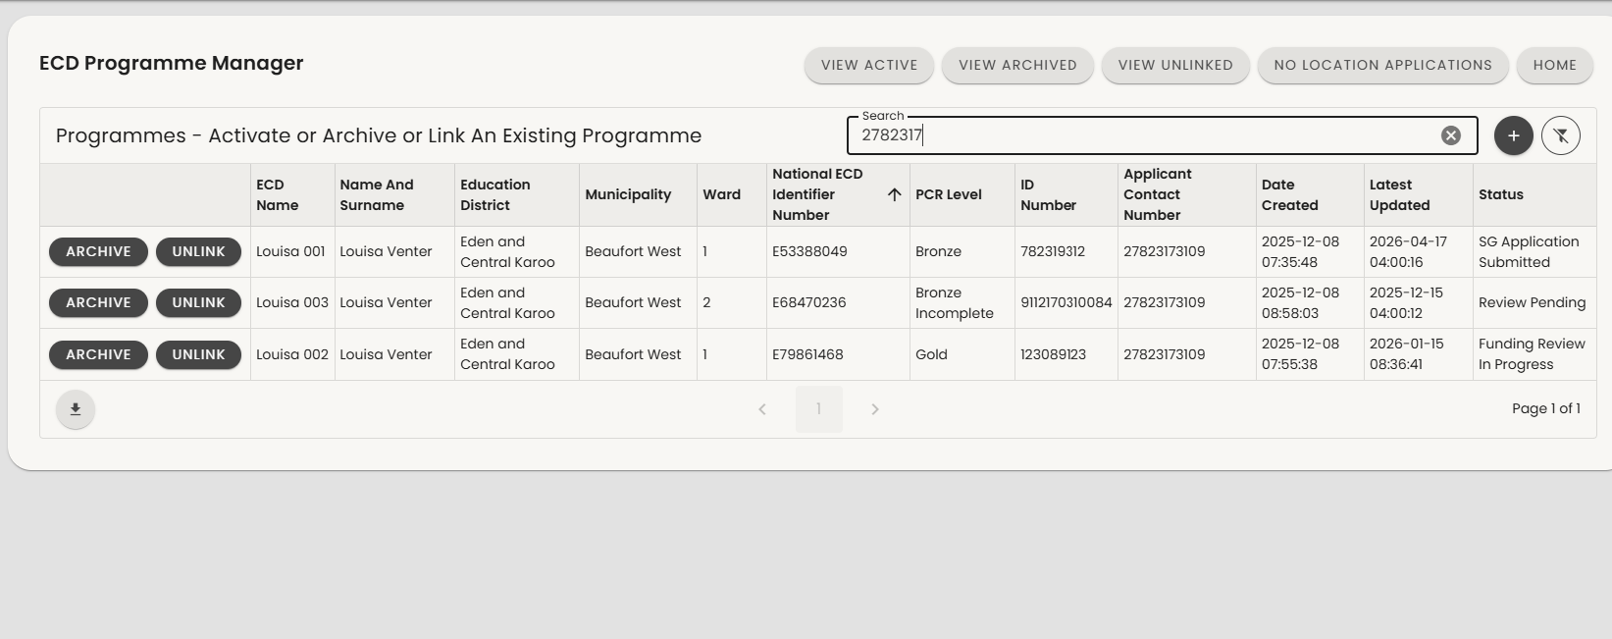
LINKING: USERS WITH MULTIPLE OR DUPLICATE ECDs
If the person was already registered check they don’t have duplicate ECDs
1
Select VIEW ACTIVE
Type the phone number into the SEARCH bar in 27XXXXXXXX format.
Review all ECD records linked to this number.
Archive duplicate ECDs.
NOTE: Remember that one user may be linked to more than one ECDs. Only duplicate records need to be archived.
2
4
c
3

Slide 27
LINKING ECD PROFILES: PROCESS FLOW
Find and match
Introduce user to eCares
Linking user and ECD profile
Help user to log in
Update data
You have now matched and linked a responsible user to an ECD record.
It’s time to help them log in to eCares for the first time.
Identify migrated ECD profile in eCares and invite their owners / principals to link. Alternatively, you can host helpdesks at big events and send out mass invitation to all ECDs registered pre-2024.
ECDs must bring their registration certificate, funding SPA/TPA and IDs for linking
Explain what eCares is and why all ECDs need to be able to log in and use eCares. You can share eCares flyers and information materials.
Use the function to link the user to the ECD profile
Let the user know that they will receive an SMS with log in details shortly.
The user should receive the SMS within minutes. The SMS will contain their username and password to log into eCares.
Show the user how to use the username and password to log into eCares on their device.
Run through all the data on the eCares profile to check for correctness and add any missing details.

Slide 28
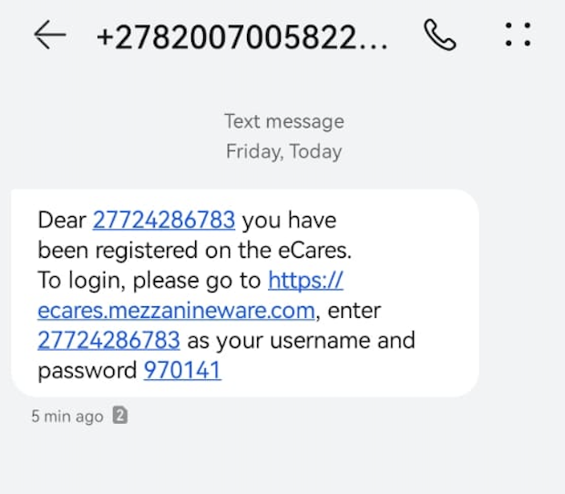

LOGGING IN: USER WILL RECEIVE AN SMS
The user will receive an SMS to the number in eCares confirming registration within minutes of linking. The SMS will contain a temporary login and a temporary password.
The link in the SMS will take them to the sign-in page.
Enter the mobile number used to register, starting with 27
(RSA dialing code), followed by the rest of the cell number.
Enter the password received via SMS.
Click on ‘SIGN IN’ in to continue.
1
c
2
c
3
4
5

Slide 29
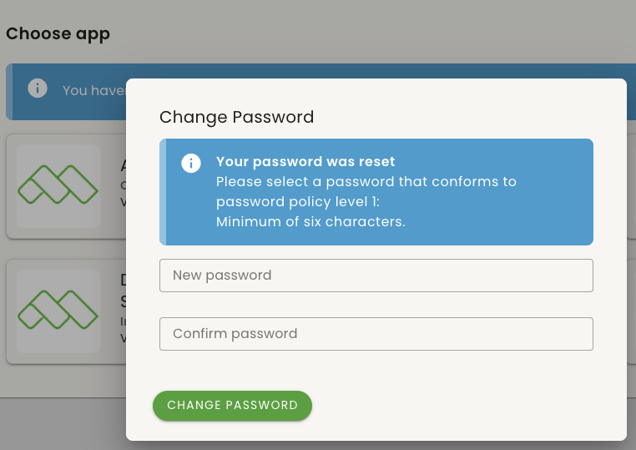
LOGGING IN: RESETTING PASSWORD
Help the responsible person to find their SMS and login
1
Once logged in for the first time, eCares will prompt the user to change their temporary password to one they will remember easily. It must be at least 6 characters long.
Enter the new password, confirm it, and click on 'Change Password’.
The user can now log in properly with their new password.
NB: Remind the user to make sure they remember and write down their password.
2

Slide 30
LINKING ECD PROFILES: PROCESS FLOW
Find and match
Introduce user to eCares
Linking user and ECD profile
Help user to log in
Update data
Identify migrated ECD profile in eCares and invite their owners / principals to link. Alternatively, you can host helpdesks at big events and send out mass invitation to all ECDs registered pre-2024.
ECDs must bring their registration certificate, funding SPA/TPA and IDs for linking
Explain what eCares is and why all ECDs need to be able to log in and use eCares. You can share eCares flyers and information materials.
Use the function to link the user to the ECD profile
Let the user know that they will receive an SMS with log in details shortly.
The user should receive the SMS within minutes. The SMS will contain their username and password to log into eCares.
Show the user how to use the username and password to log into eCares on their device.
Run through all the data on the eCares profile to check for correctness and add any missing details.
You have now matched and linked a responsible user to an ECD record, and helped them log in.
Lets use this opportunity to update as much missing data on the ECD as possible.

Slide 31
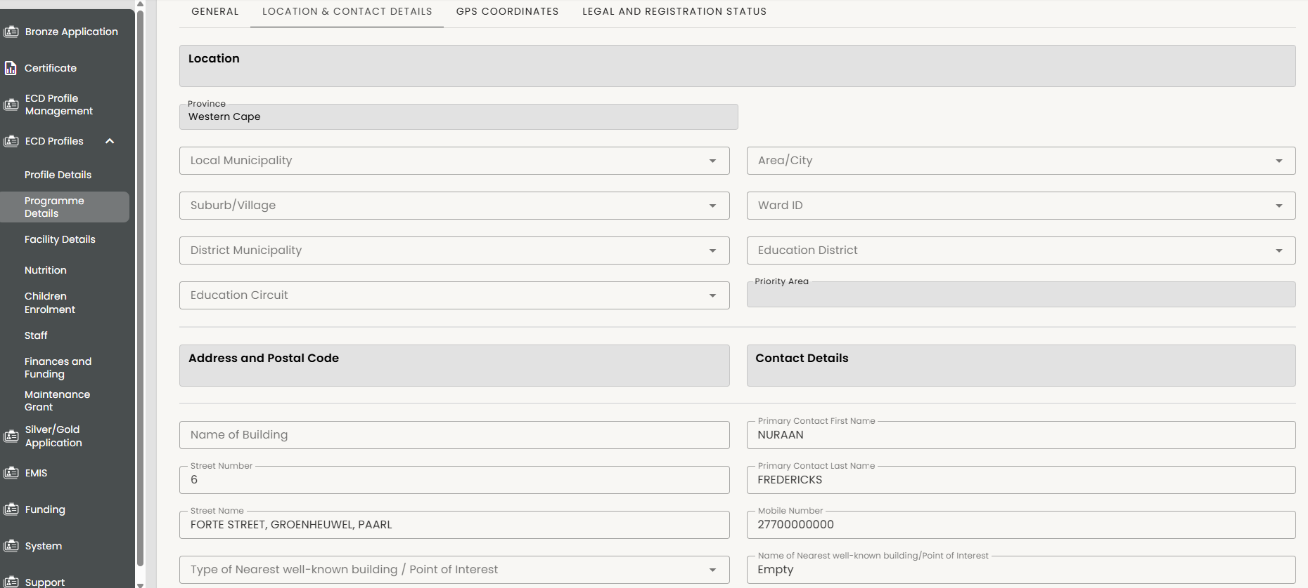

UPDATING DATA: LOCATION AND CONTACTS
Use the opportunity while the responsible person is with you to make sure any missing key data is updated.
Return to ECD Profile Management in the menu and ECD Programme Editor Role
First check Location details down to suburb level – allows for zoning and funding targeting
Also check address details and contact details and alternates so that you can find them again.
1
2
3

Slide 32
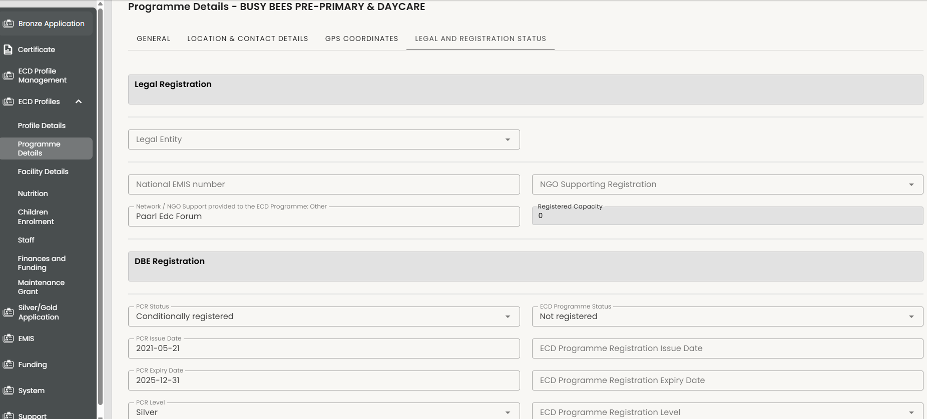
UPDATING DATA: LEGAL AND REGISTRATION DETAILS
If they brought a registration certificate with them update
Registration details including expiry dates
Capacity
EMIS Number
These are important for funding eligibility and renewals

Slide 33
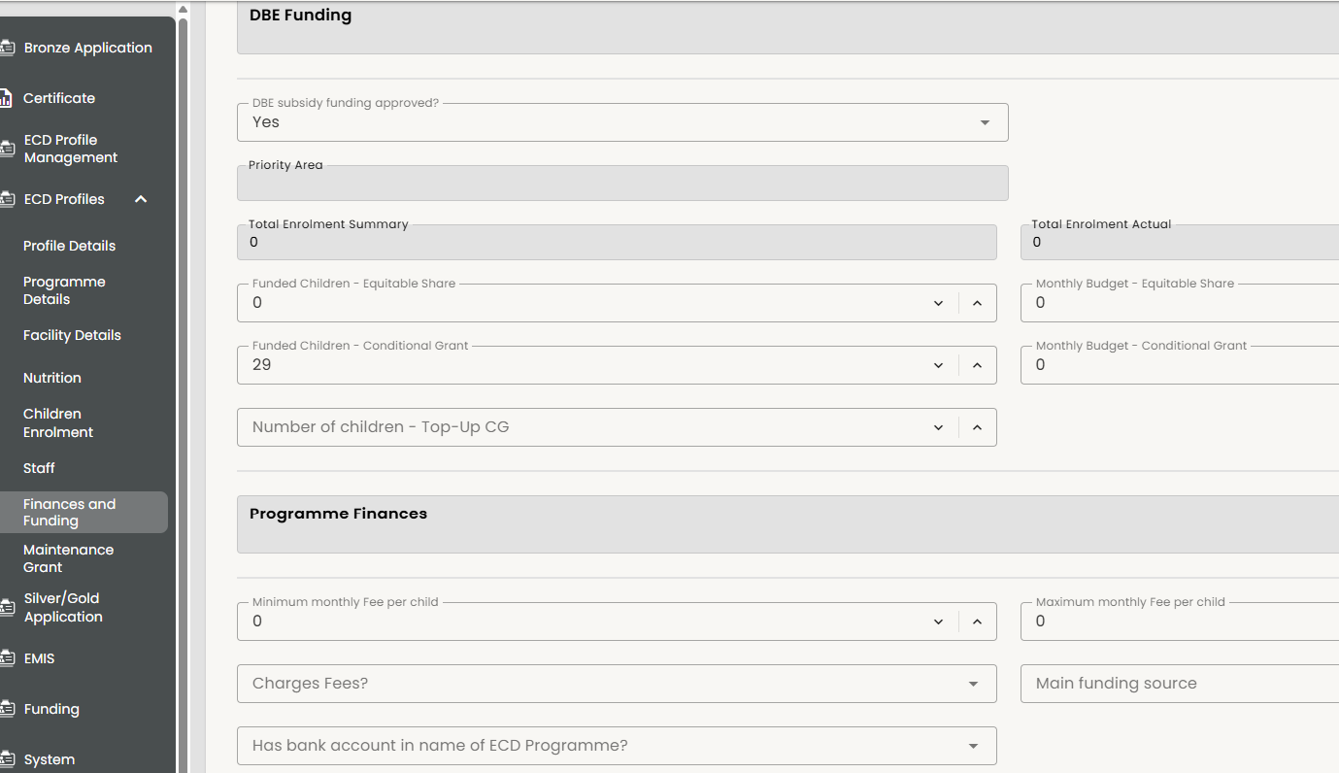
UPDATING DATA: FINANCES AND FUNDING
Check the Funding Master List or Provincial Approved Funding list or SLA and update the CG and ES funding fields
NB! Do not ask the ECD for this information – it must come from an official source like an approved list or signed SLA.

Slide 34
LINKING ECD PROFILES: PROCESS FLOW
Find and match
Introduce user to eCares
Linking user and ECD profile
Help user to log in
Update data
Identify migrated ECD profile in eCares and invite their owners / principals to link. Alternatively, you can host helpdesks at big events and send out mass invitation to all ECDs registered pre-2024.
ECDs must bring their registration certificate, funding SPA/TPA and IDs for linking
Explain what eCares is and why all ECDs need to be able to log in and use eCares. You can share eCares flyers and information materials.
Use the function to link the user to the ECD profile
Let the user know that they will receive an SMS with log in details shortly.
The user should receive the SMS within minutes. The SMS will contain their username and password to log into eCares.
Show the user how to use the username and password to log into eCares on their device.
Run through all the data on the eCares profile to check for correctness and add any missing details.

Slide 35
THANK YOU

