Slide 1

eCares Training for ECD Registration Drive
Bronze Review & Approval
Provincial and District Education officials
13 November 2024

Slide 2
Contents
Section | Pages
Introduction to eCares | 4-6
Overview of the Bronze ECD Registration Process | 7-13
Introduction to the Bronze ECD Registration Module in eCares | 14-15
Accessing eCares – User set up; Login and Password Resets | 16-20
PED ROLES for Bronze Registration Process
Registration Application Administrator - Role & Review Process | 21-52
Registration Application Reviewer - Role & Review Process | 53-84
Registration Application Approver - Role & Review Process | 85-113
Registration Application Certificate Generator | 114-121
Registration Application Report Viewer | 122-127
Bronze Registration Dashboards | 128-130
User Support | 131-132
Appendices – ECD Applicant and Application Support Roles | 140-198

Slide 3
Introduction to eCares

Slide 4

Introduction to eCares
The eCares system is a new digital tool to help the Department of Basic Education (DBE) better manage Early Childhood Development (ECD) services. Instead of using paper, everything will be done online, making things quicker and easier.
Here are the main things the system will do:
Collect accurate information about ECD services to share with people who need to make decisions.
Make it easier and faster for ECD programs to get registered and approved by the DBE.
Help the DBE give support to the right programs fairly and clearly.
Help improve the quality of ECD services, not just make sure they follow basic rules.
Allow the DBE to check how well ECD programs are doing and make smart choices based on up-to-date information.
Provide clear reports and useful information to help improve programs and use resources wisely.
The system will be launched step by step, with six different parts released over time.

Slide 5






REGISTRATION MODULE
Notes:
The Bronze registration module is the first module to support Provincial Education Departments. Next will come Organisation Profiles for managing information on registered ECDs. Then the full Silver/Gold registration module followed by Funding applications and approvals, Quality Assurance and Support modules and a Maintenance Grant module.

Slide 6
Overview of the Bronze ECD Registration Process
In this section, we remind you of the new streamlined ECD registration process.

Slide 7
What are the aims of the mass registration drive?
1
To enable government to have oversight of every out-of-home setting where children are cared for.
To support ECD programmes to comply with legal requirements.
Further down the line, to ensure that more ECD programmes are able to apply for the ECD subsidy for children from low-income households.
To make the registration administration processes quicker and less resource-intensive for officials and social service professionals
2
3
4

Slide 8
Which part of the registration process does
the Bronze eCares Module support?
STAGE 1
Initial conditional registration
STAGE 2
Support for compliance and site visits
STAGE 3
Review and determination
APPLY
COMPLY
COMPLETE
NEW BRONZE
NEW SILVER / GOLD
GOAL:
Every ECD programme in the system
GOAL:
Every ECD programme compliant
GOAL:
Every ECD programme registered
NEW MASS REGISTRATION PROCESS
Notes:
The part of eCares that we are training you on today is to support STAGE 1 – the apply stage which results in an initial conditional registration valid for 1 year. After this every ECD will need to complete the other steps towards silver or gold registration.

Slide 9
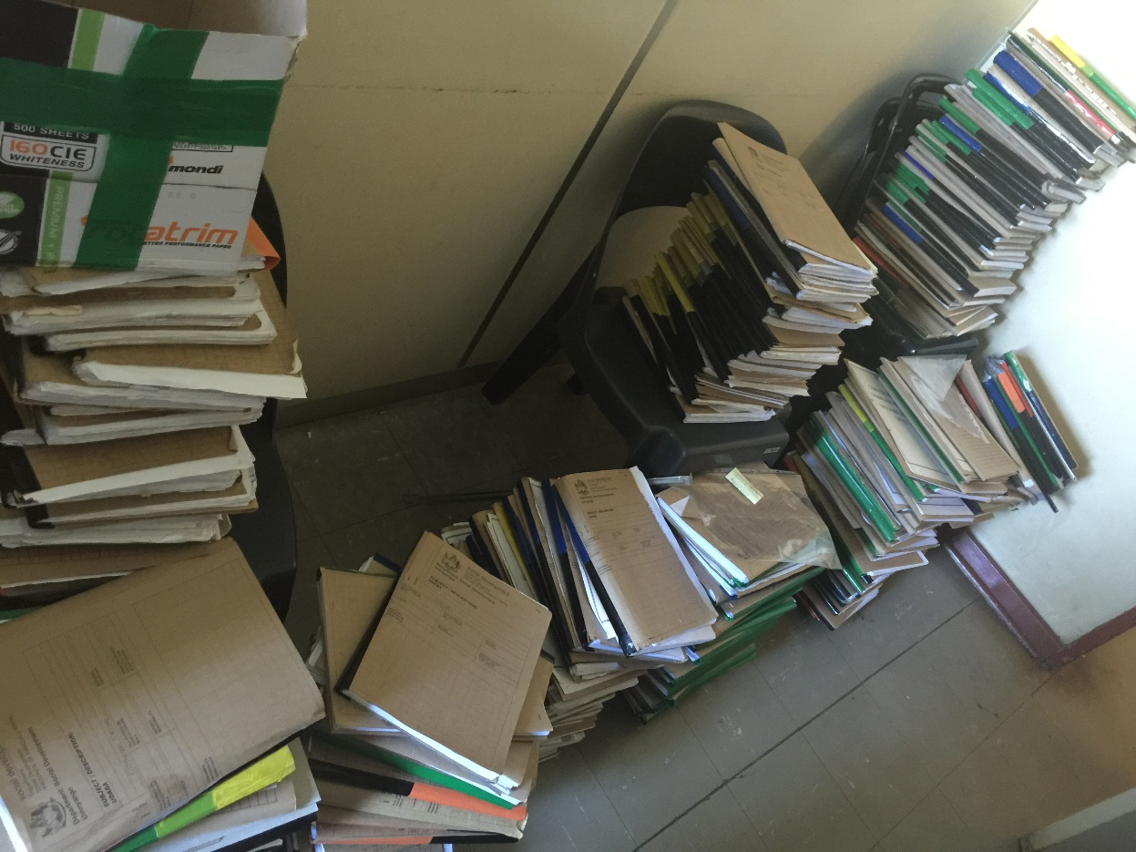
What is the old way for application
submission review and approval?
Site Identification
Application Submission / Jamboree
Site Visits
EHP Report /Certificate
Social Worker Report
Certification
Sites are found by social workers or visit offices.
ECDs submit all necessary documents for registration in paper.
Visits by health practitioners and social workers to check compliance with standards.
A report prepared by health practitioners on how the site meets the standards.
Review and compilation of information to recommend registration or closure.
The final step where the decision is made registration certificate is issued
Notes:
These pictures of files might seem familiar to you. The old way of registration took a long time to get information to ECDs, get paper documents back from them, tell them when they had mistakes to correct and finalise a file with a recommendation. Those files had to be transported backwards and forwards to get sign off and then filed somewhere.

Slide 10


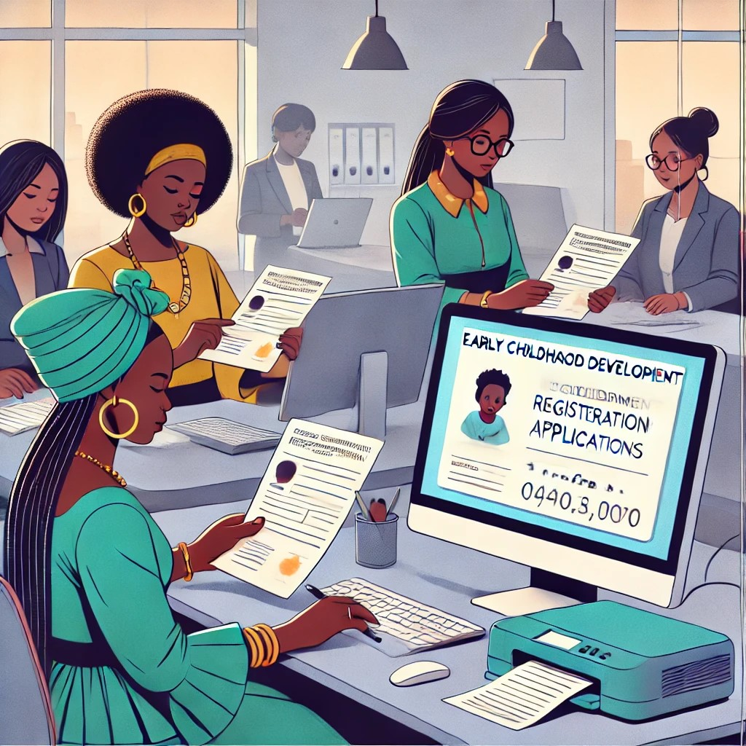
What is the NEW way for BRONZE
application Submission, review and approval?
Identify Sites:
Submit Application:
Initial Review:
Social Worker Review:
Final Approval:
ECD sites receive WhatsApp or call and can apply via WhatsApp or online links.
Applicant registers on eCares, fill out the digital form, and uploads documents online.
An administrator checks the application, verifies documents, does NCPR check and requests any missing details.
A Social Worker reviews the completed application and NCPR certificates and recommends approval or rejection.
An approver makes the final decision, and a Bronze certificate is automatically issued if approved.
Notes:
The new way of registration allows ECDs to apply themselves through an online form that collects the same information. It then allows the PED to immediately review the application and send notes back to the applicant if corrections are needed. If the application is complete a certificate can be immediately generated with the details after approval. All the information is stored so there is no need for paper files and you can always look it up later.

Slide 11
Requirements to achieve Bronze level registration:
Complete details about the programme and applicant in an online application form – combined Form 11 and Form 16
Complete an online health and safety self-assessment confirming minimum standards have been/will be met.
Provide information and documents so that all staff members can be checked against the National Child Protection Register. (some form of identification and form 30)
Key point: Bronze Apply requirements ensure safe adults and minimum standards are met.
!
Notes:
At the bronze level we are not worried about checking against the full list of norms and standards – this will happen when we visit the site. We want to know that the adults caring for the children are safe – they are not on the child protection register and that the ECD understands the minimum safety requirements they must meet.

Slide 12
Where is there more information?
Information, guidelines and tools will be added to DBE’s web page as they become available. Go to:
Bana Pele ECD Registration Drive info page

Slide 13
Introduction to the Bronze ECD Registration Module in eCares

Slide 14
User Roles in the eCares Bronze Registration Module
ECD Applicant (Web User)
Applies for Registration
Registration Application Administrator
1st check of application details
Check all staff Documents and approve or request corrections
Upload NCPR Certificates
Registration Application Reviewer
2nd check of details + documents
Check NCPR certificates and approve or reject.
Generate SW Report with recommendation
Registration Application Approver
Reviews application
Reads SW recommendation
Final Approval or Rejection
Registration Certificate Generator
Can generate certificates for approved ECDs
Registration Application Report Viewer
Lists of all applications with their current status
Notes:
In the eCares system each user is given a different role. The ECD programme has an applicant role to submit an application. Then PED users are given either an administrator, reviewer or approver role depending on what they will do in the review process. Each user must have only 1 of these 3 roles. Any PED user can also be given report viewer role and certificate generator role.

Slide 15
Accessing eCares – User set up; Login and Password Resets
All roles would need to be set up and receive login and password details

Slide 16
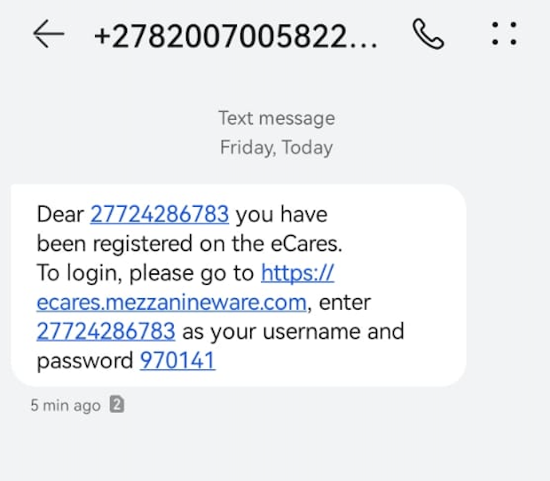
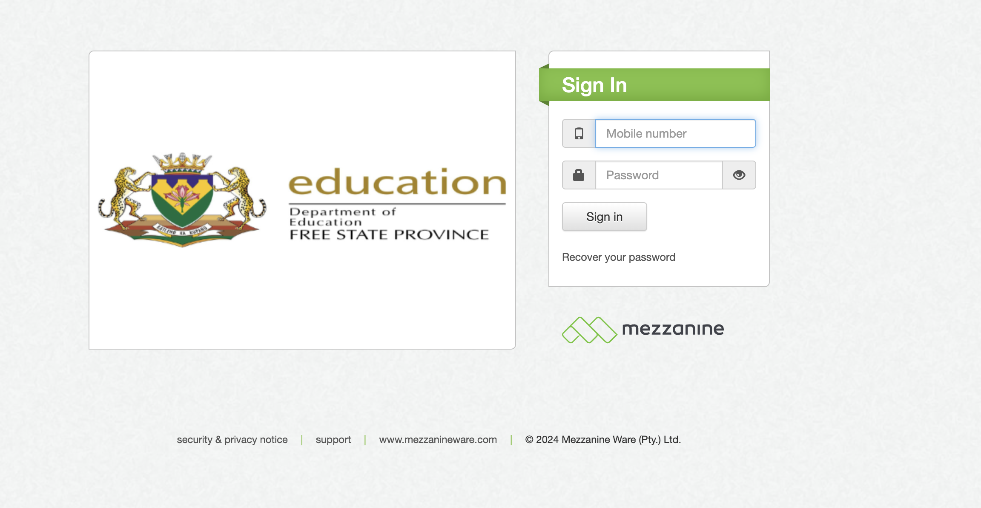
User Access on eCares
You will receive an SMS when you are set up with the URL link you must follow and a temporary password.
Go to:
https://pedusers.dbecares.gov.za/
Click on the Provinces down arrow to select your Province the first time you log in.

Slide 17
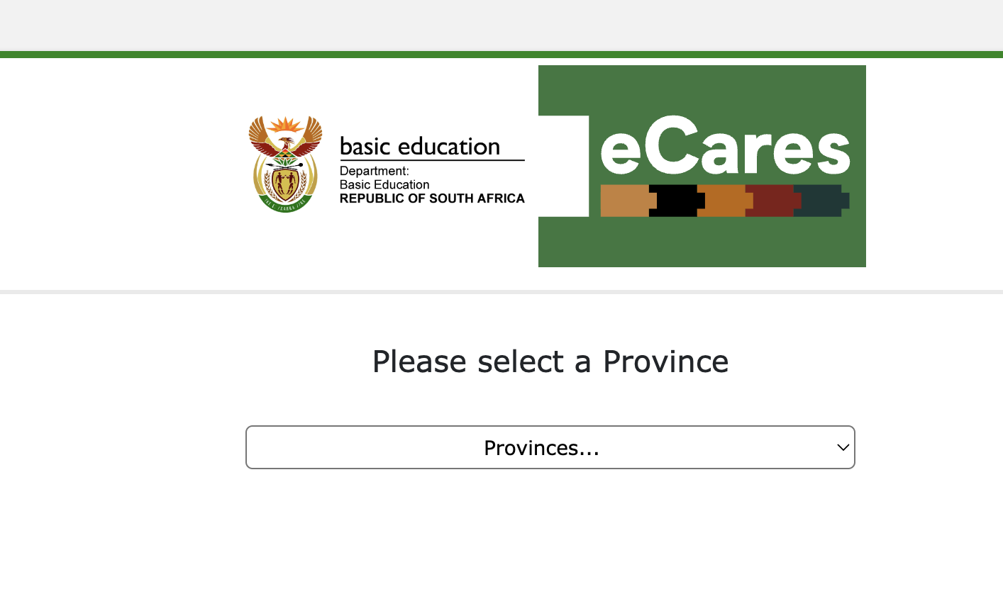
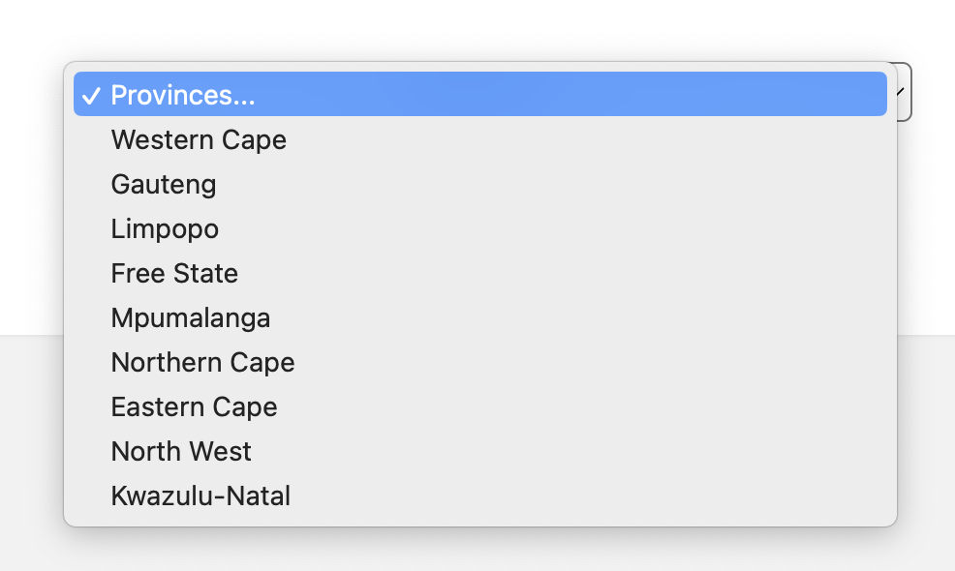
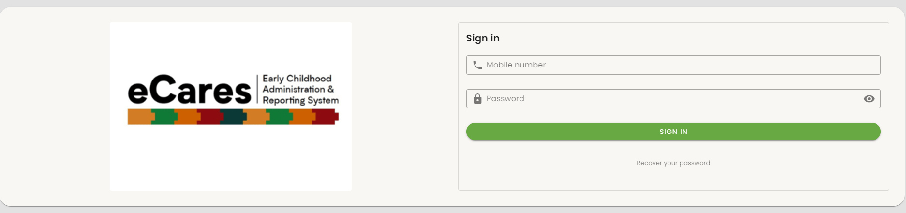
User Access on eCares Cont.
1. Select your Province and then click on Login.
2. Sign in using your User Name which is your mobile number with the first 0 replaced by 27. e.g. Cellphone number: 083 456 7890 Login: 27834567890
3.Use the temporary password provided in your SMS
3
2
3

Slide 18
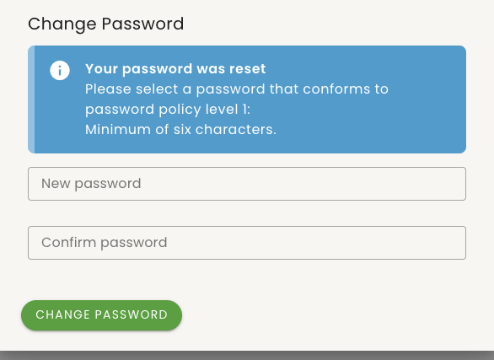
User Access on eCares Cont.
The system will now prompt you to change the password to your desired one. It must be at least 6 characters long.
Enter your new password, confirm it, and click on 'Change Password’.
Use a password that you will find easy to remember

Slide 19
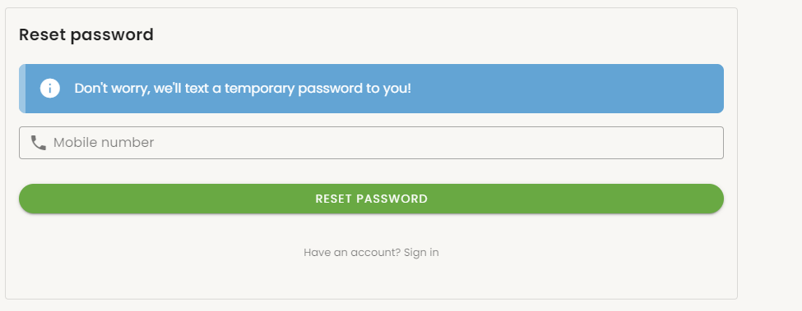
User Access on eCares Cont.
If you forget your password in the future, you can click on “Recover your password”
You will be asked for your mobile number. Remember to replace the first 0 with a 27.
Use the temporary password provided in your SMS
You will receive an SMS with a temporary password. Go back to the login page and use this.
1
2

Slide 20
Registration Application Administrator
Role & Review Process
The individuals who will do the first review of applications.
This manual covers how to access and view applications for review, capture notes, approve and reject documents, check the NCPR, upload Clearance Certificates for each staff member and make decisions per application.

Slide 21
Bana Pele Application Support Post training
1. Query Submission: District officials submit questions and concerns to their respective District Supervisors.
2. Consolidation and Escalation:
District Supervisors compile and organise queries from their teams, then forward consolidated inquiries to SMEs via the dedicated Support Channel
3. Resolution and Empowerment:
SMEs provide comprehensive answers and solutions, equipping District Supervisors with the knowledge to address team concerns effectively.
District Supervisors
Please send your number to Khuthala.
You will be added to a WhatsApp group

Slide 22
What is the role of an application administrator?
!
Check all application form details are completed correctly
Check each staff member has an ID and Form 30 that matches their name and captured ID.
If No – return for corrections
If Yes – Approve the documents THEN
Check each staff member in the DSD NCPR, download the certificate and upload it to each staff member.
Key point: Application Administrators
Check and approve documents.
Upload NCPR certificates

Slide 23
Application Administrator: Process Flow
Login
Dashboard Overview
Application Review
Documents uploaded
Submit/decline applications
Enter your login credentials
Access the Administrator Dashboard
Access the list of all submitted applications.
Filter applications to select ones to review.
Select an application to review.
Review Application details.
Send corrections notes to applicant if additional information is required.
Check for all uploaded required documents (certified ID and Form 30) then accept or decline the document. Add correction comments for any document declines.
Conduct NCPR checks and upload the Clearance certificate.
If the application is complete and accurate, submit it to the reviewer with Admin notes, if any .
If the application is incomplete or inaccurate, send correction notes to the Applicant.

Slide 24
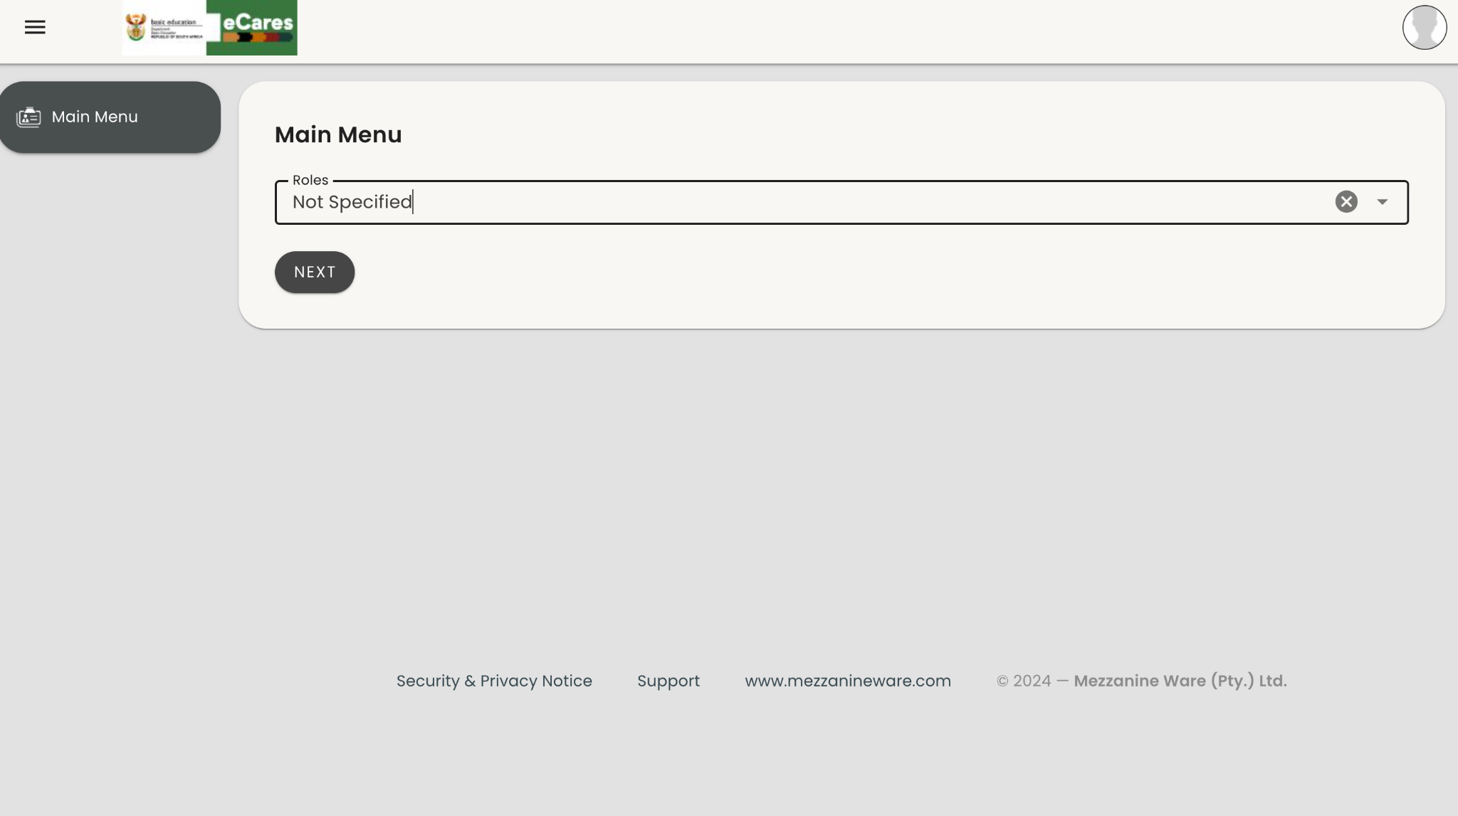
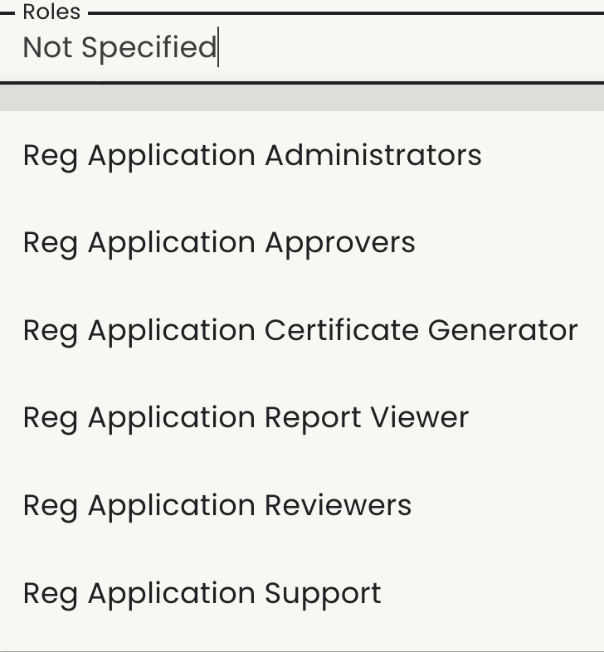
After logging in to eCares
On the Home Page Menu, you will find:
Main Menu: Access various user roles.
To access Reg Application Administrator role:
Navigate to the Main Menu.
Click on "Not specified” below Roles to reveal a dropdown list.
Select Reg Application Administrator from the dropdown.

Slide 25
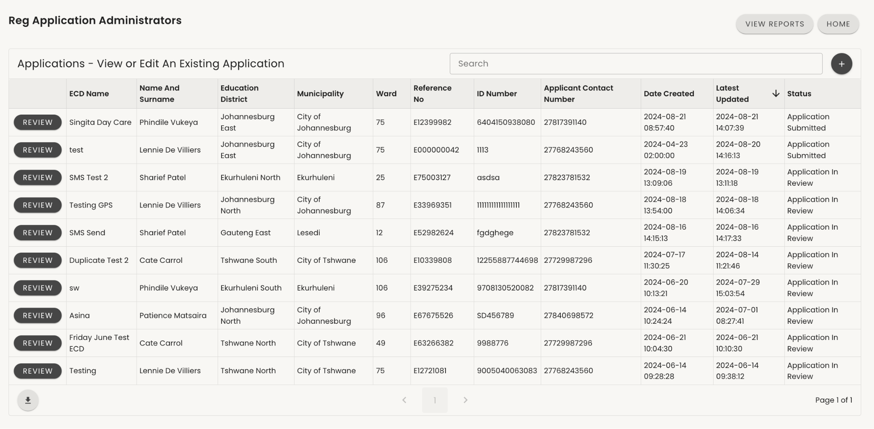
Applications-Administrator Landing Page
2
As an Reg Application Administrator you are the first to review an application after the applicant has submitted.
You are able to:
Add Corrections notes and view historic correction notes.
Review the staff uploaded documents
Do Staff NCPR validation and upload NCPR certificates
Select an application by clicking on the ‘REVIEW’ button next to the applicant to start reviewing the application (1).
Click on ‘HOME’ to return to the Main Menu(2).
1

Slide 26
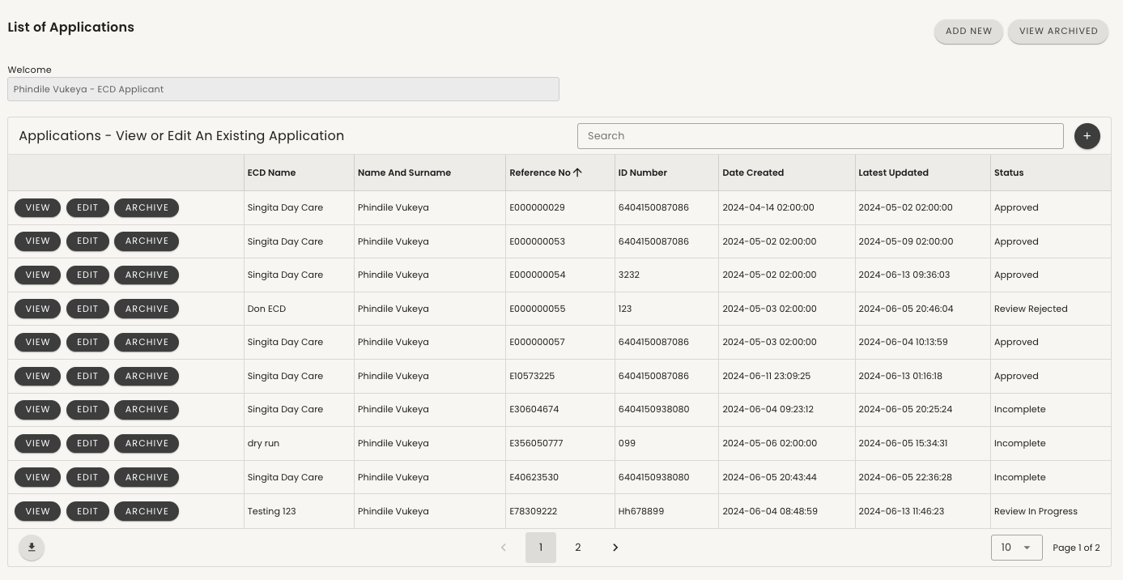
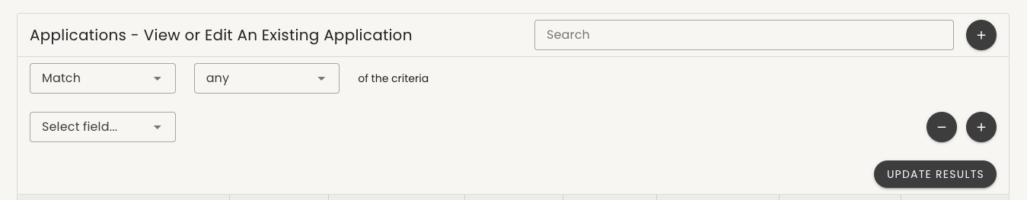
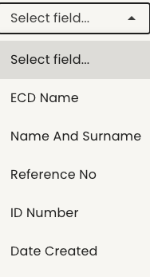

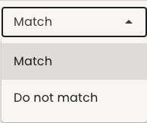
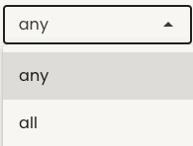
Searching & Filtering Applications
Search for a specific item in the table by typing the name of the item in the search box. (1)
For an advanced search, click on the "+"(2):
Criteria: Choose how the data should be found. Use the Match drop-down to choose if it must have exact match or "Do not" if it doesn't have to match exactly.
Search Field: Select the column or table heading you want to search against. Choose if your desired search should "begin with" or "contain" specific words, then type what you want to search for.
Click on "+" to add another search field.
Click on "-" to close the advanced search or remove an added search field.
Confirm your search selection and retrieve your desired filter by clicking on "UPDATE RESULTS".
2
1
5

Slide 27
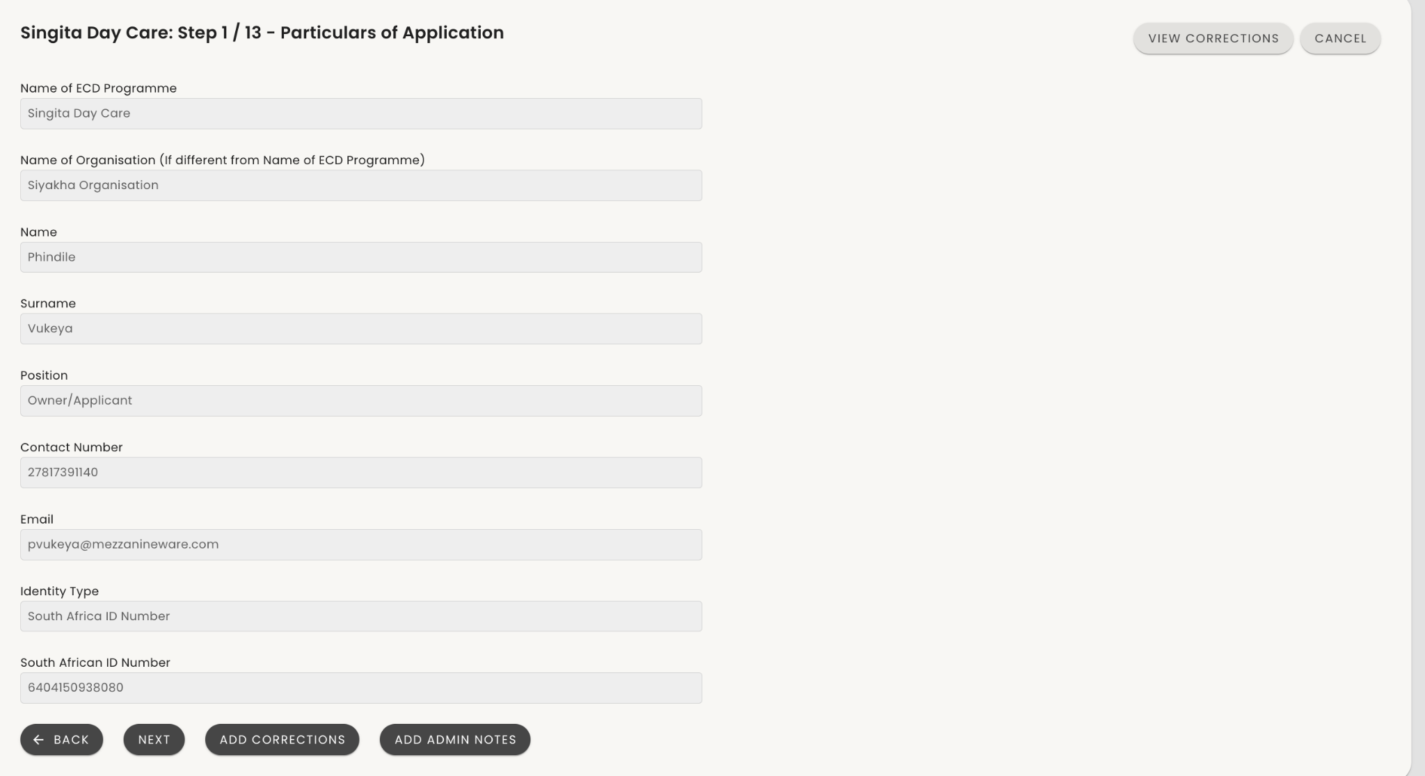
Administrator Step 1/12 - Application Particulars
Review the details of the selected application.
Ensure all required applicant information is captured:
Name
Surname
Position
Contact Number
Email
Identification Type
Identity Number
You can add a correction note at each step of the application if there's missing information.
[Note: Add corrections, View corrections and Add admin notes are available at every step.]

Slide 28
Note on Add Corrections
Please note that “Add corrections” are not sent to applicants after every note is saved.
Following the end of the review process and if “SUBMIT CORRECTIONS” is selected, applicants will receive an SMS notification to revisit their application. All captured corrections will be shown here.

Slide 29
Note on Admin Notes
Please note that Admin notes are NOT visible to applicants. Applicant will NOT receive a notification for notes submitted
Admin notes for every page are internal PED notes that will be visible to the Administrator, Reviewer and Approver.

Slide 30
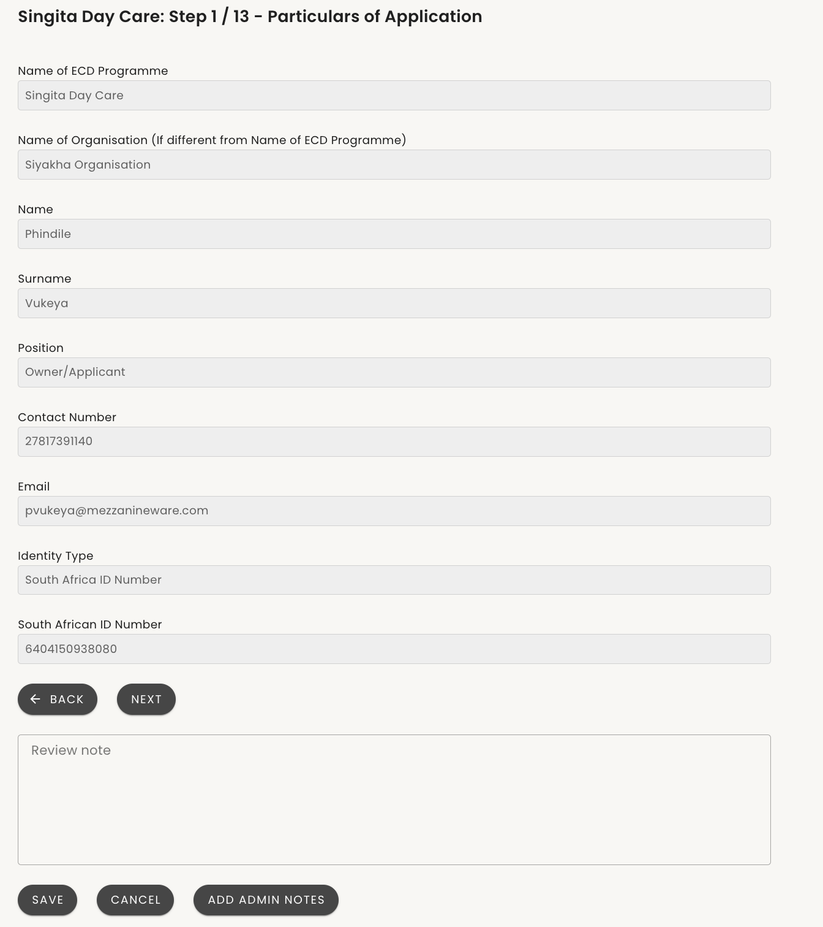
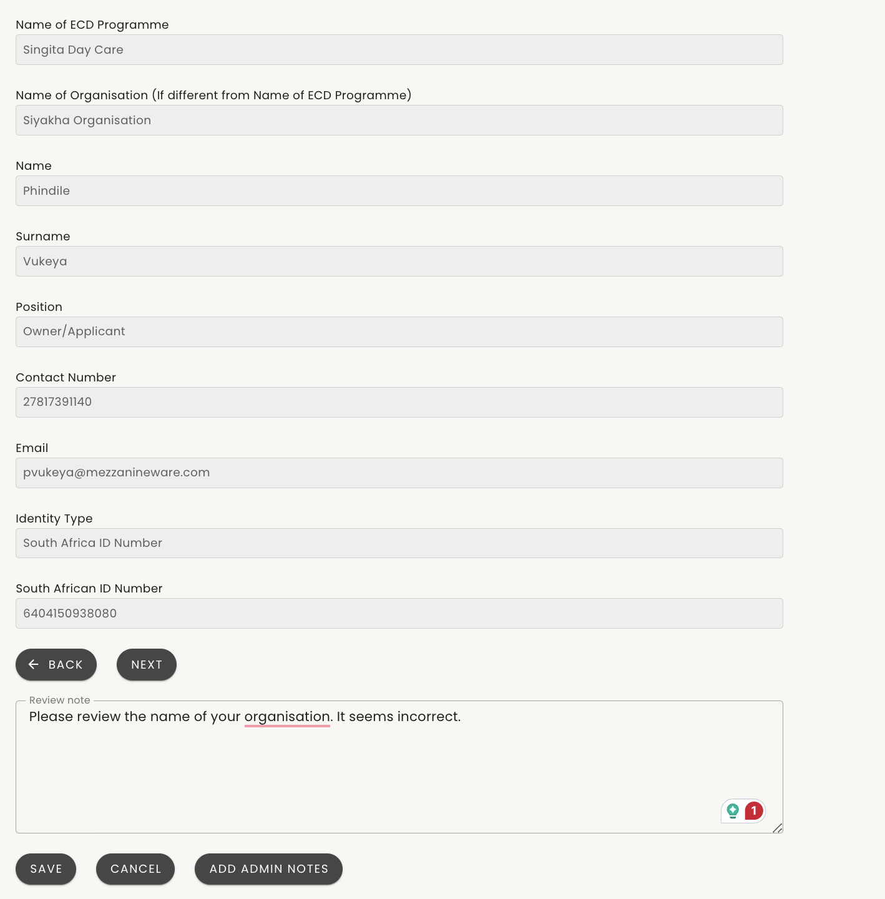
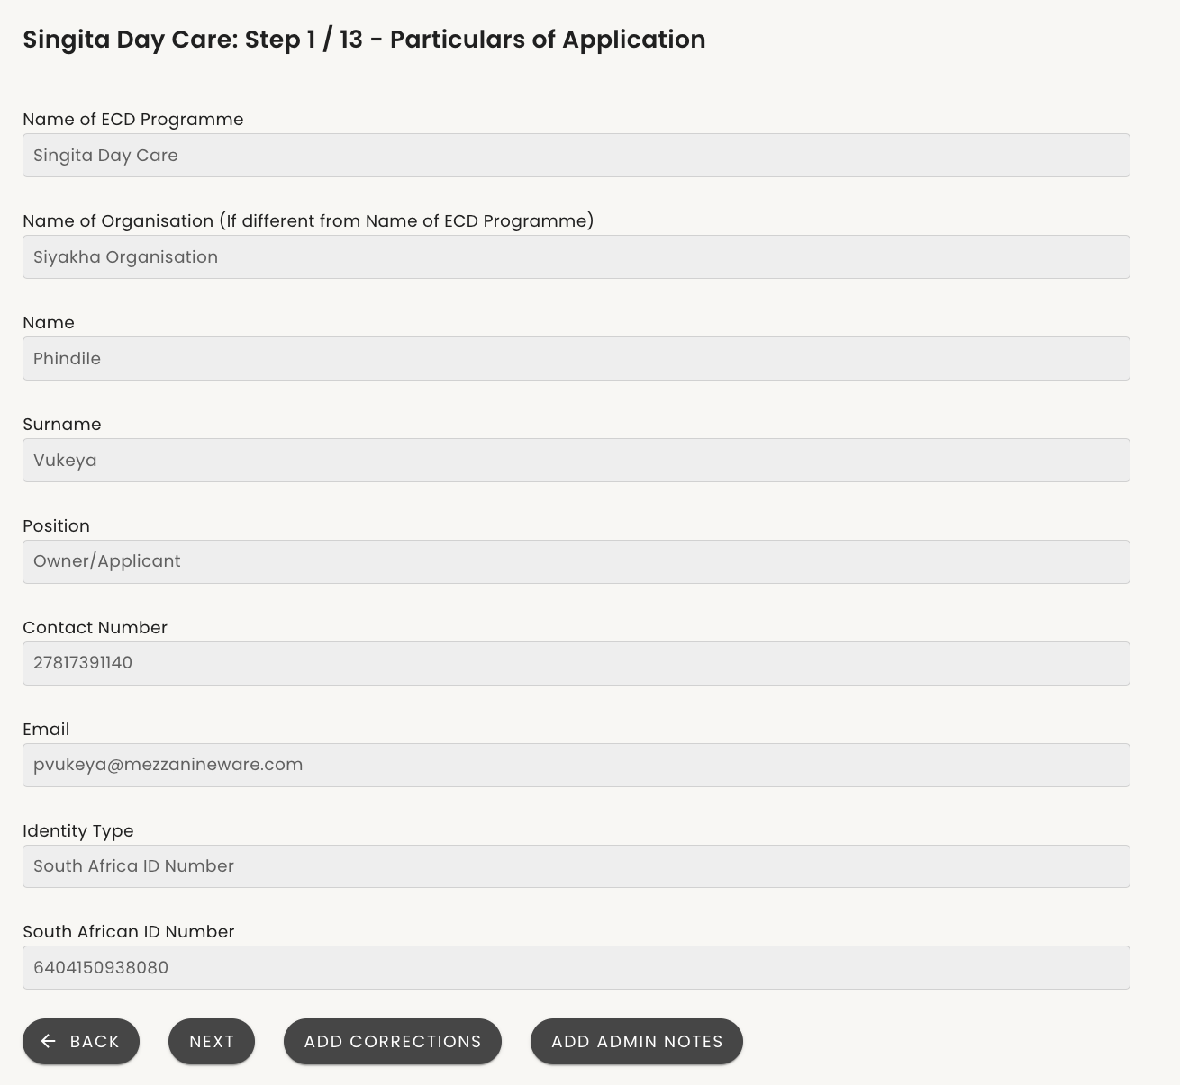
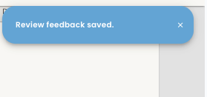
Administrator Step 1 / 13 - Particulars of Application & Add corrections (cont)
1
2
3
5
After selecting “ADD CORRECTIONS” as per the previous step, a text box with space for notes to be captured will appear.
Capture the note/reason for corrections. You can also add admin notes on the same page by clicking on ‘ADMIN NOTES’ and the section for admin notes should appeare.
When done click on ‘SAVE’
4. You will receive a notification that the review feedback has been successfully captured
5. Click on ‘NEXT’ to proceed to the next step

Slide 31
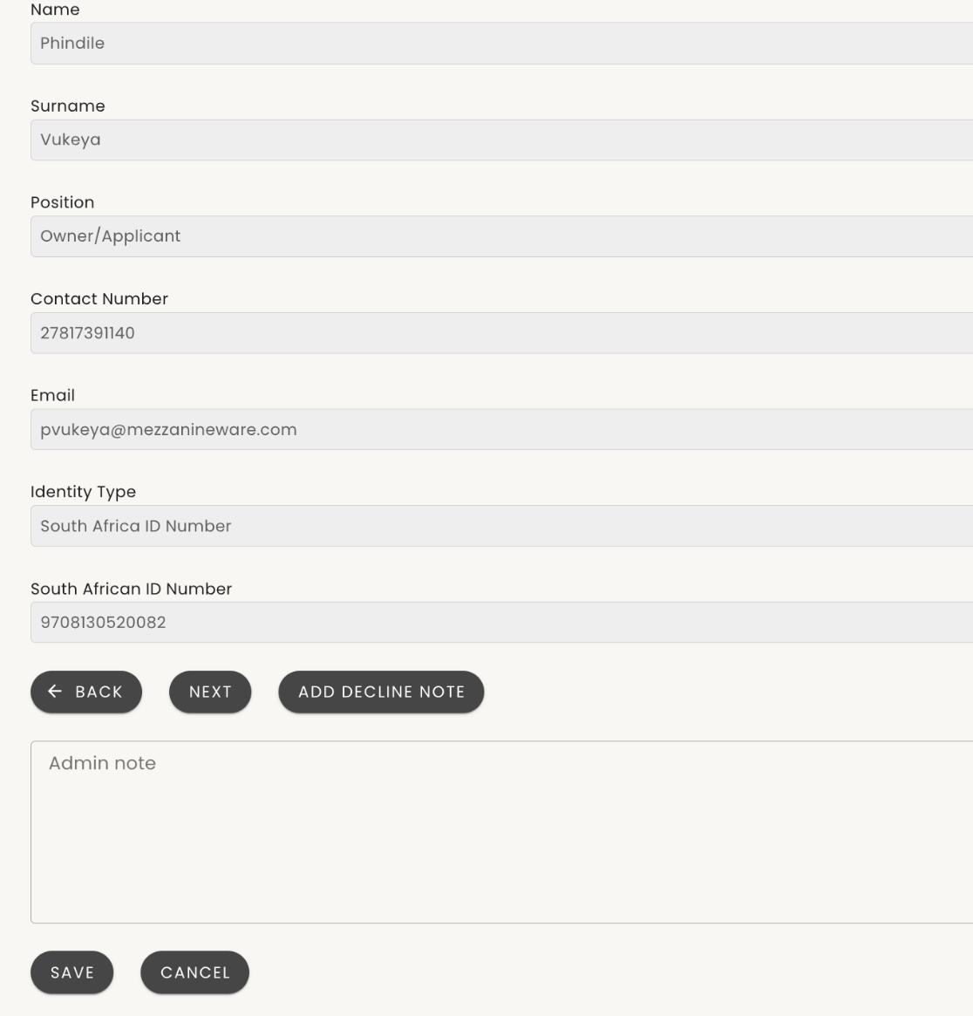
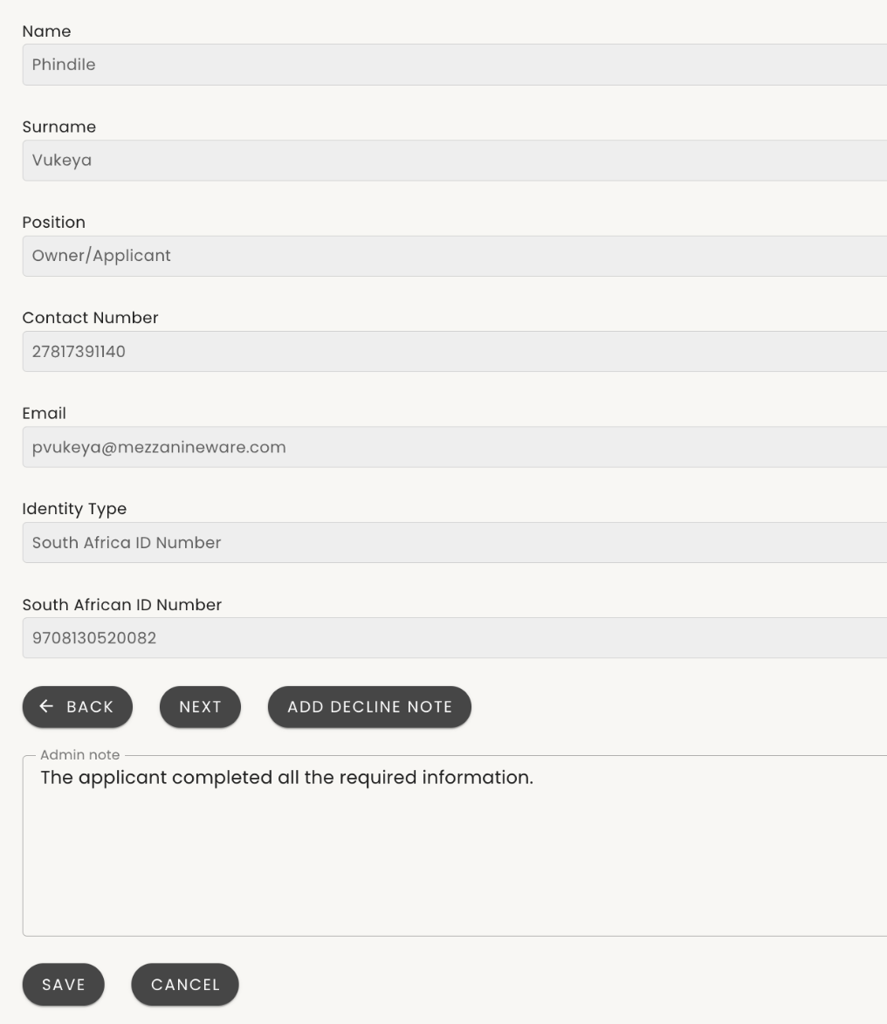
Administrator Step 1 / 13 - Particulars of Application & Admin notes (cont)
1
2
3
After selecting “Add admin note” as per the previous step, a text box with space for notes to be captured will appear.
Capture the admin note/reason for
Click on ‘SAVE’

Slide 32
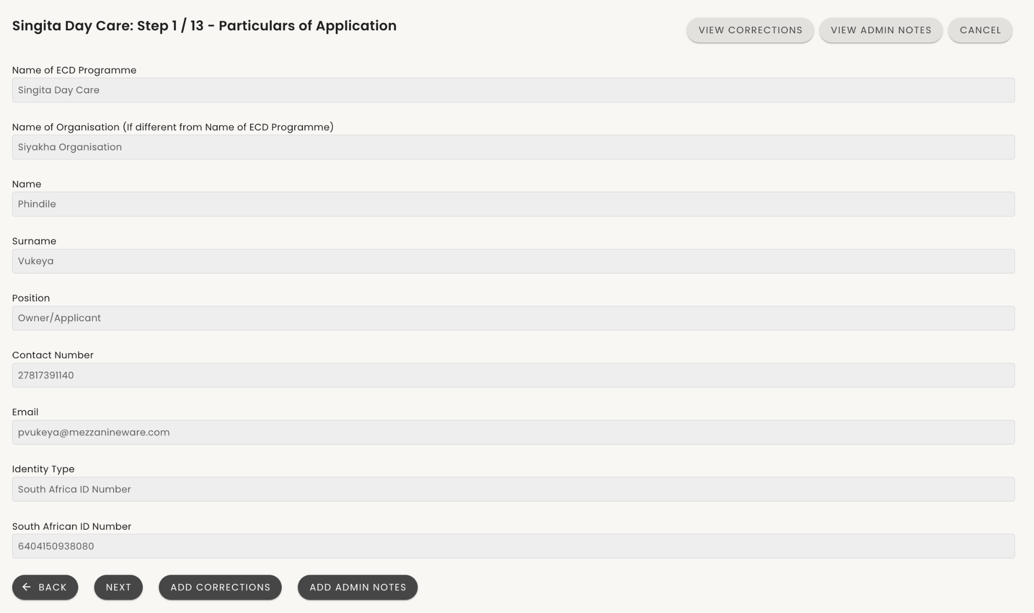
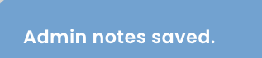
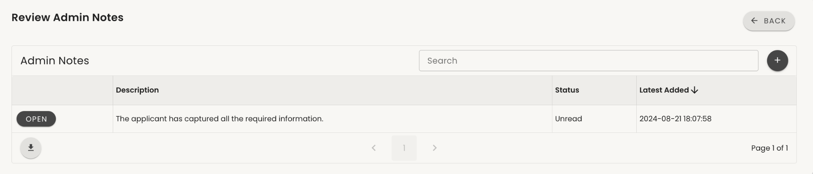
Administrator Step 1 / 13 - Particulars of Application & Admin Notes (cont)
1
You will receive a notification that the note has been successfully captured
You can click a button on the top right to review saved admin notes.
Click ‘OPEN’ to review the admin notes.
Click ‘ADD ADMIN NOTES’ to record notes for the page
Click on ‘NEXT’ to proceed to the next step
4
3
2

Slide 33
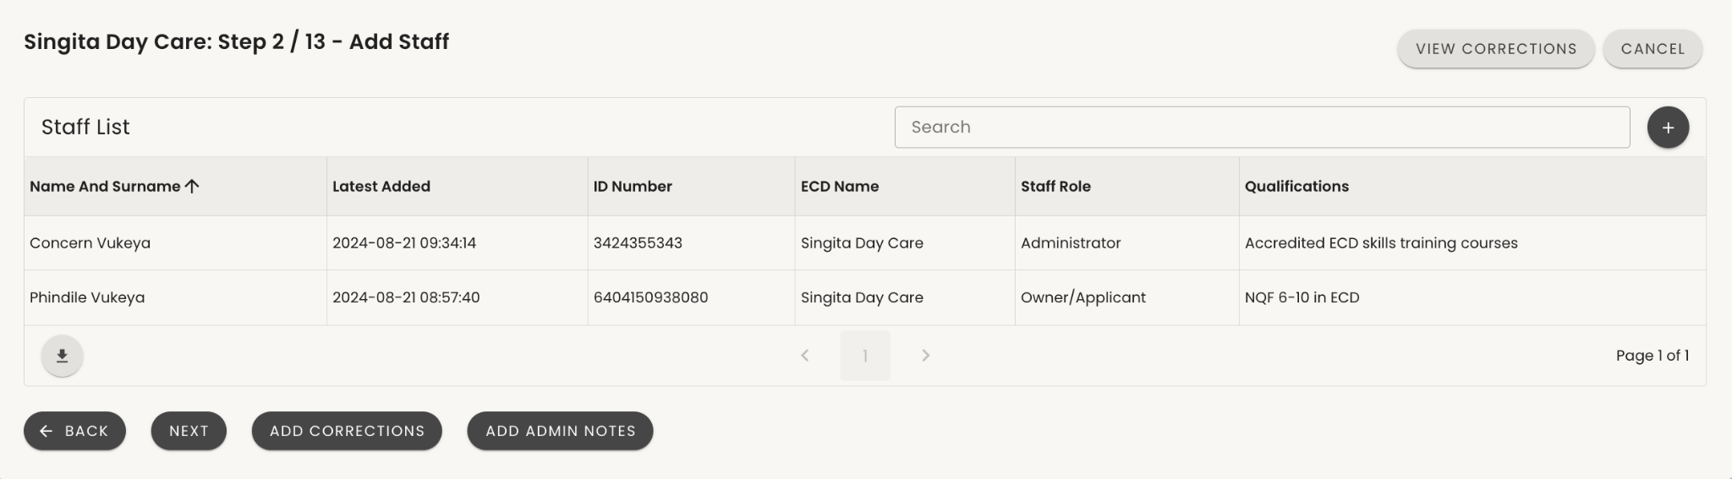
Administrator Step 2 / 13 – Review Staff
Review the staff list and ensure all staff details, including roles and qualifications, are captured.
You can add corrections at each step of the application if there's missing information or add admin notes relevant to each step.
After completing the review, click 'NEXT’(1) .
1

Slide 34
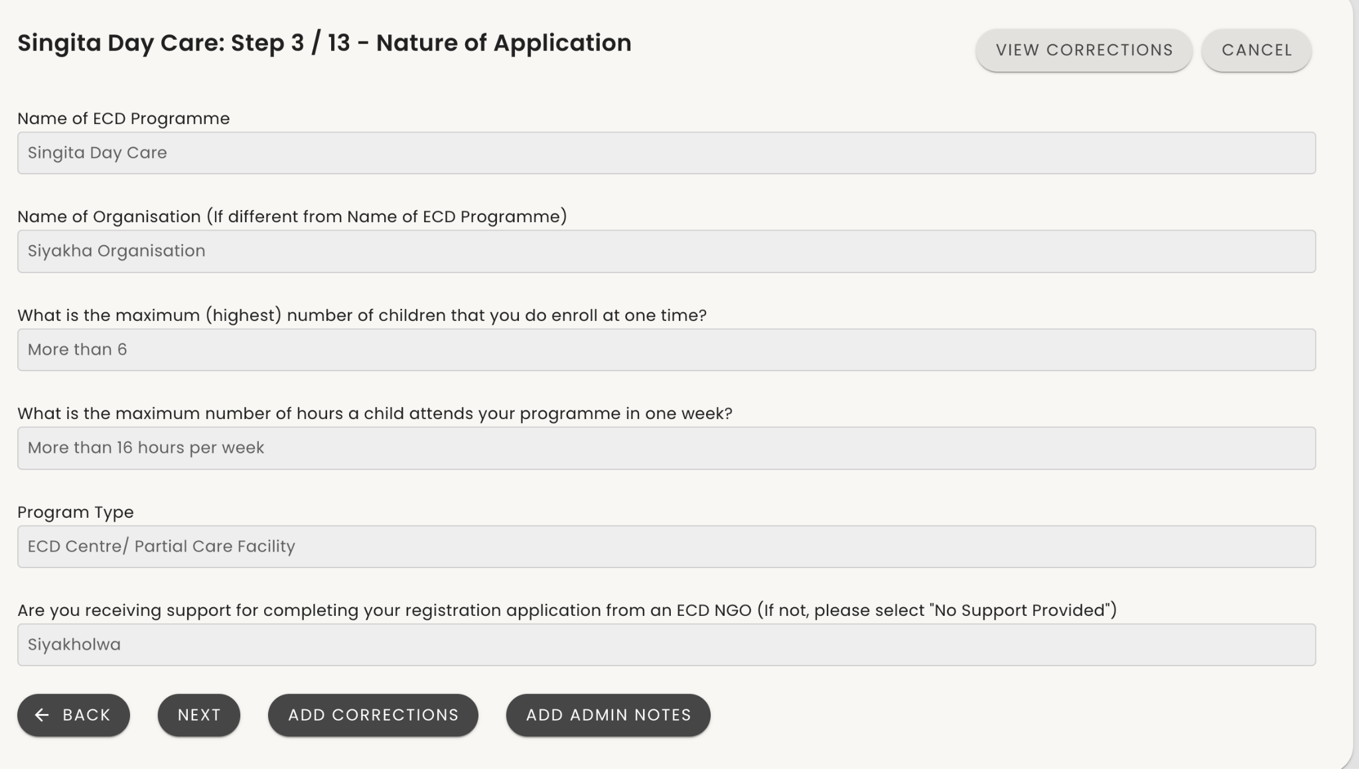
Administrator Step 3 / 13 - Nature of Application
Review the information captured for the “Nature of the Application”
Note: The Name of Organisation is for Organisations who own and run multiple ECD programmes. If that is not the case, the name will just be the same as the ECD Programme Name.
Note: The Program Type is automatically calculated by the two questions before.
3
4
1
2

Slide 35
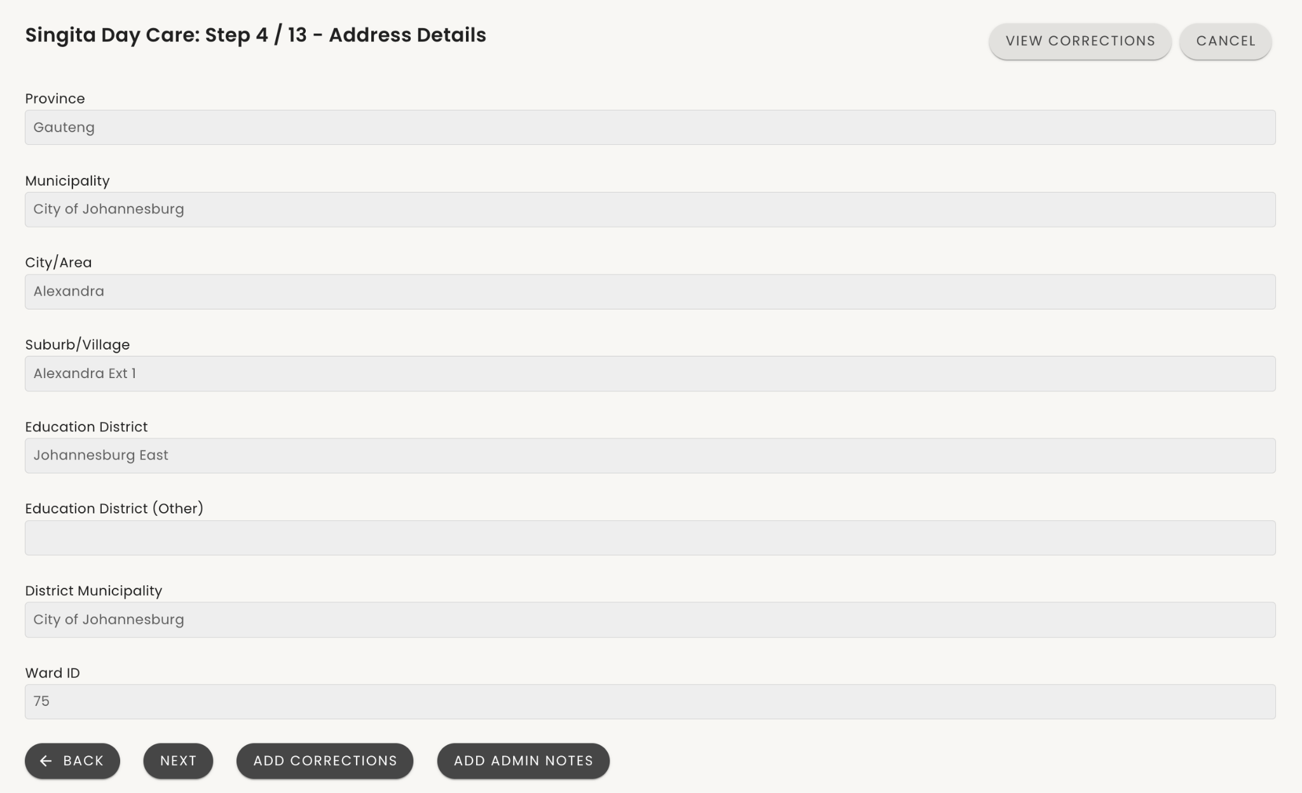
Administrator Step 4/13 - Address details
3
Review the information captured for the ECD programme address details.
Note that the Education District and Ward are automatically applied based on the suburb/village selected.
If an error is noted, capture it by clicking on ‘ADD CORRECTIONS’
To review historic saved corrections click on “VIEW CORRECTIONS”
To leave a note for this page click on”ADD ADMIN NOTES”
If no error or once a corrections notes has been added, click ‘NEXT’
4
1
2

Slide 36
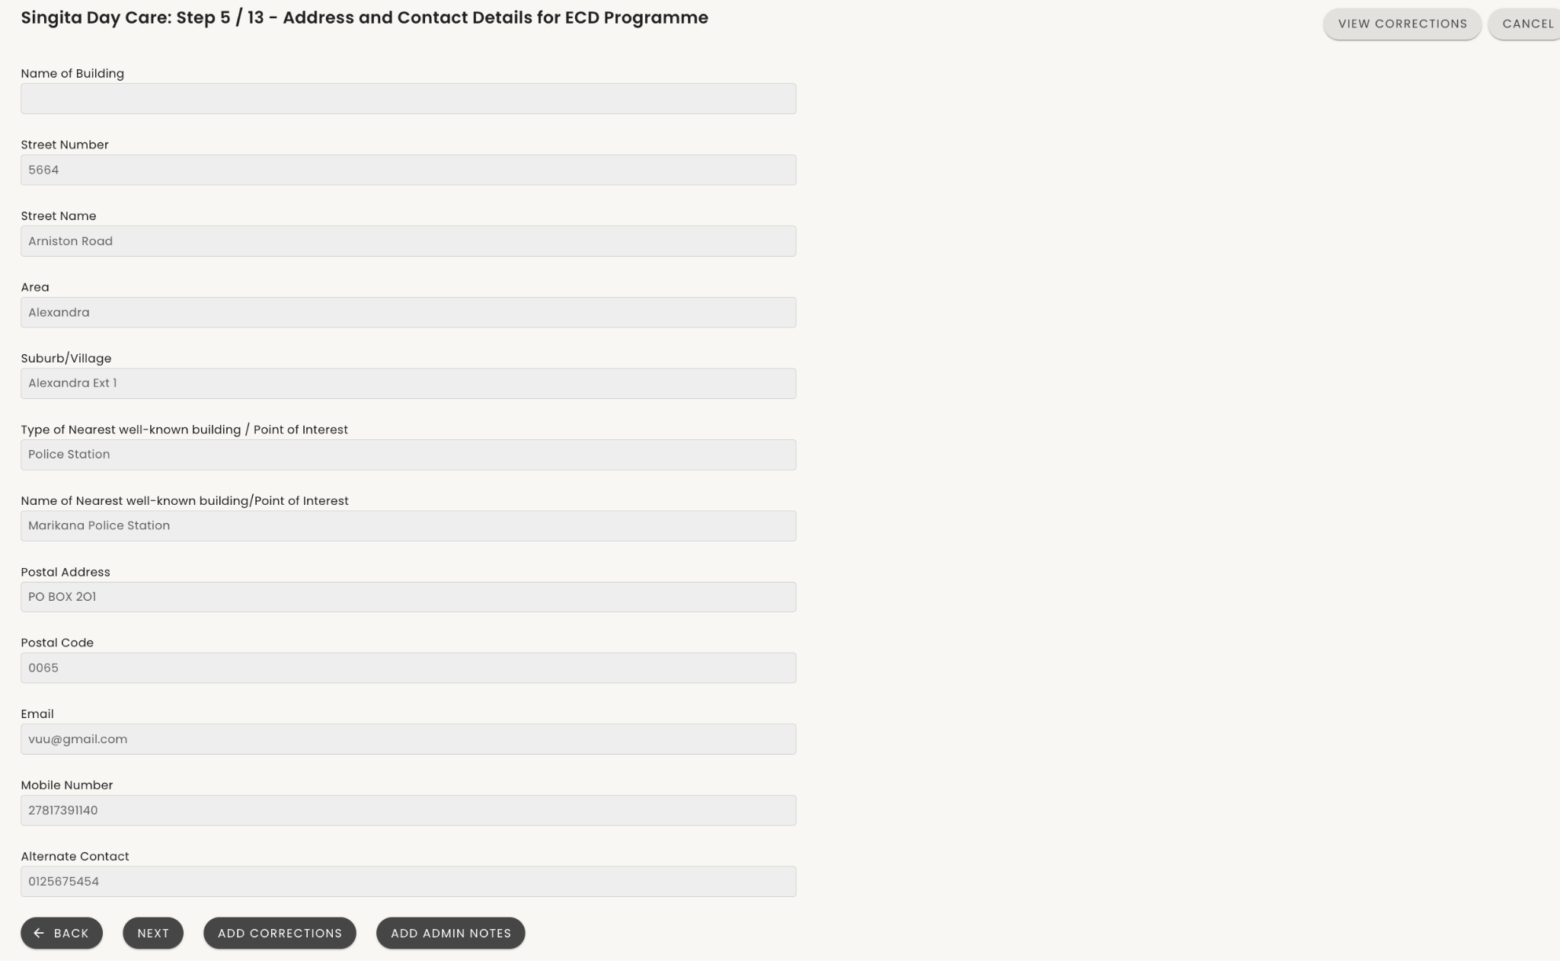
Administrator Step 5 / 13 - Address and Contact Details for ECD Programme
Review the information captured for the ECD programmes Physical address and Contact details.
Applicants are able to capture a street address (if available), alternatively, a point of interest and details of the point of interest can be captured.
Note that Street Address and Postal Address are not mandatory if they do not have one.
3
3
1
2

Slide 37
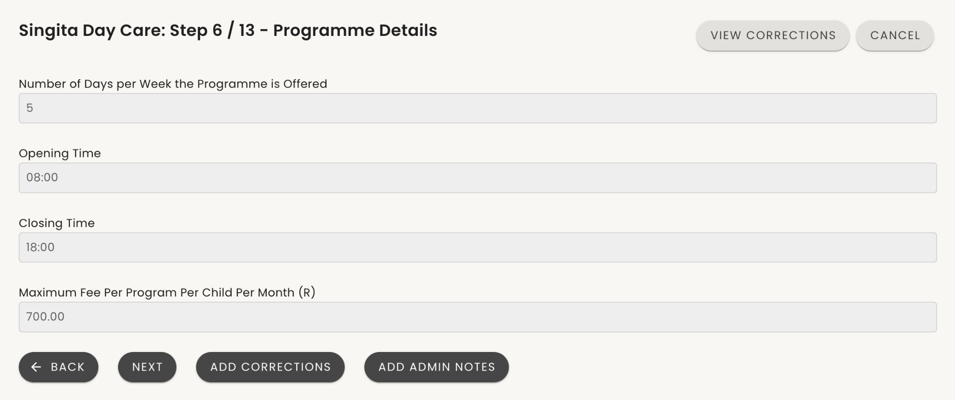
Administrator Step 6/13 - Programme Details
Review the information captured for the ECD programme details;
Days that the programme is offered in a week
Opening time
Closing Time
Maximum fee per child per month
3
4
1
2

Slide 38
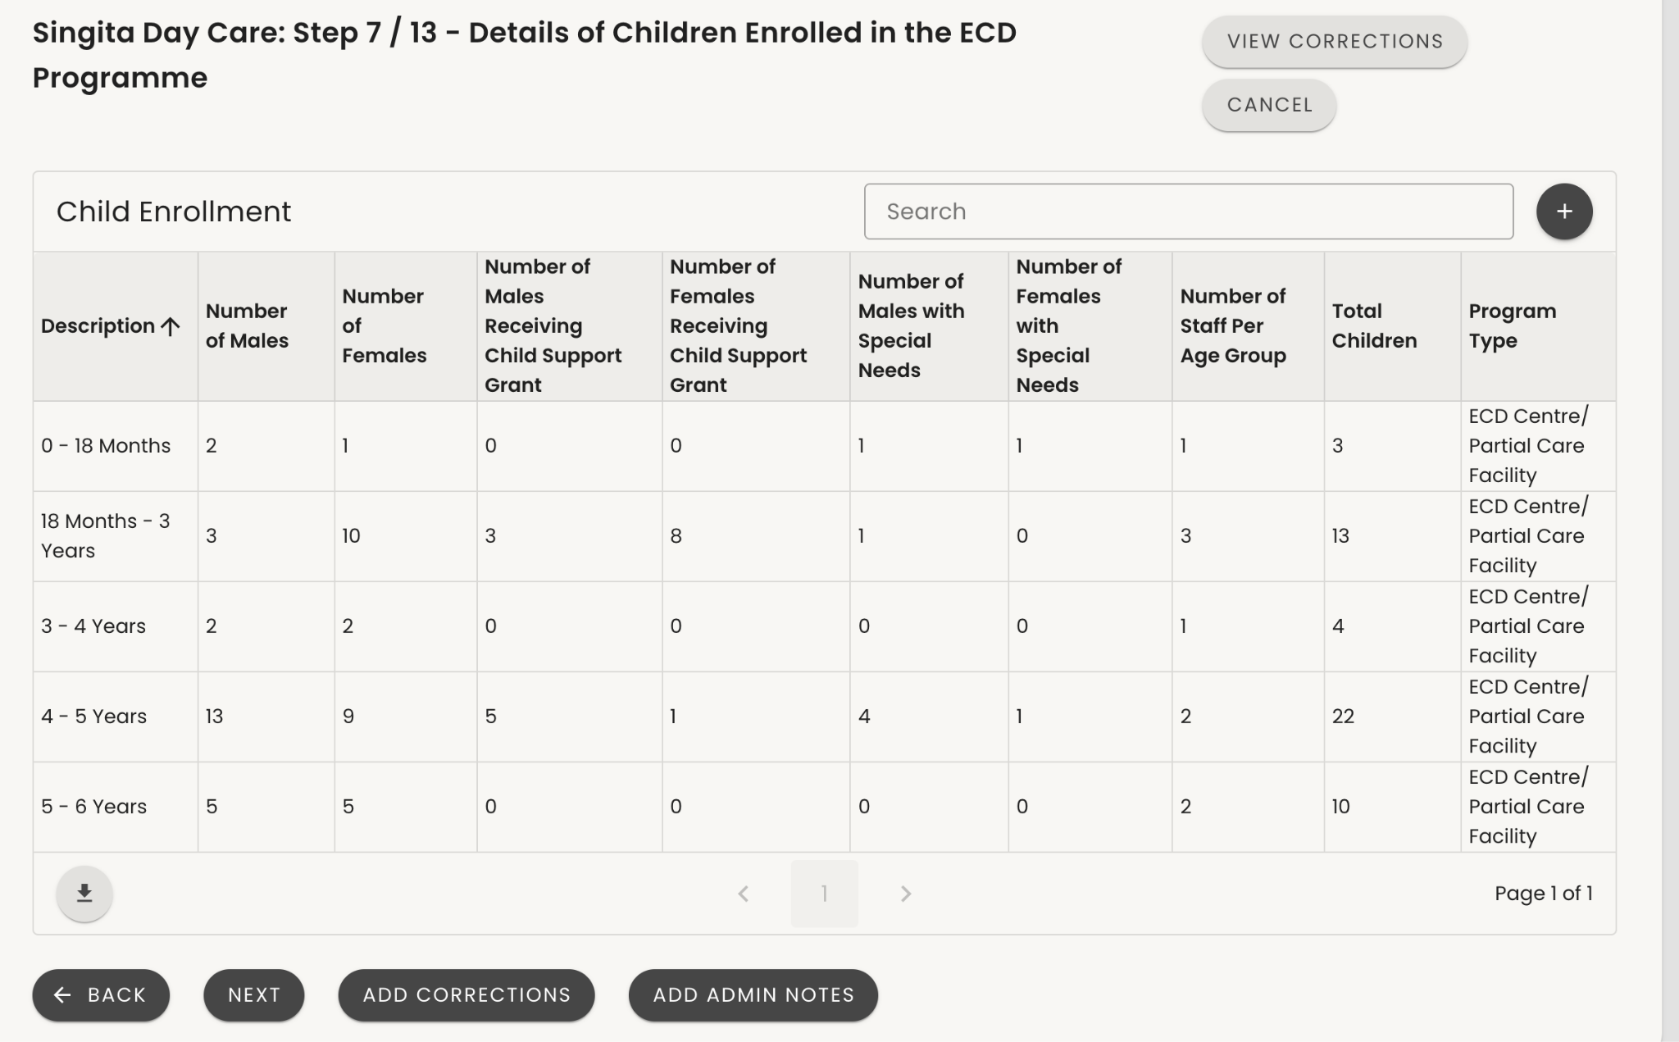
Administrator Step 7/13 -Details of
Children Enrolled in the ECD Programme
4
Review the information captured for the Children enrolled in the programme.
Please note that we are not checking staff to child ratios at Bronze level. This standard will be assessed during the site visit for silver.
All that is required at Bronze is that they declare how many children they currently have enrolled.
3
1
2

Slide 39
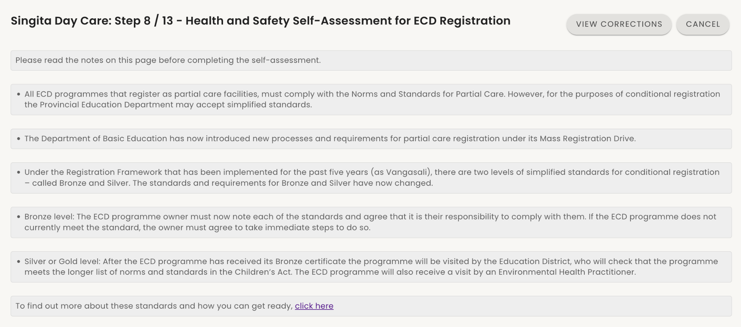
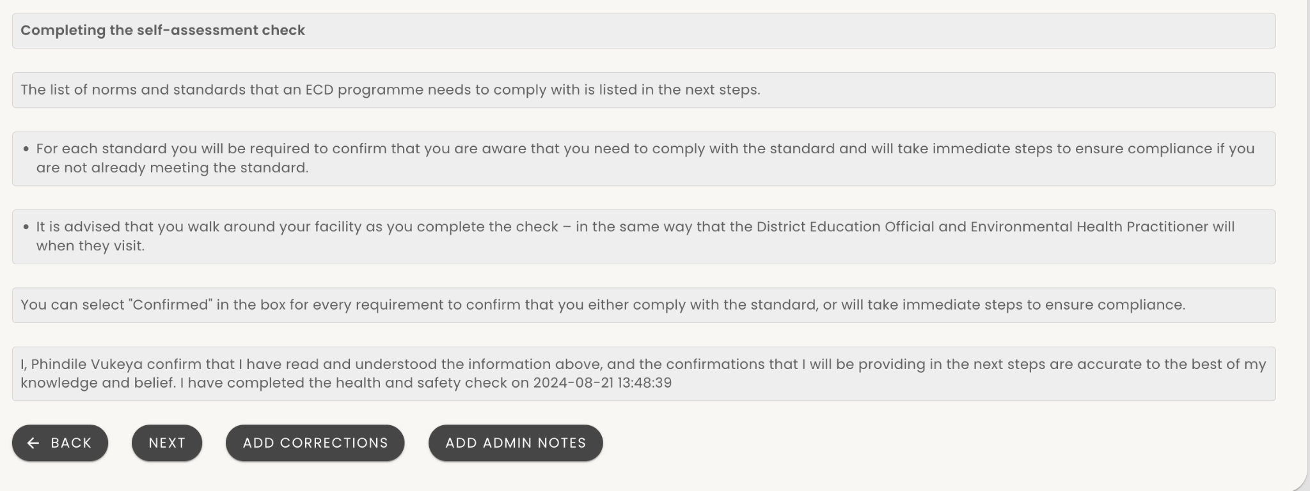
Administrator Step 8/13 - Health and Safety
Self-Assessment
Proceed to the Health and safety assessment for ECD Registration.
No applicant information is captured in Step 8 to 11.
The applicant is simply confirming that they understand that they have to meet norms and standards and that they will be checked when a site visit happens
1

Slide 40
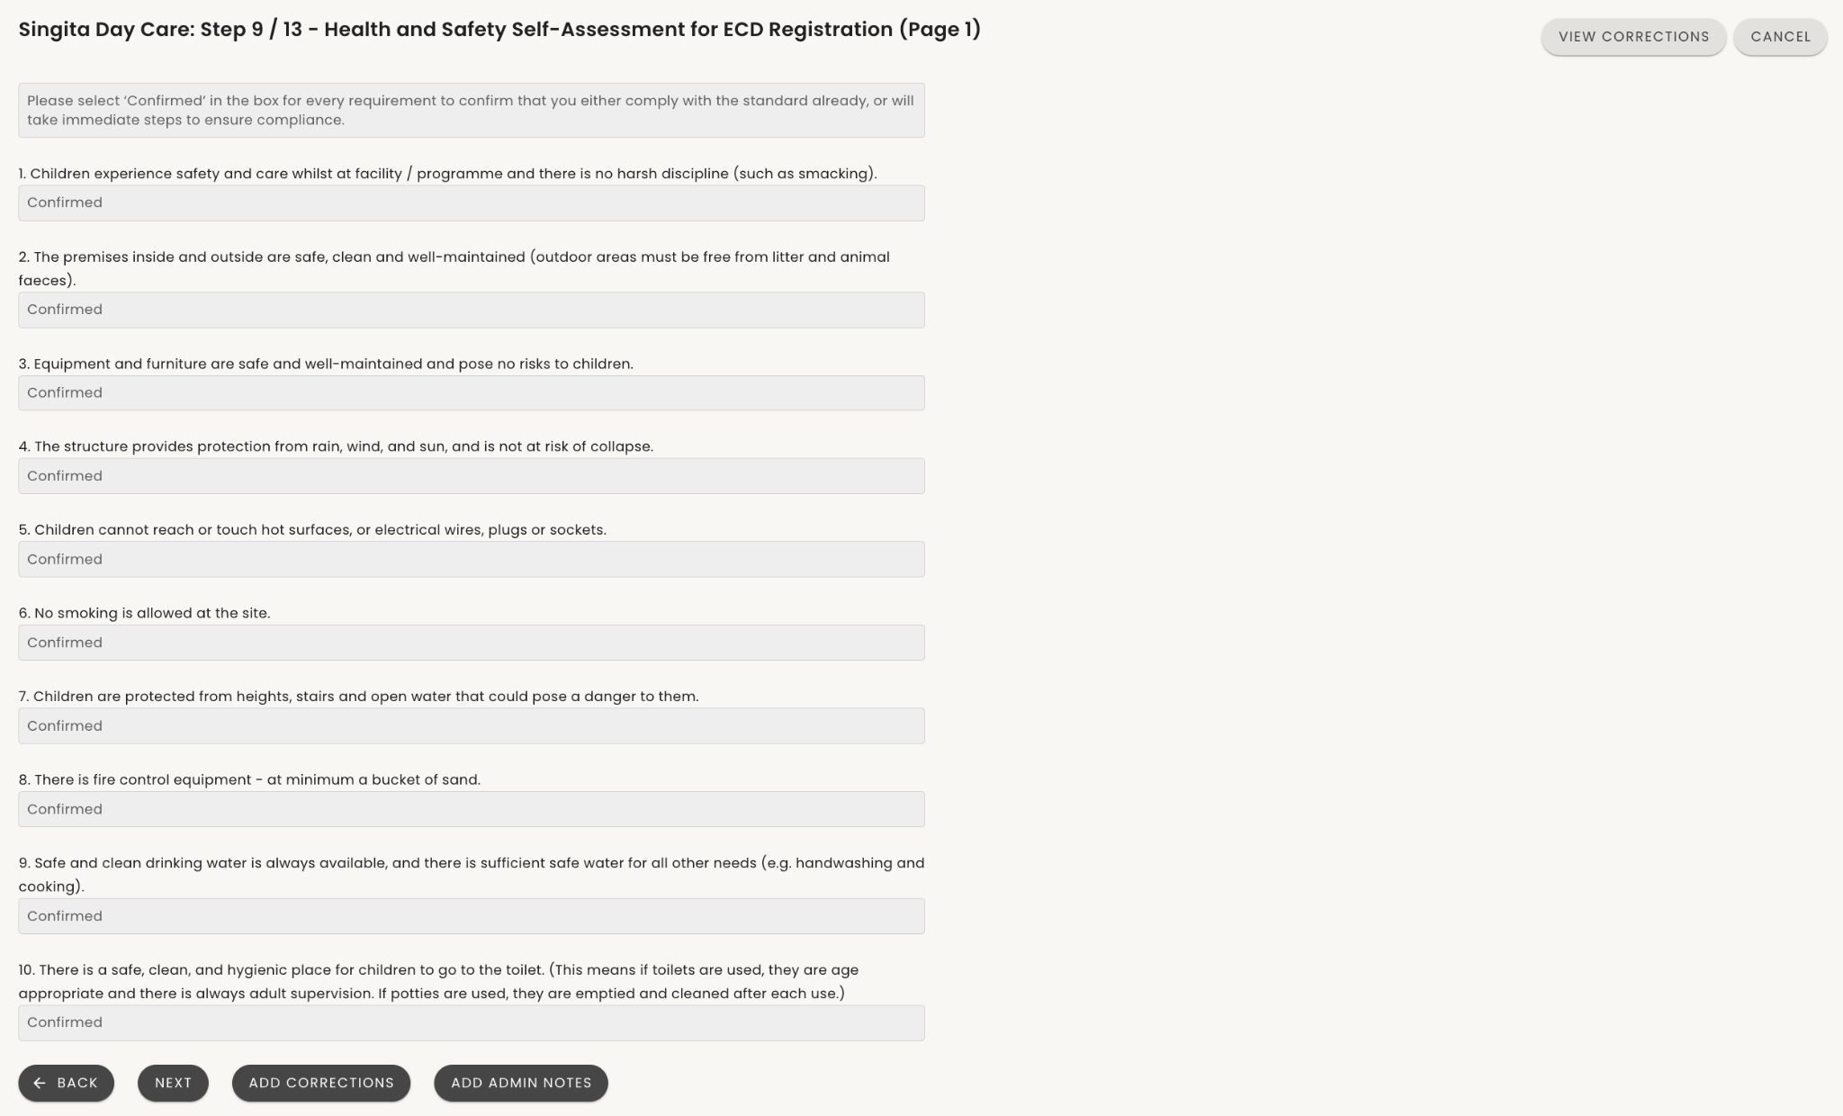
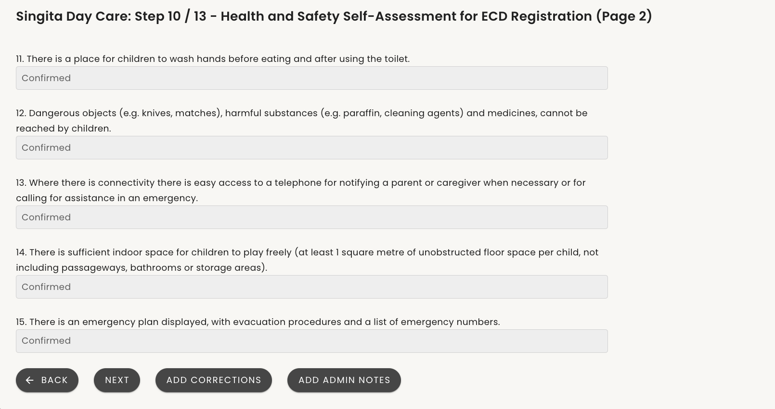
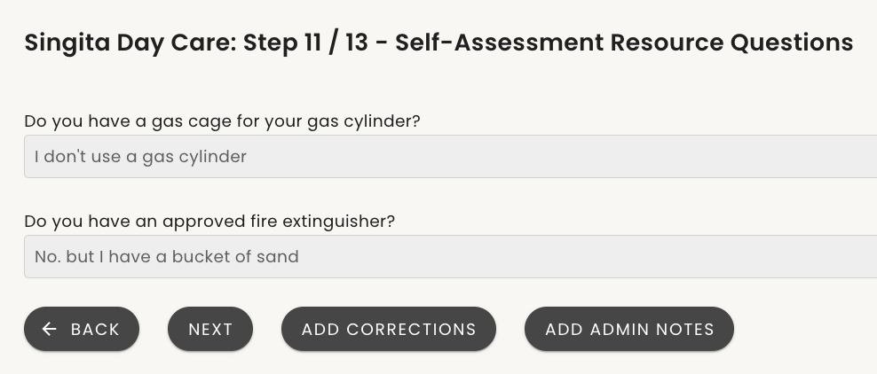
Administrator Step 9-11/13 - Health & Safety Self Assessment
Continue to the Health and safety assessment for ECD Registration.
No applicant information is captured in Step 8 to 11.
The applicant is simply confirming that they understand that they have to meet norms and standards and that they will be checked when a site visit happens.
Step 11 questions are used to inform what should be delivered in H&S packs.

Slide 41
Document Review Process: Step 12/13
Certified ID copies
Form 30
Approval
Decline
NCPR Checks and clearance certificate
Check the certification stamp to ensure it's visible and recent (within the last three months).
Verify that the ID number matches the details provided in the application.
Ensure the ID is clear and legible.
If so – approve the document – otherwise decline and add correction notes.
Ensure the form is fully completed with no missing sections.
Confirm that the form is signed and dated.
Verify the applicant’s or staff member’s details against the ID provided.
If so – approve the document – otherwise decline and add correction notes.
If the documents are satisfactory:
        Mark the document as "Approved" and proceed to the next one.
Continue the review process until all documents have been checked and approved. .
If the documents are not satisfactory :
Mark the document as Declined.
Add Correction Notes detailing what is wrong with the document (e.g., "ID copy for XXX is not certified," "Form 30 for XXX is incomplete," etc.).
Ensure your notes are clear and provide guidance on what the applicant needs to correct and for which staff member.
When you have approved ID and Form 30 for a staff member.
Enter each staff member’s ID in the NCPR system and download the certificate and upload for the staff member in eCares
Review Results:
Cleared: Not listed; staff member is approved. Download the clearance certificate from NCPR and upload to the staff member's profile
Listed: Listed; staff member cannot work with children, and application will be declined. Add admin notes for reviewer.

Slide 42
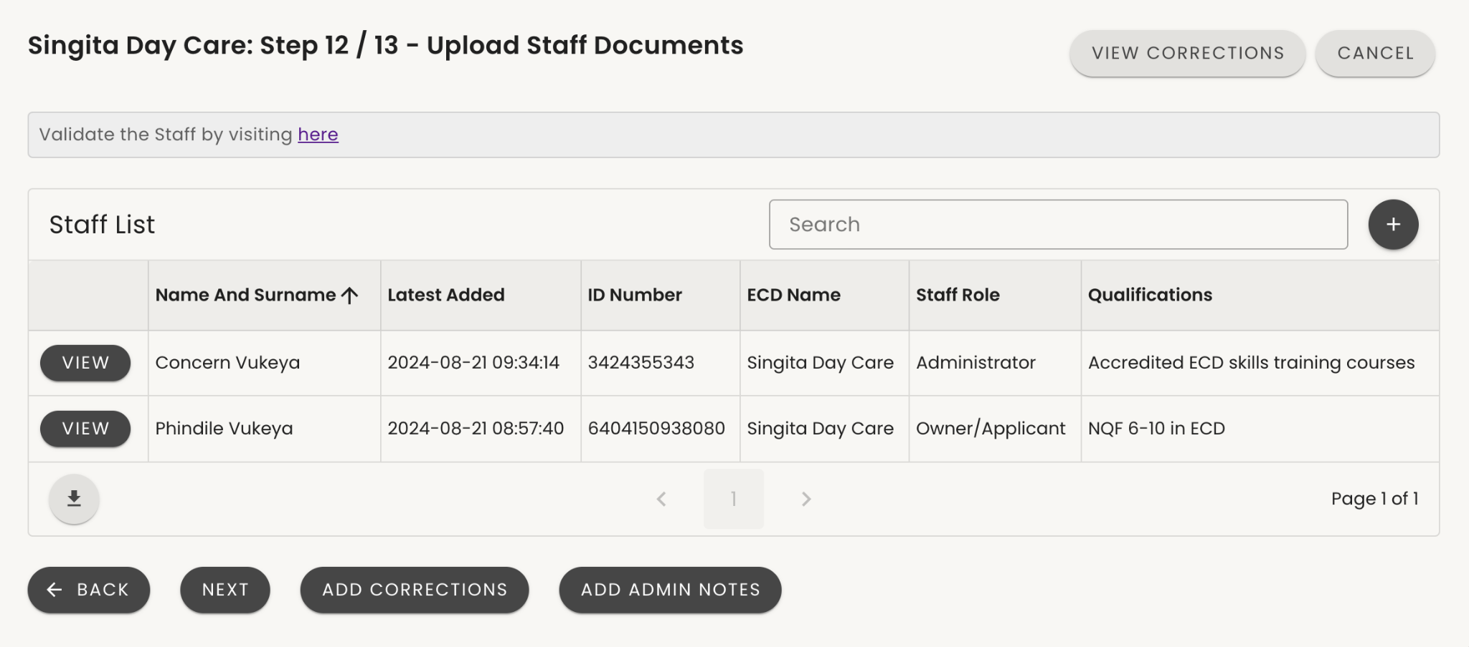
Administrator Step 12 / 13 – Review Staff Documents
Select “VIEW” (1) on Staff Member to review staff documents and upload Clearance certificate.
Remember to complete the next steps for EVERY staff member
1

Slide 43
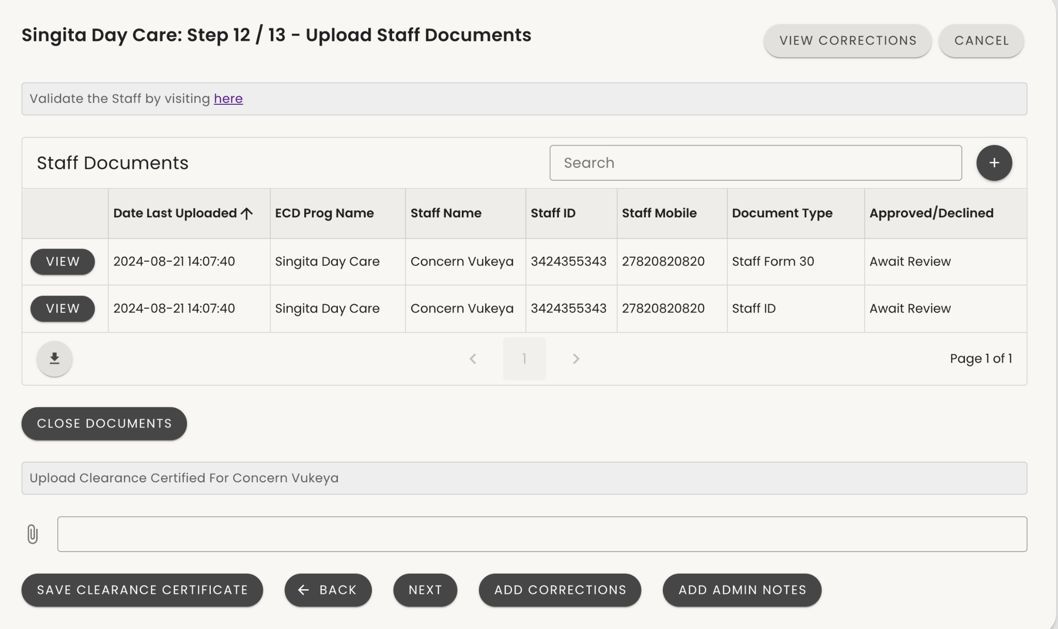
Administrator Step 12 / 13 – Review
Staff Documents (Cont)
The system will show documents uploaded for the selected Staff member.
Each staff member should have an ID and Form 30.
If any of these is missing add corrections
On Staff document table, click on ‘VIEW’ to see the documents uploaded.

Slide 44
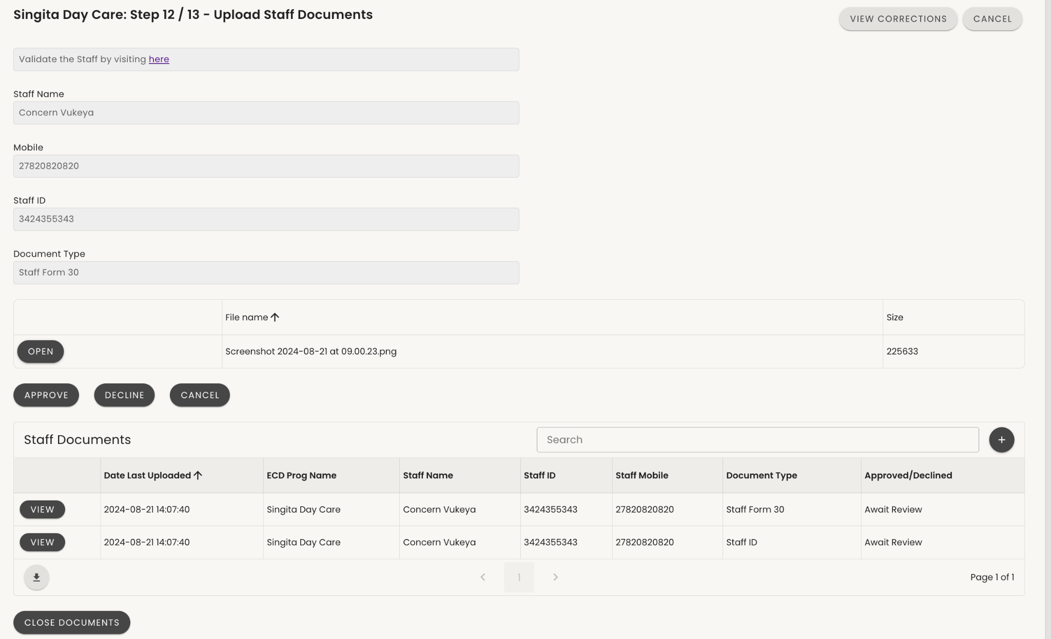
Administrator Step 12 / 13 – Review Staff Documents (Cont)
Please note - applications should include:
A certified copy of the staff member ID
Form 30 for each staff member and applicant.
Confirm this information is available by clicking on “OPEN”(1) next to a document uploaded. Check that it matches the details they captured – ID Number and Name.
Once satisfied with the documentation - select “APPROVE” (2)
If not happy with the document select “DECLINE”(3). Make sure to add correction notes after closing.
Select CANCEL(4) to stop looking at this document and go to the next one.
After viewing all the documents for this staff member select CLOSE DOCUMENTS(5) to go to the staff list
1
2
3
4
5

Slide 45
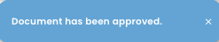
Administrator Step 12 / 13 – Review Staff Documents(Cont)
After approving the Staff ID and Form 30 document you will receive the notification that the document is approved.
Navigate to the Validate staff hyperlink in order to access the National Child Protection Register (NCPR) online site if you are an authorised user.
If users are not an authorised user, users will need to request an authorised user to check the staff member for them and provide the clearance certificate

Slide 46
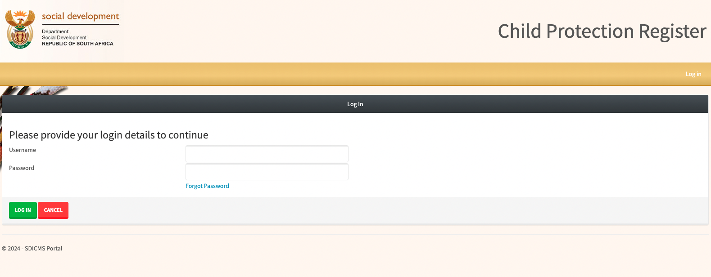
Administrator Step 12 / 13 - Review Staff Documents (Cont)
You will be directed to the DSD Child Protection Register site, and access the site using their login credentials.
From here, you will be able to download the clearance certificate for the selected staff member, using their ID number as has been provided.

Slide 47
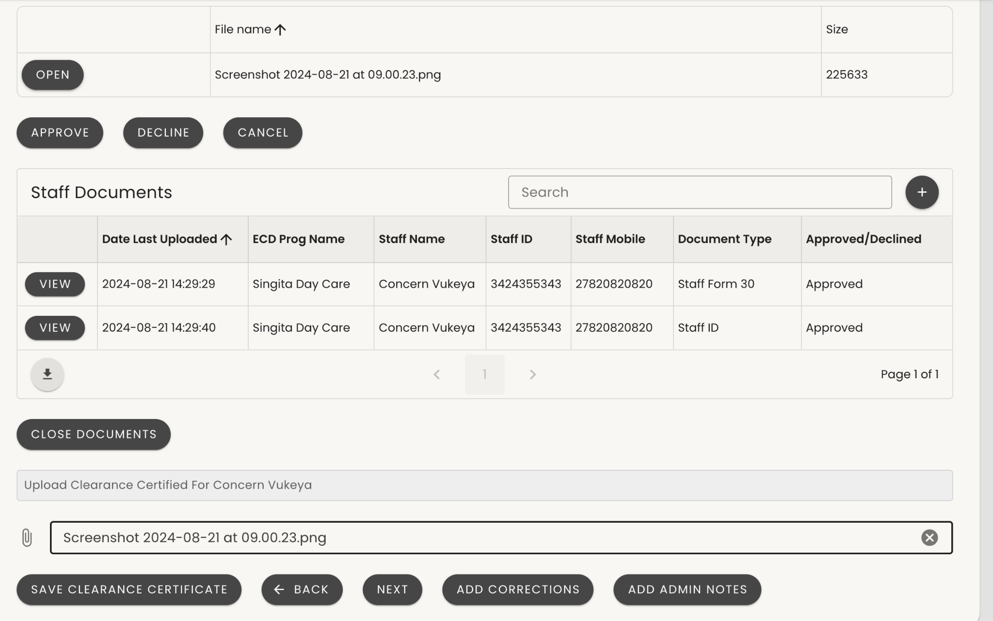
Administrator Step 12 / 13 - Review Staff Documents (Cont)
Without approval of the Certified ID and Form 30 users do not have consent to check for the clearance certificate.
Only Administrators and Reviewers can upload the Clearance certificate. The Administrator uploads first, and the Reviewer approves it. If the Administrator did not upload the certificate, the Reviewer can upload it and approve it at the same time.
To upload the clearance certificate for the selected staff member:
Click on the paper clip image (1)
Selecting a file from your device
Or try Dragging and dropping a file
Once the document has been uploaded, select ‘SAVE CLEARANCE CERTIFICATE’.(2)
1
2

Slide 48
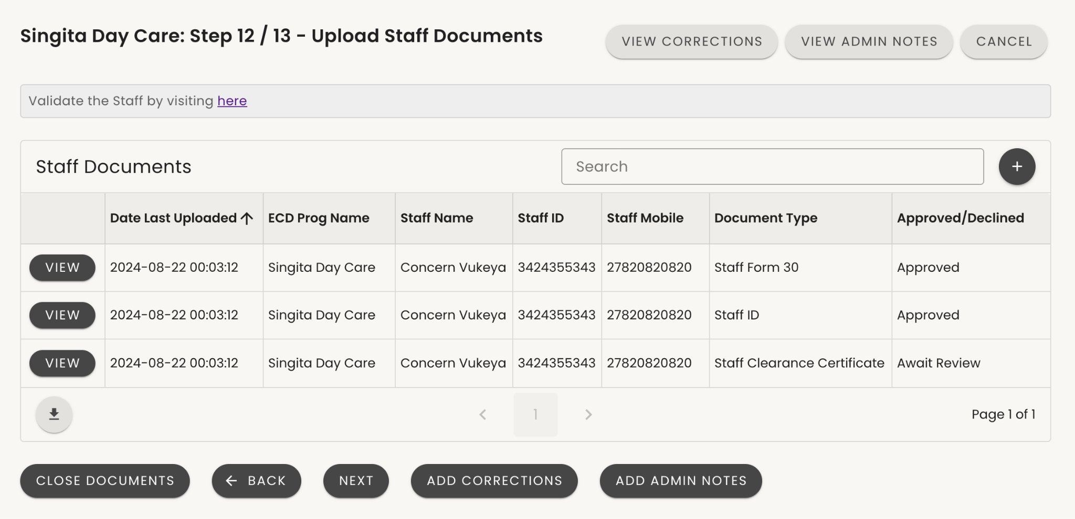
Note on Document Review
By the time an Application Administrator has reviewed an application to the point that it is ready to submit for review:
every staff member should have
an ID in Approved Status
a Form 30 in Approved Status
an NCPR certificate in awaiting review status
If this is not the case you should:
Submit corrections at the end of the review to request missing documents
Or complete the outstanding NCPR checks

Slide 49
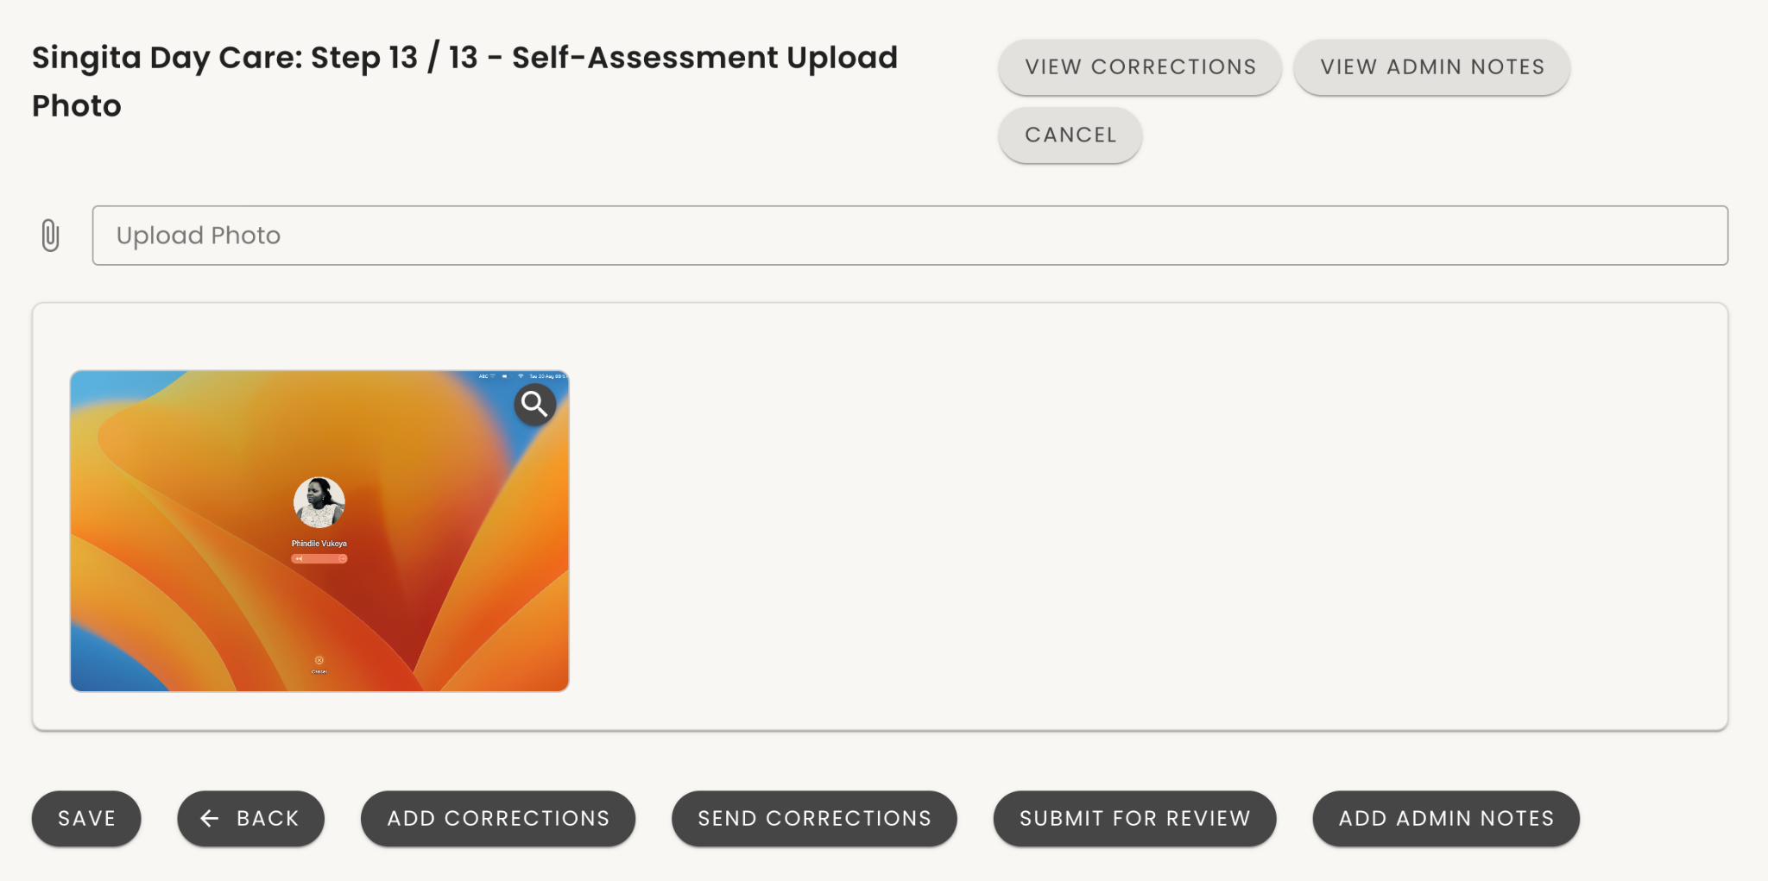
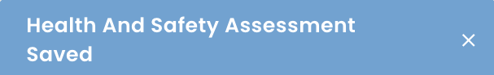
Administrator Step 13/13 – ECD Photo &
Final Decision
View the uploaded photo
You are also able to upload the Self Assessment photo on behalf of the Applicant by clicking on on ‘Upload Photo’ then after uploading click on ‘SAVE’ (1)
Please note that Photos of the ECD are NOT mandatory – do not request one if not submitted or unclear.
This is the end of your review and you now have two choices:
Click on "SEND CORRECTIONS" to return the Application to the applicant for viewing your saved correction notes and resolving corrections. Applicant will receive an SMS to review the application.
OR
Click on "SUBMIT FOR REVIEW" to say you are happy with the application and it is ready for the APPLICATION REVIEWER to review. After submission, the system will take you to the Main Menu with the application list and this application will be waiting in the landing page of the APPLICATION REVIEWER ROLE
1
2
3
5

Slide 50
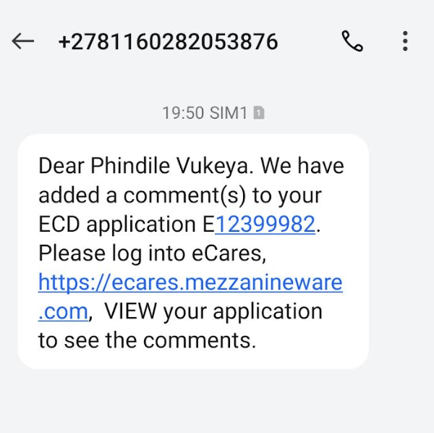
Administrator – Send Corrections
This is the SMS the applicant receives when you complete reviewing an application and hit SEND CORRECTIONS. When they log in to eCares, the application status will be "Incomplete."
If the application is submitted for review, as an Administrator, you will no longer see that application on your list to review as it will now be sent to the Reg Application Reviewer for a second review.

Slide 51
Registration Application Reviewer
Role & Review Process
The individuals who will do the second review of applications and provide the Social Workers Report and Recommendation.
This manual covers how to access and view applications for review, capture notes, approve and reject documents, check and approve or reject the uploaded Clearance Certificates for each staff member and make recommendation decisions per application.

Slide 52
What is the role of application reviewers?
!
Check all form details completed correctly
Check ID and Form 30 have been approved
Check NCPR certificate has been uploaded – Check it – if it says clear – approve the document If it says not clear/listed – reject the document (and recommend rejection of registration)
Generate a Social Work report recommending approval – or rejection if staff have been found to be on the NCPR
Key point:
Application Reviewers
Approve or reject NCPR certificates.
Recommend approval OR
Recommend rejection if staff fail NCPR check.

Slide 53
Application Reviewer: Process Flow
Login
Dashboard Overview
Application Review
Documents uploaded
Submit/decline applications
Enter your login credentials
Access the Reviewer Dashboard
Access the list of all applications sent for review by the administrators.
Filter applications to select one to review.
Select an application to review.
Review Application details.
Send correction notes to applicant, if additional information is required.
Check that all uploaded required documents (certified ID and Form 30) have been approved for all staff.
Check that a NCPR certificate has been uploaded for all staff.
View and approve the Clearance certificate OR
Reject the certificate and recommend rejection of the application.
If the application is complete and accurate, forward it to the approver with the Social Worker Report and admin notes, if any.
If the application is incomplete and inaccurate, send correction notes to the Applicant.

Slide 54
Reviewer – after logging in to eCares
On the Home Page Menu, you will find:
Main Menu: Access various user roles.
To access your Reviewer role:
Navigate to the Main Menu.
Click on "Not specified” below Roles to reveal a dropdown list.
Select your appropriate role from the dropdown.
Reg Application Reviewers are responsible for the second-round document approval by a DBE user. If Reviewers approve, the application is forwarded to the Reg Application Approver for final approval and certificate generation.

Slide 55
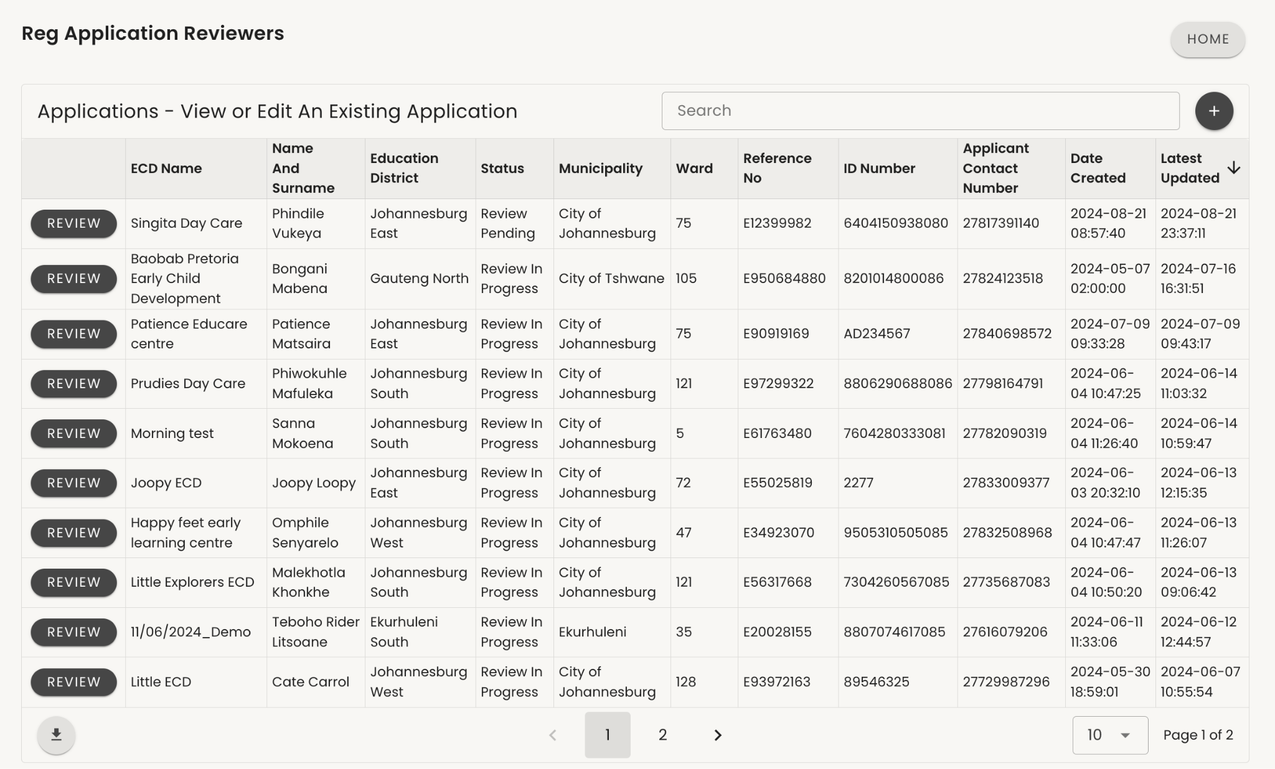
Reviewer - Landing Page
As a Reg Application Reviewer you are second to review applications after the applicant has submitted.
You are able to:
Add correction notes
Add and view Admin notes
Review the uploaded staff documents
Do Staff NCPR validation
Upload/approve Clearance certificates
Submit Social work report
Recommend Application for approval or rejection.

Slide 56
Searching & Filtering Applications
Search for a specific item in the table by typing the name of the item in the search box. (1)
For an advanced search, click on the "+"(2):
Criteria: Choose how the data should be found. Use the Match drop-down to choose if it must have exact match or "Do not" if it doesn't have to match exactly.
Search Field: Select the column or table heading you want to search against. Choose if your desired search should "begin with" or "contain" specific words, then type what you want to search for.
Click on "+" to add another search field.
Click on "-" to close the advanced search or remove an added search field.
Confirm your search selection and retrieve your desired filter by clicking on "UPDATE RESULTS".
2
1
5

Slide 57
Reviewer - Landing Page
2
As an Reg Application Administrator you are the second to review application after the Reg application Administrator has submitted.
Select an application by clicking on the ‘REVIEW’ button next to the applicant to start reviewing the application (1).
Click on ‘HOME’ to return to the Main Menu (2).
1

Slide 58
Reviewer Step 1/12 - Application Particulars
3
4
Review the information captured for the “Nature of the Application”
If an error is noted, capture it by clicking on "ADD CORRECTIONS."
To capture notes related to this step, click on "ADD ADMIN NOTES."
To review previously saved corrections, click on "VIEW CORRECTIONS."
To return to the main menu, click on "CANCEL."
To go back to the previous step, click on "BACK."
After reviewing, if there are no errors or once any corrections or notes have been added, click "NEXT."
[Note: Add corrections, View corrections and Add admin notes are available at every step.]
5
6
1
2

Slide 59
Note on Add Corrections
Please note that “Add corrections” are not sent to applicants after every note is saved.
Following the end of the review process and if “SUBMIT CORRECTIONS” is selected in the last step, applicants will receive an SMS notification to revisit their application. All captured corrections will be shown here.

Slide 60
Note on Admin Notes
Please note that Admin notes are NOT visible to applicants. Applicants will NOT receive a notification for notes submitted
Admin notes for every page are internal PED notes that will be visible to the Administrator, Reviewer and Approver.

Slide 61
Reviewer Step 1 / 13 - Particulars of Application & Add corrections (cont)
1
2
3
5
After selecting “ADD CORRECTIONS” as per the previous step, a text box with space for notes to be captured will appear.
Capture the note/reason for corrections. You can also add admin notes on the same page by clicking on ‘ADMIN NOTES’ and the section for admin notes should appeare.
When done click on ‘SAVE’
4. You will receive a notification that the review feedback has been successfully captured
5. Click on ‘NEXT’ to proceed to the next step

Slide 62
Reviewer Step 1 / 13 - Particulars of Application & Admin notes (cont)
1
2
3
After selecting “Add admin note” as per the previous step, a text box with space for notes to be captured will appear.
Capture the admin note/reason for
Click on ‘SAVE’

Slide 63
Reviewer Step 1 / 13 - Particulars of Application & Admin Notes (cont)
1
You will receive a notification that the note has been successfully captured
You can on the top right to review saved admin notes.
Click ‘OPEN’ to review the admin notes.
Click ‘ADD ADMIN NOTES’ Tto record notes for the page
Click on ‘NEXT’ to proceed to the next step
4
3
2

Slide 64
Reviewer Step 2 / 13 – Review Staff Details
Review the staff list and ensure all staff details, including roles and qualifications, are captured.
You can add corrections at each step of the application if there's missing information or add admin notes relevant to each step.
After completing the review, click 'NEXT’ (1).
1

Slide 65
Reviewer Step 3 / 13 - Nature of Application
Review the information captured for the “Nature of the Application”
Note: The Name of Organisation is for Organisations who own and run multiple ECD programmes. If that is not the case, the name will just be the same as the ECD Programme Name.
Note: The Program Type is automatically calculated by the two questions before.
3
4
1
2

Slide 66
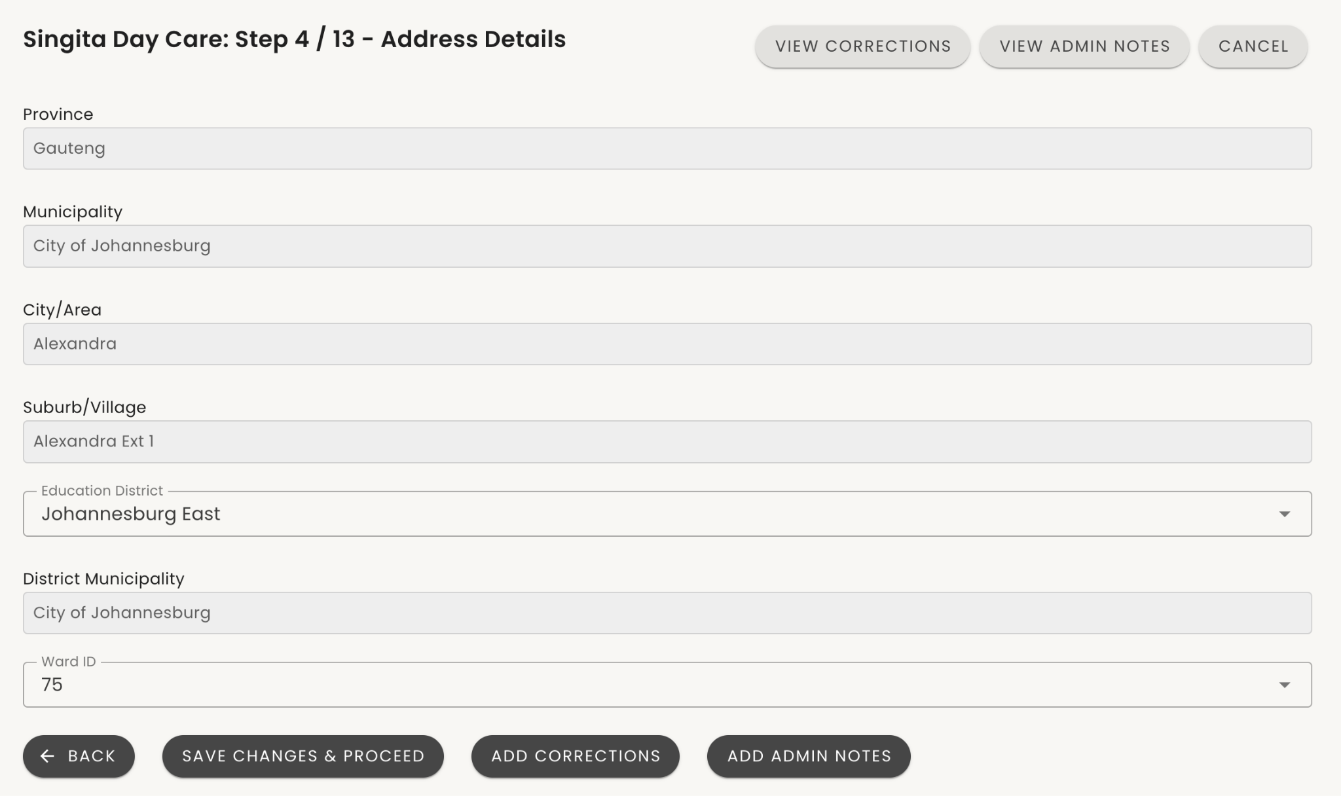
Reviewer Step 4/13 - Address details
2
Review the information captured for the ECD programme address details.
Note that the Education District and Ward are automatically applied based on the suburb/village selected.
In Step 4/13, as a Reviewer or Approver, you are able to Over-ride and update the applicant's Education District and Ward ID if you feel they have been incorrectly allocated.
If an error is noted, capture it by clicking on ‘ADD CORRECTIONS’
To review historic saved corrections click on “VIEW CORRECTIONS”
To leave a note for this page click on”ADD ADMIN NOTES”
If no error or once a corrections notes has been added, click ‘NEXT’
4
1
3

Slide 67
Reviewer Step 5 / 13 - Address and Contact Details for ECD Programme
Review the information captured for the ECD programmes Physical address and Contact details.
Applicants are able to capture a street address (if available), alternatively, a point of interest and details of the point of interest can be captured.
Note that Street Address and Postal Address are not mandatory if they do not have one.
3
3
1
2

Slide 68
Reviewer Step 6/13 - Programme Details
Review the information captured for the ECD programme details;
Days that the programme is offered in a week
Opening time
Closing Time
Maximum fee per child per month
3
4
1
2

Slide 69
Reviewer Step 7/13 -Details of
Children Enrolled in the ECD Programme
4
Review the information captured for the Children enrolled in the programme.
Please note that we are not checking staff to child ratios at Bronze level. This standard will be assessed during the site visit for silver.
All that is required at Bronze is that they declare how many children they currently have enrolled.
3
1
2

Slide 70
Reviewer Step 8/13 - Health and Safety
Self-Assessment
Proceed to the Health and safety assessment for ECD Registration.
No applicant information is captured in Step 8 to 11.
The applicant is simply confirming that they understand that they have to meet norms and standards and that they will be checked when a site visit happens
1

Slide 71
Reviewer Step 9-11/13 - Health & Safety Self Assessment
Continue to the Health and safety assessment for ECD Registration.
No applicant information is captured in Step 8 to 11.
The applicant is simply confirming that they understand that they have to meet norms and standards and that they will be checked when a site visit happens.
Step 11 questions are used to inform what should be delivered in H&S packs.

Slide 72
Document Review Process: Step 12/13
Certified ID copies
Form 30
Approval
Decline
NCPR Checks and clearance certificate
Check that the administrator has reviewed and approved each document.
If not – the reviewer is also able to do so.
Ensure the ID is clear and legible.
If so – approve the document – otherwise decline and add correction notes.
Check that the administrator has reviewed and approved each document.
If not – the reviewer is also able to do so.
Ensure the form is fully completed with no missing sections.
Confirm that the form is signed and dated appropriately.
Verify the applicant’s or staff member’s details against the ID provided.
If so – approve the document – otherwise decline and add correction notes.
If the documents are satisfactory:
        Mark the document as "Approved" and proceed to the next one.
Continue the review process until all documents have been checked and approved. .
If the documents are not satisfactory:
Mark the document as DECLINED
Add Correction Notes detailing what is wrong with the document (e.g., "ID copy for XXX is not certified," "Form 30 for XXX is incomplete," etc.).
Ensure your notes are clear and provide guidance on what the applicant needs to correct and for which staff member.
View the uploaded clearance certificates that the administrator uploaded. (IF they did not, the reviewer is also able to)
Review Results:
Cleared: Not listed; staff member is approved. APPROVE the uploaded certificate
Listed: Listed; staff member cannot work with children, and application will be declined REJECT the certificate and recommend the application for rejection

Slide 73
Reviewer Step 12 / 13 – Review Uploaded Staff Documents
Select “VIEW” (1) on Staff Member to review staff documents and uploaded Clearance certificate.
Remember to complete the next steps for EVERY staff member
1

Slide 74
Reviewer Step 12 / 13 - Review Staff Documents (Cont)
On the Staff document table, click on ‘VIEW’ to access uploaded documents for the selected Staff member.
If the Reg Application Admin has uploaded the staff clearance; your action will be to review and approve it or to reject it if it shows that the staff member is listed on the Child Protection Register
This is the most critical part of the Bronze Review process. Staff listed on the NCPR should have their clearance certificate upload rejected and a recommendation for rejection as the last step

Slide 75

Reviewer Step 12 / 13 - Review Staff Documents (Cont)
Please note - applications should include:
A certified copy of the staff member ID
Form 30 for each staff member and applicant.
NCPR clearance certificate
Confirm this information is available by clicking on “OPEN”(1) next to a document uploaded.
Once satisfied with the documentation - select the “APPROVE” (2)
If not happy with the document or it shows NCPR listing select “DECLINE”(3). Make sure to add correction notes after closing.
Select CANCEL(4) to stop looking at this document and go to the next one.
After viewing all the documents for this staff member select CLOSE DOCUMENTS(5) to go to the staff list
1
2
3
4
5

Slide 76
Reviewer Step 12 / 13 – Review Staff Documents(Cont)
If the administrator has NOT uploaded an NCPR certificate – the reviewer can still do so.
Navigate to the Validate staff hyperlink in order to access the National Child Protection Register (NCPR) online site if you are an authorised user.
If users are not an authorised user, users will need to request an authorised user to check the staff member for them and provide the clearance certificate

Slide 77
Reviewer Step 12 / 13 - Review Staff Documents (Cont)
You will be directed to the DSD Child Protection Register site, and access the site using their login credentials.
From here, you will be able to download the clearance certificate for the selected staff member, using their ID number as has been provided.

Slide 78
Reviewer Step 12 / 13 - Review Staff Documents (Cont)
Without approval of the Certified ID and Form 30 users do not have consent to check for the clearance certificate.
Only Administrators and Reviewers can upload the Clearance certificate. The Administrator uploads first, and the Reviewer approves it. If the Administrator did not upload the certificate, the Reviewer can upload it.
To upload the clearance certificate for the selected staff member:
Click on the paper clip image (1)
Selecting a file from your device
Or try Dragging and dropping a file
Once the document has been uploaded, select ‘SAVE CLEARANCE CERTIFICATE’.(2)
Then VIEW the certificate and APPROVE it to show the staff member is clear.
If they are not clear DECLINE the certificate and recommended rejection in Step 13
1
2

Slide 79
Note on Document Review
By the time an Reviewer has reviewed an application to the point that it is ready to submit for approval:
every staff member should have
an ID in Approved Status
a Form 30 in Approved Status
an NCPR certificate in approved or rejected status
If this is not the case you should:
Submit corrections at the end of the review to request missing documents
Or complete the outstanding NCPR checks

Slide 80

Reviewer Step 13/13 – ECD Photo
View the uploaded photo
Please note that Photos of the ECD are NOT mandatory – do not request one if not submitted or not viewable.
Click on NEXT to go to the final review step
1
2

Slide 81



Reviewer - Social Worker Report
This is the end of your review and you now have two choices:
Click on "SEND CORRECTIONS" to return the Application to the applicant for viewing your saved correction notes and resolving corrections. Applicant will receive an SMS to review the application. NOTE – this does not reject the registration and should not be used where staff are listed on the NCPR
OR
Complete the Social Worker Report and click "SUBMIT RECOMMENDATION" to say the application is complete and ready for a final decision.
To Submit the SW report you must:
Choose your recommendation
Bronze – if all staff are clear on the NCPR
Rejected – only if staff are found listed on the NCPR.
Check the boxes to confirm you have received all documents required and add a comment before submitting your recommendation
3
1
2

Slide 82


Reviewer - Social Worker Report
After the reviewer has pressed SUBMIT RECOMMENDATION, a Social Workers Report will be visible to the approver when they look at the application.
The report will show the recommendation as well as how many staff had NCPR certificates approved vs rejected.

Slide 83
Reviewer – Send Corrections
This is the SMS the applicant receives when you complete reviewing an application and hit SEND CORRECTIONS. When they log in to eCares, the application status will be "Incomplete."

Slide 84
Registration Application Approver
Role & Review Process
The individuals who will do the final review of applications and approve or reject the application officially.
This manual covers how to access and view applications for review, capture notes, check the uploaded Clearance Certificates for each staff member, view the Social Worker Report and make the final decision per application.

Slide 85
What is the role of application approvers?
!
Do a final check of the application details
Check ID;Form 30 and NCPR certificates have been approved by reviewers for all staff
View the Social Worker report with the recommendation.
Make a final decision to approve or reject registration for the ECD.
Key point:
Application Reviewers
Approve or reject registration applications.
Approve if all staff pass NCPR checks
OR
Reject if any staff fail NCPR check.

Slide 86
Approver: Process Flow
Login
Dashboard Overview
Application Review
Documents uploaded
Approve/reject applications (or request corrections)
Enter your login credentials
Access the Approver Dashboard
Access the list of all reviewed applications.
Filter applications.
Select an application to review.
Review Application details.
Send correction notes to applicant, if additional information is required.
Check for all approved required documents (certified ID, clearance certificate and Form 30).
View Social Worker Report and Recommendation.
If the application is complete and accurate, and NO staff have been flagged as on the NCPR - application should be approved and a New Bronze certificate is generated.
If any staff are found on the NCPR the application should be REJECTED.
If the application still needs corrections that were missed, approver sends correction notes to the Applicant.

Slide 87
When is an application review complete?
All Mandatory Documents Are Uploaded and Reviewed
All correction notes have been addressed
Application Information is Verified and Accurate
Admin Notes Are Finalized
Approval or Reject Decision is Made
Every required document (certified ID copies, Form 30 and clearance certificate for each staff member has been successfully uploaded by the applicant and reviewers.
Each document has been thoroughly reviewed for accuracy, completeness, and clarity.
Documents have been marked as "Approved" in the system.
If any documents were initially declined due to issues such as incorrect information, missing signatures, or unclear images, the applicant has corrected these issues.
The updated documents have been re-uploaded and reviewed again to ensure they now meet the required standards.
The information provided in the application is consistent with the details in the uploaded documents.
Any discrepancies between the application form and the documents have been resolved or noted.
Any admin notes required for internal communication or documentation purposes have been added.
All internal notes are clear and provide a complete picture of the review process, ensuring that any future reviewers or auditors can understand the decisions made.
Based on the review of all documents and information, a final decision to approve or reject the application is made.
If approved, the application is moved to the next stage, certificate generation.
If declined, the applicant is notified with reasons. Follow ups should be made where there are staff on the NCPR.

Slide 88
Approver - Landing Page after eCares login
On the Home Page Menu, you will find:
Main Menu: Access various user roles.
To access your Approvers role:
Navigate to the Main Menu.
Click on "Not specified” below Roles to reveal a dropdown list.
Select your appropriate role from the dropdown.

Slide 89

Approver - Landing Page
2
3
This is the Approver landing page after logging in as a Reg Application Approver.
As a Reg Application Approver, you are able to:
Conduct the final review, reject and approval of applications submitted by Reg Application Reviewers (1).
Review Social Work report
Generate Bronze Conditional Certificates (2).
View reports of existing applications (3).
1

Slide 90
Searching & Filtering Applications
Search for a specific item in the table by typing the name of the item in the search box. (1)
For an advanced search, click on the "+"(2):
Criteria: Choose how the data should be found. Use the Match drop-down to choose if it must have exact match or "Do not" if it doesn't have to match exactly.
Search Field: Select the column or table heading you want to search against. Choose if your desired search should "begin with" or "contain" specific words, then type what you want to search for.
Click on "+" to add another search field.
Click on "-" to close the advanced search or remove an added search field.
Confirm your search selection and retrieve your desired filter by clicking on "UPDATE RESULTS".
2
1
5

Slide 91

Approver Step 1/12 - Application Particulars
Review the details of the selected application.
Ensure all required applicant information is captured
You can
add a correction note to send to the applicant
and add admin notes at any step of the application for internal use.
Additionally:
View Social Work Report,
View corrections,
View admin notes are available at every step if they were recorded.
In every step of the application review you can:
Go back to the previous step
Go to the next step
Cancel to stop reviewing
3
4
5
8
6
7
1
2

Slide 92

Approver Step 2 / 13 - View Staff
4
Review the staff list and ensure all staff details, including roles and qualifications, are captured.
If an error is noted, capture it by clicking on "ADD CORRECTIONS."
To capture internal notes related to this step, click on "ADD ADMIN NOTES."
To view Social Work report click on “VIEW SOCIAL WORKER REPORT”
To review previously saved corrections, click on "VIEW CORRECTIONS."
To review previously saved admin notes, click on "VIEW ADMIN NOTES." This option appears only on steps where there are historic saved notes.
To return to the main menu, click on "CANCEL."
To go back to the previous step, click on "BACK."
After reviewing, if there are no errors or once any corrections or notes have been added, click "NEXT."
3
5
6
7
8
1
2

Slide 93
Note on Add Corrections
Please note that “Add corrections” are not sent to applicants after every note is saved.
Following the end of the review process and if “SUBMIT CORRECTIONS” is selected, applicants will receive an SMS notification to revisit their application. All captured corrections will be shown here.

Slide 94
Note on Admin Notes
Please note that Admin notes are NOT visible to applicants. Applicant will NOT receive a notification for notes submitted
Admin notes for every page are internal PED notes that will be visible to the Administrator, Reviewer and Approver.

Slide 95

Approver Step 3 / 13 - Nature of Application
Proceed to review every step following instructions explained in the previous steps.
Note: The Name of Organisation is for Organisations who own and run multiple ECD programmes. If that is not the case, the name will just be the same as the ECD Programme Name.
Note: The Program Type is automatically calculated by the two questions before.

Slide 96

Approver Step 4/13 - Address details
Follow the review steps as explained in the previous pages to review the application.
In Step 4/13, as a Approver, you are able to review and override the applicant's Ward ID if you have evidence the wrong ward has been selected.

Slide 97
Approver Step 5 / 13 - Address and Contact Details for ECD Programme
Review the information captured for the ECD programmes Physical address and Contact details.
Applicants are able to capture a street address (if available), alternatively, a point of interest and details of the point of interest can be captured.
Note that Street Address and Postal Address are not mandatory if they do not have one.
3
3
1
2

Slide 98
Approver Step 6/13 - Programme Details
Review the information captured for the ECD programme details;
Days that the programme is offered in a week
Opening time
Closing Time
Maximum fee per child per month
3
4
1
2

Slide 99
Approver Step 7/13 -Details of
Children Enrolled in the ECD Programme
4
Review the information captured for the Children enrolled in the programme.
Please note that we are not checking staff to child ratios at Bronze level. This standard will be assessed during the site visit for silver.
All that is required at Bronze is that they declare how many children they currently have enrolled.
3
1
2

Slide 100
Approver Step 8/13 - Health and Safety
Self-Assessment
Proceed to the Health and safety assessment for ECD Registration.
No applicant information is captured in Step 8 to 11.
The applicant is simply confirming that they understand that they have to meet norms and standards and that they will be checked when a site visit happens
1

Slide 101
Approver Step 9-11/13 - Health & Safety Self Assessment
Continue to the Health and safety assessment for ECD Registration.
No applicant information is captured in Step 8 to 11.
The applicant is simply confirming that they understand that they have to meet norms and standards and that they will be checked when a site visit happens.
Step 11 questions are used to inform what should be delivered in H&S packs.

Slide 102


Approver Step 12 / 13 - Review Staff Documents
Select “VIEW” on Staff Member to select a staff member whose documents you would like to review.

Slide 103

Approver Step 12 / 13 - Review Staff Documents
In this step, as a Reg Application Approver, you are able to view documents uploaded by Applicants, Administrators, and Reviewers.
To review the document, click on “VIEW” next to a particular document for the staff member to view the documents uploaded and the clearance certificate.

Slide 104

Approver Step 12 / 13 - Review Staff Documents (Cont)
Please note - applications should include:
A certified copy of the staff member ID
Form 30 for each staff member and applicant.
Clearance Certificate for each staff member.
Confirm this information is available by clicking on “OPEN”[1] next to a document uploaded.
CANCEL[2] closes the document you have open.
If the Staff Clearance Certificate has been Declined this should mean that the staff member was listed on the NCPR and shouldn’t be working with children. You can check this on the certificate uploaded.
In this case the application should be rejected in the final step.
If there are still issues with documents that the reviewers did not pick up you are able to ADD CORRECTIONS[3] and choose to send corrections at the end of the review rather than approve/decline.
CLOSE DOCUMENTS[4] takes you back to the staff list.
1
2
4
3

Slide 105



Approver Step 12 / 13 - Review Staff Documents (Cont)
After clicking on “CLOSE DOCUMENTS” the system will take you to the Staff list in order to review documents for other staff members. Click on “VIEW” to start the process of reviewing the next Staff member.
If an error is noted, Capture corrections notes by clicking on ‘ADD CORRECTIONS
When all staff have been checked and no issues detected or once correction notes have been added for issues, click “NEXT” to continue to the next step.

Slide 106
Note on Document Review
By the time an Reviewer has reviewed an application to the point that it is ready to submit for approval:
every staff member should have
an ID in Approved Status
a Form 30 in Approved Status
an NCPR certificate in approved or rejected status
If this is not the case you should:
Add Admin Notes to tell the Reviewer that they did not complete the document review
Go to the last step and select SEND TO REVIEWER to return the application to the reviewer to complete the document check

Slide 107

Approver - Social Worker Report
This is an example of a Social report after clicking on Social Work Report on each step of the page on the top right.
It contains
The ECD program details
Completeness of the application- Confirmation by the Reviewer that Staff ID and Form 30 for all Staff members have been checked.
Suitability of Application and staff- based on the number of NCPR certificates that were approved, how many staff were cleared on the NCPR or not.
Compliance with norms and Standards - Confirmation of norms and standards.
Recommendation- Recommendation of the application by the Reviewer with comments for recommendations.

Slide 108

Approver Step 13/13 – Final Decision
In this final step of the review the Approver is making the final decision to approve or reject the application. If not ready to make this decision there are options to send corrections to the applicant or return to a reviewer for NCPR certificate issues.
REJECT APPLICATION – the only reason at Bronze level for rejecting registration is if a staff member has been found on the NCPR (not fit to work with children) or another very big risk that the Approver has been made aware of. The applicant will receive an official rejection notice (see next pages).
APPROVE APPLICATION – if the application is complete and all staff are clear on the NCPR then the application should be approved for Bronze. A certificate will be generated.
SEND CORRECTIONS – if the approver found issues in the documents that were missed by the reviewers and the applicant needs to correct.
SEND TO REVIEWER – if the reviewer did not upload NCPR certificates and/or approve them, add ADMIN NOTES[5] and send back to reviewer to complete.
3
4
1
2
5

Slide 109

Approval Notification to the applicant
After the final decision; the applicant will get a notification.
Approval message– tells the applicant they have been registered with a Bronze Conditional Certificate and gives them a reference number. This is the same number you will see in your list of approved applications.

Slide 110

Rejection Notification to the applicant
This is an example of a Application Rejection report after clicking of “APPLICATION REJECTION”. The rejection note will be available on each step if the application that was rejected.
The document has the ECD program details and reason for rejection, details of the person who rejected the application and date the application was rejected.

Slide 111

Approver Generate Certificate
After approving the application, you can generate the certificate for approved applications.
On the top right of the Approver Landing page, click on ‘GENERATE CERTIFICATE’(1) and follow the steps explained in the Section 6 on how to generate the certificate.
You also have access to view the reports. The report provides a view-only list of all applications initiated, with snapshot details of each application, such as the status of the application. To access the Applications report, navigate to the top right and click on "VIEW REPORTS"(2).
1
2

Slide 112

Approver Generate Certificate
2
Once in the list of approved applications you can sort by the Last Updated Date or search by ECD Name to find the certificate you want to print.
Click on GENERATE CERTIFICATE[1]
An email will be sent to you with the certificate attached.
If you are having issues receiving emails
1. Check your email address in the blue box above[2] – if it is not correct contact the WhatsApp support line to correct your user details.
2. Check your Spam or Junk folder.
3. Ask your IT department to make sure that your Provincial server is not blocking emails from Mezzanine.
4. If none of these options work contact the WhatsApp support line to give you Reporting access and see the Reporting section for an alternate option.
1

Slide 113
Reg Application Certificate Generator
This section covers how to view approved applications and how to generate Bronze registration certificate.

Slide 114
A Certificate Generator can:
Generate certificates for all approved ECDs and access reports on application status (approved, rejected, review/approval in progress) and the registration status.
Add a search criterion on the list of applications to specify the desired field.
Download reports (csv file).

Slide 115
Certificate Generator: Process Flow
Login
Dashboard Overview
Certificate Generation
Report viewing
Enter your login credentials
Access the Certificate generator Dashboard
Access the certificates and reports of all submitted applications.
Open to generate a certificate or view or download a report with the application status.
Click on the certificate you wish to generate and it will be downloaded to your PC for printing.
Open the report to see all applications and their registration status,
Download the report in Excel (csv) for analysis.

Slide 116

Reg Application Certificate Generator- Landing Page
As a Reg Application Certificate Generator, you can:
Access a list of all approved bronze certificate applications. These applications have undergone the Reviewer and Approver processes.
View a report of all initiated applications.
To access the Reg Application Certificate Generator role after logging in:
Navigate to the Main Menu.
Click on "Not specified" below Roles to reveal a dropdown list.
Select "Reg Application Certificate Generator" from the dropdown.

Slide 117

Reg Application Certificate Generator-
Generate Certificate
To retrieve the certificate, navigate to "Generate Certificate" and click on "OPEN."

Slide 118
Reg Application Certificate Generator-
Generate Certificate
Once in the list of approved applications you can sort by the Last Updated Date or search by ECD Name to find the certificate you want to print.
Click on GENERATE CERTIFICATE[1]
You will receive a notification at the top right confirming that the certificate has been sent to your email address.
An email will be sent to you with the certificate attached.
If you are having issues receiving emails
1. Check your email address in the blue box above[2] – if it is not correct contact the WhatsApp support line to correct your user details.
2. Check your Spam or Junk folder.
3. Ask your IT department to make sure that your Provincial server is not blocking emails from Mezzanine.
4. If none of these options work contact the WhatsApp support line to give you Reporting access and see the Reporting section for an alternate option.
2
1

Slide 119

Reg Application Certificate Generator-
Generate Certificate
Here is an example of an email received with the certificate attached.

Slide 120

Reg Application Certificate Generator- Generate Certificate
Here is an example of a Bronze Conditional registration certificate which is a combination of the prescribed Form 12 and Form 17.
The conditions on the Bronze Certificate relate to three important areas:
The minimum floor space that must be provided for each child.
Compliance with the relevant norms and standards.
Submission of all remaining documents for a full application within one year.

Slide 121
Reg Application Report Viewer
This section covers how people with the Report Viewer role can view the status of all applications in their area.

Slide 122
A Report Viewer can:
View reports on application status (approved, rejected, review/approval in progress) and the registration status.
Add a search criterion on the list of applications to specify the desired field.
Download reports (csv file).

Slide 123
Report Viewer: Process Flow
Login
Dashboard Overview
Report viewing
Enter your login credentials
Access the Report generator Dashboard
Access the report of all submitted applications.
Open the report to see all applications and their registration status,
Download the report in Excel (csv) for analysis.

Slide 124
Reg Application Report Viewer Landing Page
As a Reg Application Report Viewer, you can:
View a report of all the initiatied applications in your areas with their current status
Filter and sort these reports
To access the Reg Application Report Viewer role after logging in:
Navigate to the Main Menu.
Click on "Not specified" below Roles to reveal a dropdown list.
Select "Reg Application Report Viewer" from the dropdown.

Slide 125

Report Viewer - Landing Page
This is the Report Viewer landing page where you will see all applications relating to your area (based on your user setup):
Use this view to check the current status of any submitted application.
You can:
Search – by reference number or ECD Name or Name and Surname or Phone Number
Filter – (see next slide) for applications in a particular status or in a particular area.
1
2

Slide 126

Searching & Filtering Applications
Search for a specific item in the table by typing the name of the item in the search box. (1)
For an advanced search/filtering, click on the "+"(2):
Criteria: Choose how the data should be found. Use the Match drop-down to choose if it must have exact match or "Do not" if it doesn't have to match exactly.
Search Field: Select the column or table heading you want to search against. Choose if your desired search should "begin with" or "contain" specific words, then type what you want to search for.
Click on "+" to add another search field.
Click on "-" to close the advanced search or remove an added search field.
Confirm your search selection and retrieve your desired filter by clicking on "UPDATE RESULTS". In this example we have filtered for all approved applications.
1
2

Slide 127
Bronze Registration Dashboards
This section covers the dashboards that are available to Provincial Directors and District Supervisors.
Please contact Malaudzi.A@dbe.gov.za if you would like support in understanding your dashboards.

Slide 128

Province Dashboard
The Provincial Dashboard shows a summary at the top with complete applications and approved applications for the Province.
It also shows a breakdown by Education District.
Where Education District is Null is where incomplete applications don’t have address details yet to locate them in a District.
This dashboard helps the Provincial Director to track how each District is progressing towards ECD Registration Drive targets.

Slide 129

District Dashboard
The District Dashboard shows how many applications are in each stage of review – cascading down to the final bar which shows the number of approved in green and the number rejected in red.
In the bottom section it shows which users have completed reviews and which are in progress.
This dashboard helps District Supervisor to track how many applications are waiting in each review step and to plan workload for the week.

Slide 130
Support
User Support Contacts and Support levels

Slide 131
Bana Pele Application Support Post training
1. Query Submission: District officials submit questions and concerns to their respective District Supervisors.
2. Consolidation and Escalation:
District Supervisors compile and organise queries from their teams, then forward consolidated inquiries to SMEs via the dedicated Support Channel
3. Resolution and Empowerment:
SMEs provide comprehensive answers and solutions, equipping District Supervisors with the knowledge to address team concerns effectively.
District Supervisors
Please send your number to Portia
You will be added to a WhatsApp group

Slide 132

Requesting User Access on eCares
To get access to eCares you will have to complete a user access form where you give your details and request specific role/s.
Make sure your cellphone number provided can receive SMS as this is where your password will be sent.
Select the right role/s
Read the terms you are agreeing to around data protection and use.
Get it approved and submit for setup.
Read the terms and conditions carefully – you are signing to say that you will act responsibly with the personal information that you have access to and will be liable if you sell it or share it where it is not needed for supporting ECDs or reporting.
You are also responsible for system security by never sharing your user details and password with anyone else or writing it down where someone could see it.

Slide 133
Live Instance Practice
Review 1 Application

Slide 134
Post Training Survey
https://forms.gle/YSXkSTmAzyP4ZuCSA

Slide 135


Slide 136
APPENDICES
The applicant and applicant support processes which are not completed by PEDs but are included for reference.

Slide 137
Support Overview
End users
Champions_PED & Champions WhatsApp Group
(First Line support)
Mezzanine
(Second Line Support)
Individuals who are registered on the system are the end users. End users should reach out to the eCares champions in their district whenever they have queries related to the system or project.
Information needed when logging a request:
  Name and Surname
  Name and Reference of ECD you are working with
  Screenshot/video of issue where system related
  Full description of the issue or question
The District eCares Champions (First Line support team) are responsible for assessing each request received by their end-users to determine whether it can be resolved on their end or whether it should be directed to the WhatsApp MRD team.
The WhatsApp team will respond to queries raised on the WhatsApp group.
If there are system technical related issues these will be directed to Mezzanine
Information needed when logging a request:
  Champion Name and Surname
  Name and reference of ECD working with if not general question
  Screenshot/video of issue where system related
  Full description of the issue or question.
Mezzanine support desk offers second line support. If the issue remains unresolved after the champions and WhatsApp support have engaged with the end-user, the issue is then escalated to the Mezzanine Support team via the support channels
Mezzanine Support will provide feedback to the champion, and the champion will in return engage with the end user when the issue is resolved
  Bugs/Issues
  Configuration assistance
  Technical tasks

Slide 138
First line Support -Issue logging process
First Line Support Overview
Issue logging process
First line Contact details
First Line Support is provided directly to the PED end-users.
A district champion should be identified who will be added to a WhatsApp group where MRD queries can be raised.
The training manager will identify a group of individuals (Knowledge Experts) who will be responsible for queries such as:
  Removal, adding or editing of end user details on the system
  Training related queries
  Process related queries
The requester send requests to the
  Whatsapp support channel
When logging questions on the First line Support WhatsApp group, the requester should include the ECD name they are working on (if not a general process question), the name and surname of the end user who is experiencing the issue as well as a detailed description of the issue at hand.
Whatsapp Support Number:
XXXXXXXX

Slide 139
ECD Applicant (WebUser Role)
Completing an online application for ECD Registration as an ECD Applicant
In this section, we explain how an applicant submits an application for ECD registration on the eCares platform. This process involves providing comprehensive details about employed staff members, summarising the number of attending children, uploading staff documentation, and completing a health and safety self-assessment.

Slide 140
Applicant: Summarised Process Flow
Register and Login
Dashboard Overview
Capture information required
(Step 1-11)
Upload documents
(Step 12)
Submit application
To begin registration, go to User registration and enter your first name, last name, mobile number, and email address to register.
When registered, enter your login credentials received by SMS.
Access the Applicant’s Dashboard.
Access the list of existing applications to edit/archive.
Add a New Application.
Add Applicant particulars.
Add staff members.
Add the Nature of Application.
Add address details.
Add Programme details.
Add children enrolled.
Complete the Health and Safety assessment.
Upload required documents (certified ID and Form 30) for every employee captured.
Submit your application and await approval/ rejection/ comments.
If comments are sent to you, you’ll receive an SMS to correct/update on the portal.

Slide 141
Application Submission
Register and Login
Application Review
Approved Application
Rejected Application
Applicant receives an SMS notification confirming the approval of their application (with reference number) for the New Bronze Certification.
Applicant receives the New Bronze Certificate (successful registration of the ECD programme on the eCares system).
A certified ID, for each of the staff members listed (stamped within the last 3 months).
A fully completed Form 30, for each staff member listed, with no missing sections.
Applicant receives an SMS notification from the eCares system regarding the status of their application.
Applicant updates their application by uploading the required documents or correcting any issues highlighted in the feedback and resubmits.
Applicant receives an SMS notification through the eCares system informing them of the rejection with reason(s) (staff on the NCPR).
Applicant addresses the issue of non-compliance
Reapply or Appeal.

Slide 142

ECD Applicant - Registering as a user on eCares
Access the ECD web registration portal using a phone; laptop or tablet at:
https://dbecares.dbe.gov.za/user-registration/
To begin registration, go to User registration and enter your first name, last name, mobile number, and email address (skip email address if you do not have one).
After entering the details, click on 'Register'.
Upon successful registration, you can begin the process of submitting an ECD registration application on the eCares platform.
For NGOs supporting ECDs: Please note that this is the live platform - if you are testing it out please name any applications as TESTxxxx and ARCHIVE upon completion.

Slide 143


ECD Applicant - Registering as a user on eCares
After clicking on "Register," a pop-up will appear indicating that registration is complete. Click "OK" to navigate to https://dbecares.dbe.gov.za/
Following registration, you will receive an SMS and email confirming successful registration

Slide 144


ECD Applicant - Registering as a user on eCares
You will receive an SMS confirming your registration. The SMS will also contain a temporary login password. After registration, the website will take you to the sign-in page.
Enter the mobile number you used to register, starting with 27 (RSA dialing code), followed by the rest of your cell number.
Enter the password you received via SMS.
Click on ‘SIGN IN’ in to continue.
1
2
3

Slide 145
ECD Applicant - Registering as a user on eCares
The system will now prompt you to change the password to your desired one. It must be at least 6 characters long.
Enter your new password, confirm it, and click on 'Change Password'.

Slide 146



ECD Registration Applications Landing Page
On your first login, you'll be directed to the 'List of Applications' page, which will initially be blank.
On this page, as an applicant you are able to:
Create a New application by clicking on 'ADD NEW' button
View Archived applications
View and Edit incomplete applications
Archive an application
Display all applications initiated and their statuses.
1
2
3
3
4

Slide 147

ECD Registration Applications- Adding New Applications
To begin with a new application, on the top right, navigate to ‘ADD NEW’.(1).
On a mobile phone you will see ACTIONS and then select ADD NEW
1

Slide 148

Create New Application - Instructions and Consent
Before creating an application, it's crucial to understand the requirements and ensure you have all the necessary documents ready.
Required documents:
Certified ID Copies for the applicant and each staff member.
Form 30 for the applicant and each staff member (a copy is accessible via the hyperlink on the screen).
Read the consent paragraph carefully to ensure you know what you are applying for and agreeing to.
Note: Click ‘NEXT' to consent and continue with the application
1
2

Slide 149




New Application - Step 1 Applicant Particulars
Your details (Name, Surname, Email, Mobile) are pre-filled from your first eCares self-registration.
Note: On Identity Type. If you selected 'South African ID number' as Identity Type:
Ensure you enter a valid ID number and the system will automatically validate it.
If the ID number is not correct, you will not be able to proceed with the application until a valid ID number is captured
If the ID number is linked to another application already in progress you will not be able to continue but will be directed to view the other applications.
1
1

Slide 150

New Application - Step 1 Applicant Particulars
On "Name of the ECD Programme," fill in the name of the ECD centre as registered.
On "Name of the Organisation," fill in the name of the organisation the ECD belongs to if it is legally owned/managed by another organisation.
Please ensure that you submit only one application per ECD Programme to avoid duplication, which may result in slowing the progress of reviewing your application.
Fill in the additional details as an applicant, and when done, click "SAVE CHANGES & PROCEED" to continue.
1
1

Slide 151

New Application - Step 2/13 Add Staff
Your details as the Applicant will be pre-populated on the staff list.
Start by updating your qualifications as the first applicant by clicking on ‘EDIT’.

Slide 152



New Application - Step 2/13 Add Staff (cont)
Update the applicants “Highest ECD Qualifications”
To update, click on 'Not Specified' to open the dropdown list and select the appropriate option.
After entering the information, click on 'SAVE'. After saving you'll receive confirmation that the staff member has been updated.

Slide 153

New Application - Add Staff (cont)
After updating the first staff member details.
Click on ‘ADD NEW’ to add additional staff members.

Slide 154



New Application - Step 2/13 Add Staff (cont)
Continue by adding details of a staff member and click on “SAVE” when done.
To add another staff member, click on “ADD NEW” and follow the same steps. After adding the last staff member, click on “SAVE CHANGES AND PROCEED”
If ID number already exists for a staff member the system will not accept the ID number.
You can go back and delete or edit a saved staff member. Navigate to the name of the member and click on ‘REMOVE’ or ‘EDIT’.

Slide 155

New Application - Step 2/13 Add Staff (cont)
This will be a table of the staff list. When you have finished adding ALL staff members, click ‘SAVE CHANGES & PROCEED’ to continue to the next step or click on ‘ADD NEW’ to keep adding additional members.

Slide 156


New Application - Step 3/13 Nature of Application
For questions that require selections from a dropdown menu, click on "Not Specified" to see the options, then choose the appropriate one.
This sections determines what kind of ECD programme you are running.
First select the maximum number of children you enroll at one time - if the dropdown selection is “6 or less,” the program type of your ECD will automatically be Daymother or Child Minder, regardless of the number of hours a child attends the program in one week.
Then select the maximum hours that 1 child attends in a week.

Slide 157

New Application - Step 3/13 Nature of Application (cont)
If the dropdown selection is:
“More than 6” children and the maximum number of hours a child attends the program in one week is “16 hours or less per week,” you will have to select the program category. The system will remind you to capture it.
If the selection is "More than 16 hours per week," the system will automatically set the ECD program type to “ECD Centre/Partial Care Facility.”

Slide 158

New Application - Step 3/13 Nature of Application
If your ECD is being supported to complete this application please select the organisation that is providing the support from the list provided.
If it is not on the list you can select - “Yes, but not on this list” and you will be given space to add the name.
If you are not receiving support to complete the application select No Support.
After making all selections click on ‘SAVE CHANGES & PROCEED’ to continue to the next step.

Slide 159

New Application - Step 4/13 Address Details
Capture ECD Address details by selecting from the dropdown:
Province, Municipality, City/Area, Suburb/Village and Ward ID
The system will auto-populate Education District, District Municipality, and Ward ID.
If the location has multiple possible Ward IDs, the system will allow you to select your Ward from the drop-down list.

Slide 160

New Application - Step 4/13 Address Details
To select the appropriate Province, click on 'Not Specified' to open the dropdown menu, then choose the desired Province
Follow the same process to capture Municipality, City/Area Suburb/Village and Ward ID.

Slide 161



New Application - Step 4/13 Address Details
When all address information has been captured click on ‘SAVE CHANGES & PROCEED’
Ensure you fill in all fields.If some fields are not specified, you will receive this notification and won't be able to proceed until the information is provided.

Slide 162



New Application - Step 5/13 Physical Address
Provide additional address details, such as the street address of the ECD if there is one.
You also MUST specify the nearest point of interest for the ECD program so that we can find you easily.
For "Type/Point of Interest," if your choice is not in the dropdown list, select "Other" and specify it in the "Other" field.
Capture the Name of the nearest point of interest. For example, if you chose Clinic as the type then give the clinic name e.g. Freedom Park Clinic

Slide 163

New Application - Step 5/13 Physical Address
The mobile number is auto-populated.
An alternate contact number is a compulsory field so that we can contact you if the first number does not work.
If you do not capture the comulsory field information, you will not be able to proceed and will be prompted with a red alert mark. “0” will always be pre-populated; you only need to fill in the remaining 9 digits of the cell number.
When done click on ‘SAVE CHANGES & PROCEED’ to continue with an application

Slide 164



New Application - Step 6/13 Programme Details
Capture the programme details of the programme to help us to understand your programme better:
Number of days: Please note that if you enter more than seven days a week, you will receive the following error.
Operating hours: The Opening time and Closing time default to 08:00 and 16:00, respectively. You can adjust these according to your operational hours.
Maximum fee per child per month: Type in values only
Click ‘SAVE CHANGES & PROCEED’ when complete to continue with the application.

Slide 165

New Application - Step 7 / 13 - Details of Children Enrolled in the ECD Programme
In this step capture the summary enrolment numbers of the children enrolled in the ECD programme in different age categories.
Click on 'EDIT' to input details for each relevant age group.
These numbers will appear in your registration certificate so ensure you complete them accurately.

Slide 166





New Application - Step 7/13 Children enrolled (cont)
All fields are mandatory, and the system has built-in validation rules to check the captured information.
Validation 1:
The number of children (male/female) receiving a grant must not exceed the total number of children entered e.g.
Validation 2:
The number of children (male/female) with special needs must not exceed the total number of children entered.
Validation 3:
Any response in this step must be greater than or equal to 0.
Validation 4:
Every Age group with children enrolled must have at least 1 staff member.
After entering the details, click 'SAVE' to continue. You will receive a confirmation prompt in the top right corner of the screen indicating that the enrolment has been saved."

Slide 167

New Application - Children enrolled (cont)
After saving the enrollment, you'll be redirected to a page displaying all captured enrollment numbers in a table.
To review and edit the details for each age group, click on 'EDIT'.
The total children should add up to the total number of children in your programme.
When you have added all the age groups that you have, to continue with the application, click on 'SAVE CHANGES & PROCEED'.

Slide 168


New Application Step 8 / 13 - Health and Safety Self-Assessment
Read the terms and conditions as outlined in the Health & Safety self-assessment. You will be confirming that you understand the basic set of norms and standards that you need to comply with.
You can access more details about health and safety standards by clicking on the hyperlink, see the next page.
To continue, click on ‘SAVE CHANGES & PROCEED’

Slide 169

New Application - Step 8/13 Norms and Standards for ECD Registration
Landing page after clicking on the link about Health and Safety standards

Slide 170


New Application - Step 9/13 Health and Safety Self-Assessment for ECD Registration (Page 1)
Proceed to read and confirm the Health and Safety self-assessment. Please note that all questions require a mandatory 'Confirmed' response to confirm that you meet the standard now or will take immediate steps to meet it.
These will be assessed at the site visit for Silver/Gold registration.
You won't be able to proceed without providing a response, indicated by text in red.

Slide 171

New Application - Step 9/13 Health and Safety
Self-Assessment for ECD Registration (Page 1)
To answer, click on 'Not Specified' to open the dropdown menu and select 'Confirmed' to show that you either currently comply with the standard or will take immediate steps to ensure compliance.
If at least one question is answered as “Not Specified”, you won't be able to proceed with the application until the issue is resolved. The application will exit, and you'll be taken back to the Application list page.
When done answering questions click ‘SAVE CHANGES & PROCEED’

Slide 172


New Application - Step 10 / 13 - Health and Safety
Self-Assessment for ECD Registration (Page 2)
If at least one question is not answered, the unanswered fields will be highlighted in red text. You won't be able to proceed with the application until all the questions are answered.
After responding to all questions click on ‘SAVE CHANGES & PROCEED’

Slide 173
The health and safety self-assessment for the APPLY stage is to help ensure that a baseline of safety is in place and that ECD programmes understand their responsibility for compliance with the relevant norms and standards.
Assessment of compliance with the Children’s Act norms and standards will occur at COMPLY stage.
Health and safety support packs:
The DBE has identified low-cost items that could help more ECD programmes to comply with the norms and standards. These include things like hand-washing basins, water containers, mattresses and first aid kits. The DBE is working with partners to identify funding for these packs. In the short-term, the packs will be tested in some areas – but will not be available everywhere.

Slide 174


New Application - Step 11 / 13 - Self Assessment Resource Questions
These questions help us to understand what resources you may need help with to comply with norms and standards.
If at least one question is not answered, the unanswered fields will be highlighted in red text. You won't be able to proceed with the application until all the questions are answered.
After responding to all questions click on ‘SAVE CHANGES & PROCEED’

Slide 175


New Application - Step 12/13 Upload staff documents
You will now be directed to the Staff list based on the information captured in Step 2.
Upload the Certified ID copies and Form 30 documents for each staff member listed.
To add documents for each staff member, click on 'EDIT'.
To begin to upload documents click on ‘UPLOAD DOCUMENT’.

Slide 176


New Application - Step 12/13 Upload staff documents
First choose the document type (Staff ID or Staff Form 30) from the dropdown list and then go and tap on 'Upload Document'.
You have two options for uploading documents:
Navigate to your device folders or photo libarary, select the appropriate file, and click 'SAVE'.
OR
Take a Photo of the document directly.
Click SAVE to save the first document.
Then Click on ‘UPLOAD DOCUMENT’ to add additional document types.
Please make sure that images are clear and names and numbers can be seen clearly.
1
2

Slide 177



New Application - Step 12/13 Upload staff documents
After saving, the first document will be stored in the 'Staff Documents' table. You can review the file by clicking on 'View', 'Add/view', or 'Remove'.
When done uploading document for first staff member click on ‘CLOSE DOCUMENTS’
To upload documents for other staff members, click 'EDIT' next to their name, then click 'PROCEED' when finished.
Ensure you upload all documents for all staff members in order to continue to the next step.

Slide 178
New Application - Step 12/13 Upload staff documents
When done uploading for all staff members click on ‘SAVE CHANGES & PROCEED’

Slide 179


New Application Step 13 / 13 - Self-Assessment Upload Photo
Where available:
Click on ‘Upload Photo’ to upload an image of the ECD programme (1)
Please ensure children's faces are not shown in the photograph. You can ask them to face backwards or put their hands over their faces.
After uploading click on the “SAVE” button (2).
1
2

Slide 180


New Application Submit Complete Application
After a successful upload you will get a prompt that Health and safety assessment is saved.
Once satisfied that the application is complete (from Step 1 to 13)- click ‘SUBMIT APPLICATION’

Slide 181


New Application Complete
After submitting the application you will be taken to the homepage, displaying a list of your current applications. You will also receive an SMS confirming that your application is submitted and giving you a reference number.
The status of each application will be one of the following: Application Submitted, Review Pending, Approval Pending Approved or Rejected. Once completed, the application is sent to a DBE user for review.
You may get further SMSs saying that comments have been added to your application for review. If this happens click on EDIT on the application and you should see a button to VIEW CORRECTIONS where you will see notes on any missing information or documents on each step. You can edit the application with these and SUBMIT again.

Slide 182
Section 2 – Addressing Review Corrections
In this section we show applicants how to view incomplete applications, resolve corrections and re-submit an application.

Slide 183



Applicant - List of Applications
After you submit an application and it undergoes DBE review,
If it has NOT been rejected but CORRECTIONS have been requested , you'll receive a notification that your application has comments added (SMS notification) (2)
Applicants can select ‘EDIT’ to access the application and review feedback (1).
If it is officially rejected it will appear in the list of applications as 'Approval Rejected' on status, you'll receive a notification that your application has been rejected (SMS notification (3). You can VIEW(4) your application and see the rejection letter at the top of the page on Step 1 explaining why.
4
1
2
3

Slide 184



Applicant - Addressing review feedback
1
Where you've received corrections feedback, it will be noted at the top of each step where feedback has been given. (1)
You address the feedback by either editing or adding additional information. Once you're satisfied that the feedback has been addressed, click on 'MARK READ'(2). You will see by below that note has been marked as read.
Then click 'PROCEED'(3) to continue to the next step of the application. Finally, you complete the final submission as per your application training, and the application is directed back to the DBE official. It will show as Review/Approval Pending(4).
2
4
3

Slide 185

Applicant - Addressing review feedback
Where you've received Review feedback, it will be noted at the top of each step where feedback has been given. (1)
You address the feedback by either editing or adding additional information. Once you're satisfied that the feedback has been addressed, click on 'MARK READ'(2). You will see by a message below that note has been marked as read.
Then click 'PROCEED'(3) to continue to the next step of the application. Finally, you complete the final submission as per your application training, and the application is directed back to the DBE official. It will show as Approval Pending(4).
1
2
4
3

Slide 186
Section 3 - Reg Application Support User Role
This section covers how to view reports, initiate a new application, register a new applicant user, and assist an applicant in completing the application.

Slide 187
Support: Process Flow
Login
Dashboard Overview
Application Review
Documents uploaded
Submit applications
Enter your login credentials
Access the Support Dashboard
Access the list of all submitted applications.
Filter applications based on status to Edit.
Add a new application on behalf of the new application.
Review Application details and ensure all details are captured.
Check for all uploaded required documents (certified ID and Form 30) for the captured employees.
If the application is complete and accurate submit application for review.

Slide 188


Reg Application Support User - Landing Page
Support Users assist applicants who may be stuck in completing the registration process. As Support user you are able to:
Guide the applicant through the registration and identify the stage at which they were stuck.
Create new application on behalf of an Applicant
Register an Applicant user on the system to be able to create an application.
View reports of existing applications
To access Reg Application Support role after login:
Navigate to the Main Menu.
Click on "Not specified” below Roles to reveal a dropdown list.
Select Reg Application Support from the dropdown.

Slide 189
Navigation and Sorting
In the tables you can:
Sort the table (A-Z, Z-A, lowest to highest or highest to lowest) by clicking on the column name.
Download the content of the table to CSV.
Expand the selection by paging or selecting more rows.
View all pages by clicking on the drop-down arrow to view up to 100 applications per page.
1
2
3
4

Slide 190
Searching & Filtering Applications
Search for a specific item in the table by typing the name of the item in the search box. (1)
For an advanced search, click on the "+"(2):
Criteria: Choose how the data should be found. Use the Match drop-down to choose if it must have exact match or "Do not" if it doesn't have to match exactly.
Search Field: Select the column or table heading you want to search against. Choose if your desired search should "begin with" or "contain" specific words, then type what you want to search for.
Click on "+" to add another search field.
Click on "-" to close the advanced search or remove an added search field.
Confirm your search selection and retrieve your desired filter by clicking on "UPDATE RESULTS".
2
1
5

Slide 191

Reg Application Support User- Finding An Application
If the applicant has already started their application and needs further assistance, you first need to locate their application. You have two options to find an applicant/application:
Open the dropdown menu under “Create Application On Behalf of.” A list of applicants will appear; select the appropriate applicant and then navigate to the Application table to find the correct application (1).
OR
Use the search bar at the top left to search for applicants by entering their Name, Surname, Reference No, or ID number (2).
Once you’ve found the applicant, click “EDIT” to access the application (3).
Follow the same steps as the applicant to navigate through their application. You can also make changes to the application.
1
2
3

Slide 192

Reg Application Support User- Create new Application
1
To begin a new application on behalf of an applicant who is already registered:
Release the drop-down menu on "Add A New Application On Behalf" (1) A list of applicants will appear; then select the appropriate applicant and click on "ADD NEW" (2).
Please always search carefully for existing applications before starting a new one. Look in the Report View as well as this view as they may already be submitted.
You will now be on the first page of the new application process (3).
Click on “NEXT” to and follow the steps explained in Section 1 of Applicant to navigate throughout the application process.
2
3

Slide 193



Reg Application Support User- Register New Applicant User
To register a new applicant, click on "CREATE NEW USER" (1).
Fill in the details of the user you want to register (2). Remember to start with 27 when capturing cell phone number.
After filling in the details, click on "SAVE" (3).
The applicant will also receive an email confirmation that they have been successfully registered. See the next slide for email example.
Once the user is set up you can look for them in the Add a New Application on Behalf of dropdown list and click ADD NEW to create an application.
1
2
3

Slide 194

Reg Application Support User- Register New Applicant User
This is an email an applicant receives confirming their registration.

Slide 195

Reg Application Support User- View Reports
To access the Applications report, navigate to the top right and click on "VIEW REPORTS."
The report shows a view-only list of all applications initiated with snapshot details of each application, such as the registration and status of the application.

Slide 196

Reg Application Support User- View Reports
6
This is the view-only list of all applications initiated.
Use the search bar at the top right to search for applicants by entering their Name, Surname, Reference No, or ID number.
To sort applications, click on the desired table heading to sort either alphabetically from A-Z or numerically from low to high.
The system will always show 10 applications per page. To view additional pages of applications, use the arrows or numbers at the bottom center to navigate.
To view all applications, navigate to the bottom right and click on the drop-down arrow to view up to 100 applications per page.
To download the report as a CSV file, navigate to the bottom left and click on the down arrow sign.
To return to the Main Menu page, click on "HOME."
1
2
5
3
4

