Slide 1




FEBRUARY 2025
APPLICATION FOR SILVER/GOLD REGISTRATION
WHAT NEXT?

Slide 2
COMPLY: SILVER PROCESS

Slide 3
COMPLY: SILVER PROCESS

Slide 4

YOU ARE BRONZE APPROVED - CONGRATULATIONS!
YOU ARE REQUIRED TO SUBMIT AN APPLICATION FOR SILVER/GOLD:
Bronze approved
Registration Application Administrator
1st check application details
Check documents and approve or request corrections
NEXT STEPS

Slide 5
WHY IS THE SUBMISSION OF THESE DOCUMENTS IMPORTANT?
Required by Children’s Act Regulations
Aligned to norms and standards
A key step in the silver process
Provides a sense of how the ECD programmes is managed
Can reduce some of the standards that need to be observed onsite by a social worker
ECD Applicant
Login to eCares
Answer a few questions
Submit the documents listed in the guidelines
Submit an Environmental Health Report / Certificate if received
Registration Application Administrator
1st check application details
Check documents and approve or request corrections
Registration Certificate Generator
Can generate certificates for approved ECDs

Slide 6

FOR SUBMISSION
CENTRE-BASED
NON CENTRE-BASED
Business plan
ECD programme overview
Management Committee Structure
Fees and Finances
Daily Programme
Disciplinary Policy
Gold: Approved building plan,
Silver: Application for building plan approval OR Hand-drawn Site layout
Founding document
(Constitution if voluntarily association)
Emergency plan
ECD Applicant
Login to eCares
Answer a few questions
Submit the documents listed in the guidelines
Submit an Environmental Health Report / Certificate if received
Registration Certificate Generator
Can generate certificates for approved ECDs

Slide 7
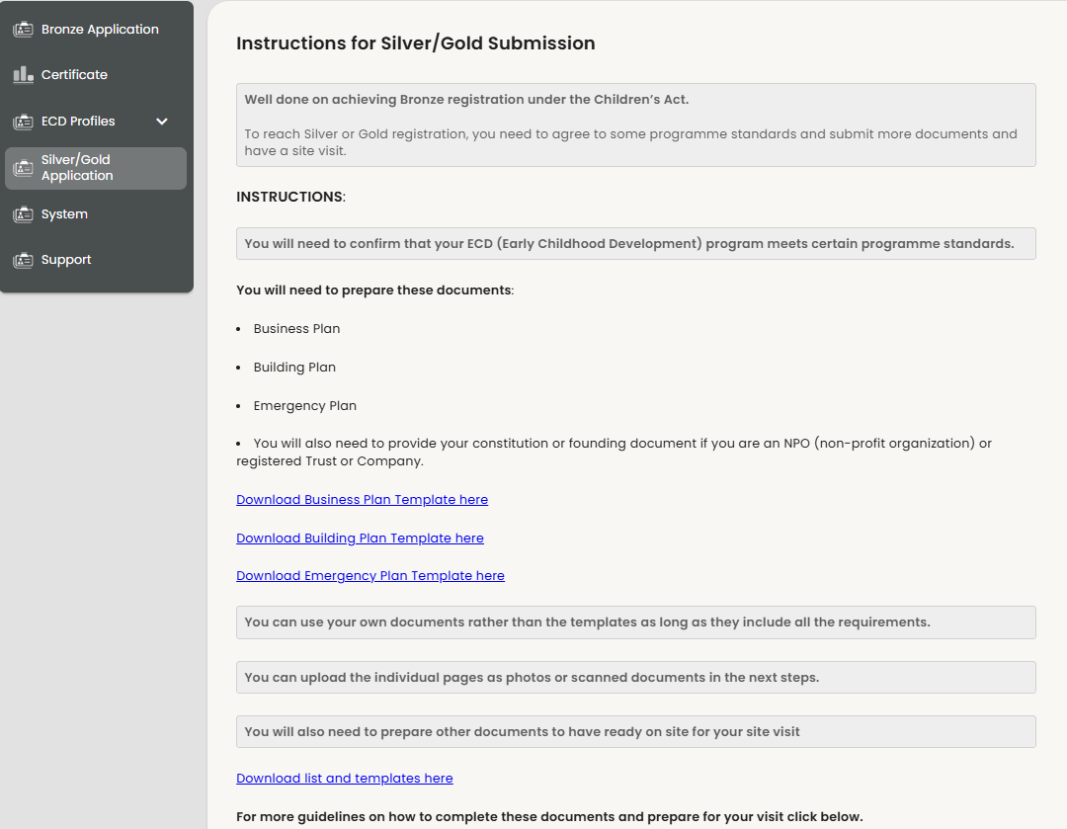
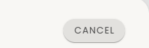

SILVER/GOLD SUBMISSION DOCUMENT TEMPLATES
DOWNLOAD DOCUMENTS HERE

Slide 8



INSTRUCTIONS ON COMPLETING THE DOCUMENTS

Slide 9
WHEN COMPLETING THE DOCUMENTS, REMEMDER:
ECD reference number from eCares must be completed on every document
This is a document template, so making use of this document is optional
NB! Should own versions of documents be used, ensure documents are aligned to the templates.
ECD Applicant
Login to eCares
Answer a few questions
Submit the documents listed in the guidelines
Submit an Environmental Health Report / Certificate if received
Registration Application Administrator
1st check application details
Check documents and approve or request corrections
Registration Certificate Generator
Can generate certificates for approved ECDs

Slide 10
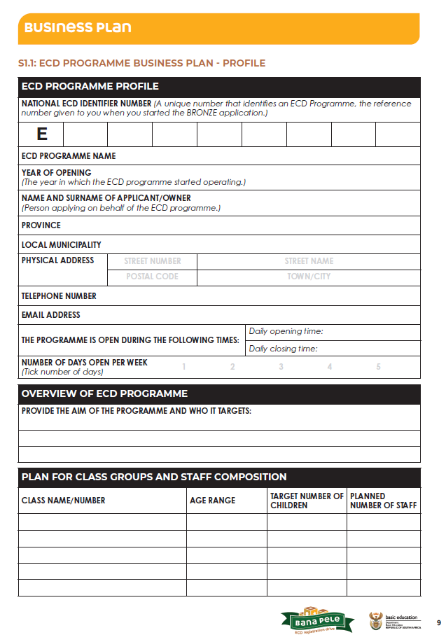
BUSINESS PLAN: ECD PROGRAMME OVERVIEW
Your BUSINESS PLAN provides an overall picture of your programme and helps the Department of Basic Education (DBE) understand how you run your programme.
1
ECD programme Overview:
Describes the programmes in detail and who it is aimed at
Make sure you include the same information that was used to complete the bronze application, especially information linked to your profile
[1] Overview of the ECD programme: Why does you programme exist and does your programme benefit?
[2] Class groups and composition: How many classes do you have and what is the planned number of children and staff you aim to meet.
1
1
2
Registration Certificate Generator
Can generate certificates for approved ECDs

Slide 11
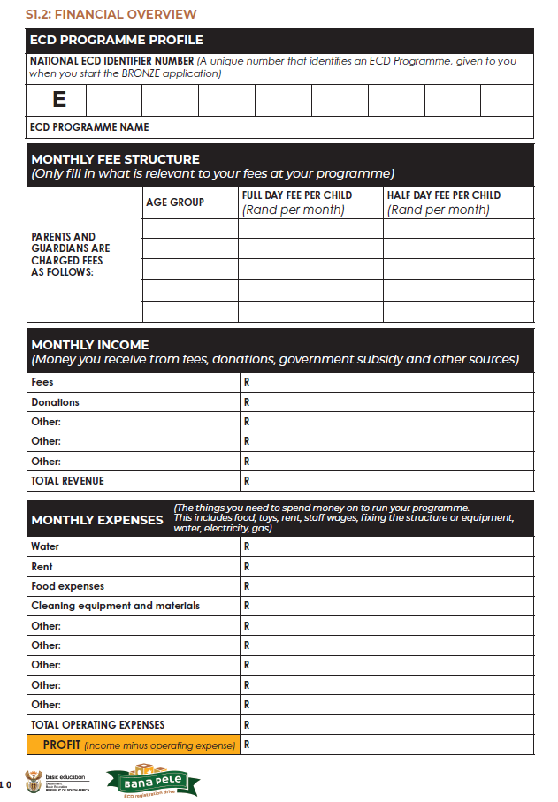
BUSINESS PLAN: FEES AND FINANCES
Shows how money is managed, including fees charged, income and monthly expenses
[3] Monthly fee structure: Include fees charged per age group
[4] Monthly income: Include where money is received and how much
[5] Monthly expenses: include the things money is spent on and how much to ensure the programme keeps running
[6] Profit: Money the programme receives – money the programme spends
3
4
5
Registration Certificate Generator
Can generate certificates for approved ECDs
6

Slide 12
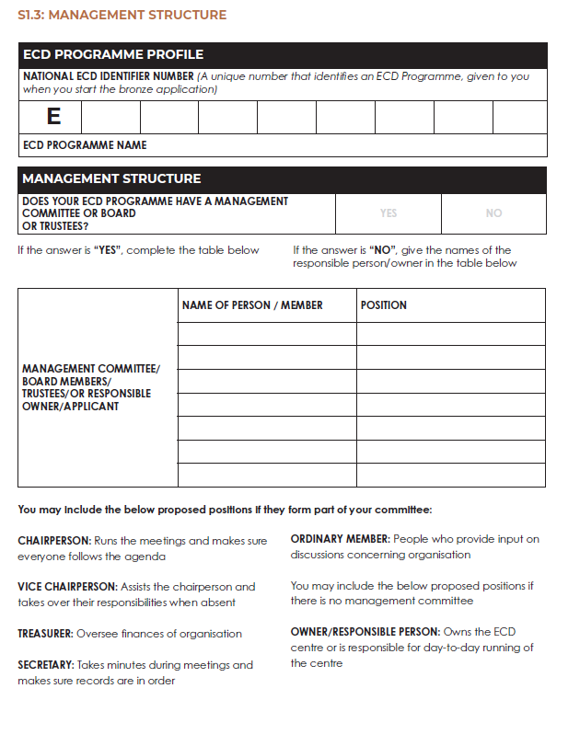
BUSINESS PLAN: MANAGEMENT COMMITTEE STRUCTURE
People who run or are responsible for the programme.
[7] Indicate whether the programme has a management committee or board
[8] If your programme has a structure committee/board – add names of the board members to the table
[8] If your programme does not structure committee/board – add names of responsible person
[9] Examples of roles is provided
7
8
9
Registration Certificate Generator
Can generate certificates for approved ECDs

Slide 13
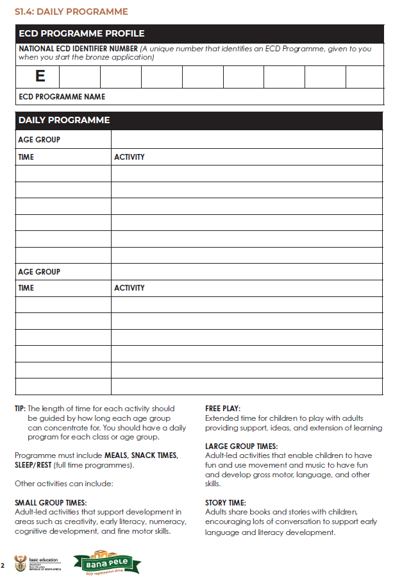
BUSINESS PLAN: DAILY PROGRAMME
Show what you do (activities) and when you do it
Its is important to provide a variety of different activities
[10] Include the age group and the activities that are planned on a daily basis
[11] Examples of the types of activities are listed
Remember for full day programmes, its important to include rest times.
Snack and meals times should be included for all programmes
10
11
Registration Certificate Generator
Can generate certificates for approved ECDs

Slide 14
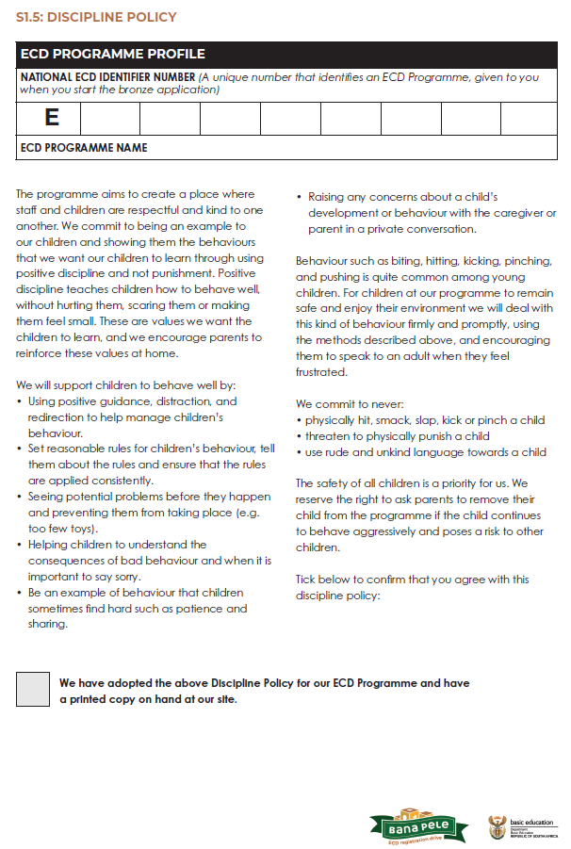
BUSINESS PLAN: DISCIPLINARY POLICY
Sets expectations of how children's behaviour is managed in a way that promotes positive guidance while avoiding harsh or physical punishment
[12] if this template will be used in the ECD programmes, adopt the policy by ticking the box
There should be a printed copy at the site that is accessible.
Own policies can be used, however, ensure that policies align with the content of the template
12

Slide 15
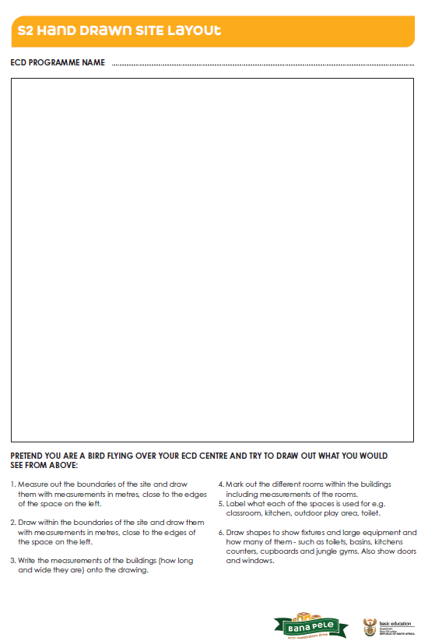
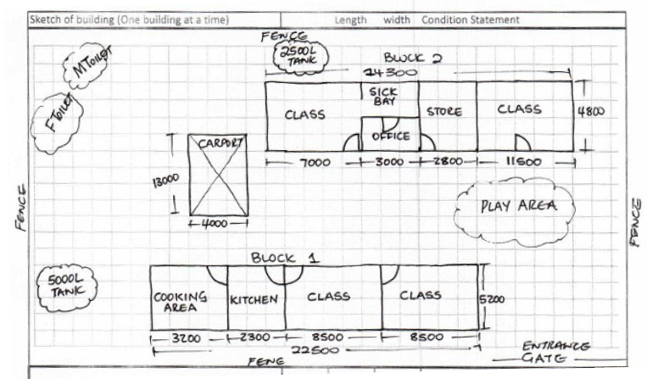
BUILDING PLANS/HAND-DRAWN SITE PLANS
GOLD:APPROVED BUIDLING PLAN
To qualify for gold registration an approved building plan is required
Submit this document if you have it available
13
SILVER: APPLICATION FOR BUIDLING PLAN APPROVAL
Some ELP programmes may still be in the process of getting an approved building plan.
In this case an application for approved building plan can be submitted – this would mean that the programme would qualify to meet silver requirements
OR
14
SILVER: HAND-DRAWN SITE LAYOUT
For programmes can also submit a hand-drawn site plan
[13] Draw your site plan using the instructions [14] provided. Show measurements in cm or meters

Slide 16
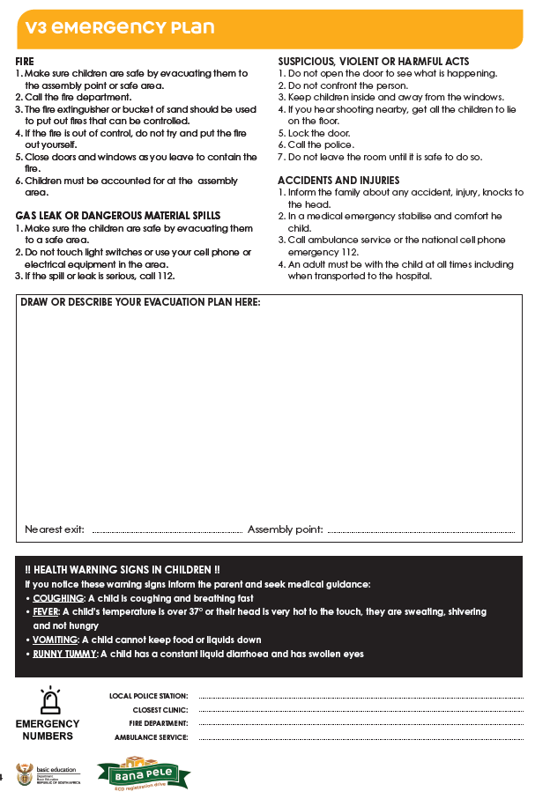
EMERGENCY PLAN
Shows what to do in an emergency, where the exit and assembling points are.
Submitting own emergency plans are accepted, however ensure that it includes evacuation procedures, emergency numbers
[15] Draw emergency plan and evacuation procedures
[16] Add emergency numbers from your local community
An emergency plan must be displayed at the ECD programme. Ensure that the emergency plan is also displayed at the site.
15
Registration Certificate Generator
Can generate certificates for approved ECDs
16

Slide 17
FOUNDING DOCUMENT (CONSTITUTION IF VOLUNTARY ASSOCIATION
Programmes registered as legal entities are required to submit a constitution or a founding document. This only applies to:
Voluntary association
Non-profit organisation
Trust
For-profit company
Partnership
Key sections to include in a constitution:
Organisation’s name and purpose
How it is governed and the roles different people play
Rules of decision-making and finances
Registration Certificate Generator
Can generate certificates for approved ECDs

Slide 18
FEBRUARY 2025
SUBMITTING AN APPLICATION FOR SILVER/GOLD REGISTRATION IN ECARES
INSTRUCTIONS FOR BRONZE REGISTERED ECDS AND NGOS SUPPORTING REGISTRATION

Slide 19
YOU HAVE RECEIVED BRONZE REGISTRATION – WHAT HAPPENS NEXT?
ECD Applicant
Login to eCares
Answer a few questions
Submit the documents listed in the guidelines
Submit an Environmental Health Report / Certificate if received
Registration Application Administrator
1st check application details
Check documents and approve or request corrections
Site Visit
Check the ELP programme and site against the norms and standards
Registration Application Reviewer + Approver
Reviews application
Creates recommendation
Final Approval or Refusal Notice
Registration Certificate Generator
Can generate certificates for approved ECDs

Slide 20
ACCESSING ECARES –
LOGIN AND PASSWORD RESETS

Slide 21
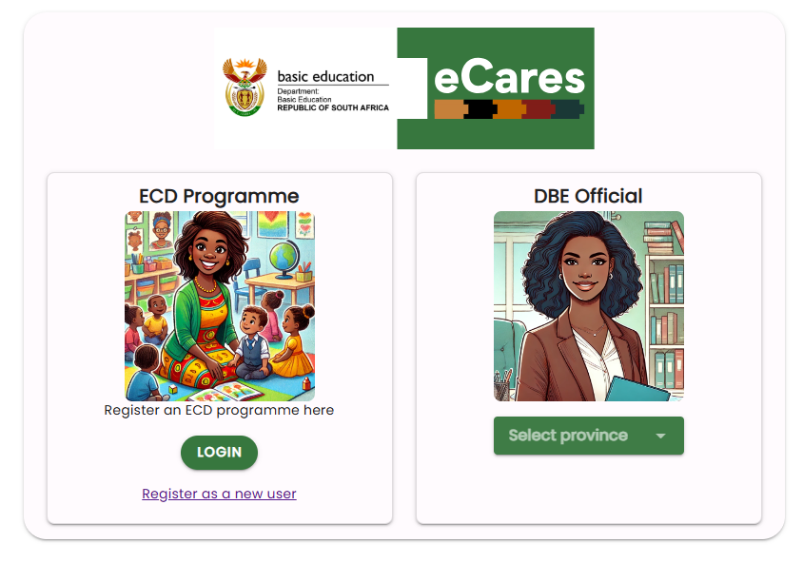
ECD APPLICANT – LOGGING IN TO YOUR ECARES PROFILE
Access the eCares portal using a laptop or tablet or phone at:
https://dbecares.dbe.gov.za
Choose LOGIN as an ECD Programme
21

Slide 22

ECD APPLICANT – LOGGING IN ON ECARES
After clicking on "Register," a pop-up will appear indicating that registration is complete.
Click "OK" to navigate to https://dbecares.dbe.gov.za/
Following registration, you will receive an SMS and email confirming successful registration
Sign in using your mobile/cell phone number and your eCares password.
Remember to start your number with 27 and remove the 0.
If you forget your password click on Recover your password and complete the details – you will be sent a new one-time pin and need to enter a new password.
22

Slide 23
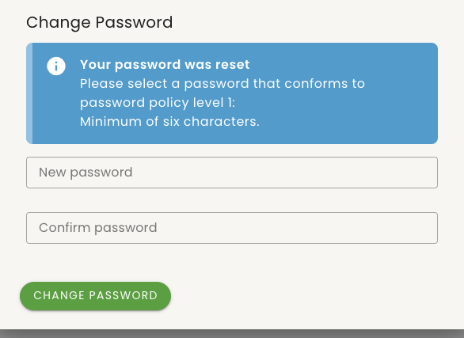
ECD APPLICANT – CHANGING A PASSWORD
The system will prompt you to change the password to your desired one. It must be at least 6 characters long.
Enter your new password, confirm it, and click on
'Change Password'.
23

Slide 24
SUBMITTING REQUIRED DOCUMENTS AND INFORMATION FOR SILVER / GOLD REGISTRATION

Slide 25
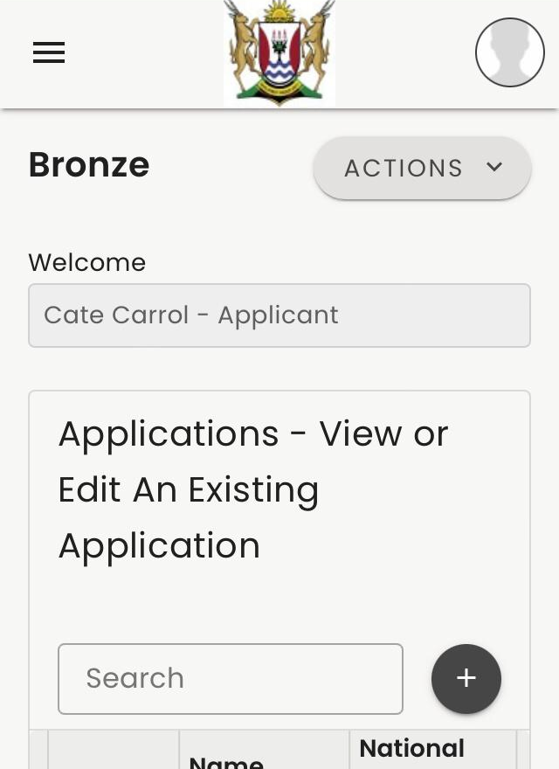
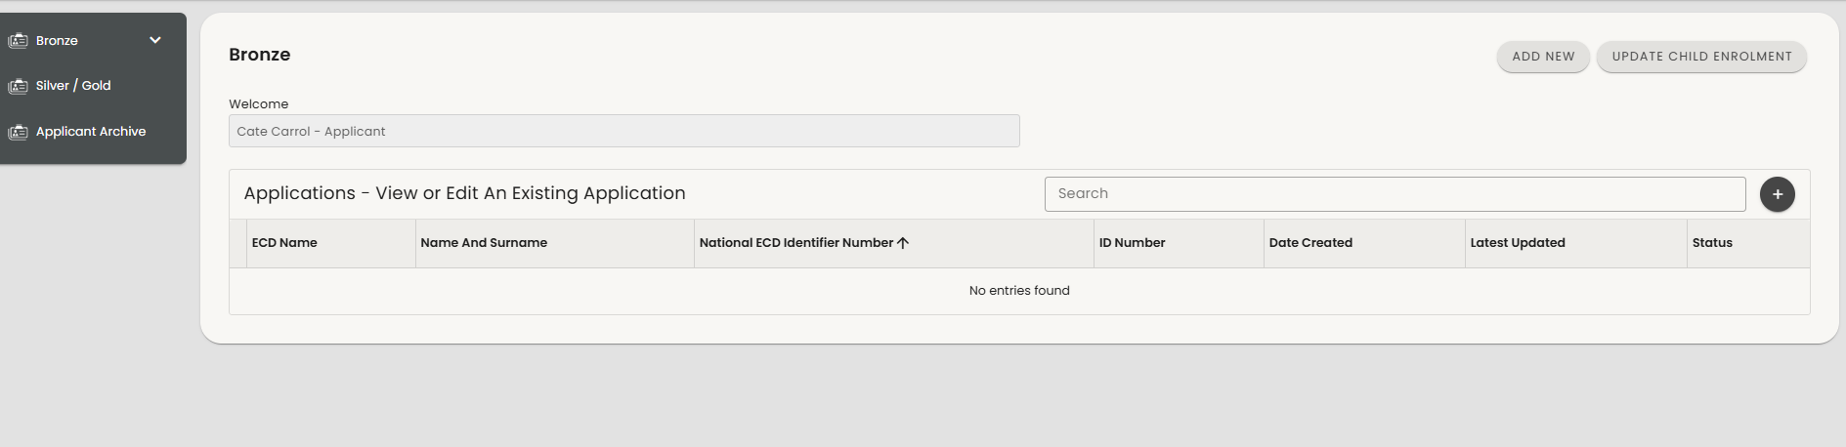
ECD REGISTRATION APPLICATIONS LANDING PAGE
2
1
On your first login, you'll be directed to the 'List of Bronze Applications’
If you are using a laptop or tablet your menu will be down the left-hand side – [1]
If you are on your phone you need to click on the three stripes on the top left of the screen to see your menu [2]
25

Slide 26
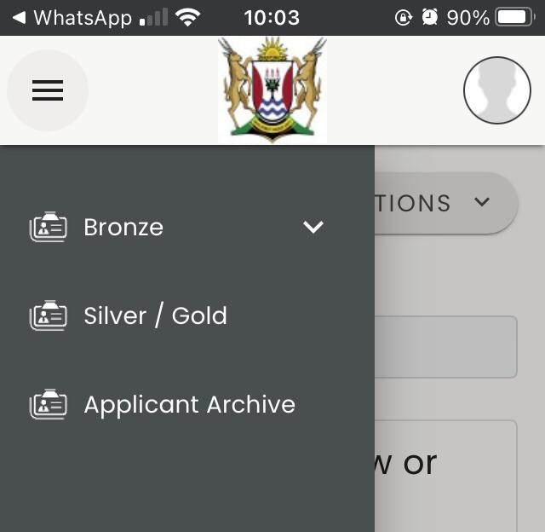
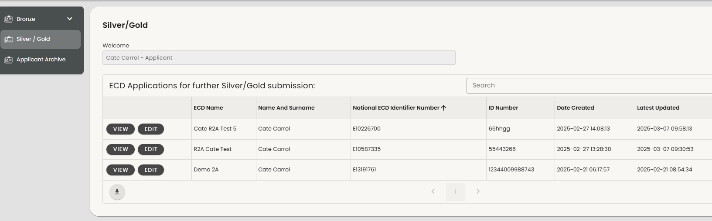
ECD REGISTRATION APPLICATIONS LANDING PAGE
2
1
3
2
Select Silver/Gold to see your approved Bronze application that is ready for Silver/Gold submission
If you are using a laptop or tablet your menu will be down the left-hand side – [1]
If you are on your phone you need to click on the three stripes on the top left of your screen to see your menu and then select Silver/Gold [2]
Then select Edit [3] for the Bronze approved application that you want to begin Silver/Gold submission for
26

Slide 27
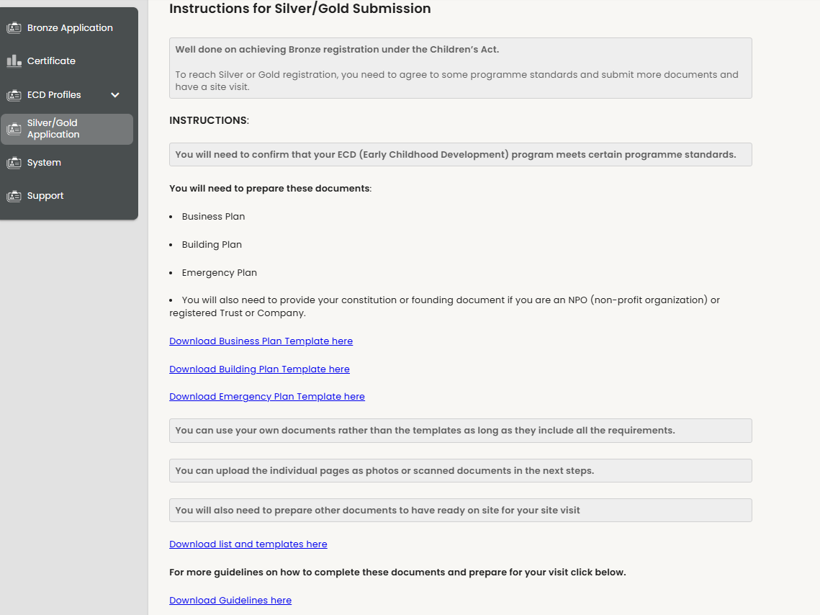
STARTING A SILVER/GOLD SUBMISSION
5
In the first step you will see instructions for what needs to be submitted
You can download individual templates for documents needed for submission [1] and a checklist for the documents that need to be submitted and prepared for site visit [2]
Otherwise, you can download the full set of templates with guidelines [3]
Remember you can use your own documents if they have all the information shown in the templates
Press BACK or NEXT [4] to move through the application.
Press CANCEL [5] at any time to close the application – you can continue with it at any time by selecting EDIT
1
2
3
4

Slide 28
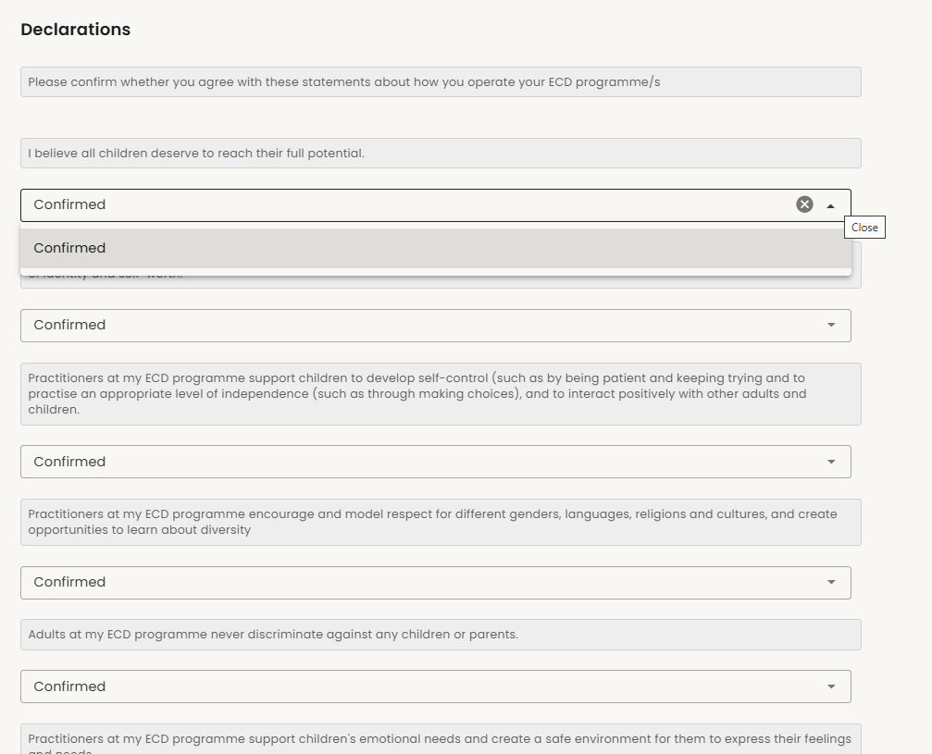
STARTING A SILVER/GOLD SUBMISSION
The next step contains a number of statements that must be confirmed to show that you are meeting the standards for an ECD programme.
These standards are difficult to assess in a site visit so your confirmation provides assurance that they are met.
Please read these carefully and make sure you agree with them before confirming. These are all very important standards for child safety, well-being and development
Click on the arrow icon [1] under each statement to select that you confirm.
1

Slide 29
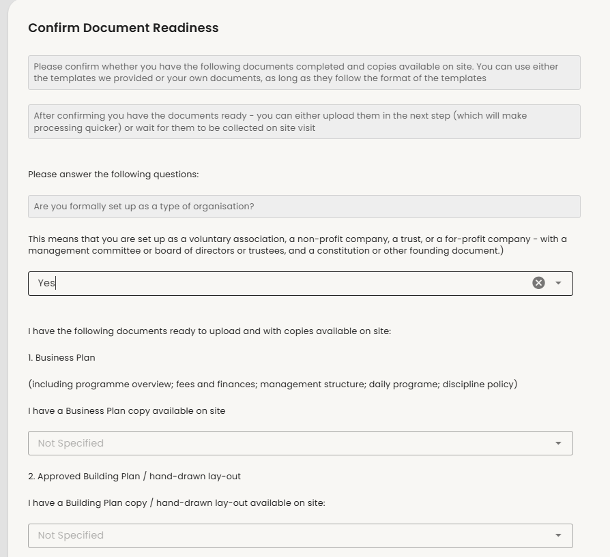
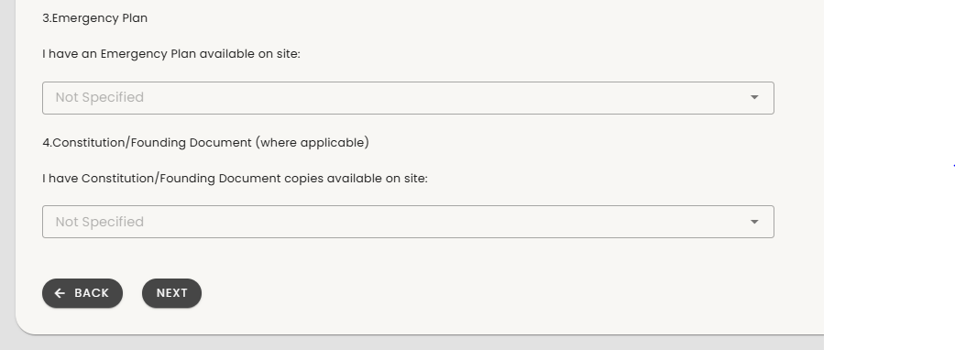
STARTING A SILVER/GOLD SUBMISSION
The next step checks what documents you need and allows you to confirm whether you have them ready on site.
Please answer the questions honestly so that your registration process is not delayed.
Click on the down arrow [1] to choose your answer
You will not be able to proceed with submission until you have confirmed that all your documents are ready.
Once you have confirmed document readiness a site visit can happen at any time.
Note that documents required will look different for non-centre based ECD programmes as per the check-list.
1

Slide 30
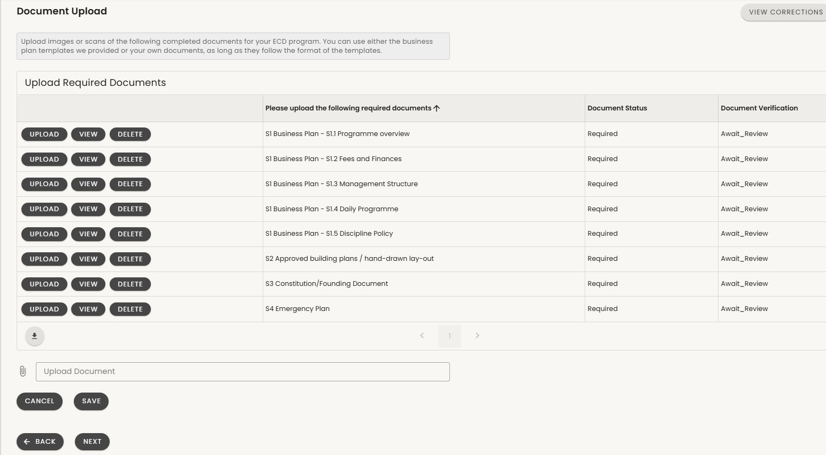
SILVER/GOLD DOCUMENT SUBMISSION
1
2
The next step is for submission of all your Silver/Gold documents.
You will see the list of documents you need to upload [1]. Note S1 are all sections of the business plan – please upload each section as a separate picture or pdf.
The document status [2] shows which documents are uploaded and which are still required.
Note that documents required for Non-centre based ECD programmes will be reduced as per the checklist
30

Slide 31
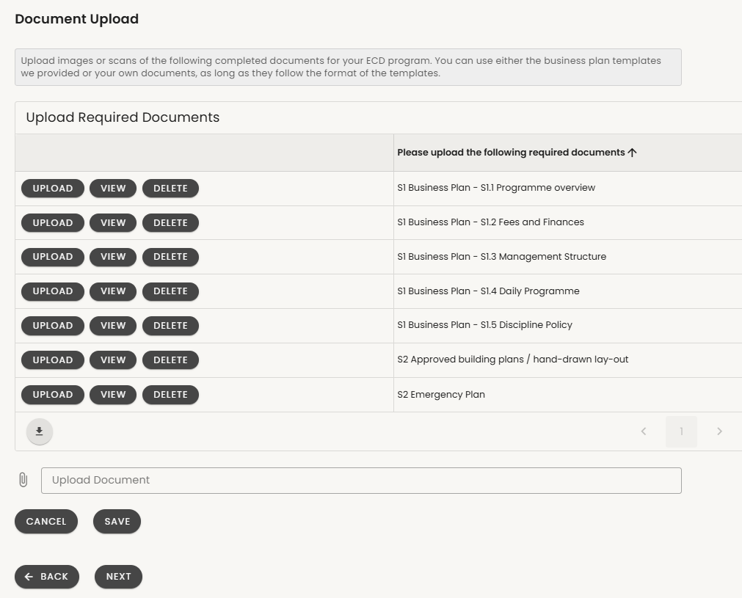
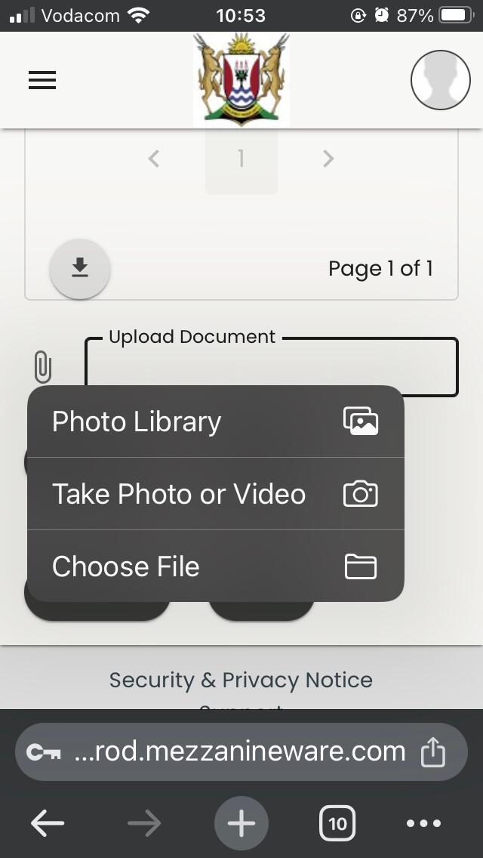
SILVER/GOLD DOCUMENT SUBMISSION
To upload documents first choose the document name you want to upload and make sure you have the right document ready [1].
Click/select UPLOAD [2]
Go to the bottom of the page and use the paper clip icon to choose a document [3]
On your phone it will allow you to choose a libriary or file where your image or document is saved or to take a photo [4]
When your image or document is uploaded click on SAVE [5]
Do the same for all your documents until all the statuses show uploaded.
2
1
1
4
3
5

Slide 32
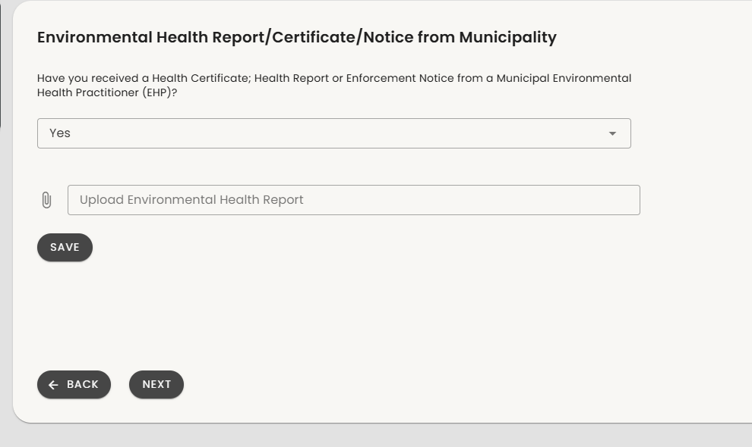
ENVIRONMENTAL HEALTH DOCUMENT SUBMISSION
If you are a centre-based programme you will be asked if you have received a document after an Environmental Health visit from the municipality.
Answer ‘Yes’ or ‘No’ [1] (please only answer yes if the document has not expired.)
If you have answered ‘Yes’ it will ask you to upload the document.
Click on the paper clip icon [2] to choose to upload.
On your phone it will allow you to choose where your image or document is saved or to take a photo [3].
When your image or document is uploaded click on SAVE [4].
Note – check the document for its expiry date – only upload if still valid
1
2
4
3

Slide 33
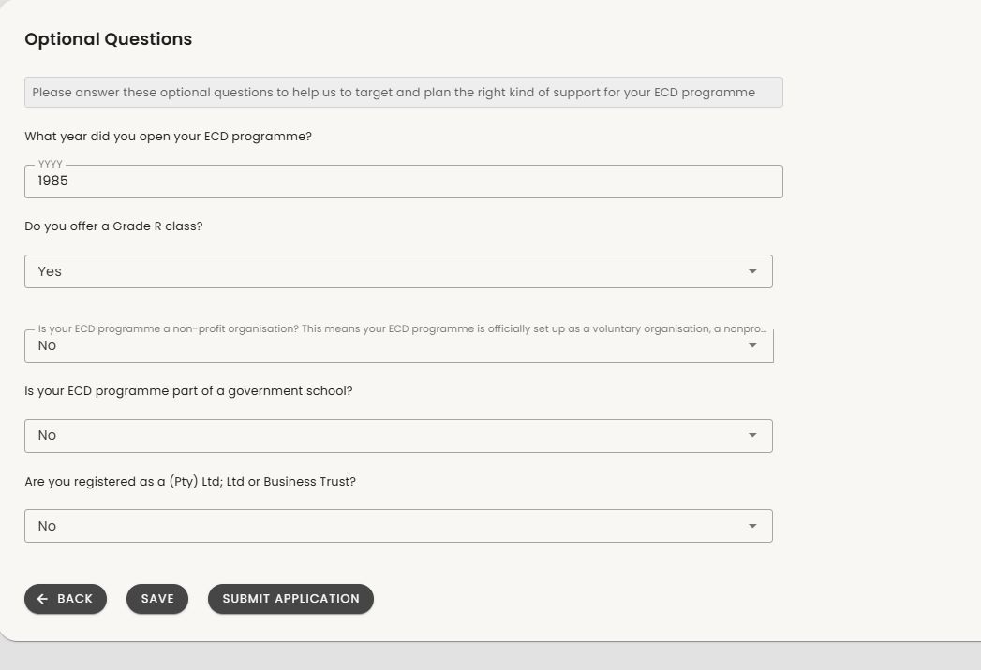
FURTHER INFORMATION QUESTIONS
The final step is a set of questions that are not part of registration requirements but that will help us to understand the type of ECD organization you are.
The questions asked will change depending on your answers to previous questions so please consider your selections carefully.
When you are done select SUBMIT [1]
You can now check the status of your Silver/Gold submission back on the Silver/Gold menu.
Look out for a message about any corrections required and prepare for your site visit
1

Slide 34
THANK YOU.

