Slide 1




FEBRUARY 2025
SUBMITTING AN APPLICATION FOR SILVER/GOLD REGISTRATION IN ECARES
INSTRUCTIONS FOR BRONZE REGISTERED ECDS AND NGOS SUPPORTING REGISTRATION

Slide 2
YOU HAVE RECEIVED BRONZE REGISTRATION – WHAT HAPPENS NEXT?
ECD Applicant
Login to eCares
Answer a few questions
Submit the documents listed in the guidelines
Submit an Environmental Health Report / Certificate if received
Registration Application Administrator
1st check application details
Check documents and approve or request corrections
Site Visit
Check the ELP programme and site against the norms and standards
Registration Application Reviewer + Approver
Reviews application
Creates recommendation
Final Approval or Refusal Notice
Registration Certificate Generator
Can generate certificates for approved ECDs

Slide 3



ACCESSING ECARES –
LOGIN AND PASSWORD RESETS

Slide 4

ECD APPLICANT – LOGGING IN TO YOUR ECARES PROFILE
Access the eCares portal using a laptop or tablet or phone at:
https://dbecares.dbe.gov.za
Choose LOGIN as an ECD Programme
4

Slide 5

ECD APPLICANT – LOGGING IN ON ECARES
After clicking on "Register," a pop-up will appear indicating that registration is complete.
Click "OK" to navigate to https://dbecares.dbe.gov.za/
Following registration, you will receive an SMS and email confirming successful registration
Sign in using your mobile/cell phone number and your eCares password.
Remember to start your number with 27 and remove the 0.
If you forget your password click on Recover your password and complete the details – you will be sent a new one-time pin and need to enter a new password.
5

Slide 6
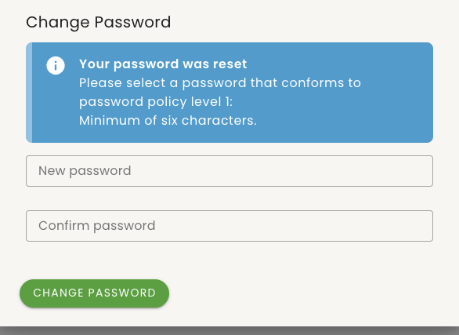
ECD APPLICANT – CHANGING A PASSWORD
The system will prompt you to change the password to your desired one. It must be at least 6 characters long.
Enter your new password, confirm it, and click on
'Change Password'.
6

Slide 7
SUBMITTING REQUIRED DOCUMENTS AND INFORMATION FOR SILVER / GOLD REGISTRATION

Slide 8
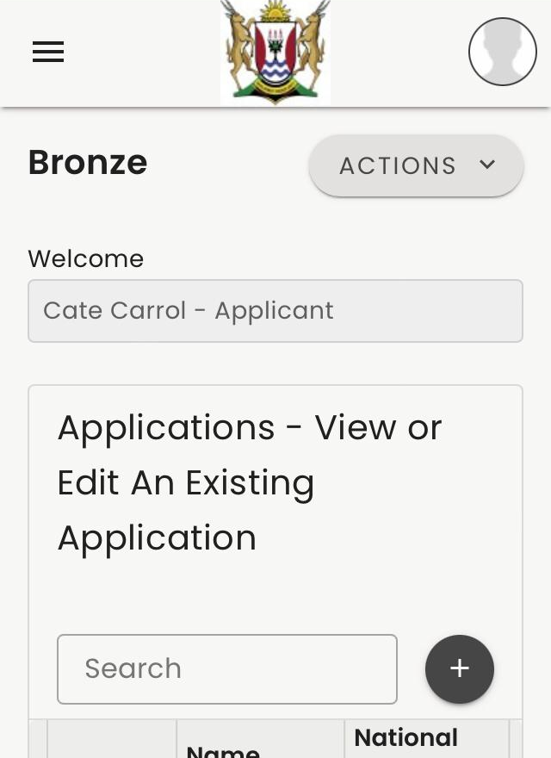
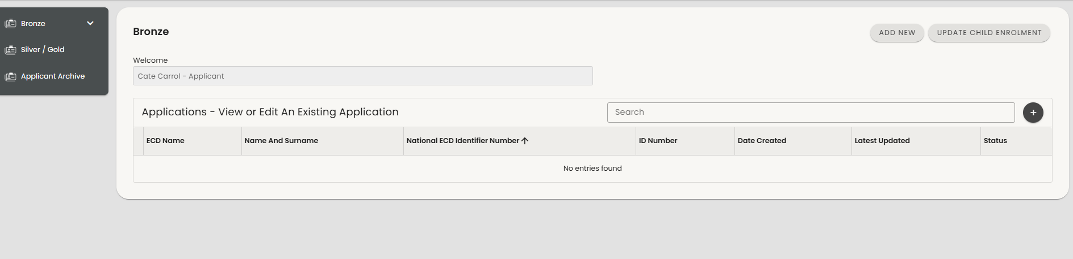
ECD REGISTRATION APPLICATIONS LANDING PAGE
2
1
On your first login, you'll be directed to the 'List of Applications’
If you are using a laptop or tablet your menu will be down the left-hand side – [1]
If you are on your phone you need to click on the three stripes on the top left of the screen to see your menu [2]
8

Slide 9
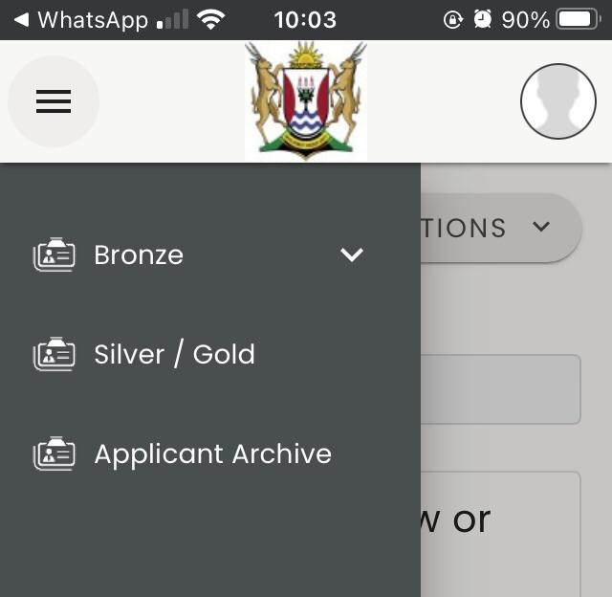
ECD REGISTRATION APPLICATIONS LANDING PAGE
2
1
2
Select Silver/Gold to see your approved Bronze application that is ready for Silver/Gold submission
If you are using a laptop or tablet your menu will be down the left-hand side – [1]
If you are on your phone you need to click on the three stripes on the top left of your screen to see your menu and then select Silver/Gold [2]
9

Slide 10
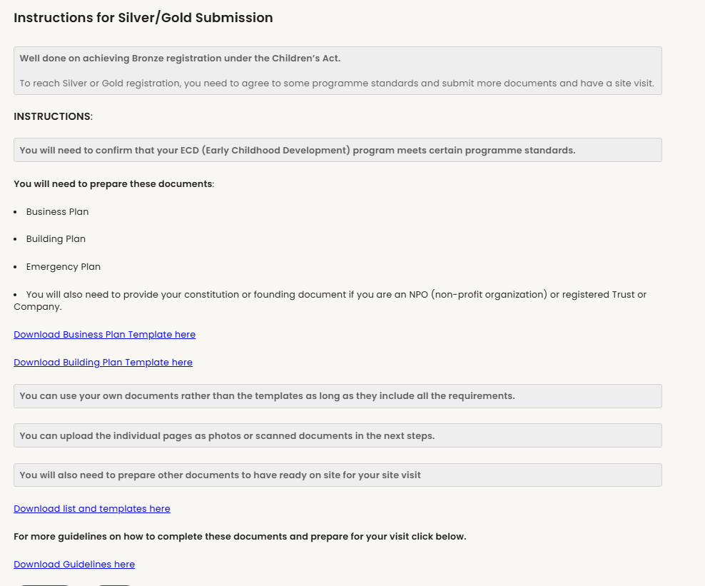
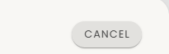

STARTING A SILVER/GOLD SUBMISSION
5
In the first step you will see instructions for what needs to be submitted
You can download individual templates for documents needed for submission [1] and documents that need to be prepared for your site visit [2]
Otherwise, you can download the full set of templates with guidelines [3]
Remember you can use your own documents if they have all the information shown in the templates
Press BACK or NEXT [4] to move through the application.
Press CANCEL [5] at any time to close the application – you can continue with it at any time by selecting EDIT
Note – the Site Layout Plan is not required for non-centre based ECDs
1
2
3
4

Slide 11
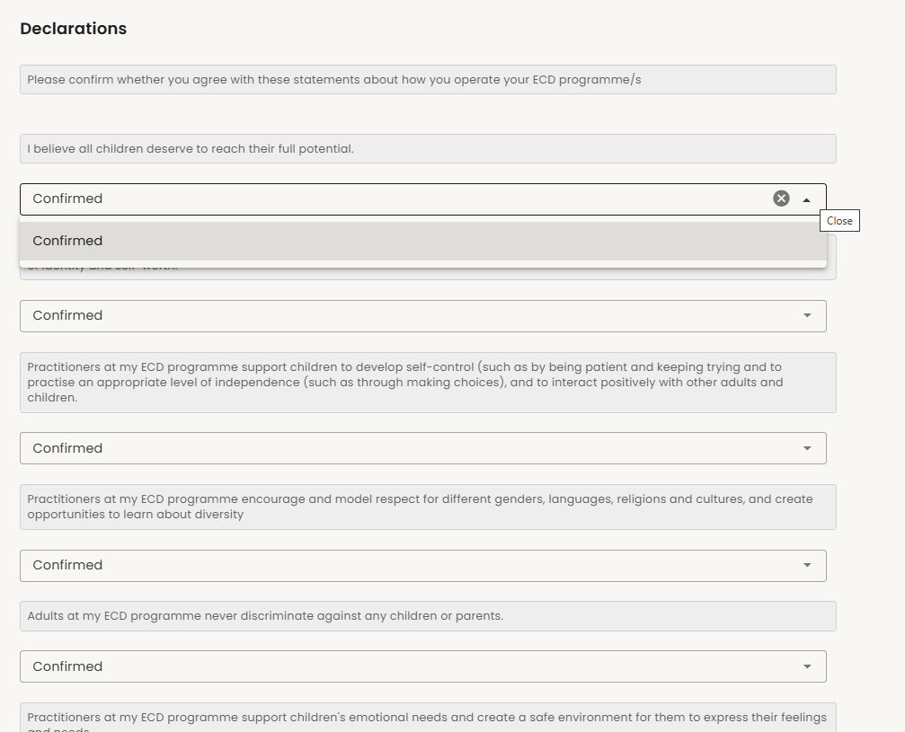
STARTING A SILVER/GOLD SUBMISSION
The next step contains a number of statements that must be confirmed to show that you are meeting the standards for an ECD programme.
These standards are difficult to assess in a site visit so your confirmation provides assurance that they are met.
Please read these carefully and make sure you agree with them before confirming. These are all very important standards for child safety, well-being and development
Click on the arrow icon [1] under each statement to select that you confirm.
1

Slide 12
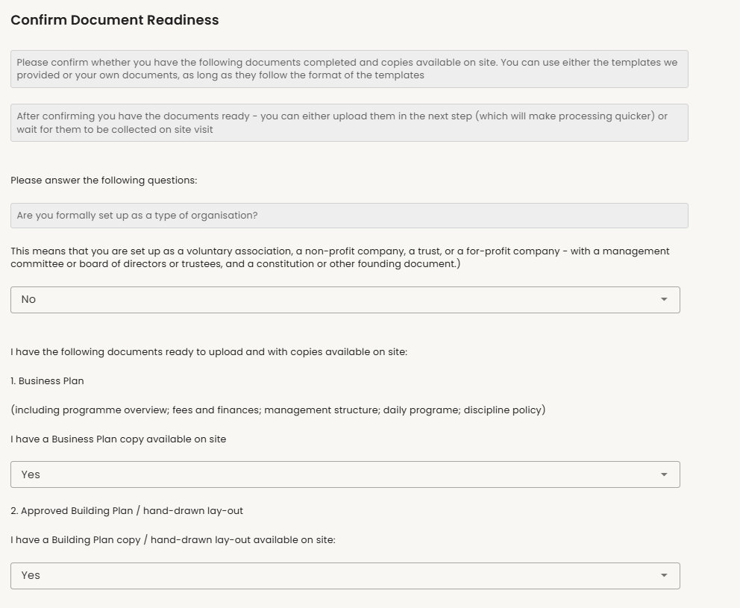
STARTING A SILVER/GOLD SUBMISSION
The next step checks what documents you need and allows you to confirm whether you have them ready on site.
Please answer the questions honestly so that your registration process is not delayed.
Click on the down arrow [1] to choose your answer
You will not be able to proceed with submission until you have confirmed that all your documents are ready.
Once you have confirmed document readiness a site visit can happen at any time.
NOTE – Non-centre based ECDs will see fewer document requirements
1

Slide 13
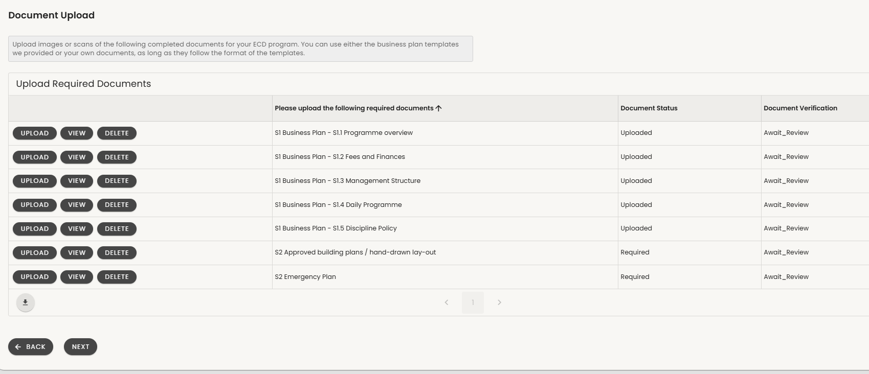
SILVER/GOLD DOCUMENT SUBMISSION
1
2
The next step is for submission of all your Silver/Gold documents.
You will see the list of documents you need to upload [1]. Note S1 are all sections of the business plan – please upload each section as a separate picture or pdf.
The document status [2] shows which documents are uploaded and which are still required.
You will not be able to proceed with submission until you have confirmed that all your documents are ready.
Once you have confirmed document readiness a site visit can happen at any time.
13

Slide 14
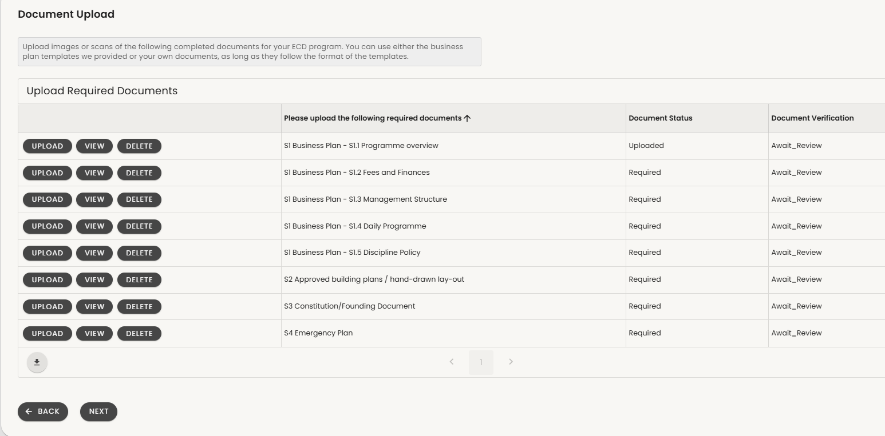
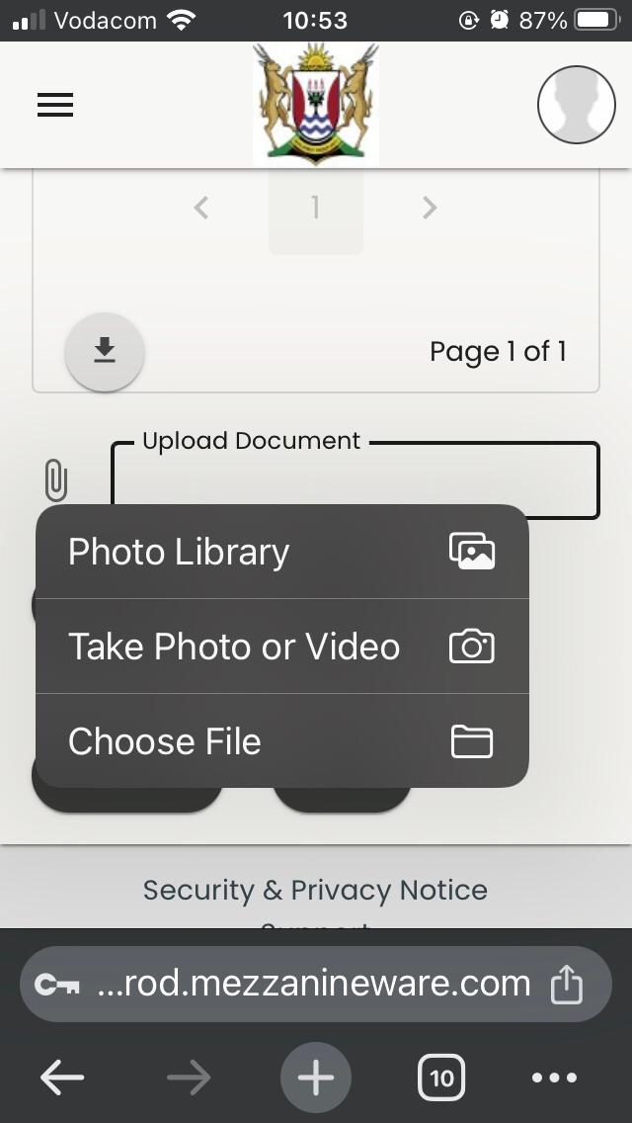
SILVER/GOLD DOCUMENT SUBMISSION
To upload documents first choose the document name you want to upload and make sure you have the right document ready [1].
Click/select UPLOAD [2]
Go to the bottom of the page and use the paper clip icon to choose a document [3]
On your phone it will allow you to choose where your image or document is saved or to take a photo [4]
When your image or document is uploaded click on SAVE [5]
Do the same for all your documents until all the statuses show uploaded.
1
2
4
3
5

Slide 15
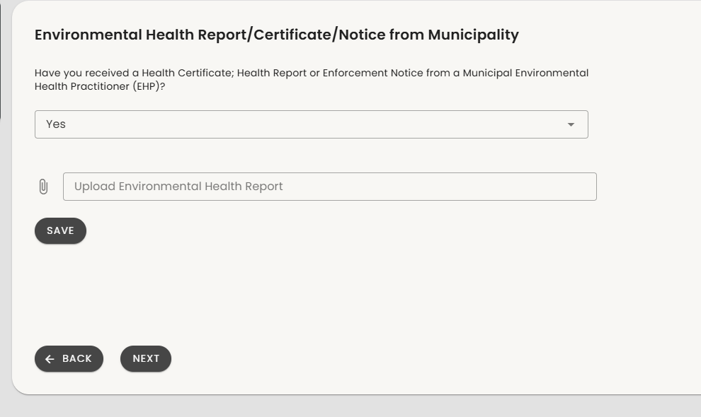
ENVIRONMENTAL HEALTH DOCUMENT SUBMISSION
If you are a centre-based programme you will be asked if you have received a document after an Environmental Health visit from the municipality.
Answer ‘Yes’ or ‘No’ [1] (please only answer yes if the document has not expired.)
If you have answered ‘Yes’ it will ask you to upload the document.
Click on the paper clip icon [2] to choose to upload.
On your phone it will allow you to choose where your image or document is saved or to take a photo [3].
When your image or document is uploaded click on SAVE [4].
1
2
4
3

Slide 16
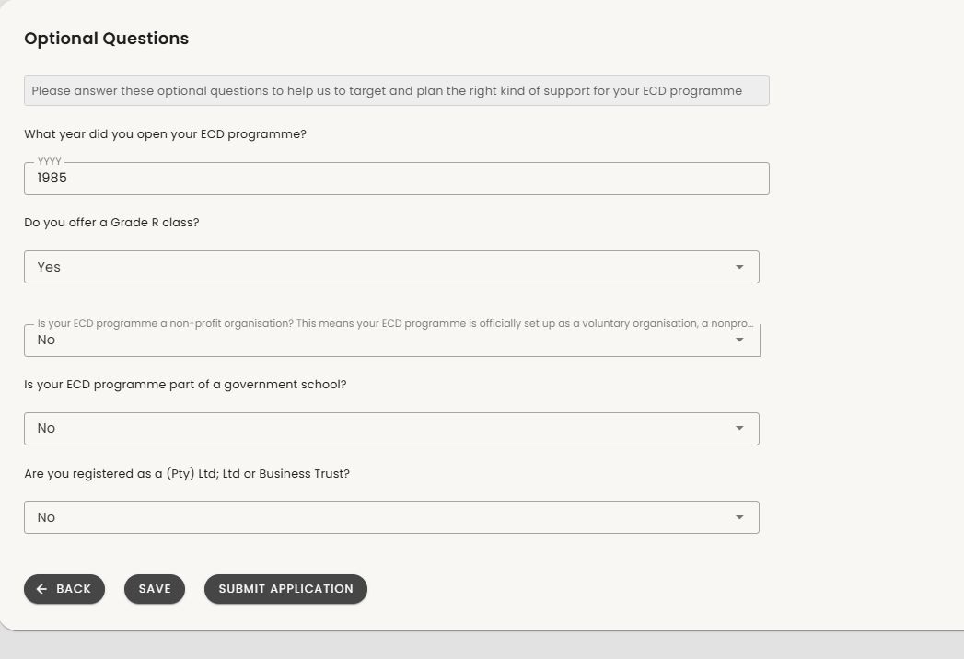
SUPPORT TARGETING QUESTIONS
The final step is a set of questions that are not part of registration requirements but that will help us to target the right kind of support to you.
The questions asked will change depending on your answers to previous questions so please consider your selections carefully.
When you are done select SUBMIT [1]
You can now check the status of your Silver/Gold submission back on the Silver/Gold menu.
Look out for a message about any corrections required and prepare for your site visit
1

Slide 17
THANK YOU.

