Slide 1



BANA PELE ECD REGISTRATION DRIVE
SILVER/GOLD
REGISTRATION TRAINING

Slide 2

WHY ARE WE HERE

Slide 3



CONTEXT
Nationally, at least half of all ECD programmes are currently not registered in terms of the children’s Act and operate in diverse contexts.
Every child young child in South Africa should have access to quality early learning
The Bana Pele Mass Registration Drive is the first step to making this vision possible through:
Pulling every out-of-home ECD programme into the regulatory net to allow proper oversight by government
The Children’s Act gives wide-ranging powers to provinces to adopt a developmental approach

Slide 4
THROUGH THE LENS OF THE ECD PROGRAMME

Slide 5
BANA PELE REGISTRATION PROCESS
APPLY
COMPLY
COMPLETE
NEW BRONZE
NEW SILVER / GOLD
  Initial conditional registration
Support for compliance and site visits
Review determination

Slide 6
SILVER PROCESS
BRONZE APPLICATION
BRONZE APPROVED
DOCUMENT UPLOADS
INSPECTION VISIT
COMPLETE: SILVER/GOLD
REGISTRATION READINESS ASSESSMENT

Slide 7
REGISTRATION READINESS ASSESSMENT
Improves the chances of an ELP meeting norms and standards to optimize resources.
A set of simple questions aligned to key norms and standards
Note: Not a compulsory step in registration – not all ECDs will be reached
Identifies potential registration failures for an ECD programme before a site inspection
Provides data for planning government support and inspection visits (e.g. if a programme can be ranked according to registration readiness, then social workers could plan visits)
Provides immediate feedback so that programmes can make own improvements
Provides the data required to refer programmes for support
How is a readiness assessment conducted?
Telephonic assessment
Onsite assessment
Notes:
Not 100% of programme will receive readiness assessment

Slide 8
Key Areas For RRA
Programme
Infrastructure
Health and safety
Administration
Practitioner to child ratio
Basic stimulation (daily programme)
Sufficiently skilled practitioner
Rest in full day programmes
Physical environment
Structural elements of the structure
Water and sanitation
Sufficient space
Fire safety
Basic first aid
Hazardous items
Emergency plan
Waste bins
Written policies
Registers

Slide 9
BANA PELE REGISTRATION PROCESS
Activities outside of eCares
Journey App
Enabled by eCares
Registration readiness Assessment
Comms via Whatsapp Bot to verify site contact details and link to digital combined Form 11/16
ELP completes online application and health and safety declaration
Supported via call centre, SWs
and NGOs
PED processes complete applications with child protection register checks, and approves bronze application
Call centre/NGO conducts registration Readiness Assessment with ELPs
STAGE 1: APPLY (new Bronze)
EHP conducts site inspection and issues inspection report or health certificate
Social worker does site inspection using Registration Framework (RF)
ELP submits silver documents: business plan, building plan/hand-drawn building plans, constitution, inspection report/health certificate
Supported via call centre and NGOs
ELP receives health & safety support pack/Infrastructure refurbishments
Via MG Grant/ private fund/NGOs/Self-funded
STAGE 2: COMPLY (Silver/Gold)
PED processes application:
Outcome of RF, EHP report/certificate &silver documents
PED issues registration certificate (silver or gold)
ELP completes municipal compliance steps (if conditionally registered)
ELP submits for gold registration if necessary
STAGE 3: COMPLETE (Silver/Gold)
OR failed standards and issued with refusal notice
Notes:
Municipalities - Joint site visits, prompts for visits,

Slide 10
BANA PELE
PROCESS
EXPLAINER
ACTIVITY AND DISCUSSION

Slide 11
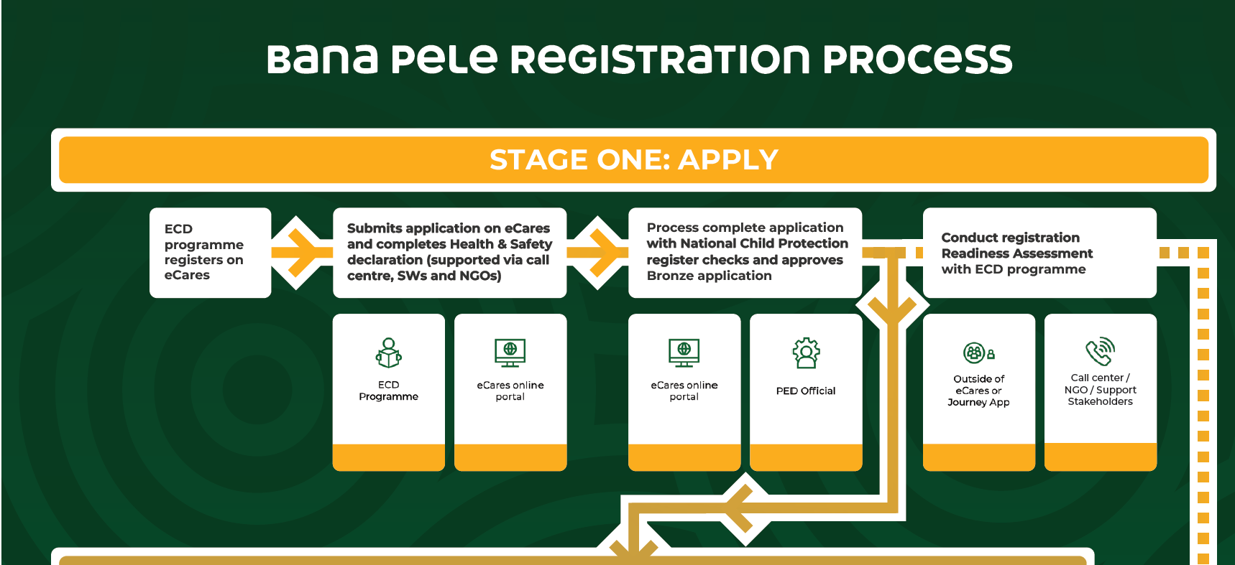

Slide 12
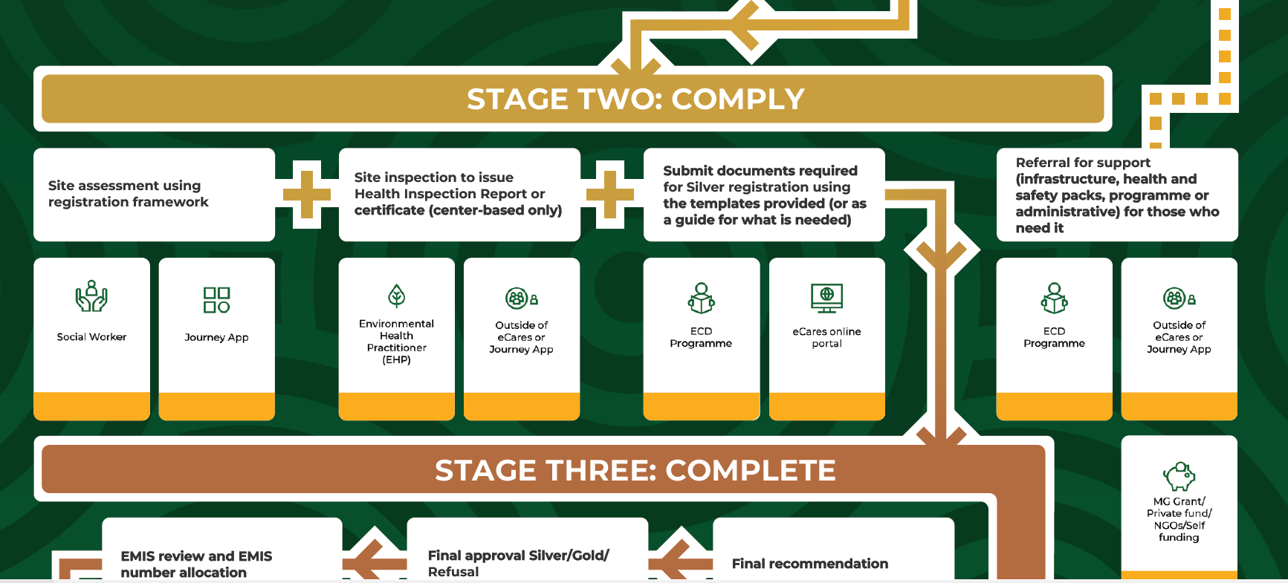

Slide 13
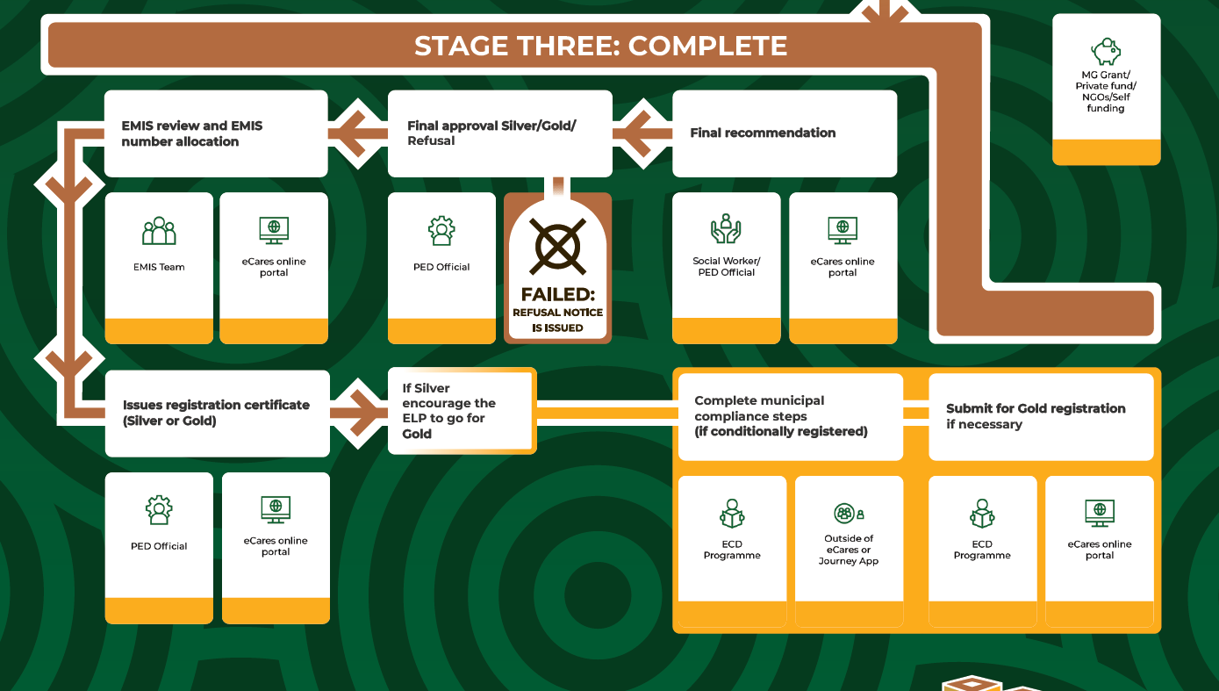

Slide 14
SILVER/GOLD APPLICATIONS

Slide 15
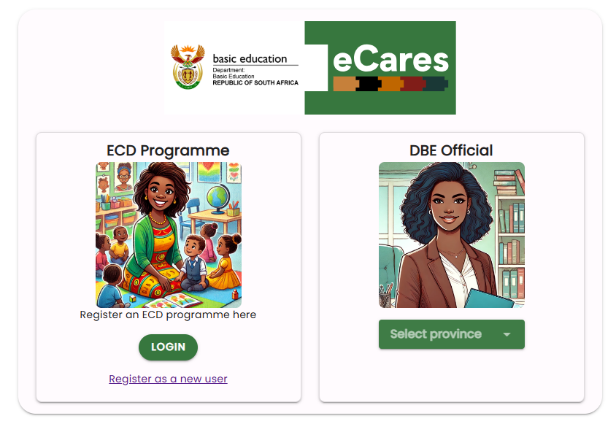
WHY IS THE SUBMISSION OF THESE DOCUMENTS IMPORTANT?
Required by Children’s Act Regulations
Aligned to norms and standards
A key step in the silver process and to achieve registration requirements
Can reduce some of the standards that need to be observed onsite by a social worker
Provides insight on how the ECD programmes is managed
SUBMISSION PROCESS:
Bronze approved
SMS is sent with a link to start silver/gold document submission
Link is accessed via the link
Registration guide and document templates can be downloaded
Document are completed
Document are uploaded in eCares, questions are answered, declaration completed and submitted
Registration Certificate Generator
Can generate certificates for approved ECDs
Call Centre and SWs will be able to support document upload in eCares if ECD sends or SW collects on site

Slide 16
SILVER/GOLD APPLICATION SUBMISSION
Who can support and ECD programme to an application:
Social worker (on behalf of the ECD programme)
NGO
Youth field worker (youth initiatives)
EHPs can:
Leave the EHP document with the ECD programme
Email the document to the social worker
A completed application submission:
  Uploading application documents required
  Confirm declaration (Hard to observe standards)
  Upload EHP document
  Answer additional questions

Slide 17

SILVER/ GOLD APPLICATION SUBMISSION DOCUMENTS
CENTRE-BASED
NON CENTRE-BASED
Business plan: ECD programme overview, Management Committee Structure, Fees and Finances, Daily Programme, Discipline Policy
Gold: Approved building plan,
Silver: Application for building plan approval OR Hand-drawn Site layout
Founding document (Constitution if registered as a legal entity)
Emergency plan
Health Report/Certificate
Implementation Plan
Qualifications: ECD Qualification NQF Level 1-6 of the supervisor or any staff member (Silver) ECD Qualifications NQF 1-6 of the applicant (gold)
OR proof of 3 years experience (work contract or CV)
ECD Applicant
Login to eCares
Answer a few questions
Submit the documents listed in the guidelines
Submit an Environmental Health Report / Certificate if received
Registration Certificate Generator
Can generate certificates for approved ECDs

Slide 18
Declaration statements (hard to observe standards)
I believe children need to reach their full potential
Practitioners at my centre create opportunities for children to explore their world, learn about themselves and develop a sense of identity and self-worth.
Practitioners at my ECD programme support children to develop self-control (such as being patient and keep trying and to practice an appropriate level of independence (such as through making a choice), and to interact positively with other adults and children.
Practitioners at my ECD programme encourage and model respect to different genders, languages, religions and cultures, and create opportunities to learn about diversity.
Adults at my programme never discriminate against children
Practitioners at my ECD programme support children’s emotional needs and create a safe environment for them to express their feelings and needs.
My ECD programme uses community resources to develop the whole child – such as accessing the local library or toy library, and having a relationship with the clinic and social worker to support health, nutrition, and birth registration- where these are available.
IMPORTANT NOTE: These are considered “hard-to-observe” standards at a point in time. These standards are NOT assessed as part of the registration Framework, therefore ECD programmes must commit to meeting these standards by agreeing to the declarations.

Slide 19
SILVER/GOLD APPLICATION SUBMISSION REVIEW
Review application documents to check they are filled in correctly and completely
Ensure that EHP documents are classified correctly (Health Certificate, Inspection Health Report, EHP Compliance notice)
Ensure EHP document is not expired
Application questions – Check that these questions have been completed
Corrections notes can be sent to the application to request to correct or complete the application
Only send application for corrections if the documents are incomplete or not completed correctly

Slide 20
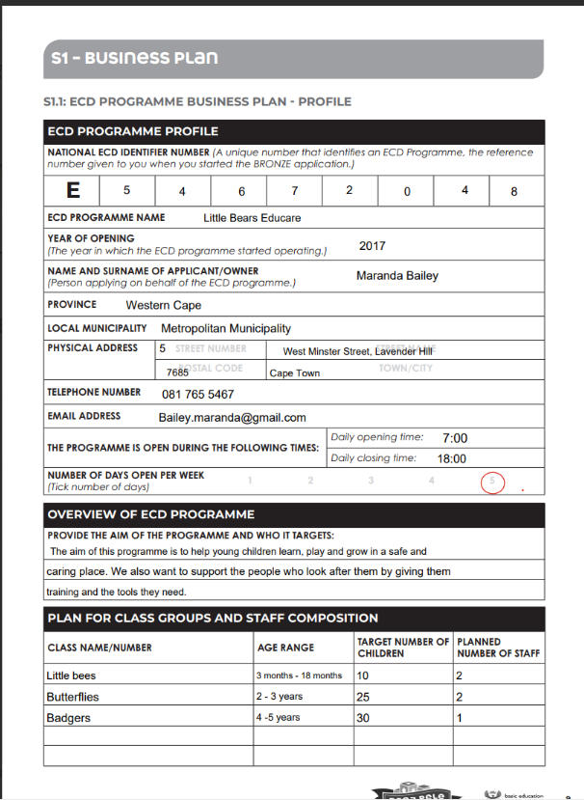
BUSINESS PLAN: ECD PROGRAMME OVERVIEW
Your BUSINESS PLAN provides an overall picture of your programme and helps the Department of Basic Education (DBE) understand how your run your programme.
ECD programme Overview:
Describes the programmes in detail and who it is aimed at
Make sure you include the same information that was used to complete the bronze application, especially information linked to your profile
[1] Overview of the ECD programme: Why does your programme exist and who does your programme benefit?
[2] Class groups and composition: How many classes do you have and what is the planned number of children and staff you aim to meet.
1
1
1
2

Slide 21
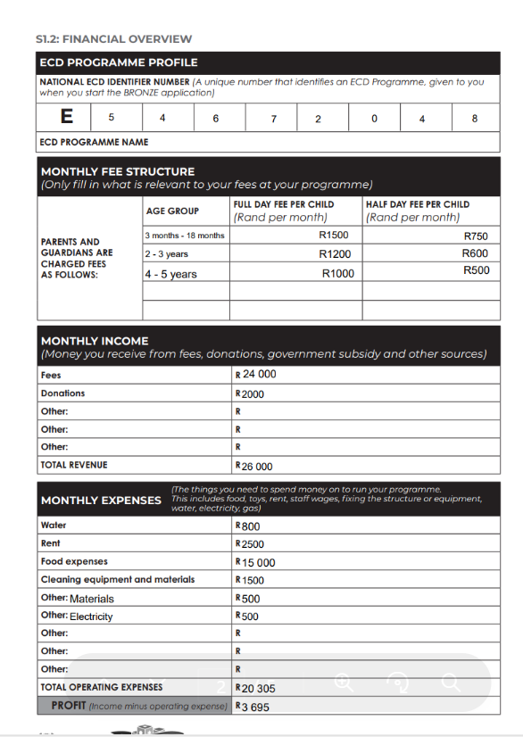
BUSINESS PLAN: FEES AND FINANCES
Shows how money is managed, including fees charged, income and monthly expenses
[3] Monthly fee structure: Include fees charged per age group
[4] Monthly income: Include where money is received and how much
[5] Monthly expenses: Include the things money is spent on and how much to ensure the programme keeps running
[6] Profit: Money the programme receives – money the programme spends
3
4
5
Registration Certificate Generator
Can generate certificates for approved ECDs
6

Slide 22
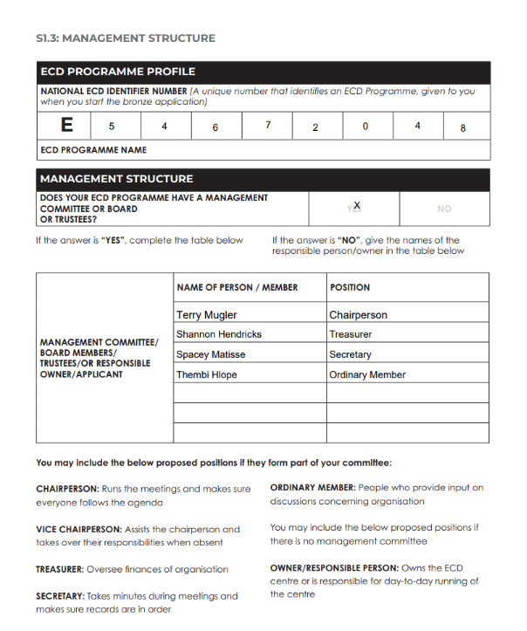
BUSINESS PLAN: MANAGEMENT COMMITTEE STRUCTURE
People who run or are responsible for the programme.
[7] Indicate whether the programme has a management committee or board
[8] If your programme has a structure committee/board – add names of the board members to the table
[8] If your programme does not structure committee/board – add names of responsible person
[9] Examples of roles is provided
7
8
9
Registration Certificate Generator
Can generate certificates for approved ECDs

Slide 23
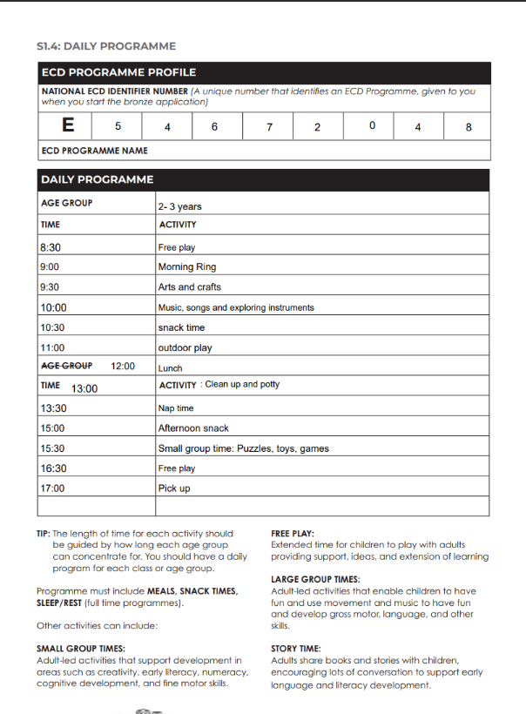
BUSINESS PLAN: DAILY PROGRAMME
Show what you do (activities) and when you do it
Its is important to provide a variety of different activities
[10] Include the age group and the activities that are planned on a daily basis
[11] Examples of the types of activities are listed
Remember for full day programmes, its important to include rest times.
Snack and meals times should be included for all programmes
10
11
Registration Certificate Generator
Can generate certificates for approved ECDs

Slide 24
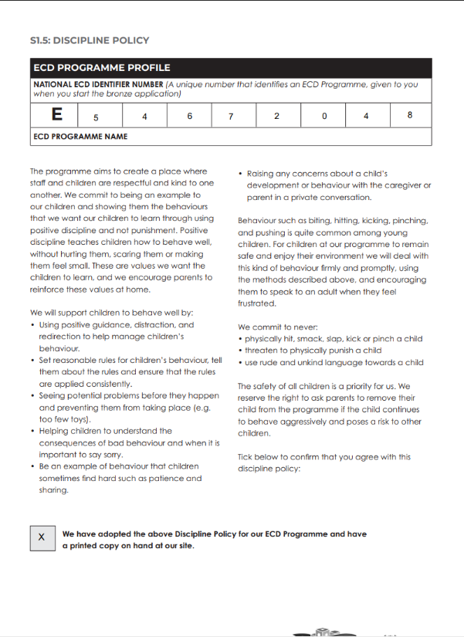
BUSINESS PLAN: DISCIPLINE POLICY
Sets expectations of how children's behaviour is managed in a way that promotes positive guidance while avoiding harsh or physical punishment.
[12] If this template will be used in your ECD programmes, adopt the policy by ticking the box
There should be a printed copy at the site that is accessible.
Own policies can be used, however, ensure that policies align with the content of the template
12

Slide 25

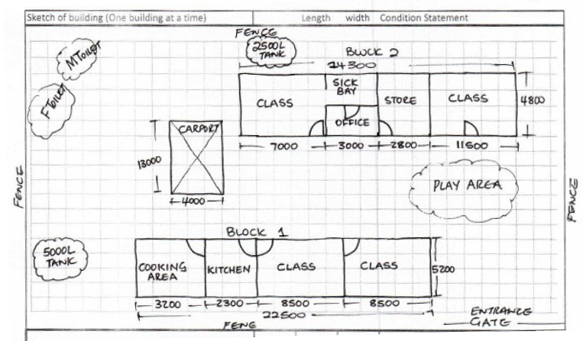
BUILDING PLANS/HAND-DRAWN SITE PLANS
GOLD:APPROVED BUILDING PLAN
To qualify for gold registration an approved building plan is required
Submit this document if you have it available
13
SILVER: APPLICATION FOR BUIDLING PLAN APPROVAL
Some ELP programmes may still be in the process of getting an approved building plan.
In this case an application for approved building plan can be submitted – this would mean that the programme would qualify to meet silver requirements
OR
14
SILVER: HAND-DRAWN SITE LAYOUT
For programmes can also submit a hand-drawn site plan
[13] Draw your site plan using the instructions [14] provided. Show measurements in cm or meters

Slide 26
FOUNDING DOCUMENT (CONSTITUTION IF REGISTERED AS A LEGAL ENTITY)
Programmes registered as legal entities are required to submit a constitution or a founding document. This only applies to:
Voluntary association
Non-profit organisation
Trust
For-profit company
Partnership
Key sections to include in a constitution:
Organisation’s name and purpose
How it is governed and the roles different people play
Rules of decision-making and finances
Registration Certificate Generator
Can generate certificates for approved ECDs

Slide 27
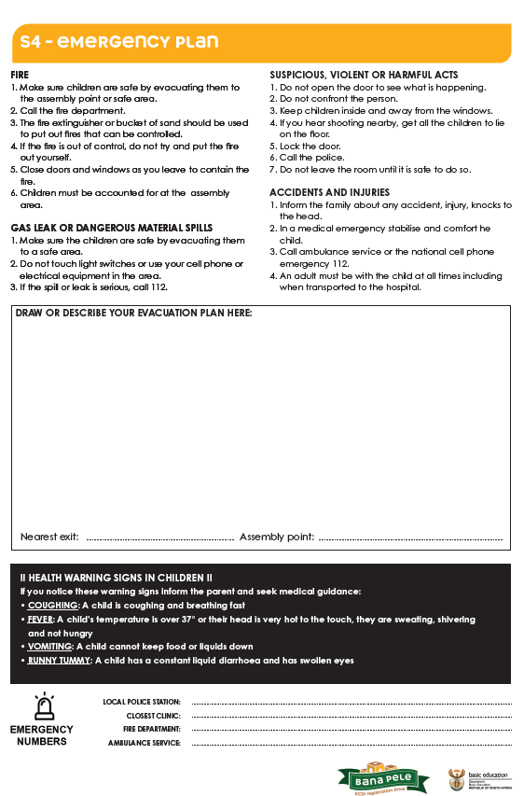
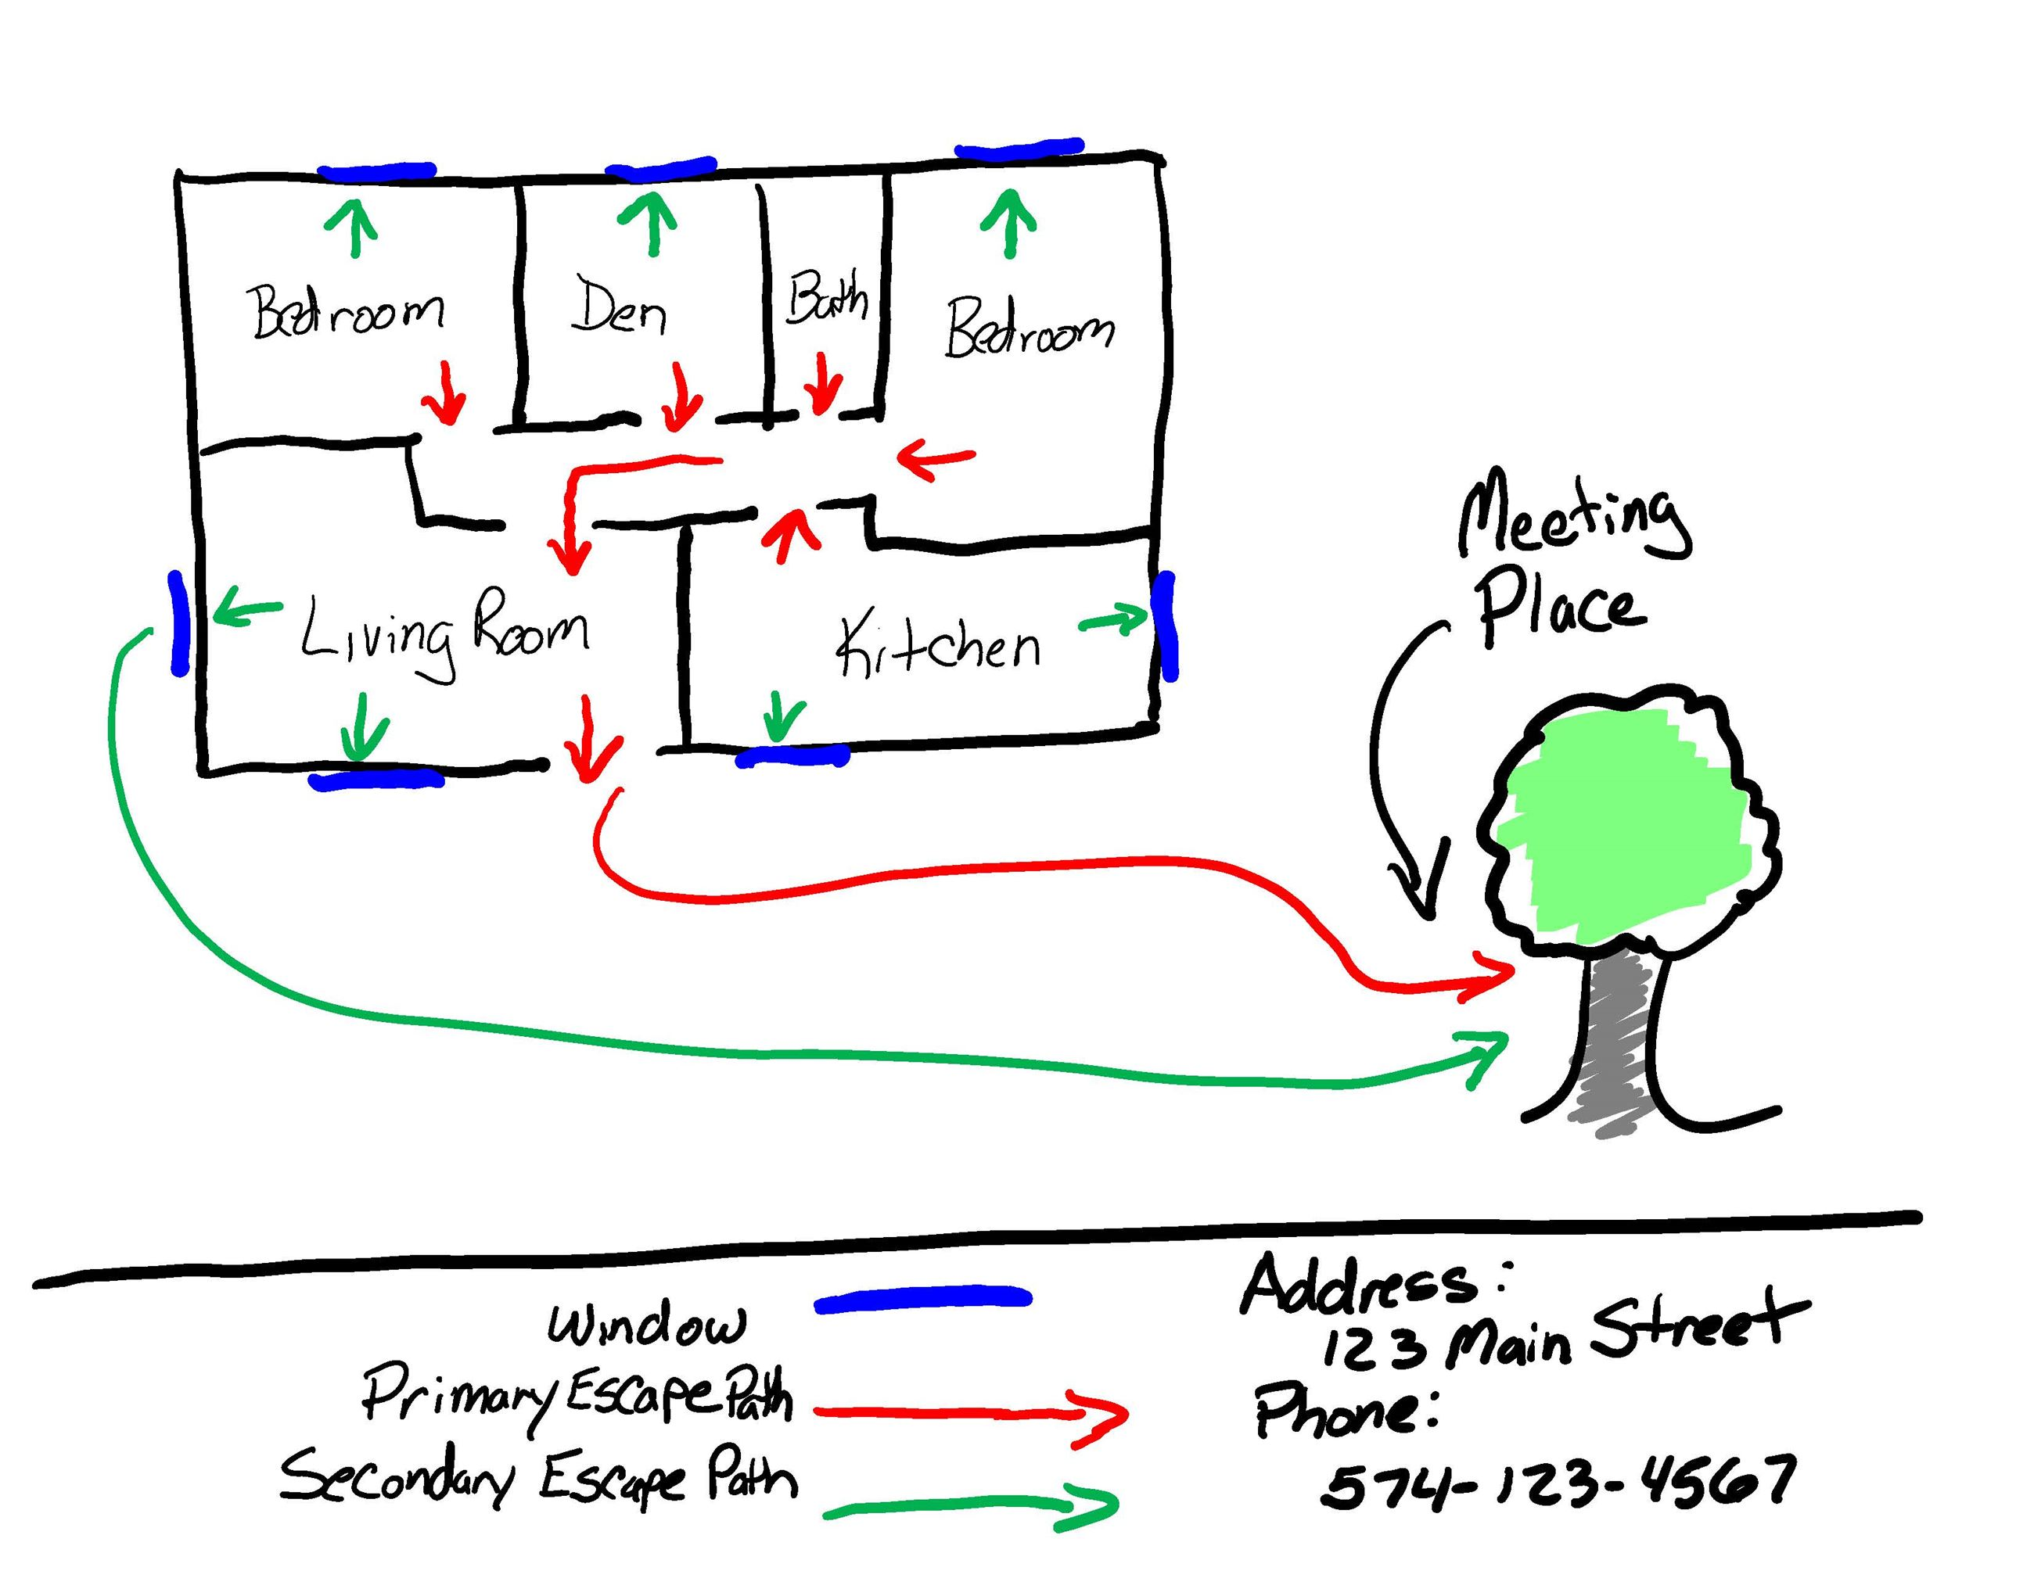
EMERGENCY PLAN
Shows what to do in an emergency, where the exits and assembling points are.
Submitting own emergency plans are accepted, however ensure that it includes evacuation procedures, emergency numbers
[15] Draw emergency plan and evacuation procedures
[16] Add emergency numbers from your local community
An emergency plan must be displayed at the ECD programme. Ensure that the emergency plan is also displayed at the site.
15
16

Slide 28
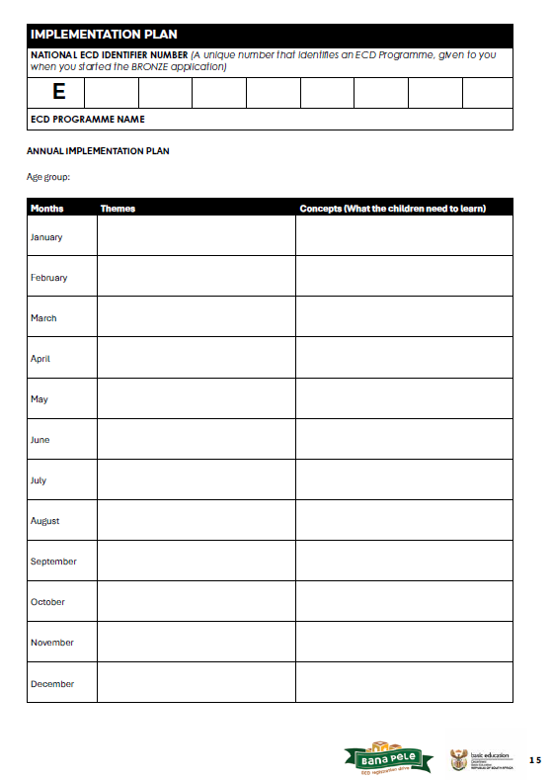
IMPLEMENTATION PLAN
17
18
An implementation plan shows the broad learning and development areas/themes and concepts that would be covered in a year.
[17] Add ECD identifier number
[18] Complete implementation plan

Slide 29
QUALIFICATIONS
SILVER:
ECD Qualification NQF Level 1- 6 of the supervisor or any staff member
GOLD:
ECD Qualifications NQF 1-6 of the applicant
OR
proof of 3 years experience (work contract or CV) in the ECD field

Slide 30
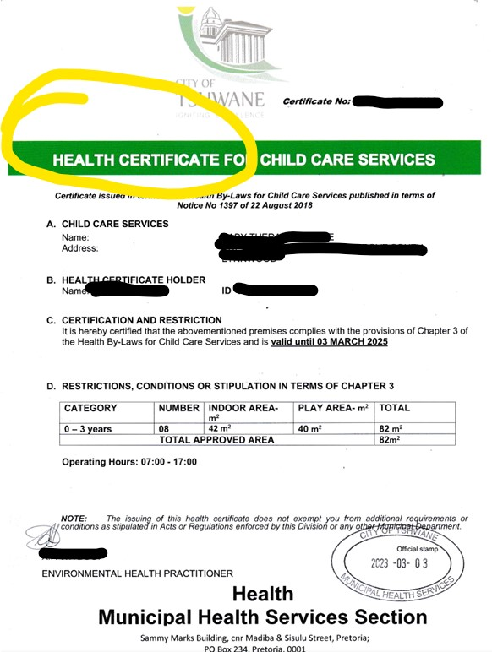
Health certificate:
Space and capacity of children must be provided
Operating hours
Check expiry date
Named differently in across provinces:
  Health certificate
  Health Permit

Slide 31
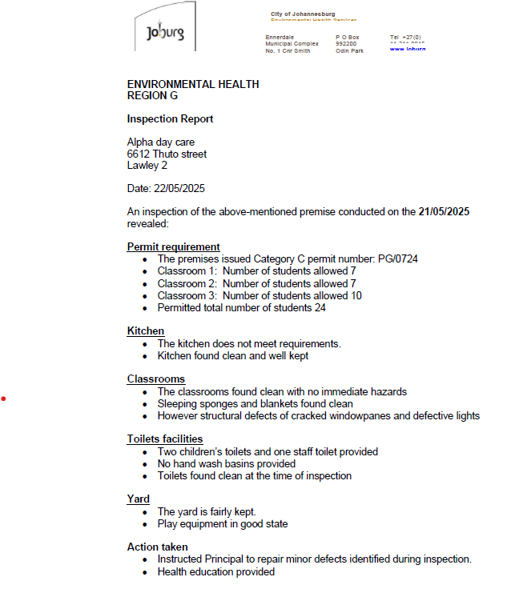

Action taken
Capacity provided

Slide 32
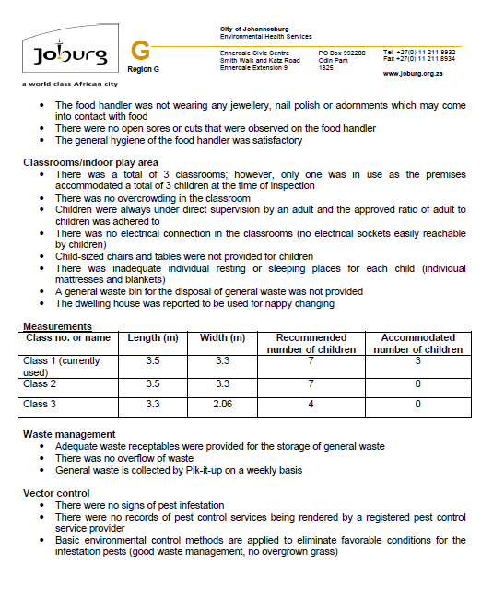
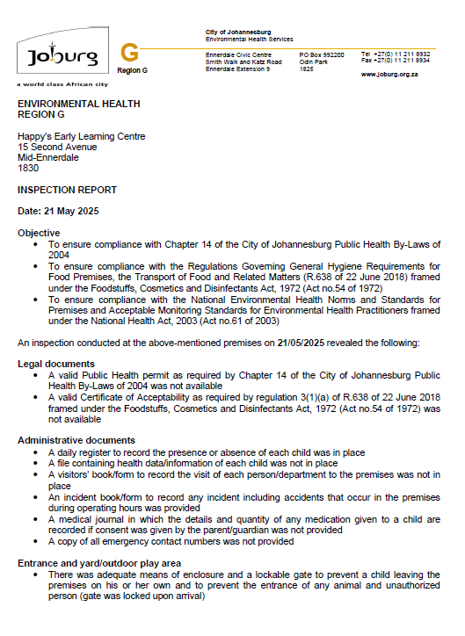
Capacity provided

Slide 33
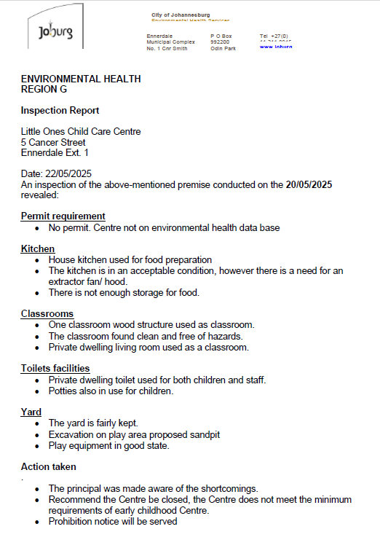
Action Taken: prohibition notice will be served and recommend centre closure

Slide 34
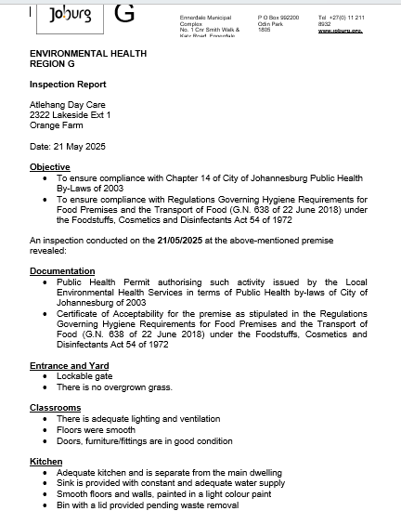
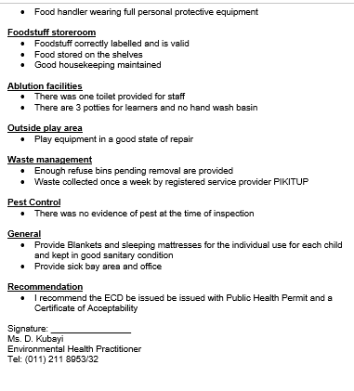
Recommendation: public health permit and certificate of acceptability

Slide 35
REGISTRATION FRAMEWORK OVERVIEW

Slide 36
WHY THE CHANGE TO THE REGISTRATION FRAMEWORK?
Reduce time taken by social workers assessing an ELP
Research shows that while previous Registration Frameworks aimed to provide a developmental approach, their minimum requirements were still too high for many ECD programmes, given the challenging contexts they operate in.
Reduce complexity
To ensure that the threshold for meeting registration is lower

Slide 37
REGISTRATION FRAMEWORK DESIGN PROCESS
Objective: Simplify and streamline the registration framework by satisfying the standards in multiple ways
Partial Care
Standards
(Chapter 5)
Programme
standards
(Chapter 6)
Reduced NEHNS
Cross-referenced (Where applicable)
Removed duplication
Removed duplication
Addressed elsewhere: EHP, bronze application
Declaration
Notes:
Explain that DBE is finalising these stages and going through internal sign-off processes, and that officials will receive training in due course.

Slide 38
REGISTRATION FRAMEWORK – KEY SHIFTS
CENTRE-BASED
PARTIAL CARE STANDARDS
PROGRAMME STANDARDS
NON-CENTRE BASED
PROGRAMME STANDARDS
HEALTH AND SAFETY STANDARDS
The standards are framed as statements that you will need to observe or ask the practitioner

Slide 39

REGISTRATION FRAMEWORK – KEY SHIFTS
The Registration Framework is designed to assess ECD programmes using the norms and standards to be able to determine conditional (silver) or full registration (gold) or failed silver.
SILVER (CONDITIONAL REGISTRATION)
GOLD (FULL REGISTRATION)
For Silver there are non-negotiable standards. These standards must be met, unless they do not apply.
Standards with conditions: There are also standards that may not be met at the time of assessment but can be addressed within a week without incurring significant costs.
All standards are non-negotiable and must be met for Gold, unless the standard does not apply.

Slide 40
SITE ASSESSMENT

Slide 41
Journey App
The Journey App is an application that can be used offline on a mobile device to conduct the site assessment
How will the Journey app enable and support my site assessment?
    Capture GPS location
    Capture/change any missing contact details
    Change programme type ONLY if required (centre-based vs Non-Centre-Based)
    View document status
      If there are missing documents, you can help the ECD programme by uploading them to the ECD programme profile
    Assess the ECD programme with the Registration Framework
The Journey App will generate the result of the assessment

Slide 42
REGISTRATION FRAMEWORK ASSESSMENT

Slide 43
Link or
take note
Non-centre based
And
Centre based
Response
options
ICONS AND COLOURS
These icons will help navigate the slides
Gold
Tips
Silver

Slide 44
COMPLIANCE DOCUMENTS
    Discipline policy
    Health and hygiene policy
    Daily programme
    Emergency plan
    Hand-drawn site plan/building plan
    Staff qualifications/proof of experience
    Accident and Incident register
    Attendance Register
    Child admission form
    Discipline register
    Structural emergency and disaster procedures (Gold only)
    Medicine Register (where applicable)
Centre-based & non-centre-based
The accident and incident register, attendance register and child admission, is not assessed as part of the non-centre based framework standards however these documents can be checked onsite, but non-centre based programmes will not be penalised for not having them.
Centre-based only

Slide 45
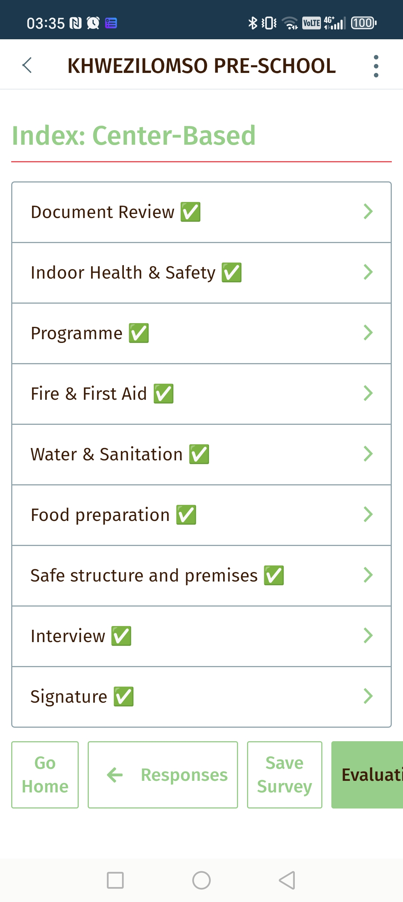
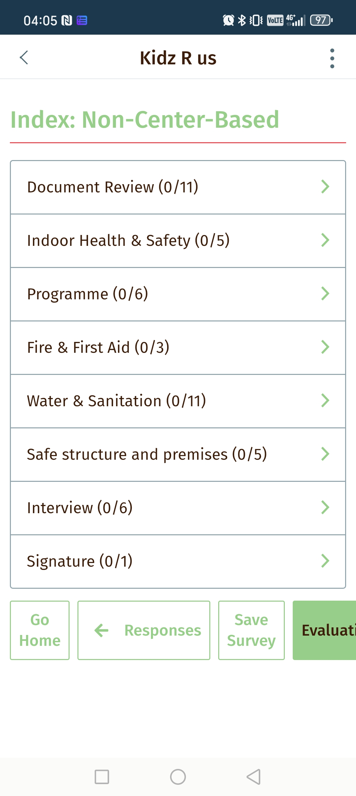
    Grouping of standards:
    Document review
    Indoor Health and safety
    Programme
    Fire and first aid
    Water and sanitation
    Food preparation
    Safe structure and premises
TIPS
Guidance
on how to assess
    These tips do not form additional standards. Rather, they should help you by sharing some ideas about how to assess the centre.

Slide 46
CHANGED STANDARDS

Slide 47

Where applicable, new buildings and alterations to buildings comply with the building standards as set out by the National Building Regulations and Building Standard Act, 1997 (Act No.103 of 1997).
Ask for an original copy of the approved building plans or a copy of the building plans that has been submitted for approval if the application for the approval of the building plans is still under consideration.
You could also ask for a decision letter have the programme has one. This applies to new, old and with alterations.
GOLD
                NA

Slide 48

                There is a Health and Hygiene Policy or another written document includes practices to prevent spread of diseases that are contagious. A template for a Health and Hygiene Policy is included in the document pack available to all ECD programmes
Check Health and Hygiene Policy includes practices to prevent the spread of contagious diseases.
SILVER & GOLD
                Minimum Standard

Slide 49
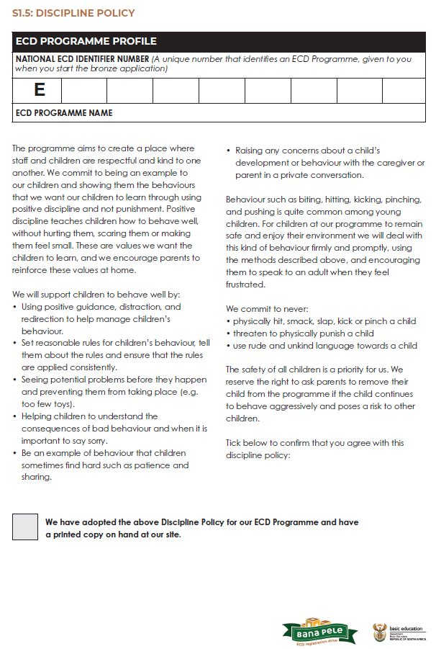
There is a Discipline Policy that includes humane methods of discipline and considers the child’s developmental stage and evolving capacities. Children may not be punished physically by hitting, smacking, slapping, kicking or pinching.
                You may want to check that the discipline policy prohibits harsh or physical punishments. A template for a Discipline Policy is included in the document pack available to all ECD programmes.
SILVER & GOLD

Slide 50
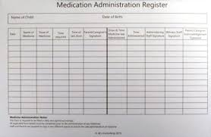

                If there is not a medicine register advise the principal to impliment this immediately if the programme administers medicine. This could be a simple hand-written list recording the date, childs name, name of medication and amount given. A template is included in the document pack available to all ECD programmes.
                Remember this standard may not apply to programmes who do not administer medicine.
There is a register for administering medicines
SILVER & GOLD
                YES, WITH CONDITIONS
                NA

Slide 51
                Check the ECD programme files for attendance register, child admission form for each child which includes any allergies or chronic medical conditions. Some ECD programmes might refer to the child admission form as an application form. There must also be a discipline register where significant discipline issues are recorded for each child.
                .
Documents on file:
Attendance register
Child admission form
Discipline Register
SILVER & GOLD
                YES, WITH CONDITIONS

Slide 52
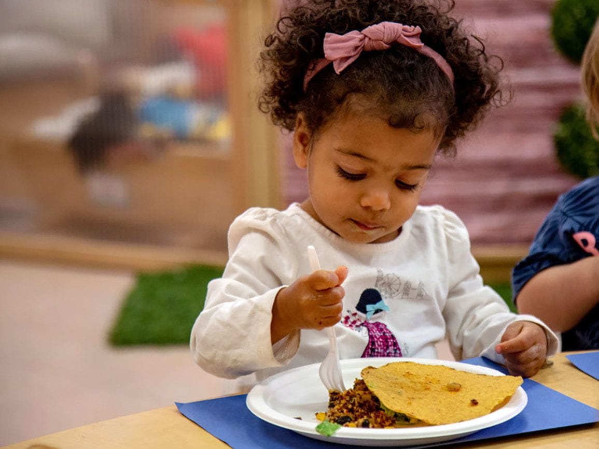
Daily menu should have a good mix of protein (like lentils, beans, or meat), fruits, and vegetables.
No Menu: Ask principal how they ensure the food and snacks are healthy. (request description of the food provided)
Full-day programmes ensure that children
receive at least one meal and
one snack per day.
(The meal or snack can be
provided by the parent or caregiver.)
SILVER & GOLD
At least one meal and
one snack per day.
(The meal or snack can be
provided by the parent or caregiver.)
                You could ask if there is a daily menu. If there is not one, ask the Principal how s/he makes sure that children receive meals and snacks.
                NA

Slide 53
At Silver, you can choose Yes with conditions if the programme keeps child files but is missing some of the information. Advise the supervisor on what is needed to meet the standard and should be implemented immediately
Check to see how the Principal organises and files information on individual children.
A partial care facility or the provider of a partial care service must keep a separate file in respect of each child in which the following information must be filed:
(a) All documents relating to the child received at the time of admission;
(b) any document or correspondence relating to the child;
(c) reports and notes by the provider of a programme within a partial care facility on any developmental delay or disability of the child with particular reference to any possible deviation from the normal development of the child having regard to his or her age;
(d) reports and notes by the provider of a programme within a partial care facility on any irregular behavioural pattern of the child; and
(e) reports and notes on any injury or bruise observed during the daily care of the child, including any observations which may relate to the possible abuse of the child.
SILVER & GOLD
                Yes, with conditions

Slide 54
An applicant for registration of an early childhood development programme must possess the following qualifications, skills and
training:
a) (i) The National Certificate in Early Childhood Development at National Qualification Framework (NQF) Level 1-6 of the South African Qualifications Authority;
(ii) an appropriate early childhood development qualification; or
(iii) a minimum of three years experience of working in the early childhood development field;
(b) appropriate knowledge about early childhood development;
(c) the ability to identify, record and report on the progress and developmental needs of the child to inform early childhood development opportunities and interventions;
At Gold level this must be the applicant - the owner or principal of the ECD programme. You may want to ask the principal to show you copies of the staff qualifications or evidence of ECD training and working experience.
Evidence of working experience could be a work contract or a CV.
GOLD

Slide 55
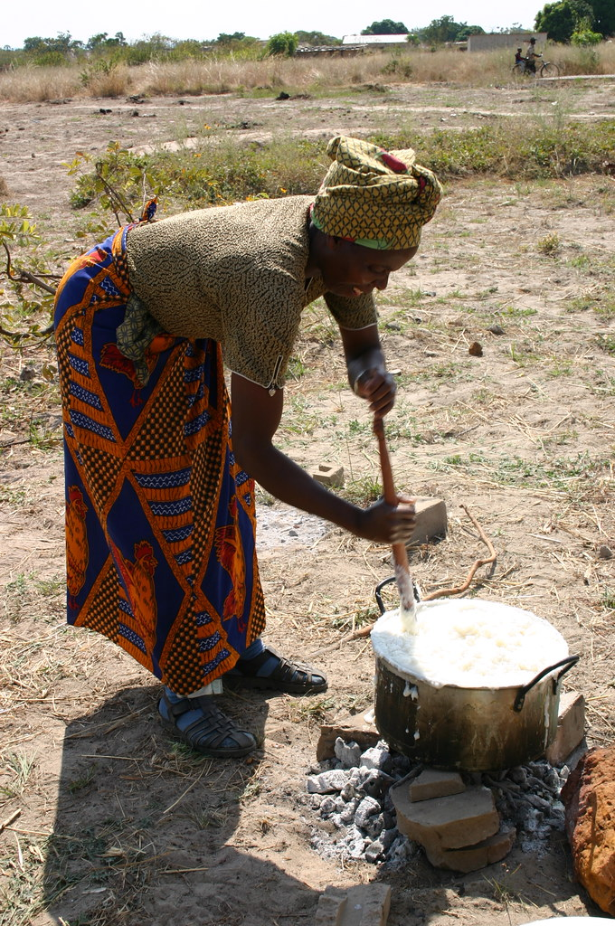
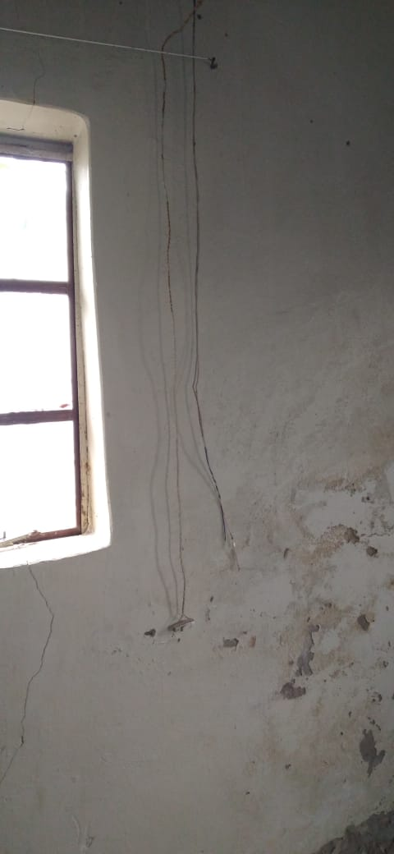
If cooking is done on-site, you check whether there are barriers that prevent children from accessing the cooking area. Also, check if plugs and wall sockets are safely covered.
Children are protected from open fires, the cooking area, and any hot surfaces. Electrical plugs are always covered, and children cannot reach or touch electrical wires or fittings.
SILVER & GOLD
Children are protected from open fires, the cooking area, and any hot surfaces. Electrical plugs are always covered, and children cannot reach or touch electrical wires or fittings. There are no exposed electrical wires.
                Minimum Standard

Slide 56
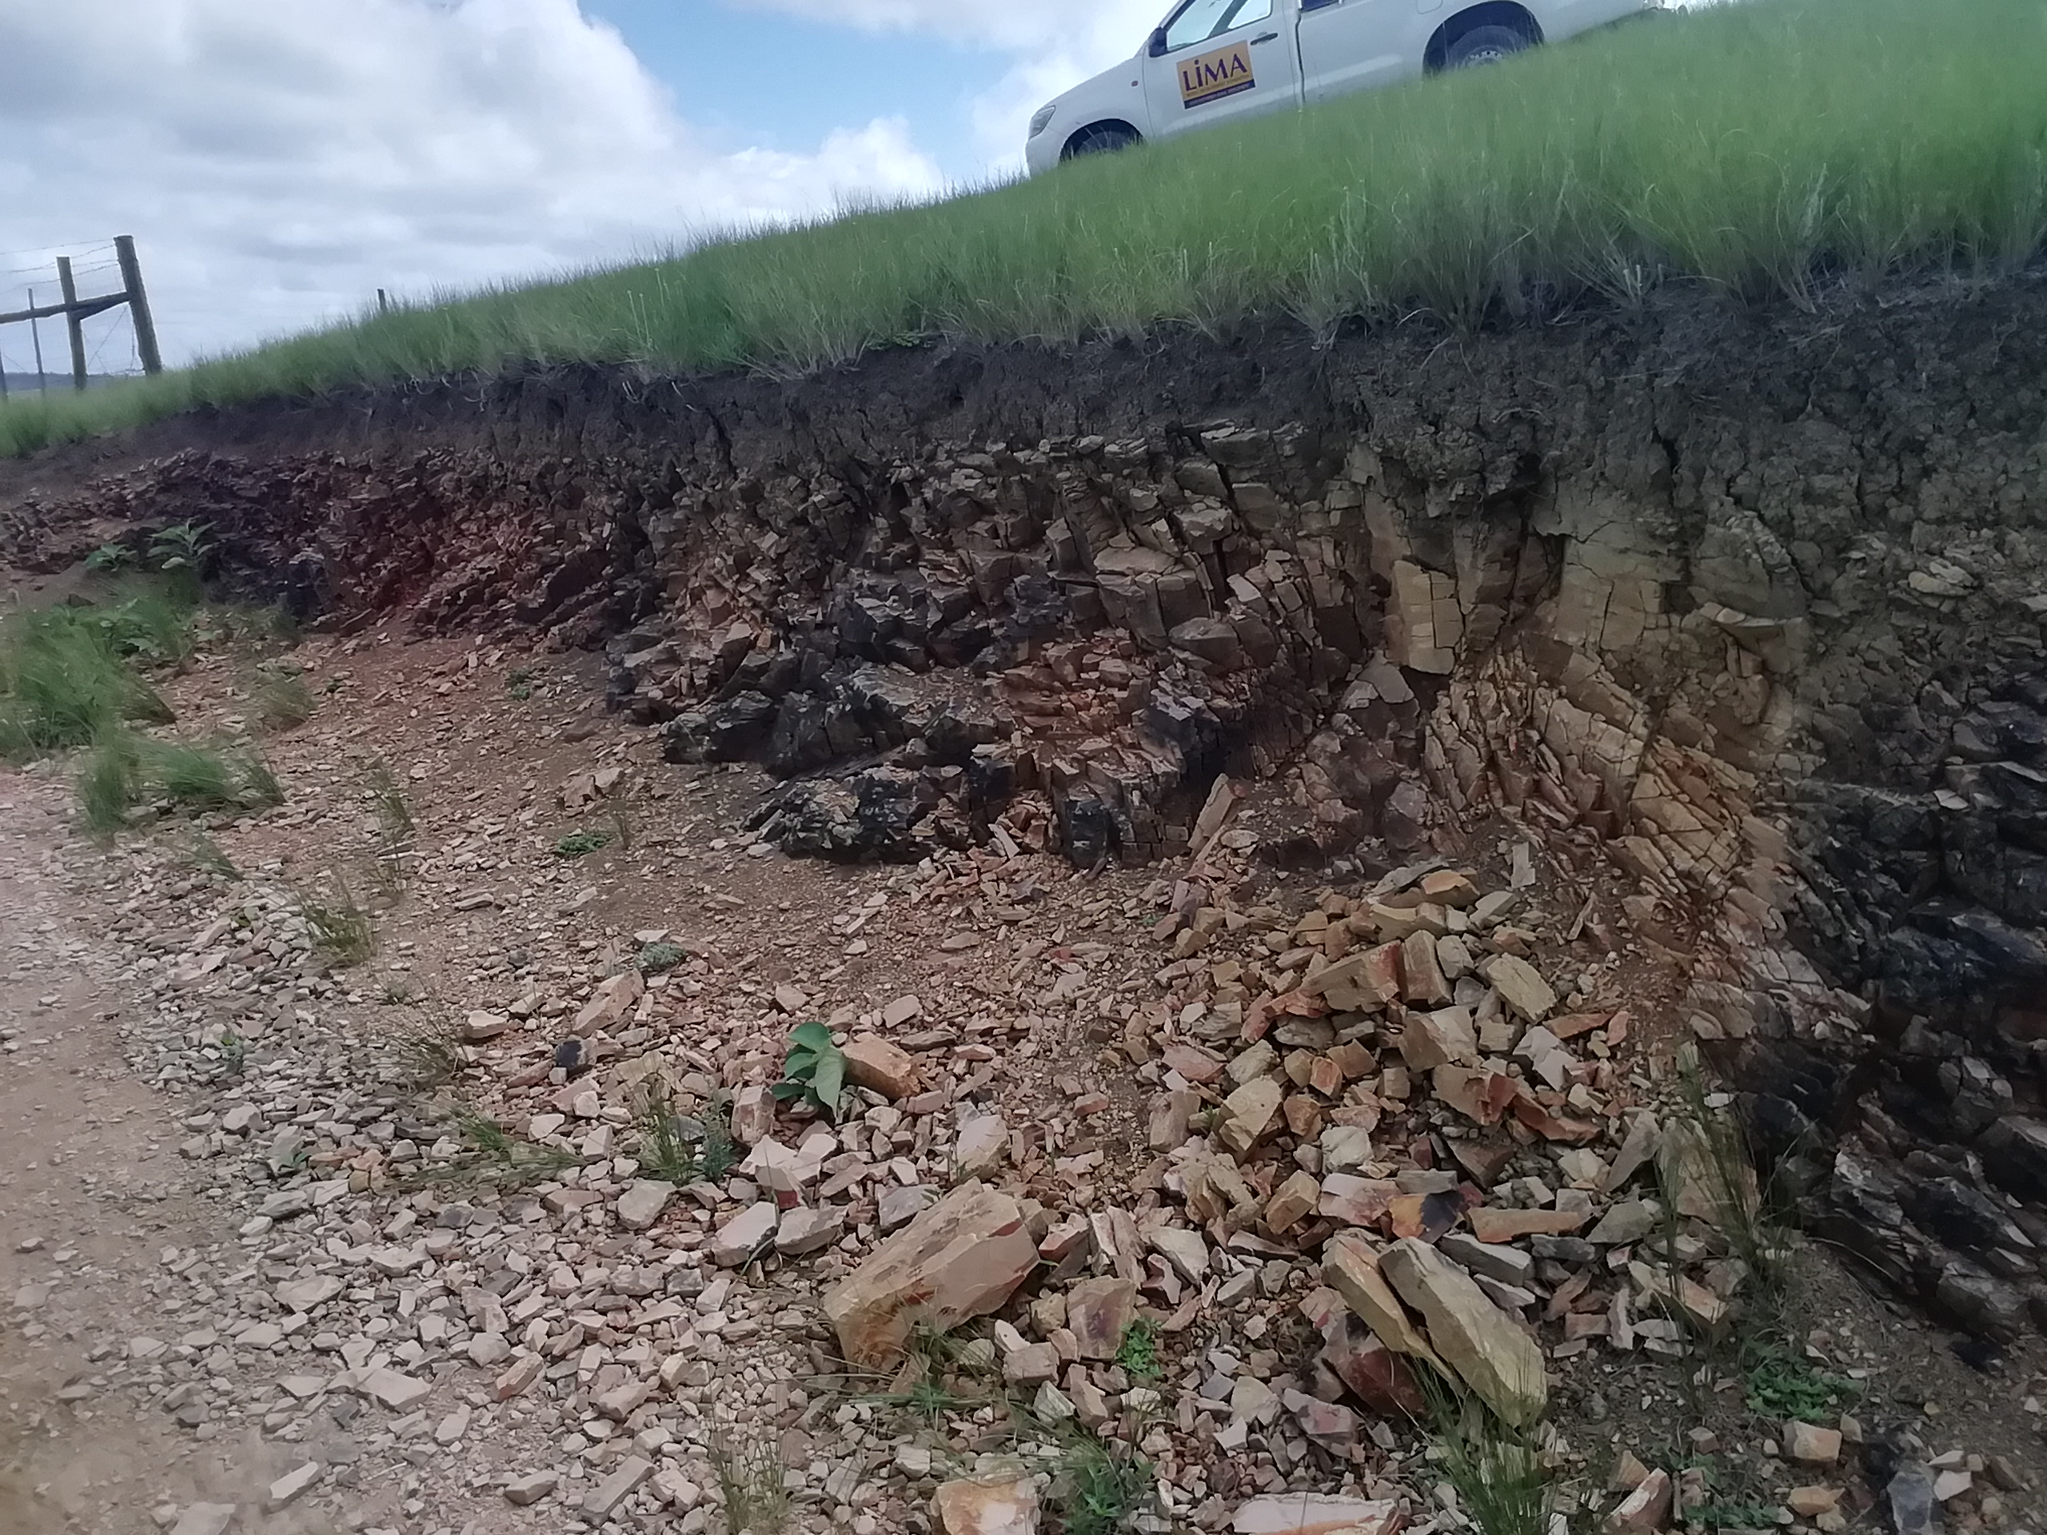
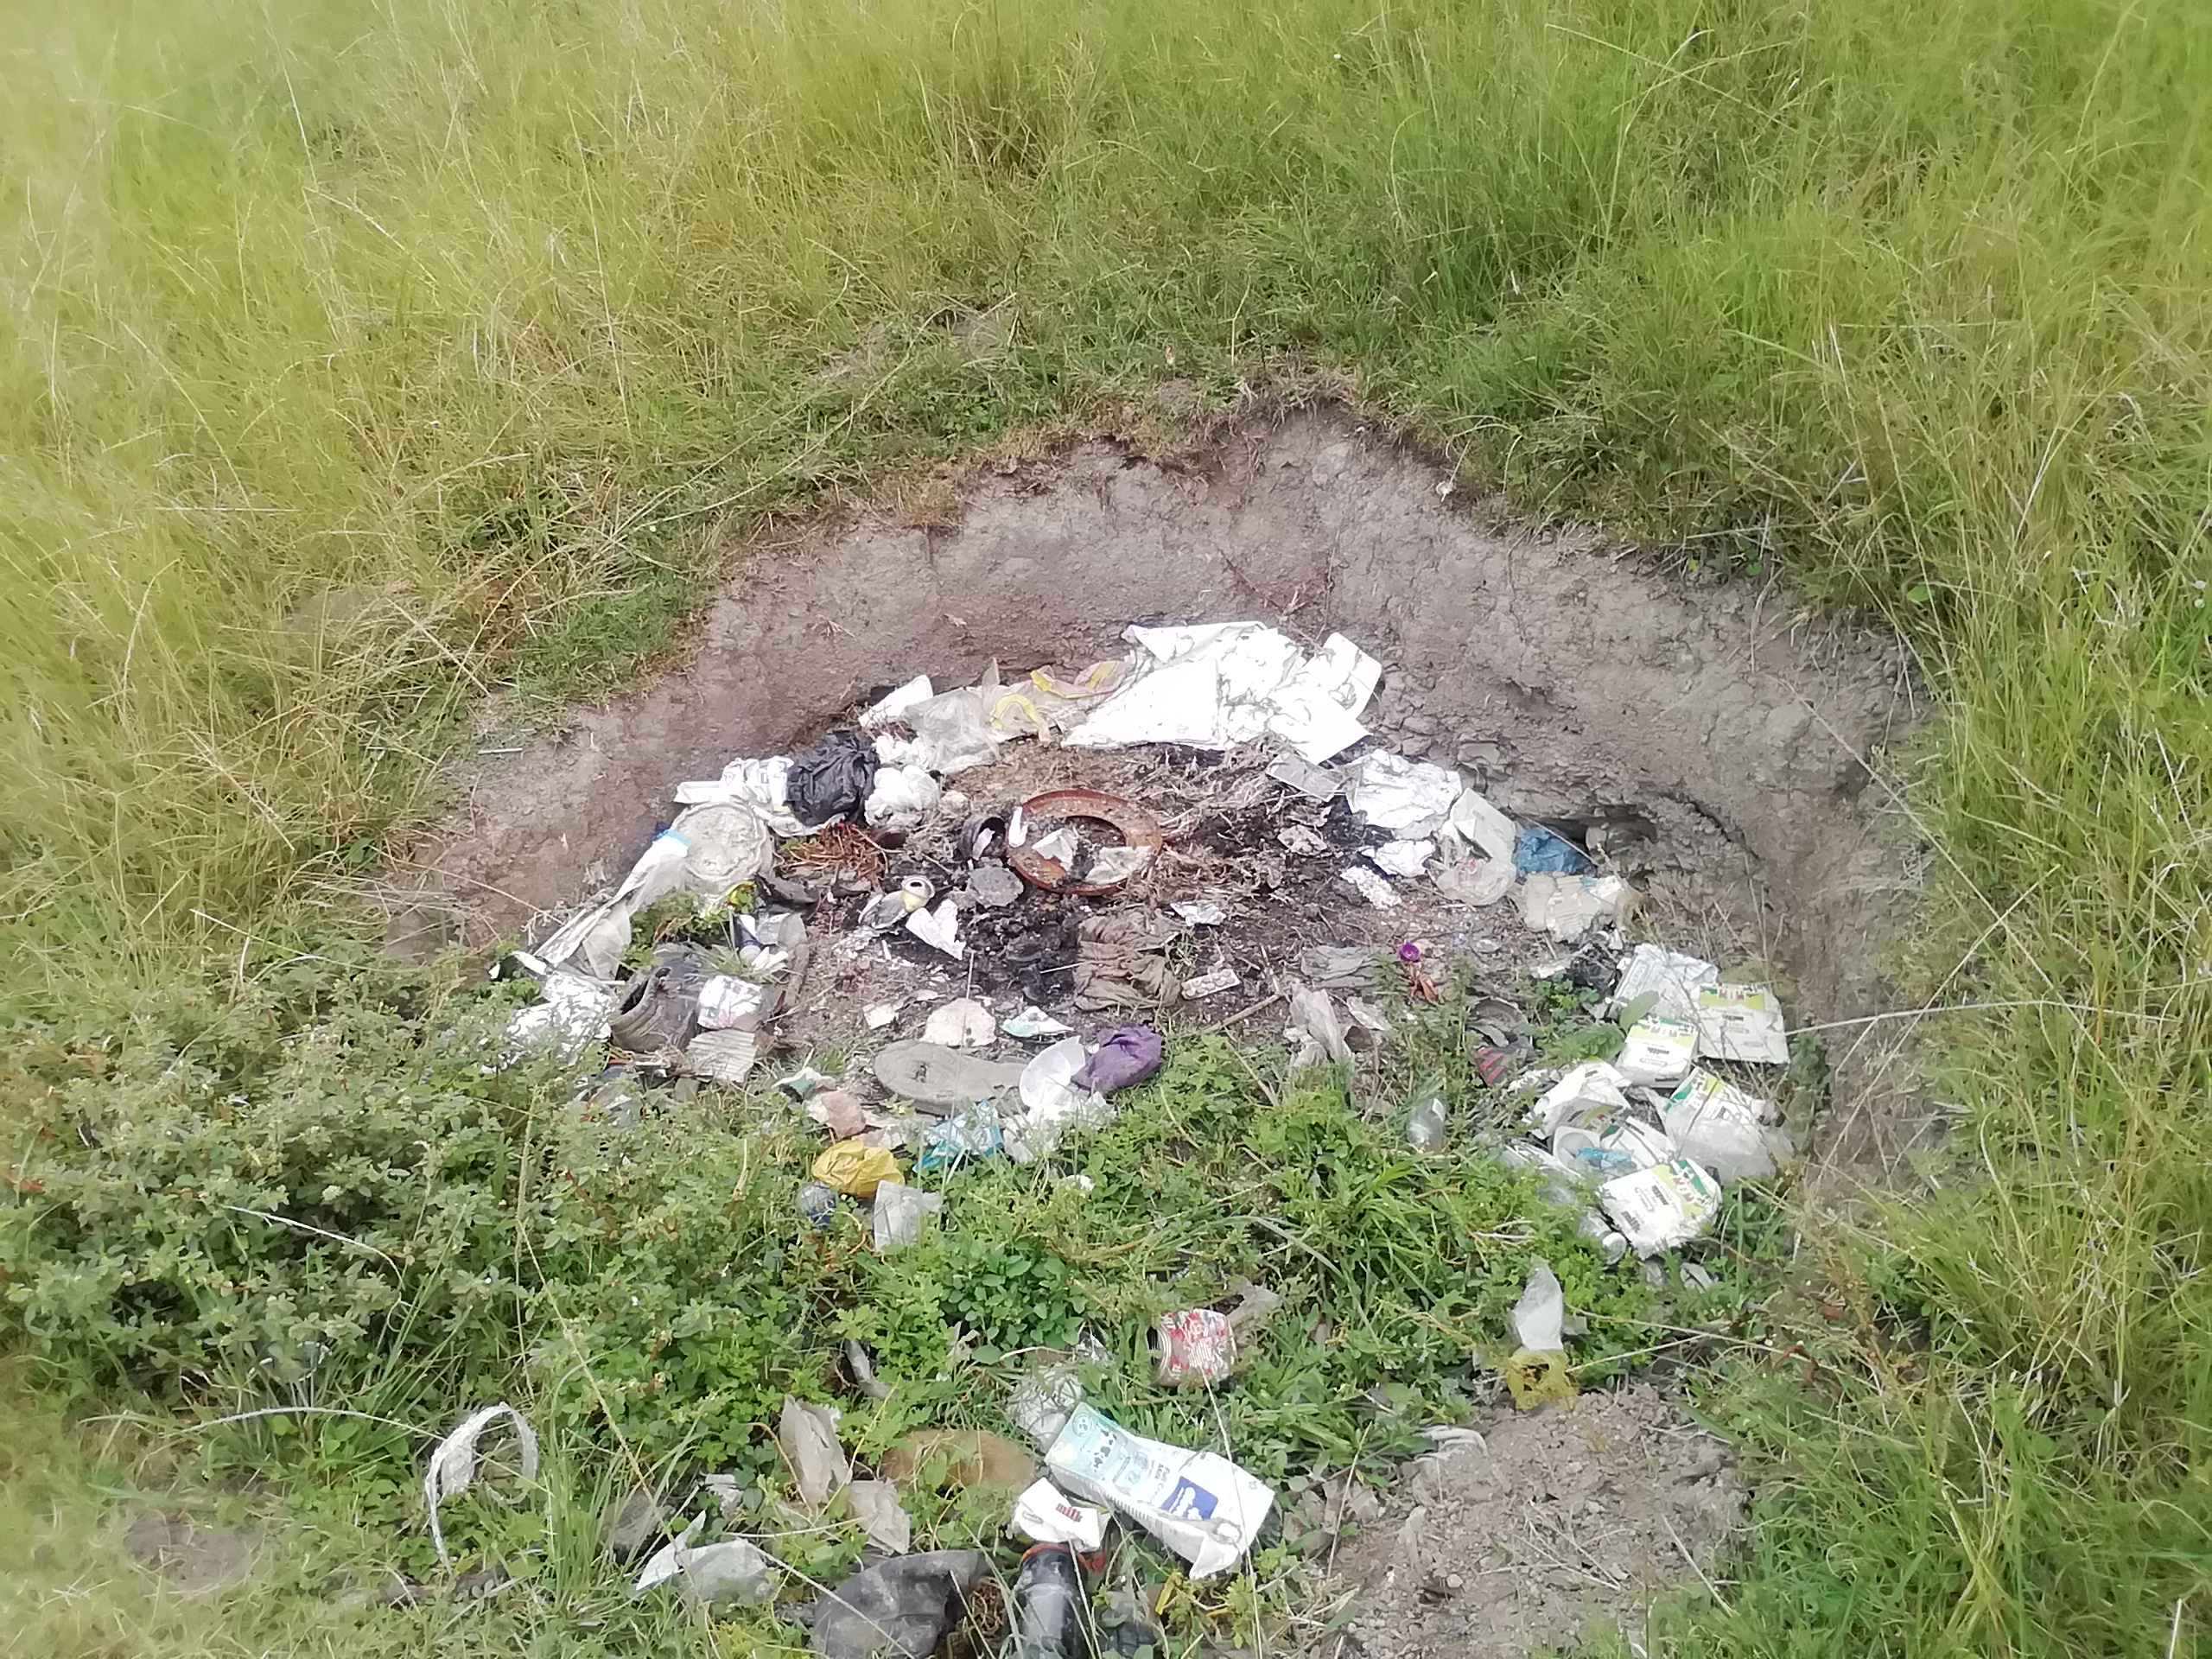
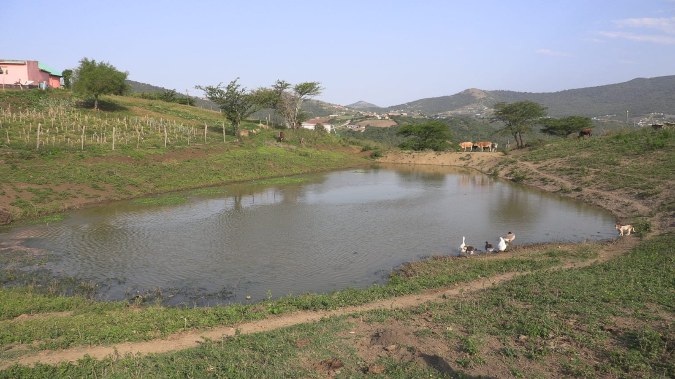
Programmes must protect children from these risks and other measures to limit access to dangerous areas. Examples of protective barriers are fences, and handrails
Children are protected from heights, stairs, deep excavations and open water that could pose a danger to them.
SILVER & GOLD
                Minimum Standard

Slide 57


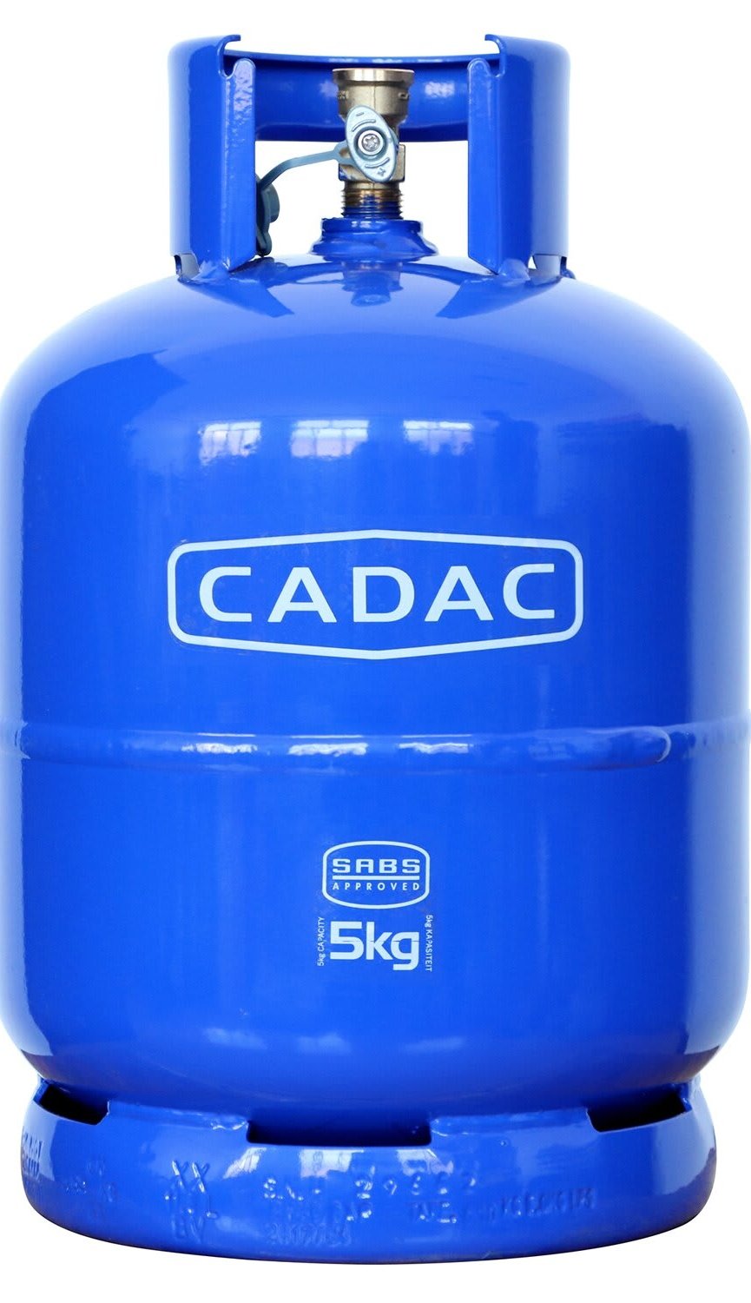
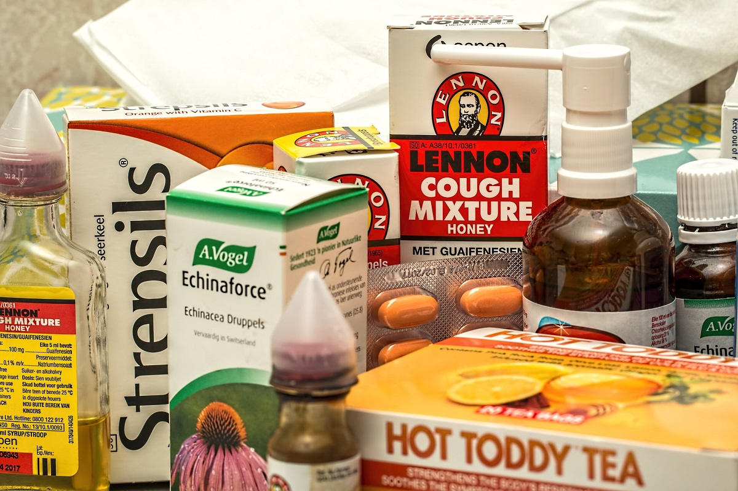
Dangerous objects (e.g. knives, matches), harmful substances (e.g. paraffin, cleaning agents) and medicines, cannot be reached by children.
At Silver, the requirement is for dangerous items to be out of reach. You may want to advise the principal to work towards meeting the Gold standard of having them in separate locked or child-proof cupboards
SILVER & GOLD
                Minimum Standard
Dangerous objects (e.g. knives, matches), harmful substances (e.g. paraffin, cleaning agents) and medicines, are kept in separate locked or child-proof cupboards

Slide 58

If the ECD programme arranges transport for children:
(a) vehicles are safe and not overloaded;
(b) transport providers comply with safety measures, including adherence to speed limits, and ensuring all passengers are seated;
(c) children are not transported in open vehicles, or in the front seat or boot.
Remember this standard only applies if the ECD programme provides transport for children.
If they do, you might want to ask the principal if children are allowed to sit in the front seat or in the back of the vehicle. Also, check if the vehicle always uses child locks on the doors.
You can suggest that the ECD programme look at the Transport Policy on the DBE website. They can print it out and use it.
SILVER
                NA

Slide 59
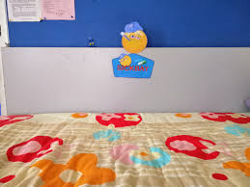
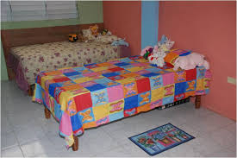
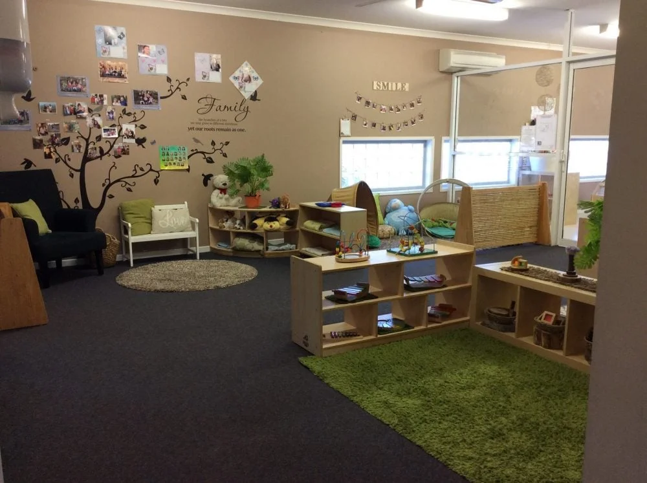
A “designated space or room” means a specific area where sick children can be looked after.
This could be a separate room or just a quiet area away from where the other children are playing.
Examples include a spot in the principal's office or a corner in the playroom with minimal distractions where the sick child can rest.
If you can’t find this space, ask the practitioner to show you where they care for sick children.
There must be a designated space or room to care for ill children
SILVER
                Yes, with conditions

Slide 60
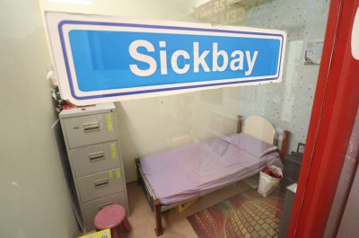
You may want to check that there are solid floor surfaces in the facility (without hazardous holes or sharp areas that could harm a child). Floor surfaces in the facility can be cleaned or washed.
ECD programmes with more than 50 children, there is a separate room or “sick bay” (dedicated room) to care for ill children
GOLD
If less than 50 children, the ECD programme should meet the silver standard – a designated space or room to care for sick children

Slide 61
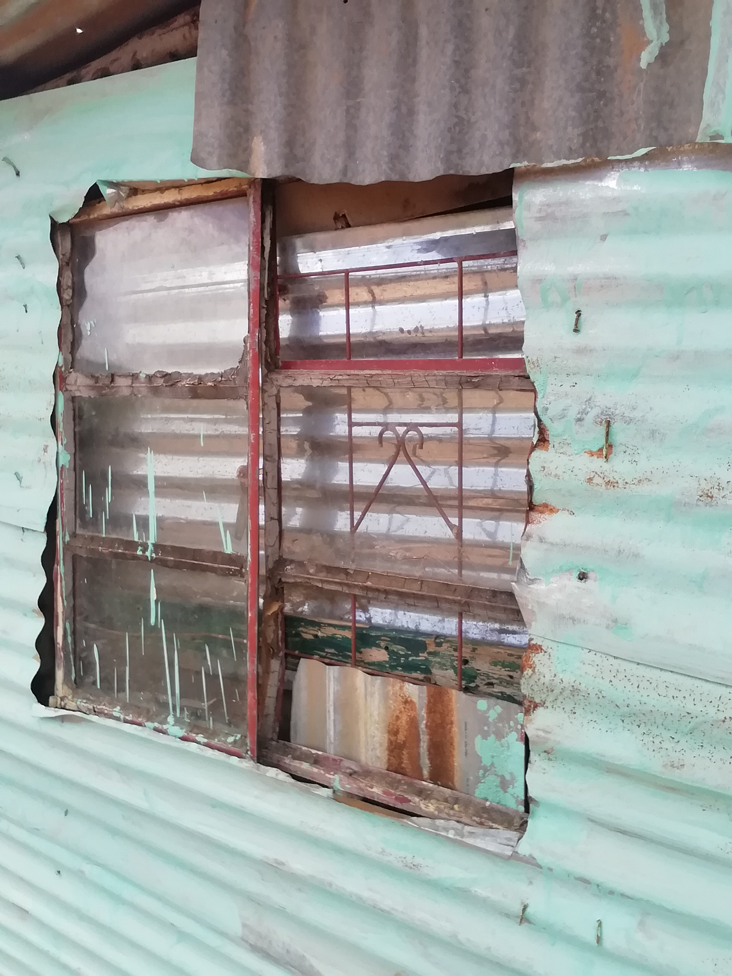
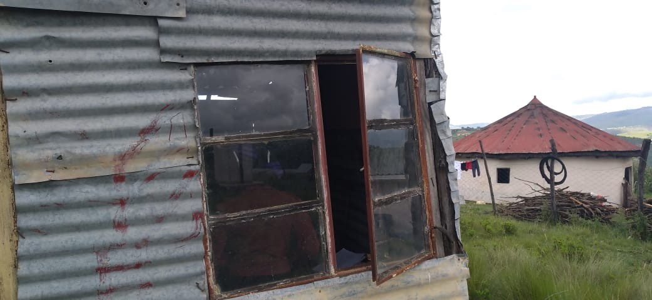
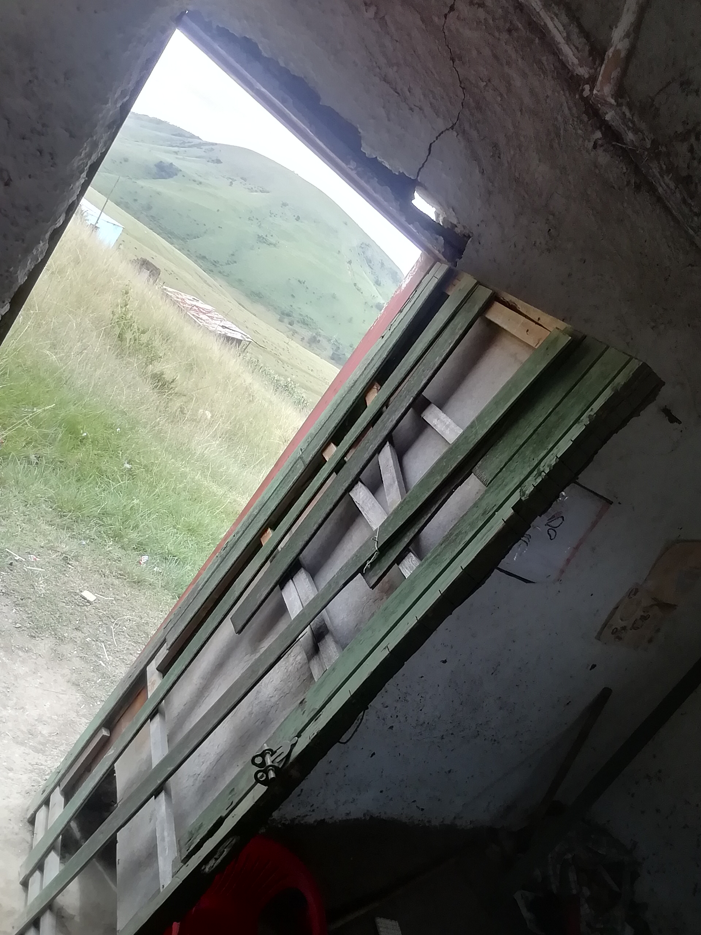
Check to see if doors and windows open and close. There should be enough light coming through for children to play and see inside the room.
There are doors and windows that can be opened and closed to provide ventilation (fresh air). Staff and children can see to read and play inside.
SILVER & GOLD

Slide 62

                This standard is not assessed at the time of assessment. This standard is used when a social worker would like to determine the capacity of an ECD programmes when an EHP has not provided this information. Capacity is also provided by the province at their discretion.
There is sufficient indoor space for children to play freely (at least 1.5 square metre of unobstructed floor space per child, not including passageways, bathrooms or storage areas).
                Minimum Standard
SILVER & GOLD
Playroom
Width
Length X Width = total Area
Total area/total number of children enrolled in that class
Length

Slide 63
Check if different activities (e.g. cooking and play) are taking place in the appropriate spaces. E.g. children should not be playing in the food preparation area, and practitioners should not be preparing food in the middle of the playroom.
Areas for different functions (cooking, play, storage) are appropriately demarcated.
GOLD

Slide 64
There is a clean and safe area for serving food to the children.
Meals or snacks could be eaten seated at clean tables or outside seated on the ground provided that the area is clear from litter, animal dung and other debris.
SILVER & GOLD
                NA
There is a separate clean and safe area for serving food to the children.

Slide 65
You could check if there is enough clean water for the ECD programme - remember that 25 litres is only required if there is no running water. If the water does not come from a tap, you can ask the Principal how they make sure it's safe to drink. One way to clean water is by adding one teaspoon of bleach to 25 litres of water.
Safe and clean drinking water is always available, and there is sufficient safe water for all other needs (e.g. handwashing, cleaning and cooking).Where no running water is available, there must be a minimum of 25 litres of drinkable water supplied on a daily basis.
SILVER & GOLD
                Minimum Standard

Slide 66
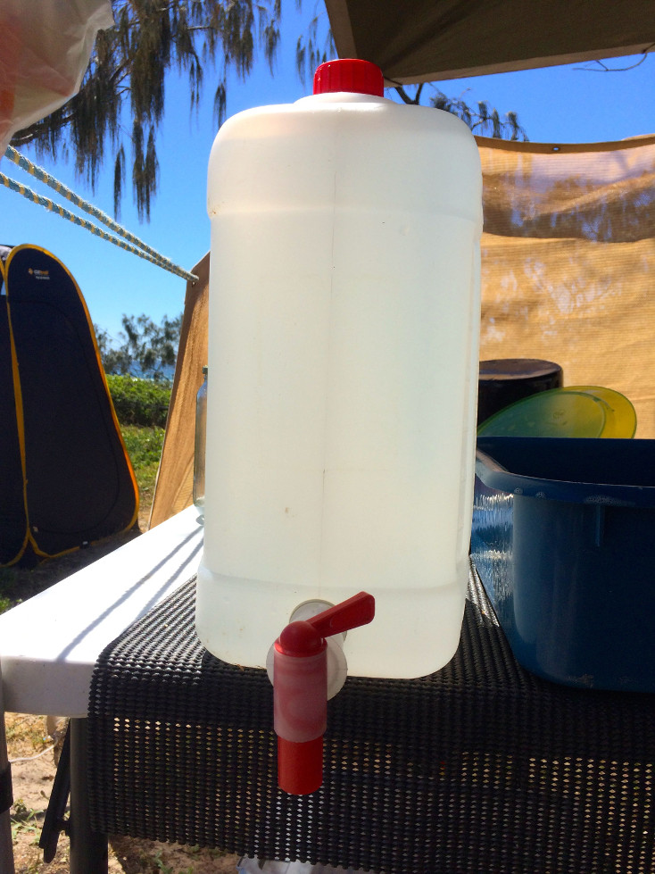
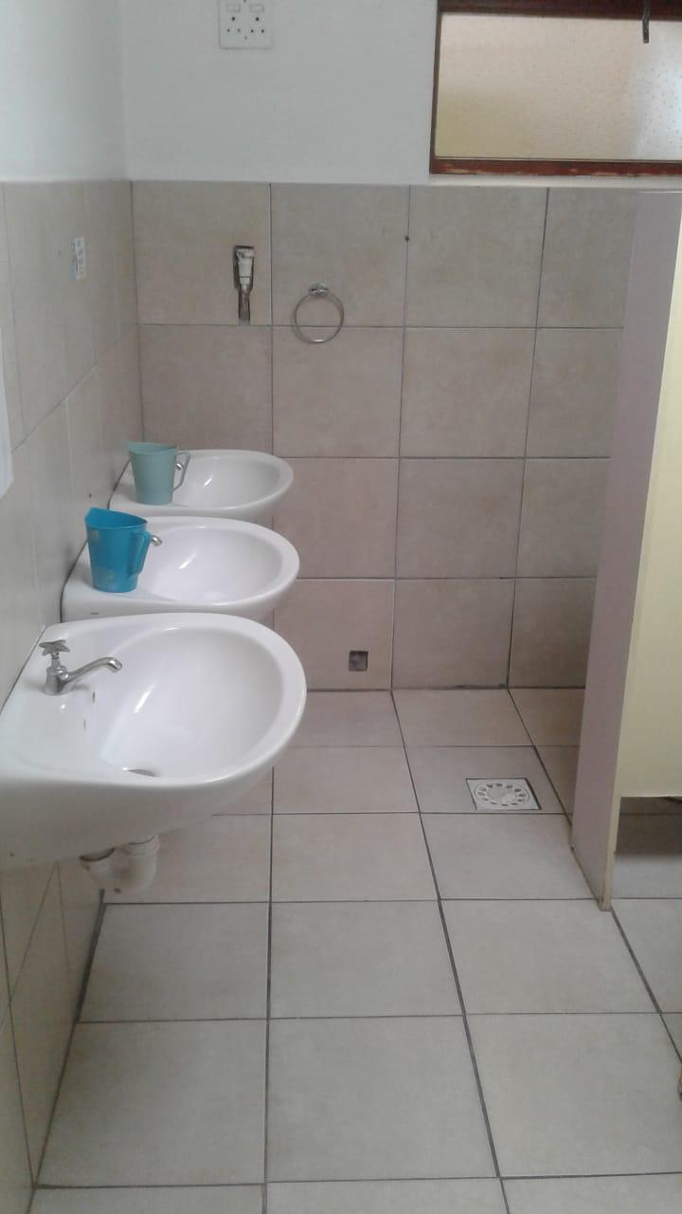
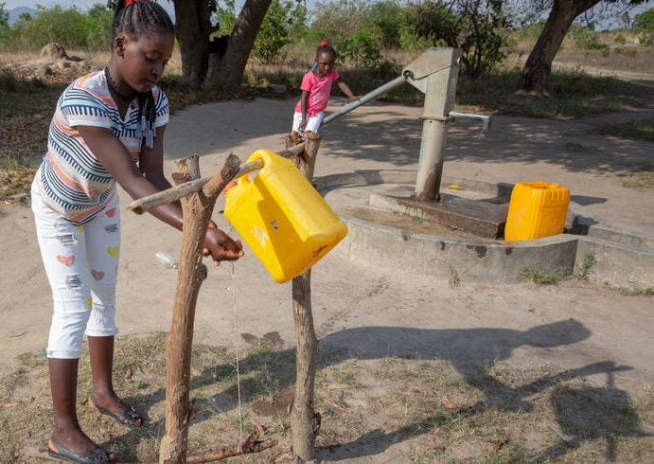
There is one washbasin or other suitable container for hand-washing for every 30 children, provided that such container is cleaned and the water changed regularly
Remember a hand washing facility can also be a tippy tap.
SILVER & GOLD
                Minimum Standard
There is one washbasin or other suitable container for hand-washing for every 20 children, provided that such container is cleaned and the water changed regularly

Slide 67
For children up to the age of three years there is-
(i). one toilet for every 30 children OR
(ii). one potty for every 5 children.
These standards only applied where there are children under 3 years of age. If not you can mark the standard as N/A. For this age group potties can be used instead of toilets.
At Gold level there are more potties or toilets required. Advise the supervisor to work towards this standard.
Where there is no sewerage, ventilated improved pit latrine or portable toilets can also be considered
SILVER & GOLD
                NA
For children up to the age of three years there is
(i) one toilet for every 20 children OR;
(ii) one potty for every child.

Slide 68
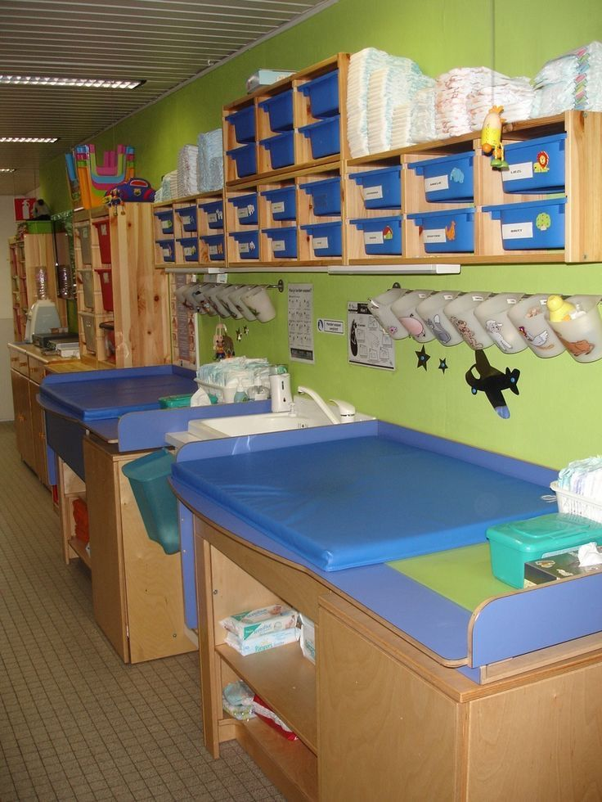
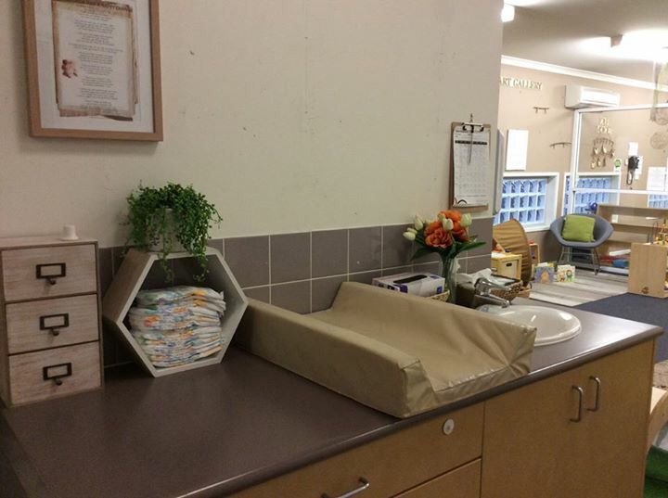
There is a safe and clean nappy changing area with a surface that can be easily cleaned, which is situated away from the food preparation area.
There is a safe and clean nappy changing area with a surface that can be easily cleaned, which is situated away from the food preparation area.
SILVER & GOLD
                NA

Slide 69
A hand washing facility can also be a tippy tap. All children must be able to reach the handwashing facility. This could mean there are steps to reach washbasins or the containers or washbasins are low enough for children.
Containers or washbasins for handwashing are reachable for children.
SILVER & GOLD
Where there are no toilets (i.e. only children under 3 years who use potties) this standard can be marked as N/A. If there are toilets they must be within the same building as the ECD or very close. Children should not have to walk to communal toilets shared with adults who are not staff at the ECD programme.
                Minimum standard
Where there are toilets, these are at the facility or immediately adjacent to the partial care facility;

Slide 70
All toilets should have a reduced pot size and height or have a seat converter with a step to ensure that it is safe for children to use.
This question can be marked as N/A if there are no children 3 years and over and only potties are used.
Toilets have reduced pot size and height, or there is a seat converter and step;
SILVER & GOLD
                Minimum standard

Slide 71
Where possible, children are separated into the following age categories in separate rooms or spaces:
Children under the age of 18 months;
children between the ages of 18 and 36 months;
children between the ages of three and four years; and
children between the ages of four and six years.
"Where possible" means when there is enough space for different groups or classes. If you can’t see this for yourself, you could ask the principal the ages of the children in each class, or check the daily attendance register.
SILVER & GOLD

Slide 72
Where a partial care facility provides after care facilities to children of school going age, these children must be kept separate from the the children in the abovementioned age groups in order to ensure that they are able to rest and complete their homework upon their return from school.
This standard only applies where the ECD programme also provides after-care services for children from Grade 1-12. If there is aftercare for school-age children they should be cared for in a separate space
SILVER & GOLD

Slide 73
Written policies include dealing with structural and environmental emergencies and disasters.
The ECD programme should have a policy for emergencies such as fires and bomb threats and natural disasters such as flooding. A template is available to all ECD programmes.
GOLD

Slide 74

At Silver, you may want to check that the Health and Hygiene Policy or another written document includes a plan for training staff in First Aid (or there is someone already trained). Sometimes, ECD programmes keep their written policies in a file or display them on the wall. A template for a Health and Hygiene Policy is included in the document pack available to all ECD programmes.
At Gold, you can ask for proof of training, like a certificate. It is a good idea to check that it is valid and has not expired.
Policies must provide for training of staff in first aid
SILVER & GOLD
At least one staff member is trained in first aid.

Slide 75
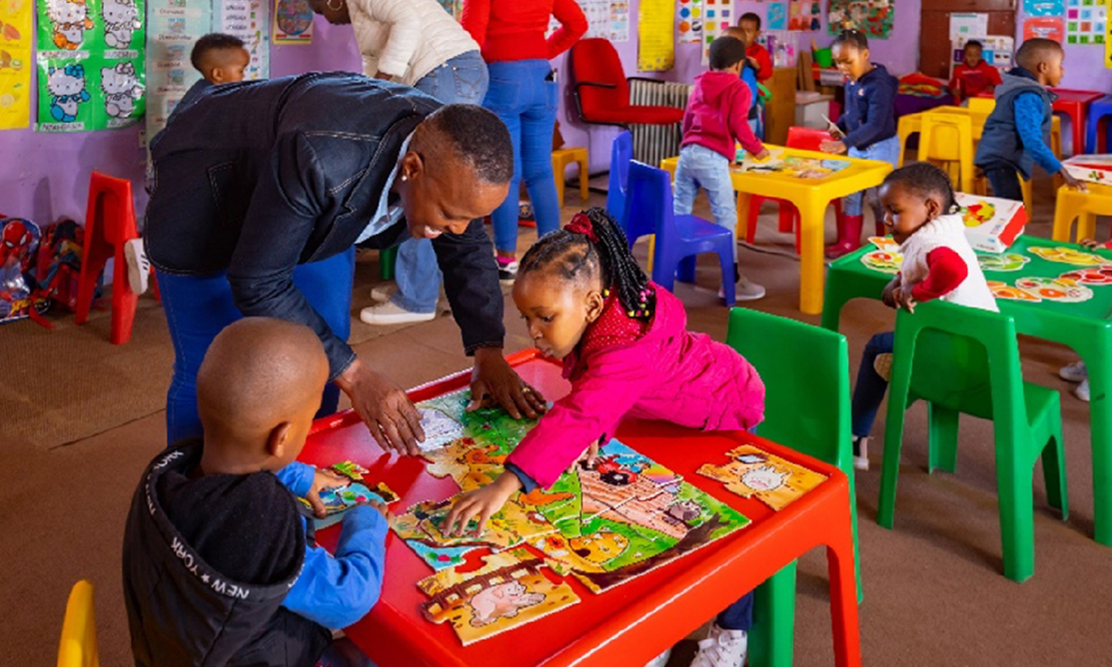
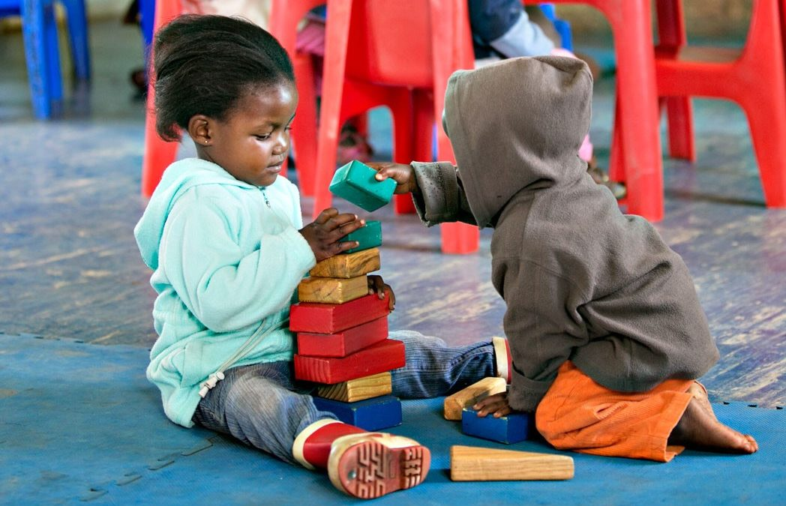
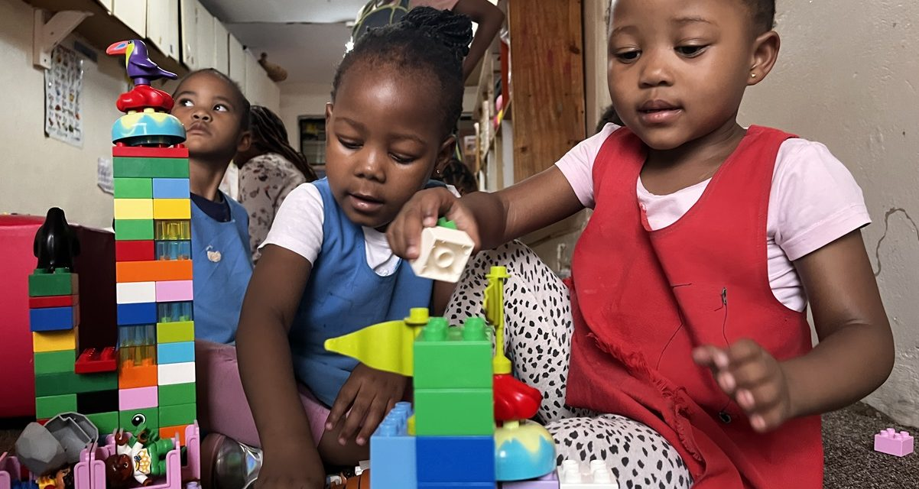
Programmes are appropriate to the developmental needs and stages of the children attending (there are toys and activities appropriate for children of different ages).
                It may help to check if the activities and toys the practitioner is using are appropriate for the children's age and abilities.
                For example, you might see rattles and soft toys for babies under 1 year. For children aged 1-3 years, you could see stacking toys, shape sorters, or large-piece puzzles. For children aged 3-6 years, building blocks, pretend play sets, and more challenging puzzles might be used. Also, watch for shorter group times with younger children, since they can't focus for long.
                Children with disabilities also need to be considered where they are enrolled, with appropriate activities and toys so that they are able to participate.
SILVER & GOLD

Slide 76
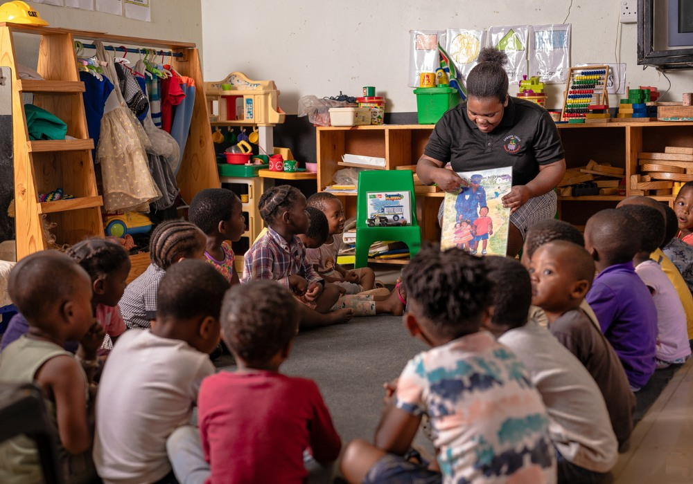
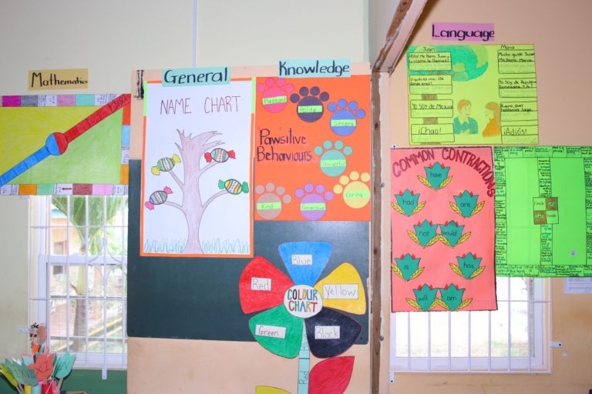
Story time, book-sharing, sharing ideas at circle time, singing, reading children books
Other ways include: extending conversations with and between the children, listening activities
Check to see if there is a lot of print material that is visible (e.g. books, magazines, posters, pamphlets or other materials).
Helpful questions to ask yourself: Is the practitioner interacting with the children? Are the children interacting with each other? Does the practitioner encourage interaction?
Programmes support children to develop language and communication skills, through plenty of talk and interaction between practitioner and children and amongst children
SILVER & GOLD

Slide 77
You can count the children in each class or check the attendance register to see how many children are in each group or ask the pracitioners. If you have an EHP report, you can also check how many children are recommended per class. Where there is a single class or group of children there must be another adult that can provide support if there is an emergency or if the practitioner has to step away.
The staff-to-child ratio must:
For children between 0-18 months – 1:6
(b) For children between 18 months and 4 years – 1:20
(c) for children between the ages five and six years, 1:30; and
(d) there must be at least one assistant (or other staff member) who can support practitioners when needed.
SILVER

Slide 78
The staff-to-child ratio must:
for children between the ages one month and 18 months be, 1:6;
(b) for children between the ages 18 months and three years be 1:12;
(c) for children between the ages three and four years be 1:20; and
(d) for children between the ages five and six years, 1:30; and
(e) for every staff member stipulated above, there must be an assistant.
Count the children in each class/ check the attendance register to see how many children are in each age group
If you have an EHP report, you can also check how many children are recommended per class.
GOLD

Slide 79
UNCHANGED STANDARDS

Slide 80
Daily Programme includes:
free play
Free play is when children have the freedom to play in whatever way they want (indoors and out). They can explore and engage freely with materials, interest areas and various activities.
At least one session of free play in the daily programme. If you do not see it on the Daily Programme, ask the practitioner or principal about each of the elements of the day.
SILVER & GOLD
Varied activities, such as play, arts,
singing and story-sharing.
If a variety of activities are not listed on the Daily Programme, ask the principal about the types of activities when you arrive at the ECD programme.
                Sleep/nap time should be included for full day programmes.
                Programmes that close earlier may not include rest in their programme and children may rest at home, you may want to select NA in this instance. If you don’t see this on the daily programme, ask the practitioner or principal.
                YES, WITH CONDITIONS
Rest time.

Slide 81
You may want to check that the Health and Hygiene Policy or another written document includes these practices. Sometimes, ECD programmes keep their written policies in a file or display them on the wall. A template for a Health and Hygiene Policy is included in the document pack available to all ECD programmes
Written policies include:
Procedures for identifying and dealing with the medical needs of children who Become ill and of children
with chronic illnesses.
SILVER & GOLD
Practices aimed at preventing the spread of
infectious diseases (such as handwashing and ensuring bed linen/blankets and
towels are washed regularly).
Cleaning routines and standards
                YES, WITH CONDITIONS
Confidentiality of health-related information
                Some ECD programmes cover confidentiality in their HIV policy.

Slide 82
There are records of:
This information could be included as a section in the child admission form and doesn’t need a separate document. You might also find these records in the child's file. Vitamin A schedules may not always be available and shared by parents.
Children's medical conditions, allergies, immunisation programme and Vitamin A schedule.
SILVER & GOLD
Health incidents
and accidents that occur at the ECD programme.
A template for an Accident and Incident Register is provided in the Document Pack available to all ECD programmes.
                YES, WITH CONDITIONS

Slide 83
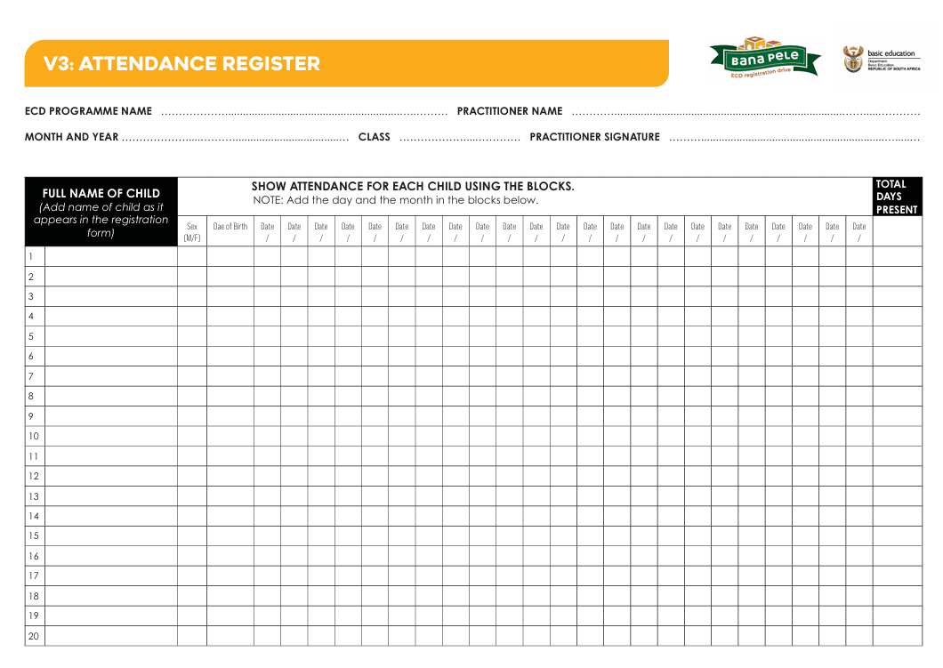



Slide 84
                An emergency plan must be displayed where it can be seen by everyone.
                A template for an emergency plan is included in the document pack available to all ECD programmes.
There is an emergency plan displayed,
with evacuation procedures and a
list of emergency numbers.
SILVER & GOLD
                Minimum Standard

Slide 85
Any register or file kept in terms of this regulation
must be kept for a period of at least
three years after the date of
termination of the partial care service
in respect of a child at a partial care facility.
                This requirement is only assessed at Gold. You may want to advise the principal to work towards meeting the Gold standard.
                Not all Principals will be aware of this requirement so you may want to check that they know what to do in the future.
GOLD

Slide 86
                If you are not able to observe, you can ask the practitioner about the language they use to teach in class. Where children do not understand that language; interpretation should be provided wherever possible
Educators utilize one medium of instruction in class.
SILVER & GOLD
                You could ask the principal if any children speak a different language from the one used for teaching.
                If they do, it's helpful to ask if they are allowed or encouraged to speak their mother tongue at school.
Children are allowed to communicate in the language of their choice and preference.

Slide 87
                You could ask if there is a daily menu. If there is not one, ask the Principal how s/he makes sure that children receive meals and snacks.
At least one meal and
one snack per day.
(The meal or snack can be
provided by the parent or caregiver.)
SILVER & GOLD
                NA

Slide 88
Observe whether children freely approach the practitioner and whether they feel comfortable in the class. Do they comfortably carrying out activities or engage with other children? Check for a Discipline Policy to see if there is policies about harsh discipline.
Children appear to be comfortable and
content and there is no harsh discipline (such as smacking).
                Minimum Standard
SILVER & GOLD
                Observe whether children are ever left alone at the ECD programme. You can also ask the practitioner how they ensure that children are always supervised, even with limited staff members, especially when the children go to the toilet.
There is adult supervision at all time
                Minimum Standard
                Check for sharp edges on furniture and indoor and outdoor equipment, nails sticking out, or torn mattresses with springs sticking out that is within in reach of children.
There is no broken or dangerously unstable furniture or equipment which may harm children.
                Minimum Standard

Slide 89
Safe toilets may be a flush toilet, portable toilet or a ventilated improved pit latrine. Safe toilets have a concrete foundation which ensures that the toilet will not collapse. Toilets should also be kept clean and free from offensive smells.
All toilets must be safe and hygienic.
SILVER & GOLD
                Minimum standard

Slide 90
Where programmes use containers to store water, these containers should be kept covered.
Indicate NA if this does not apply.
Water containers are covered at all times
SILVER & GOLD
                NA

Slide 91
The supervisor or any practitioner in the ECD programme must possess the following qualifications, skills and training:
a) (i) The National Certificate in Early Childhood Development at National Qualification Framework (NQF) Level 1-6 of the South African Qualifications Authority;
or
(iii) a minimum of three years experience of working in the early childhood development field
                At Silver level this standard can be met by any one of the practitioners. You may want to ask the principal to show you copies of the staff qualifications or evidence of working experience.
SILVER

Slide 92



You may want to ask the principal how they communicate with parents and caregivers, what kind of information they communicate about and how regularly.
Programmes communicate regularly with parents and caregivers, and alert them to any concerns regarding the development and wellbeing of their child.
SILVER & GOLD

Slide 93






The programme provides opportunities for children to handle small objects and use utensils, and to practise larger co-ordinated movements.
Small muscles or fine motor skills: drawing, painting, threading, cutting, tweezing, tearing etc.
Large coordinated movements: running and playing outside. Check for outdoor play on the daily programme.
For outdoor area, ask the practitioner whether some kind of adjustment is made to use their large muscles indoors such as standing in building
SILVER & GOLD

Slide 94


There is fire control equipment – at minimum a bucket of sand
If there is a bucket of sand, it should be a designated bucket of sand.
SILVER & GOLD
                Minimum Standard
There is approved fire control equipment which is serviced and up to date (fire extinguisher)
At gold you may want to ask for evidence that the fire extinguisher is up to date.

Slide 95

There is a basic first aid kit which includes adhesive bandages, scissors and soap.
Remember that the first aid kit could be a container with the relevant items inside.
SILVER & GOLD
                Minimum Standard
Basic first aid kit – Sterile gauze, medical tape, liquid soap, instruction soap and disposable gloves
Ensure that all relevant items are in the kits

Slide 96
Staff and children are aware of procedures to follow in the case of an emergency.
Ask the Principal how they make sure that staff and children are aware of emergency procedures.
GOLD

Slide 97
If the programme does not prepare food, the not applicable option can be chosen.
There is a separate, clean and safe area for preparing food and for cleaning afterwards.
SILVER & GOLD
                NA
If your ECD programme has children who are bottle-fed and need to re-use bottles during the day this standard applies. If not, this standard does not apply. Suitable sterilising methods can be boiling, using a steam sterilizer or cold water with a sterilizing agent such as bleach or Milton.
Where children are bottle-fed, a suitable facility must exist for cleaning the bottles

Slide 98





This standard does not require a formal brick building.
Is the building stable? Check if the walls are not leaning, are the walls cracking and crumbling?
Is the roof securely attached?
Are there are any visible holes that could lead to leaks which could make children wet
Check if the windows are intact and not broken.
The structure provides protection from rain, wind, and sun, and appears to be stable and not at risk of collapse.
SILVER & GOLD
                Minimum Standard

Slide 99

                Some examples of flooring that can be cleaned are floors covered with tiles, wood, treated concrete, vinyl or plastic.
                You may want to check that there are solid floor surfaces in the facility (without hazardous holes or sharp areas that could harm a child). Floor surfaces in the facility can be cleaned or washed.
Floors surfaces are safe and clean
SILVER & GOLD
                NA
You may want to check that there are solid floor surfaces in the facility (without hazardous holes or sharp areas that could harm a child). Floor surfaces in the facility can be cleaned or washed.
Water cannot seep through the floors

Slide 100
For children aged three years or older-there is one toilet for every 30 children
Where there are no children three years and older this standard can be marked as N/A.
You may want to advise the principal to work towards meeting the Gold standard if there are children aged 3 years or over.
Where there is no sewerage, ventilated improved pit latrine or portable toilets can also be considered.
SILVER & GOLD
For children aged three years and older—i)there is one toilet for every 20 children;

Slide 101


If potties are not used this standard does not apply.
You could ask the practitioner how potty waste is disposed of. Solid waste should be disposed of in the toilet. Toilets could be ventilated pit latrines, trench latrines, toilets or soakaway pits.
Waste from potties is disposed of hygienically.
SILVER & GOLD
                Minimum Standard
                NA
If potties are not used this standard does not apply.
One way of disinfecting the potties is using water and cleaning detergent.
Potties are cleaned after use and disinfected in a properly demarcated area.

Slide 102
If the ECD programme prepares meals for children and stores them, or needs to store prepared bottles it needs cooling facilities. This standard is not applicable if caregivers send food with children or the ECD buys and prepares perishable food on the day so that it is never left to spoil. A cooling facility could be a fridge or another cooling device.
There are cooling facilities for perishable foods and prepared bottles
SILVER & GOLD

Slide 103


The premises inside and outside are safe, clean and well-maintained (outdoor areas must be free from litter and animal faeces).
You may want to check whether there is any litter or unsafe items laying around the premises or animal faeces that has not been cleaned.
SILVER & GOLD
                Minimum Standard

Slide 104





Notes:
Explain that DBE is finalising these stages and going through internal sign-off processes, and that officials will receive training in due course.

Slide 105


Where there are no municipal waste collections, waste is disposed of in a refuse pit or using other hygienic disposal methods which are not accessible to children.
This only applies to programmes that are in areas where there is no municipal collection
                Minimum Standard
Waste bins are kept covered and out of reach of children.
Check all the bins inside and outside the programme
SILVER & GOLD
You may want to check that the waste areas look clean (rubbish bins are not overflowing and children cannot play in waste) or ask the principal how they ensure that they are regularly cleaned.
The waste bins and waste disposal areas are cleaned and disinfected regularly.
                Yes, with conditions

Slide 106
Check if there is a no smoking sign displayed at the ECD programme. If you don’t see one, it may be in their policies, ask whether smoking is allowed on the premises.
If the ECD programme was unaware of this requirement, ask them to commit to not allowing any smoking in the future.
No smoking allowed at the site
SILVER & GOLD
                Yes, with conditions

Slide 107

Staff can describe policies and processes for identifying and dealing with children who are ill. They are able to identify ill children and refer them for appropriate health services.
Check with the Principal how they make sure that all staff are aware of the contents of the Health and Hygiene Policy.
SILVER & GOLD
                Yes, with conditions

Slide 108
Transport operators are registered, suitably trained and possess the necessary licences and permits as prescribed by the National Land Transport Transition Act, 2000 (Act No. 22 of 2000),and other relevant national transport policies and regulations determined by the Department of Transport;
Transport operators are screened against Part B of the Child Protection Register
Where necessary, transport is accessible to children with
disabilities and other
special needs.
Remember this standard only applies if the ECD programme provides transport for children.
If they do, you might want to ask the principal if children are allowed to sit in the front seat or in the back of the vehicle. Also, check if the vehicle always uses child locks on the doors.
You can suggest that the ECD programme look at the Transport Policy on the DBE website. They can print it out and use it.
GOLD
                NA

Slide 109
SITE ASSESSMENT OUTCOMES

Slide 110


Silver Or Gold
Requires capacity of the centre

Slide 111



Slide 112



Slide 113

REGISTRATION FRAMEWORK OUTCOMES

Slide 114
FINAL STAGE: FINAL OUTCOME

Slide 115

IMPORTANT TO NOTE
Even if an ECD site meets Gold standards, it cannot be registered as Gold unless an Environmental Health Certificate is available. If only an inspection report is available, the site may be registered at Silver level only, even if they met Gold level registration.

Slide 116


Slide 117


Slide 118

THANK YOU.

