Slide 1




JUNE 2025
eCares TRAINING FOR SILVER/GOLD REGISTRATION
PROVINCIAL AND DISTRICT EDUCTION OFFICIALS
EMIS REVIEWER AND APPROVER ROLES

Slide 2



INTRODUCTION TO ECARES
The primary goal of the eCares system is to transition the Department of Basic Education’s (DBE) administration of Early Childhood Development (ECD) service delivery from paper-based to digital, enhancing the effectiveness and efficiency of business processes. It will provide robust data collection and reporting capabilities, enabling the DBE to monitor programme progress and make informed decisions based on real-time information.
This system will enhance the DBE’s ability to deliver high-quality and responsive administrative, regulatory, and funding services to Early Learning Programmes (ELPs) and the children they serve, ultimately contributing to improved effectiveness, transparency, and accountability in the administration of ECD services.
The system is intended to be released in a
modular fashion
over six releases.

Slide 3

INTRODUCTION TO ECARES
In this section, we remind you of the new streamlined ECD registration process and the long-term vision for eCares.
Organisation Profiles for
Early Learning Programmes
Collect and maintain a reliable set of data to enable dependable reporting on the ECD sector for stakeholders.
Streamline the registration
of ELPs by providing an efficient and user-friendly platform for DBE officials
to manage and track registrations.
Service Level Agreement
Support the DBE in managing funding allocation to eligible ELPs, ensuring transparency
and accountability in the allocation process.
Dashboards & Reporting
Organisation & Profiles
Documents
R
Organisation & Reporting
Funding Application and Approval Module
Provide comprehensive analytics and reporting capabilities to aid in decision-making processes related to ELPs, ensuring resource optimisation and programme effectiveness.
Facilitate data collection and reporting, allowing the department to monitor the progress and effectiveness of ELPs and make informed decisions based on real-time data.
Enable the DBE’s new quality assurance and support system to help the sector move beyond compliance to quality.
Maintenance
Grant Module
Quality Assurance and Support Module

Slide 4


eCARES DEVELOPMENT JOURNEY

Slide 5


Early Childhood Administration and Reporting System
eCares system is adopted as the primary administration and reporting system for ECD
Migration & maintenance of registered ELPs
Revised Paper-based
Registration Management Tool
Universal access to ECD
Online Registration Drive for unregistered ELP
Paper-based applications

Slide 6





eCares VISION: ENHANCING THE MANAGEMENT OF ELPS
eCares aims to transition the administration and management of Early Learning Programmes (ELPs) from a paper-based to a digital platform, improving the effectiveness and efficiency of ECD service delivery processes. The long-term plan for eCares is to facilitate:
eCares provides digital tools for ELP site visits and assessments to streamline these processes, significantly reducing the time compared to manual methods. Comprehensive reporting and dashboards offer detailed insights into ECD activities across provinces.
01
02
03
04
ECD registration and quality assessment
Managing funding processes, including budget calculations and allocations
Managing child profiles to ensure accurate grant distribution to ELPs
Managing staff profiles to aid in evaluating staffing needs

Slide 7
eCARES DEVELOPMENT JOURNEY
Release 0: Bronze Registration launched the Bana Pele registration drive, digitising the first step in the new registration process. The eCares portal streamlines the Bronze application process, allowing online submission, review and approval.
Release 1: Registered ECD Profiles provides ECD programme, staff and child profiles of all registered ECDs, including migrated data from RMT and PEDs.
Release 2: Silver/Gold (S/G) Registration facilitates completing the registration process for Bronze registered ECDs, resulting in Silver or Gold registration levels.
R0
R1
R2

Slide 8
eCARES DEVELOPMENT JOURNEY
RELEASE 0
RELEASE 1
RELEASE 2
Key ECD registration features:
User registration
Application submission
Document uploads
Health and safety self-assessments
Application reviews and approvals
Certificate generation
WhatsApp bot for communication
Comprehensive reporting
Compliance features e.g. upload NCPR certificate
This phase introduces functionalities for displaying and editing ECD data profiles for all registered ECDs in each Province, creating and updating annual child enrolment registers, and managing child and staff profiles. The module also features reporting, dashboards and duplicate checks.
This includes document submission, site assessments against the registration framework for silver/gold, review and approval. Upon approval of their upgraded status, the database of registered ECDs will be updated to reflect these changes, ensuring that all information in the ECD profile is current and accurate. An offline site inspection tool will also be introduced for use by social workers when they visit ECDs.

Slide 9
RECAP: RELEASE 1 FUNCTIONALITY OVERVIEW
In Release 1, the system expands to include the management of data profiles for registered ELPs. This module introduces functionalities for:
The module also features reporting and dashboards, duplicate checks. Data integrations with DSDs Child Protection Register will facilitate complete NCPR checks (Development pending approvals and agreements with relevant departments.)
RELEASE 1
KEY FEATURES
This interface allows users to interact with the master database of registered ELPs for their region (Province/Education District):
Viewing, searching, filtering, and editing ECD programme information
Adding children to ECD programmes and completing staff profiles
Annual child enrolment updates by ECD applicants
Generation of reports to support DBE users with planning and reporting
1
Displaying and editing programme data
Creating and updating annual enrolment registers
2
3
Managing child and staff profiles

Slide 10
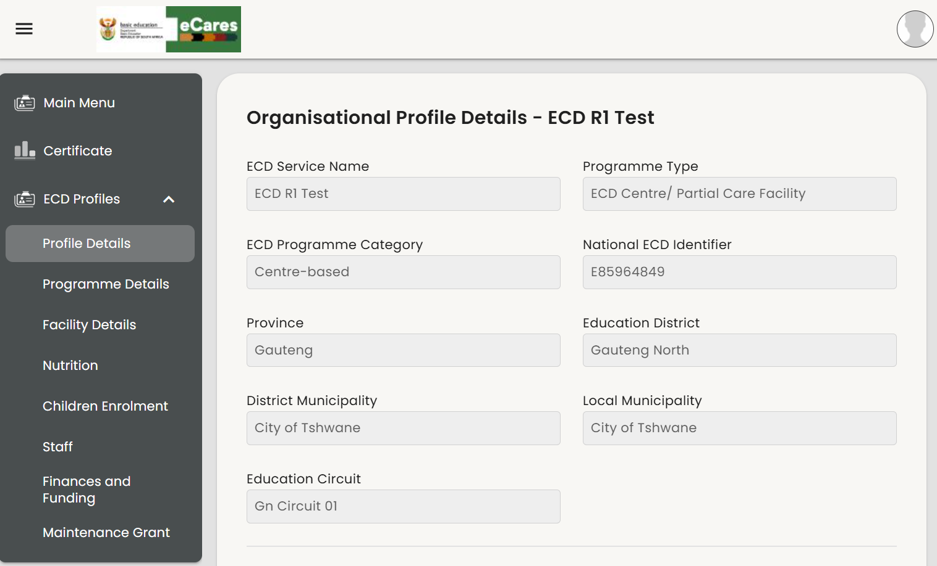
RECAP: RELEASE 1 ECD ELP, STAFF AND CHILD PROFILE DATA
Release 1 functionality allows users to have a comprehensive view of registered ELPs, staff and child profiles.
Newly registered Bronze ELPs will be on the list and have their profiles managed
Previously registered Silver and Gold ELPs migrated from RMT and other sources will be on the list
Migrated child-level data will accessible under child enrolment

Slide 11
APPLICANTS HAVE RECEIVED BRONZE REGISTRATION – WHAT HAPPENS NEXT?

Slide 12
RELEASE 2: SILVER/GOLD REGISTRATIONS
Registration Application Reviewer + Approver
Reviews the application
Generates a recommendation
Final Approval or Refusal Notice
Send for EMIS approval
ECD Applicant
Login to eCares
Answer a few questions
Submit the documents listed in the guidelines
Submit an Environmental Health Report / Certificate if received
Registration Application Administrator
1st check application details
Check documents and approve or request corrections
Plan site visits
Registration Site Assessment
Check the ELP’s site and programme against the norms and standards
Capture GPS co-ordinates
Confirm data

Slide 13
USER ROLES AND RESPONSIBILITIES FOR S/G REGISTRATION
ECD APPLICANT (WEB USER)
REGISTRATION APPLICATION ADMINISTRATOR
REGISTRATION SITE ASSESSMENT (eCARES JOURNEYAPPS)
Submit Silver/Gold registration application
Receive/view improvement record per ECD failed standards
Apply for renewal of registration before expiry date is met
Assist applicants in uploading documents
Upload and review EHP document if received
Review, approve, decline, or comment on submitted documents
View ECD programmes for site visitation
Conduct site assessment even offline
Review and update ECD profile details on the mobile app: GPS, address, programme type
View framework outcome auto assessment – details of failed points for improvements
REGISTRATION APPLICATION SUPPORT
Assist with supporting applicants to upload documents and complete SG application
13

Slide 14
USER ROLES AND RESPONSIBILITIES FOR S/G REGISTRATION
REGISTRATION APPLICATION REVIEWER
REGISTRATION APPLICATION APPROVER
EMIS REVIEWER AND APPROVER
EMIS Review and EMIS Number Allocation
Review applicant submission and SW Site Assessment report
Generate SW Report (final recommendation) and conditions of registration
Future Release: Renewals and recommend cancellation of an existing ECD registration with reasons
Review application and Social Worker report
Add comments and return for review
Approve application at certain level or approve enforcement notice
Generate Certificate of Approved Level (add associated expiry dates) after EMIS approval
Future Release: Approve a cancellation recommendation and notify ECD Programme
14

Slide 15
EMIS USERS

Slide 16
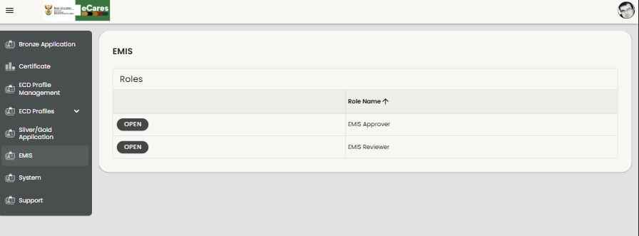
LOGIN AND ROLE SELECTION
The Main Menu page provides access to various user roles and system functionalities. It serves as a central hub where users can navigate to different sections based on their assigned roles. Each role has specific permissions that determine the level of access and actions they can perform within the system.
Users must select their role to access specific functionalities. To begin, select EMIS (1) on the menu. Then click OPEN (2) next to the EMIS Reviewer or EMIS Approver role.
2
1
The EMIS REVIEWER will complete the first review and, if all information is correct, pass the application to the EMIS APPROVER.
The EMIS APPROVER will see the same information but also has the option to enter an EMIS number, which will be allocated to the approved ECD. Once captured, a certificate can be generated that includes the EMIS number.

Slide 17
EMIS REVIEWER

Slide 18
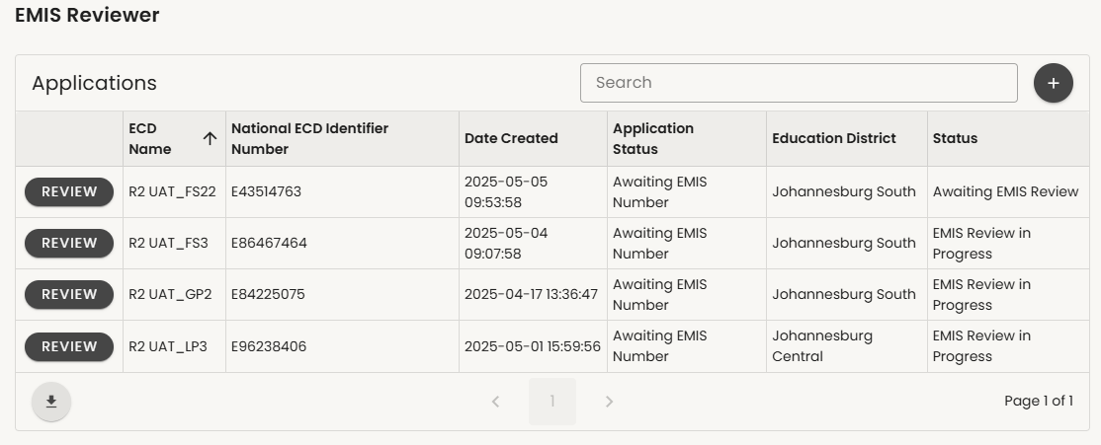
SG EMIS REVIEWER
By the end of this process, the EMIS Reviewer can:
View a list of ECDs that have been approved by the ECD Unit for Full (Gold) or Conditional (Silver) registration.
REVIEW the details of each of these ECDs.
Send back to ECD reviewers if there are any issues.
Submit for EMIS approval and allocation of EMIS number.
To begin the review process, click REVIEW (1) next to the ECD you want to work on. First review for EMIS number.
1

Slide 19
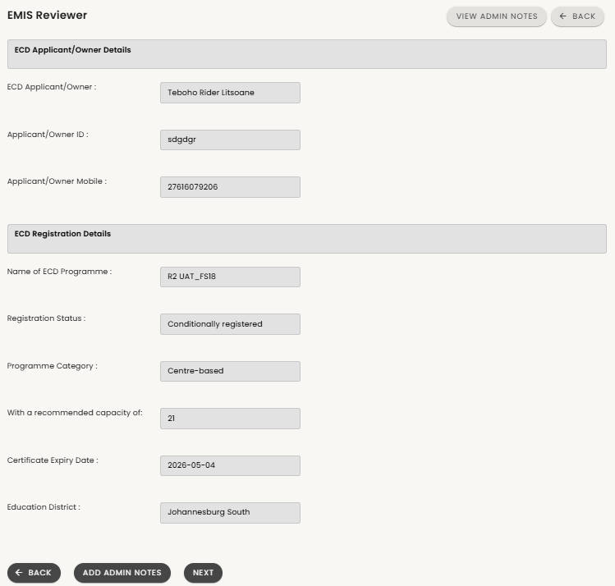
REVIEW DETAILS
1
This page outlines:
Details of the applicant (1)
Approved registration status (2)
These are non-editable fields.
Click NEXT (3) if you agree to continue.
2
3

Slide 20
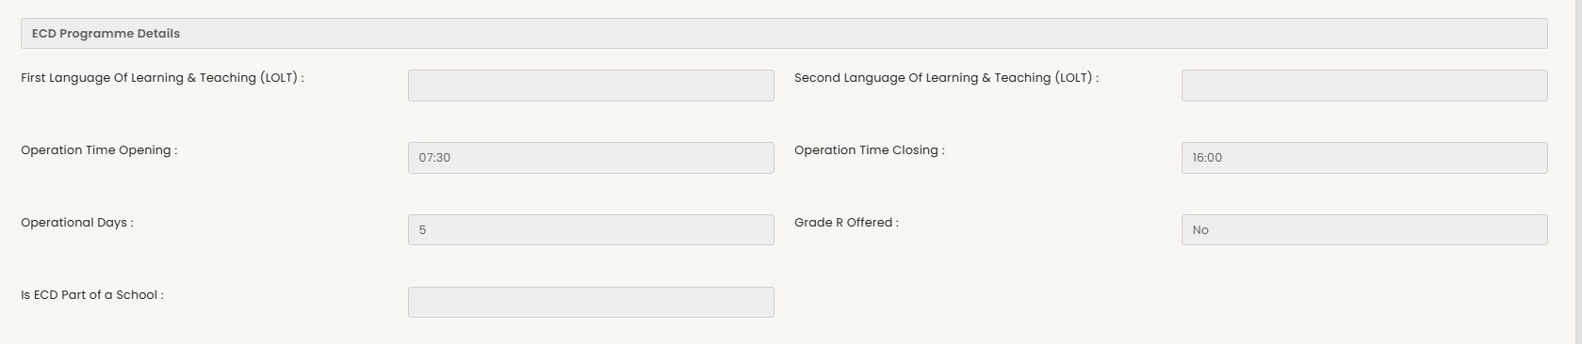
ECD PROGRAMME DETAILS
Scroll down to view the ECD programme details.
Note that some details may not have been collected during registration and can be completed later.

Slide 21
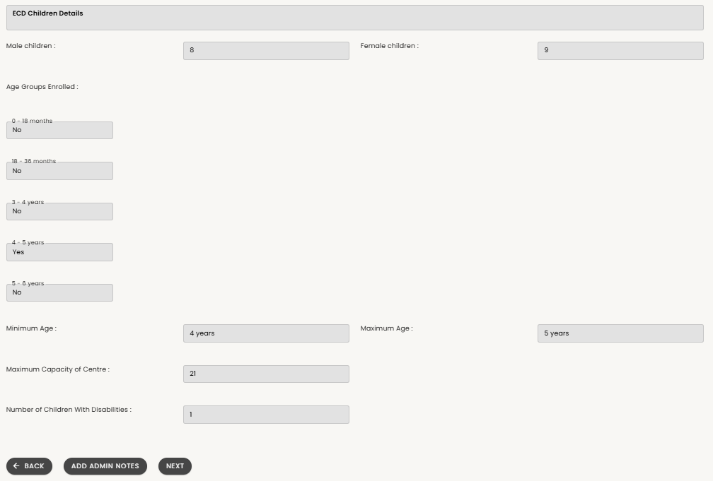
ECD PROGRAMME DETAILS
Scroll down to view the breakdown of child enrolment

Slide 22
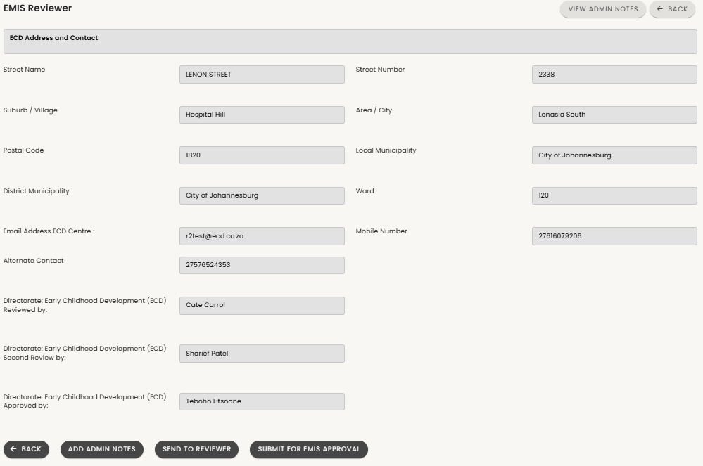
ECD PROGRAMME DETAILS
Finally, scroll down to see:
ECD location details
Reviewer can choose to SUBMIT FOR EMIS APPROVAL (1) for allocation of EMIS number
or SEND TO REVIEWER (2) to make corrections
2
1

Slide 23
EMIS APPROVER

Slide 24
LOGIN AND ROLE SELECTION
The Main Menu page provides access to various user roles and system functionalities. It serves as a central hub where users can navigate to different sections based on their assigned roles. Each role has specific permissions that determine the level of access and actions they can perform within the system.
Users must select their role to access specific functionalities. To begin, select EMIS (1) on the menu. Then click OPEN (2) next to the EMIS Reviewer or EMIS Approver role.
2
1
The EMIS REVIEWER will complete the first review and, if all information is correct, pass the application to the EMIS APPROVER.
The EMIS APPROVER will see the same information but also has the option to enter an EMIS number, which will be allocated to the approved ECD. Once captured, a certificate can be generated that includes the EMIS number.

Slide 25
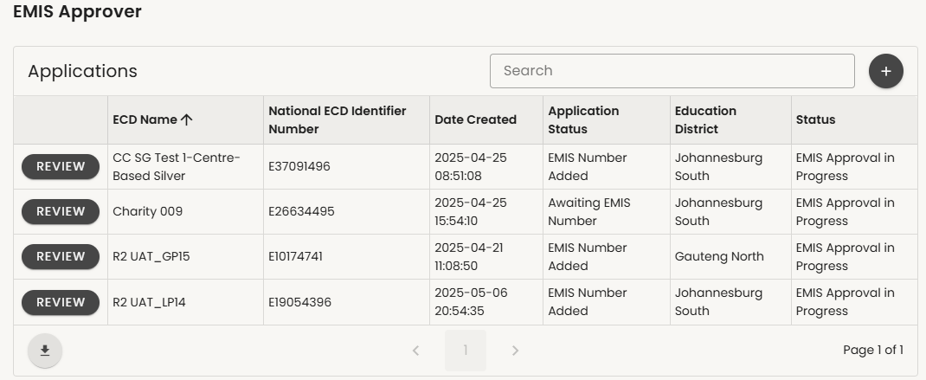
SG EMIS APPROVER
By the end of this process, the EMIS Approver can:
View a list of ECDs that have been approved by the ECD Unit for Full (Gold) or Conditional (Silver) registration and reviewed by the EMIS Reviewer.
REVIEW the details of each of these ECDs.
Send back to ECD reviewers if there are any issues.
Insert EMIS number
Submit to approve EMIS number.
To begin the review process, click REVIEW (1) next to the ECD you want to work on. First review for EMIS number.
1

Slide 26
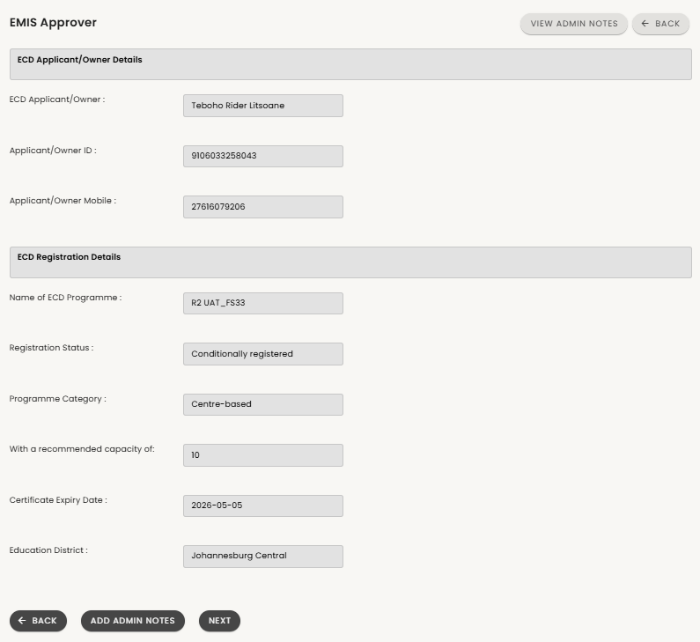
REVIEW DETAILS
1
This page outlines:
Details of the applicant (1)
Approved registration status (2)
These are non-editable fields.
Click NEXT (3) if you agree to continue.
2
3

Slide 27
ECD PROGRAMME DETAILS
Scroll down to view the ECD programme details.
Note that some details may not have been collected during registration and can be completed later.

Slide 28
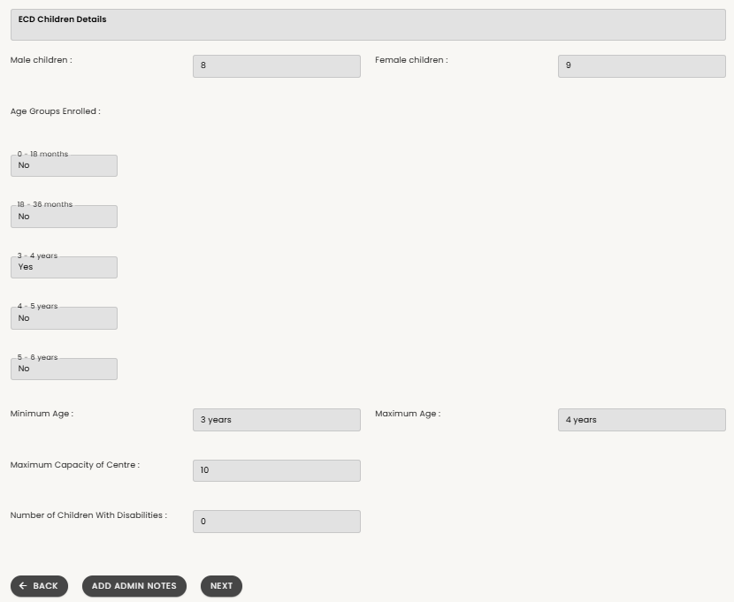
ECD PROGRAMME DETAILS
Scroll down to view the breakdown of child enrolment

Slide 29
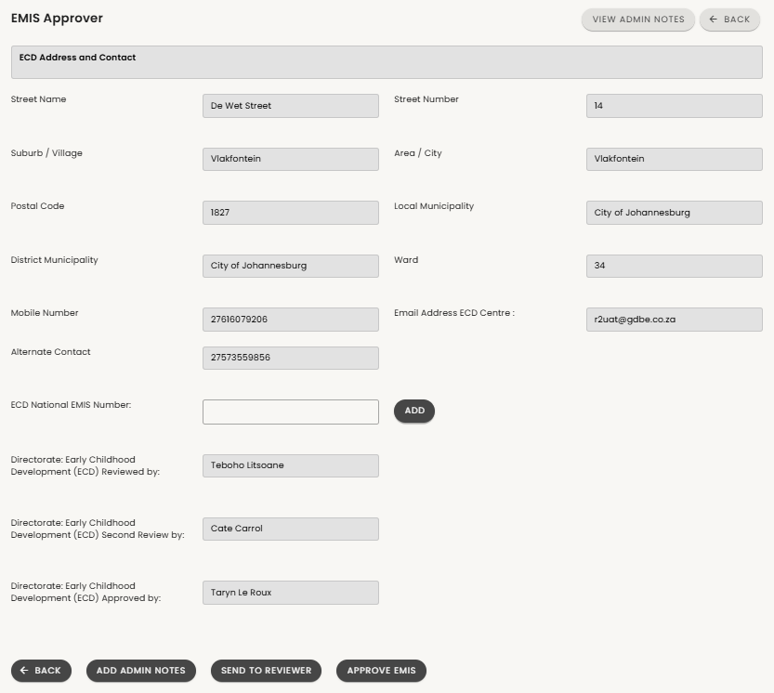
ECD PROGRAMME DETAILS
Finally, scroll down to see:
ECD location details
Review and approval by ECD Unit
Approver can choose manually type in and ADD (1) the EMIS Number, then APPROVE EMIS (2), or
or SEND TO REVIEWER (3) to make corrections
1
3
2

Slide 30
THANK YOU.

